Slide 1
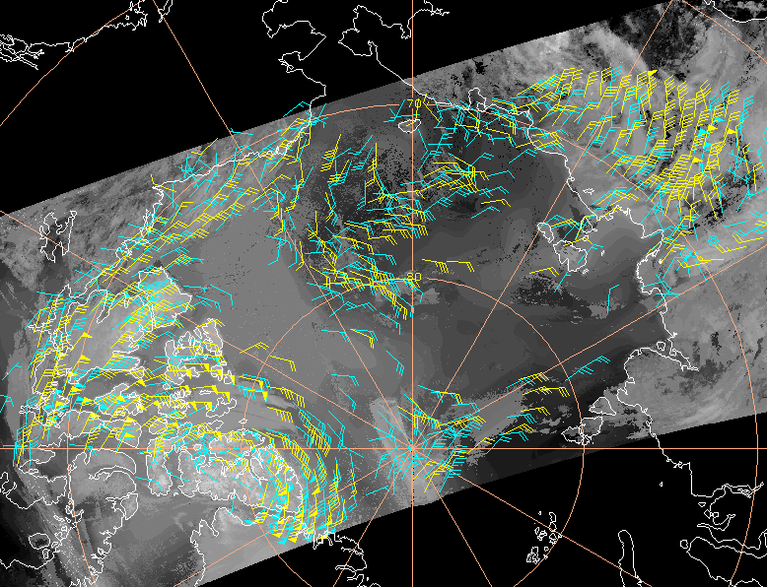
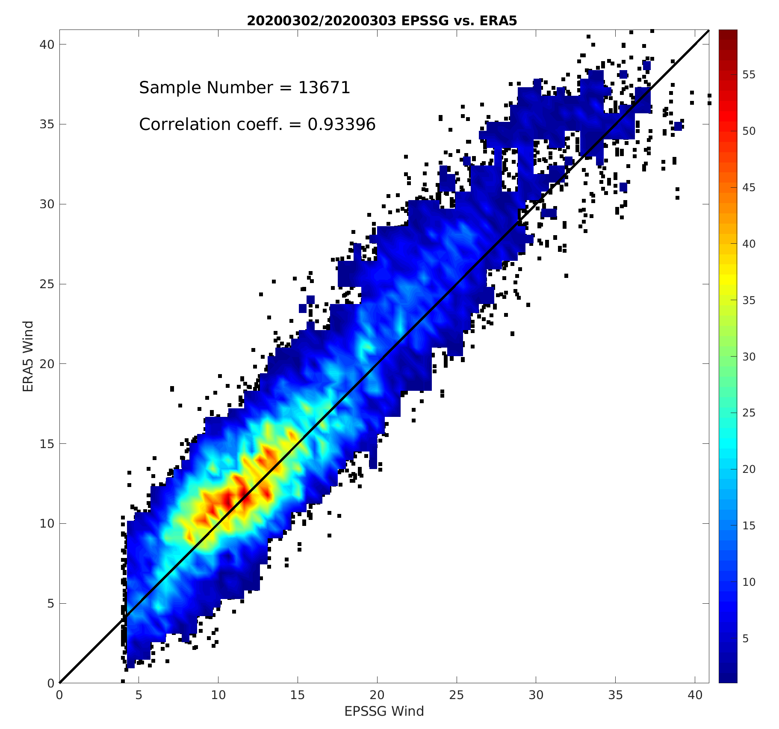
EPS-SG METimage Polar Winds
D. Santek, T. Olander, S. Nebuda
Objective
Adapt the current polar winds algorithm for use with the EPS-SG METimage data using proxy data in preparation for an operational EPS-SG satellite in 2024.
The VIIRS polar winds are being operationally assimilated or monitored in many numerical weather prediction global models, including at NCEP, the Naval Research Lab (NRL), and the NASA Global Modeling and Assimilation Office (GMAO). It is expected the METimage winds will also be used at many NWP centers.
Simulated 10.69 µm IR METimage data; 3 Jan 2000 at 0217 UTC. Raw winds (cyan); quality controlled (yellow).
ERA5 vs EPS-SG wind speed density plot from 03:30 UTC on 3 Jan 2020.
Approach
Adapt and evaluate the existing polar winds algorithm for VIIRS to the EPS-SG METimage instrument.
The current VIIRS polar winds product uses the 10.76 µm (M-15 band) which has a nearly equivalent wavelength to the METimage 10.69 µm (VII-37 band).
In addition, the METimage 6.72 µm (VII-33 band) has the same central wavelength as the MODIS band 27 water vapor band, which will enable the production of clear-sky winds which was not possible from VIIRS.
Outcomes
The Enterprise winds algorithm is not yet METimage-capable, therefore winds were derived using the CIMSS heritage winds algorithm (left figure).
Procedures were developed to compare METimage winds to the ERA5 reanalysis.
Right figure is a density plot of ERA5 vs EPS-SG wind speed; correlation coefficient 0.93.
Bias is -0.78 ms⁻¹; RMS difference is 3.89 ms⁻¹, which is similar to VIIRS winds as compared to the ERA5.

