Slide 1
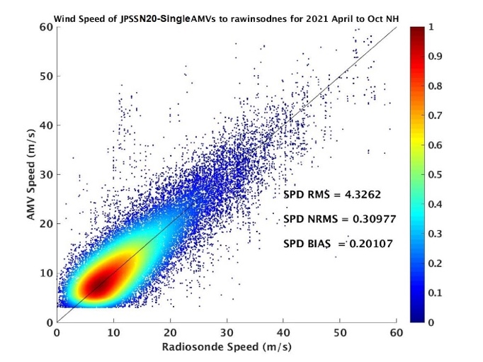
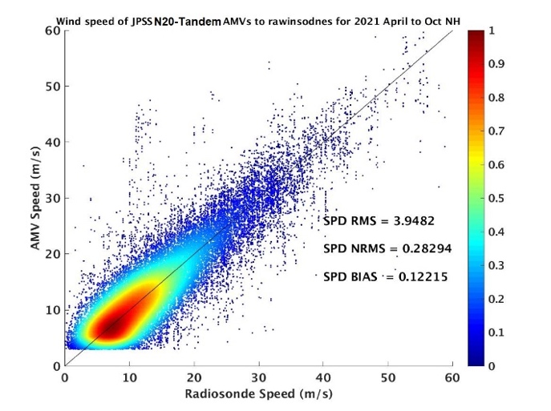
Tandem VIIRS Winds
D. Santek, R. Dworak
Objective
The VIIRS polar winds product uses three successive orbits (100-minute time step) from a single satellite to derive cloud motion. Since NOAA-20 is in a similar orbit as S-NPP but delayed by ½ orbit in time, there is an opportunity to track clouds from the NOAA-20/ S-NPP tandem.
The time interval between images will be reduced to 50 minutes, resulting in: Reduced latency in product availability, higher quality winds due to the shorter time interval for tracking, and extending the spatial coverage more equatorward.
April through October Arctic VIIRS AMVs compared to rawinsondes, for NOAA-20 single-satellite (left) and S-NPP/NOAA-20 tandem (right). Density scatter plot of VIIRS AMVs vs rawinsonde wind speed.
Approach
Use the NOAA Enterprise winds algorithm to track cloud features from a triplet of images, assembled from alternating passes of S-NPP and NOAA-20, which are flying in tandem.
Generate the product from the two combinations of triplets: S-NPP, NOAA-20, S-NPP and NOAA-20, S-NPP, NOAA-20
Outcomes
The speed RMS difference is reduced from 4.3 ms⁻¹ for single-satellite NOAA-20 to 3.9 ms⁻¹ for the tandem-satellite. Bias is also reduced from 0.20 ms⁻¹ to .12 ms⁻¹ for the single satellite vs tandem configuration..
The U.S. Naval Research Laboratory (NRL) demonstrated the positive impact of the tandem VIIRS winds in the global NAVGEM. NRL's test results for April 2021 show that the SWIR product is beneficial to numerical weather forecasts, and they are used operationally.

