Slide 1
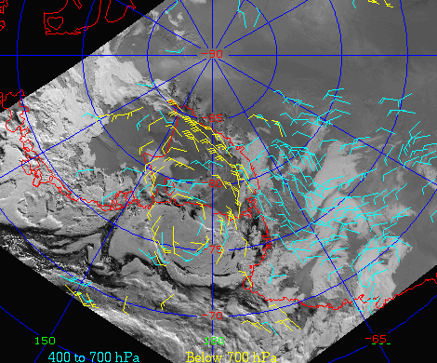
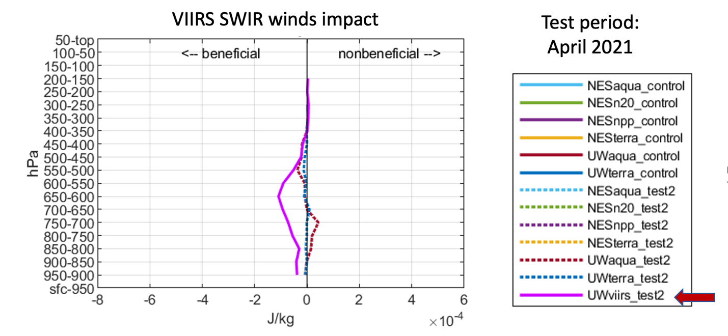
VIIRS Shortwave IR (SWIR) Winds
D. Santek, R. Dworak, D. Stettner
Objective
Derive atmospheric motion vectors (AMVs) using SWIR band as it provides greater contrast between liquid clouds and the underlying snow/ice surface compared to the visible and IR window bands.
Users of the product are primarily NWP centers (e.g., NCEP and the U.S. Naval Research Lab).
VIIRS SWIR 2.25 µm polar winds in the Antarctic from S-NPP on 08 January 2021 at 0953 UTC. Color-coded height: Yellow (below 700 hPa), cyan (400 to 700 hPa)
Impact of VIIRS SWIR in an April 2021 at NRL. The magenta line "UWviirs_test2" shows the beneficial impact (Rebecca Stone SAIC/NRL)
Approach
For many years, SWIR winds have been routinely generated using MODIS band 7 (2.1 µm) from both Terra and Aqua satellites. Beginning in early 2021, VIIRS SWIR winds have been routinely generated at CIMSS using the M11 (2.2 µm) band.
The initial product generation uses the CIMSS heritage winds algorithm. With assistance from the NOAA ASSISTT team, the product is now being produced with the Enterprise winds algorithm.
Outcomes
The SWIR winds were evaluated using two methods:
S-NPP VIIRS SWIR winds were compared to rawinsonde wind speed for a 3-month period over Antarctica. SWIR AMV wind speed had an RMS difference of 3.58 ms⁻¹ and bias of -0.95 ms⁻¹; similar to MODIS SWIR AMVs.
The U.S. Naval Research Laboratory (NRL) demonstrated the positive impact of the SWIR winds in the global NAVGEM. NRL's test results for April 2021 show that the SWIR product is beneficial to numerical weather forecasts (magenta line in figure above).
The SWIR winds product is expected to be transitioned to NESDIS operations in 2024.

