Slide 1
CIMSS polar winds update
D. Santek, D. Stettner, E. Borbas
11 June 2026

Slide 2
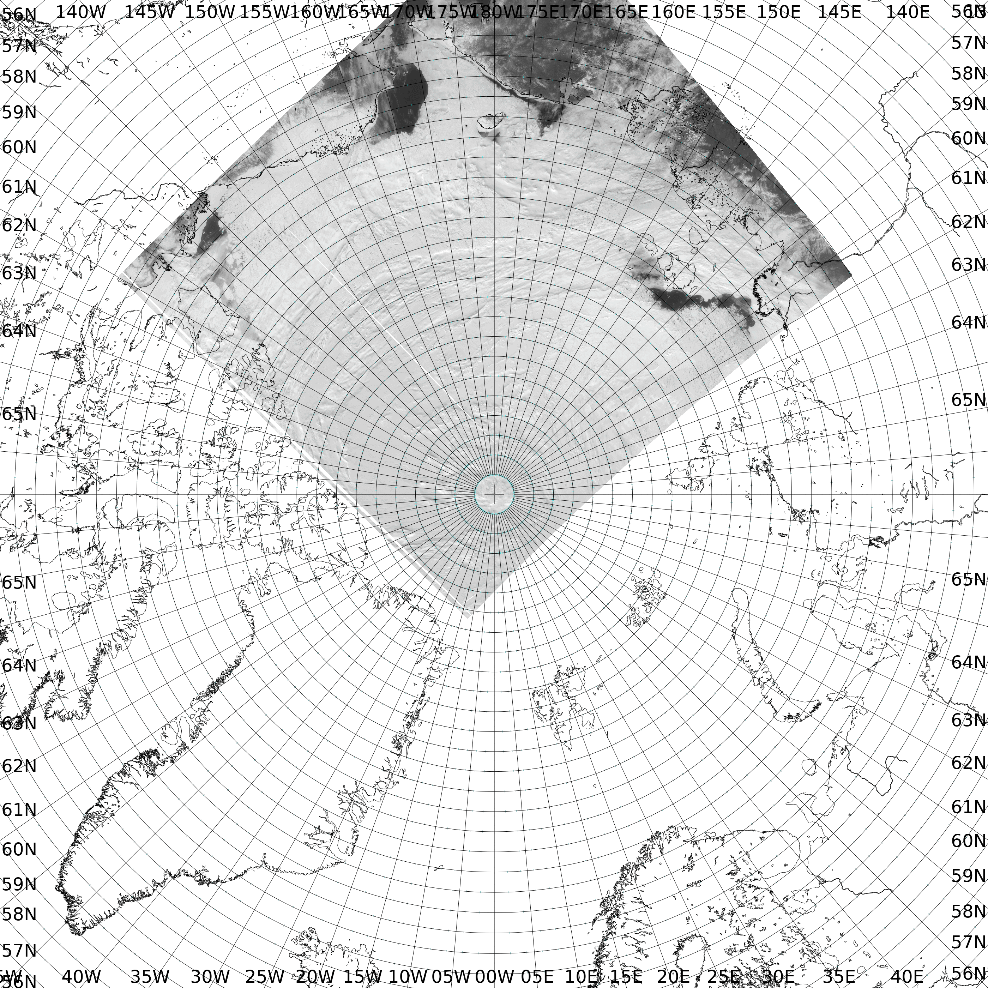
MetopSG
Ingested at Gilmore/GINA

Slide 3
NOAA-20 AMV
Parallax Correction
Granules: 2026 063 10:03 UTC
2026 064 14:48 UTC
Jun 9, 2026, Eva Borbas

Slide 4
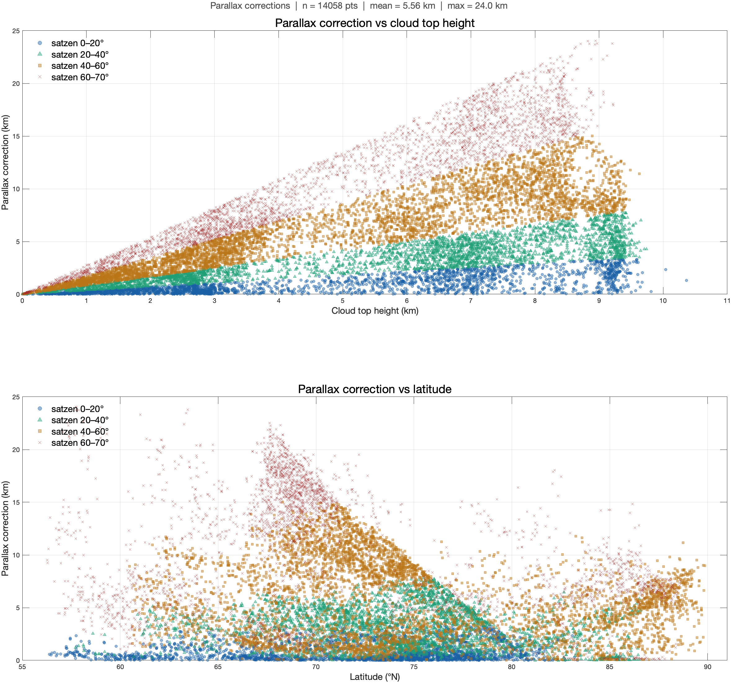
Parallax correction for all three overpasses
2026 063 at 10:03 UTC

Slide 5
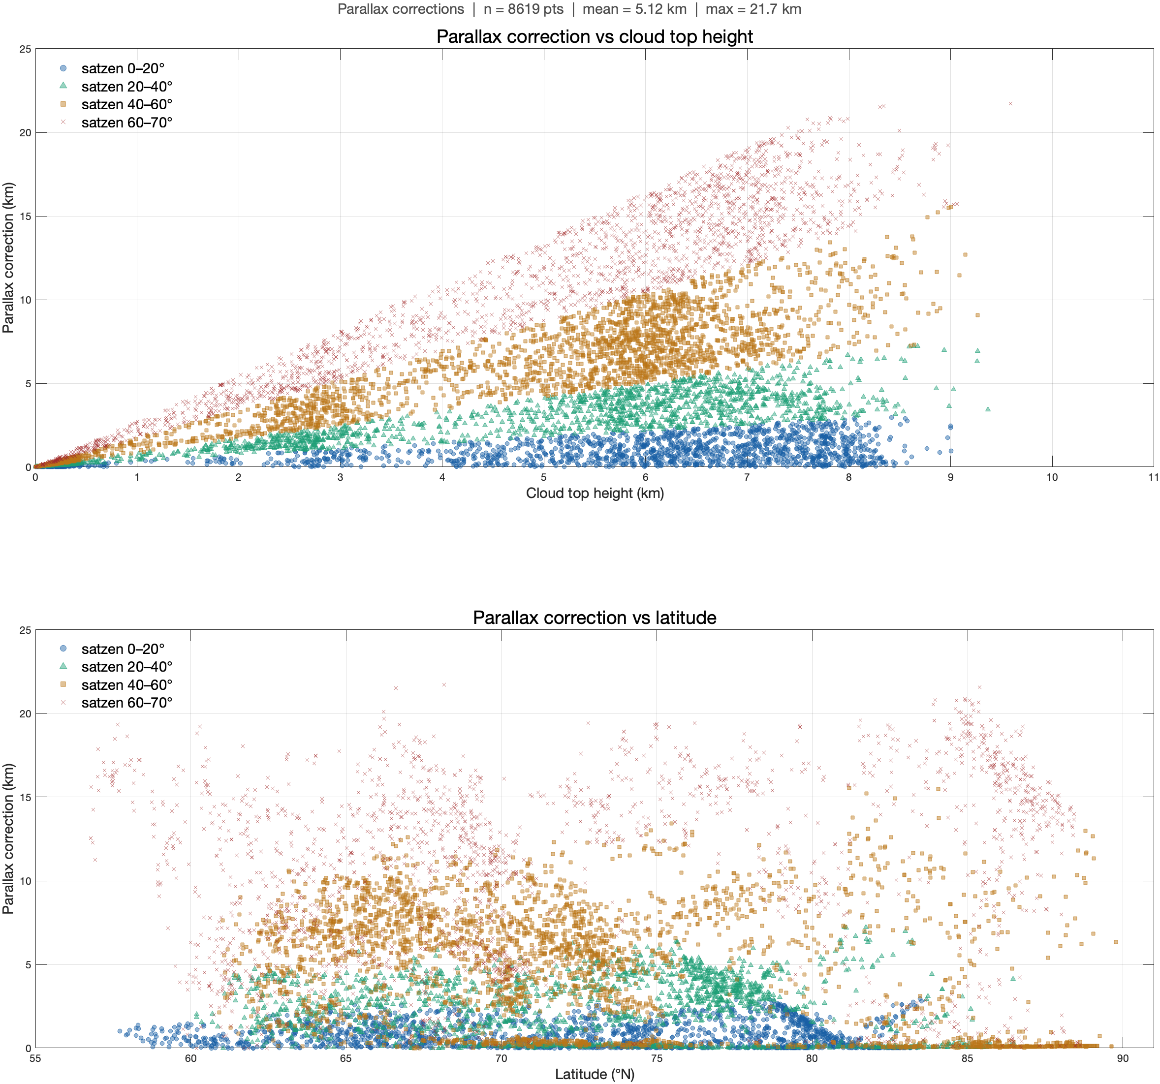
Parallax correction for all three overpasses
2026 064 at 14:48 UTC

Slide 6
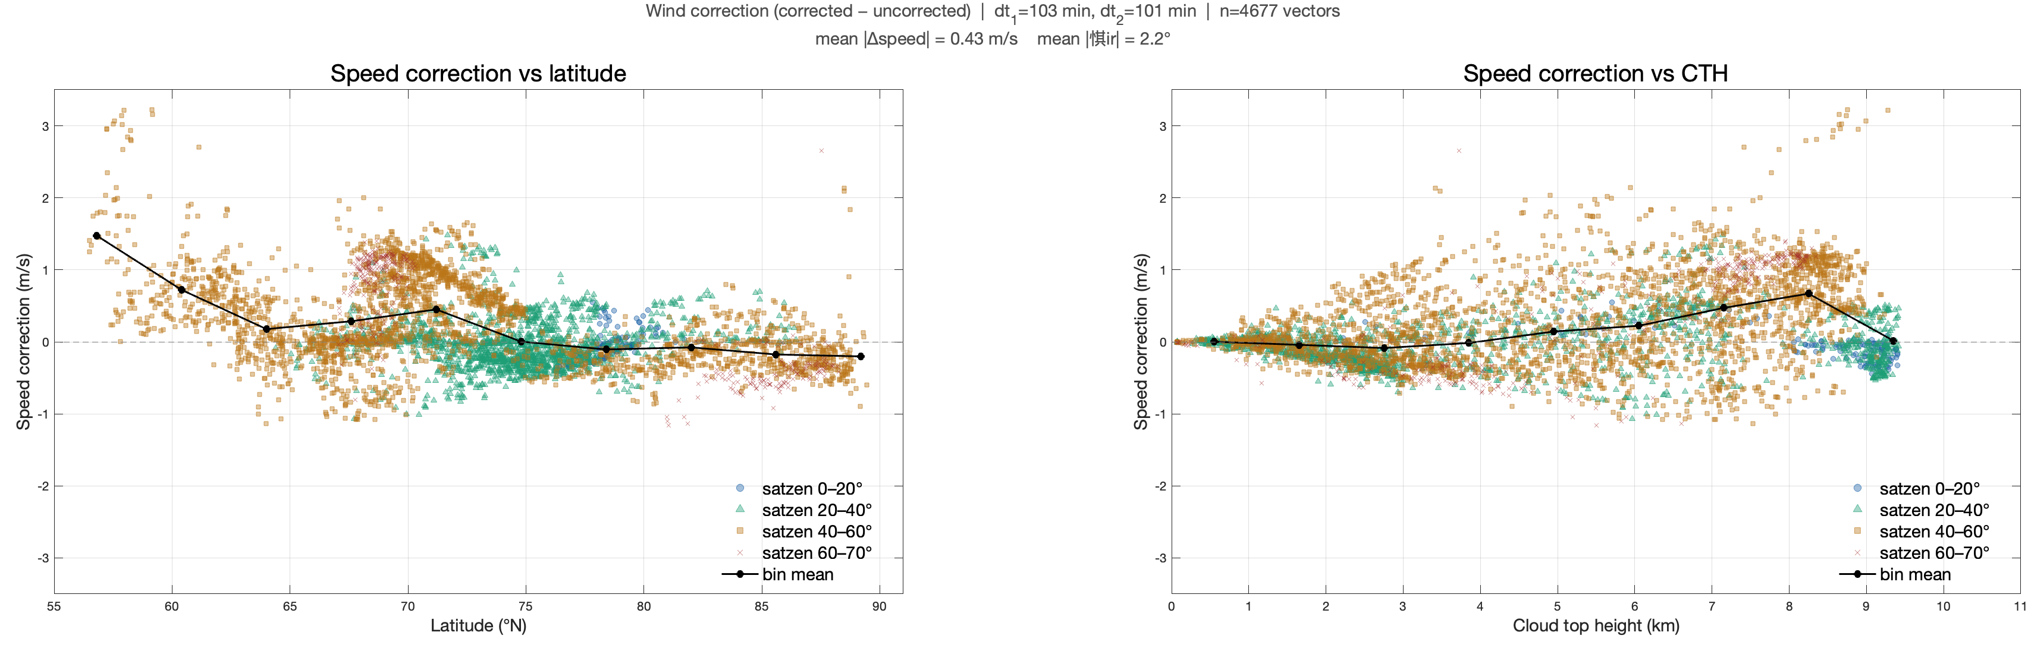
Wind Speed correction vs Latitude and CTH
2026 063 at 10:03 UTC

Slide 7
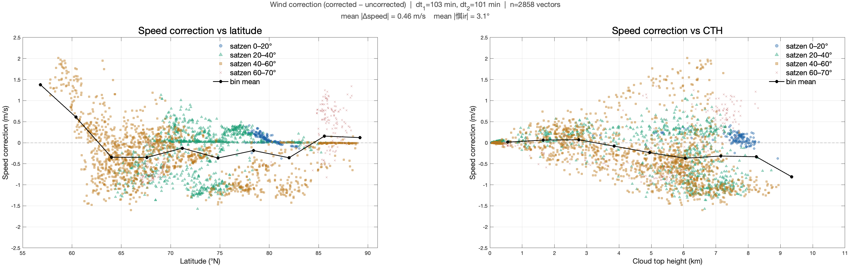
Wind Speed correction vs Latitude and CTH
2026 064 at 14:48 UTC

Slide 8
MetopSG: First look regarding parallax
Reviewed the EPS-SGA1 file format:
It appears to be very straightforward and includes all of the geometric information needed for the wind correction calculations

