Slide 1
Status of tandem satellite polar winds product
from VIIRS
Jeff Key, Dave Santek, Rich Dworak
9 Oct 2019

Slide 2
Overview
Brief history of polar winds product
Single satellite winds
Tandem winds
NOAA-20 VIIRS NWP impact
What’s next

Slide 3
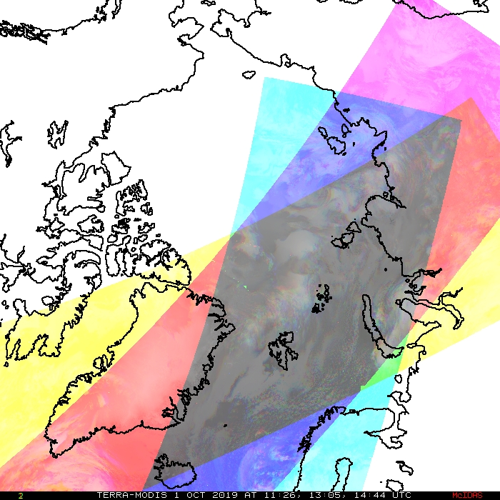
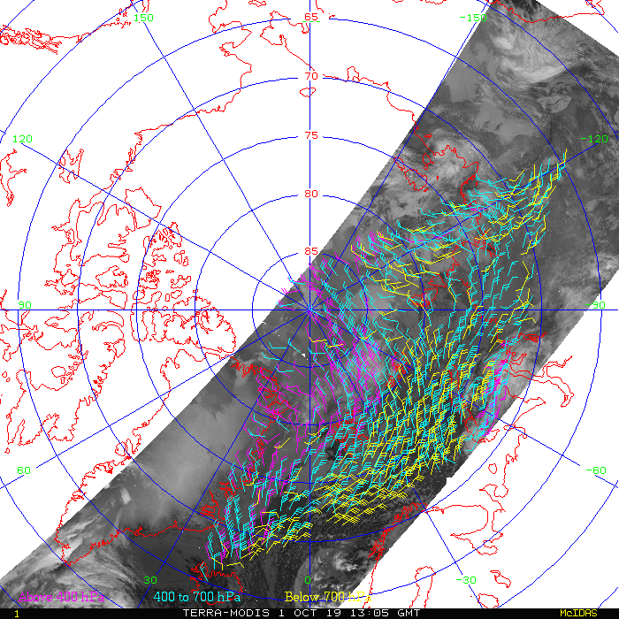
Background: Deriving Polar Winds
While geostationary satellites repeatedly image the same area, the swaths of polar-orbiters only partially overlap.
The method is to
Track cloud and water vapor features in three consecutive orbits.
Assign the wind vector height based on one or more methods
Perform consistency and quality control tests
Result: wind speed, direction, and pressure with quality indicators
The white diamond is the area of overlap for three orbits.

Slide 4
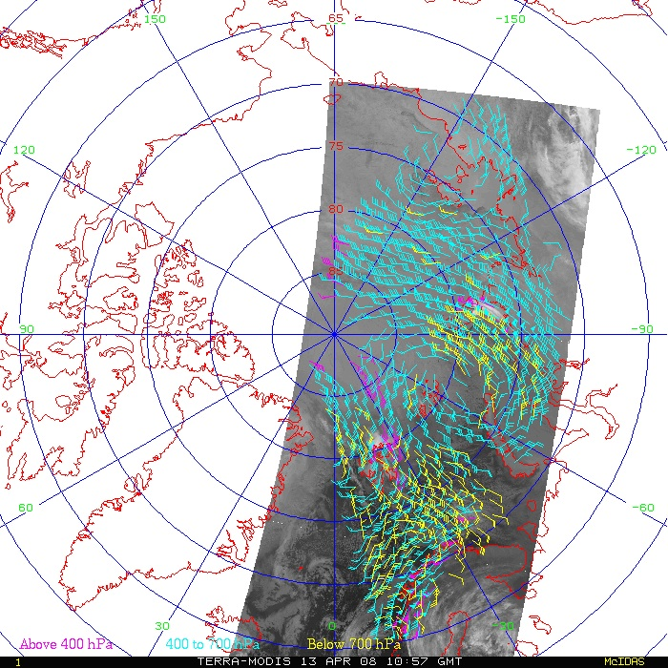
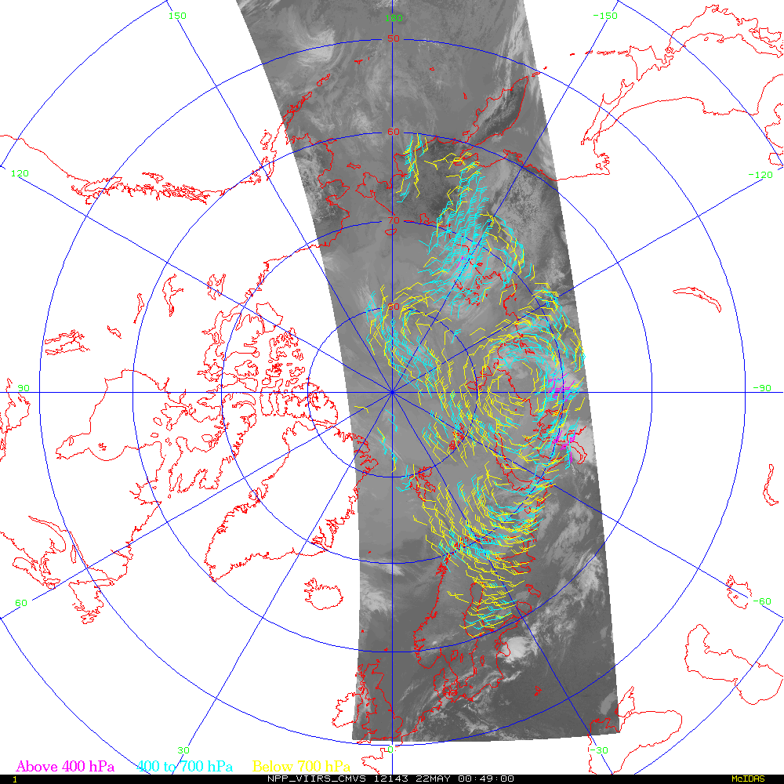
Main Product: Single-Satellite Winds
Single-satellite winds are derived from the Moderate Resolution Imaging Spectroradiometer (MODIS), the Advanced Very High Resolution Radiometer (AVHRR), and the Visible Infrared Imaging Radiometer Suite (VIIRS)
Terra MODIS
S-NPP VIIRS

Slide 5
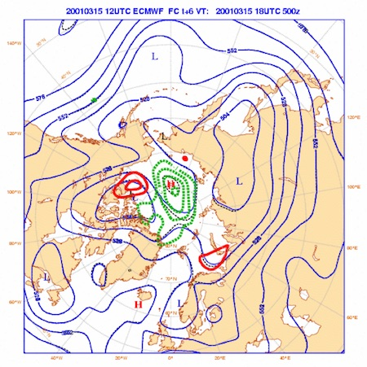
Operational NWP Users of Polar Winds
The various polar winds products are used by
13 NWP centers in 9 countries:
European Centre for Medium-Range Weather Forecasts (ECMWF)
NASA Global Modeling and Assimilation Office (GMAO)
Deutscher Wetterdienst (DWD)
Japan Meteorological Agency (JMA)
Canadian Meteorological Centre (CMC)
US Navy, Naval Research Lab, Fleet Numerical Meteorology and Oceanography Center (FNMOC)
Met Office (UK)
National Centers for Environmental Prediction (NCEP)
Météo-France
National Center for Atmospheric Research (NCAR)
Australian Bureau of Meteorology
China Meteorological Administration (CMA)
HydroMeteorological Center of Russia (Hydrometcenter)

Slide 6
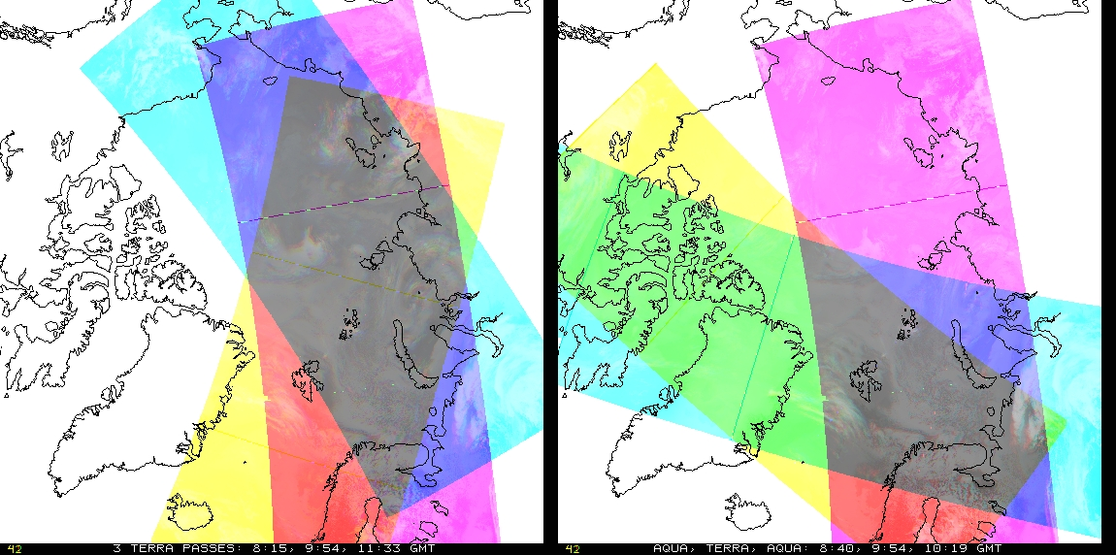
Mixed Satellite Overlap: MODIS
Terra only
Aqua, Terra, Aqua
MODIS Aqua and Terra data streams combined. Could be
A-T-A or T-A-T.
Pros: Lower latency (100 min rather than 200 for a triplet); somewhat lower latitude coverage (poleward of 65º or less).
Cons: Different orbits result in smaller area of overlap; fewer vectors each pass. Parallax correction and per-pixel times are necessary.

Slide 7
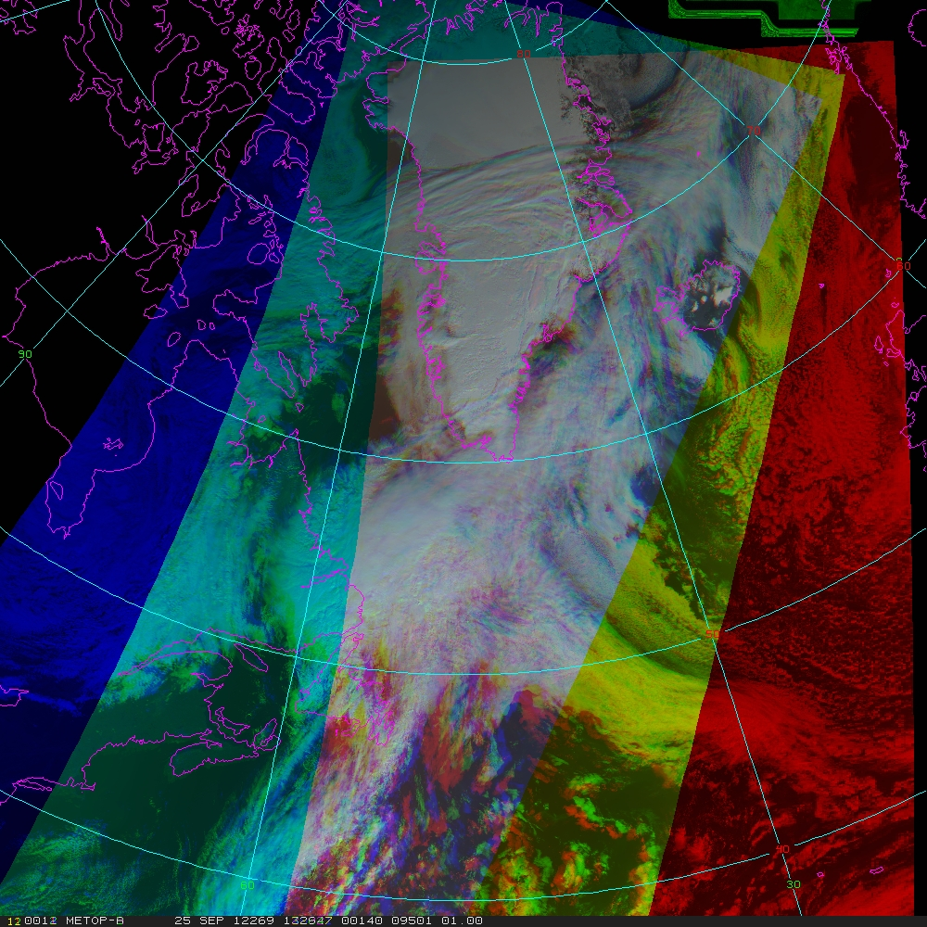
Mixed Satellite Overlap: Metop-A, -B, -A
Tandem formation: One satellite following the other separated by approximately 50 minutes.
Better spatial coverage than MODIS
Relative time difference between images is constant
50º Latitude

Slide 8
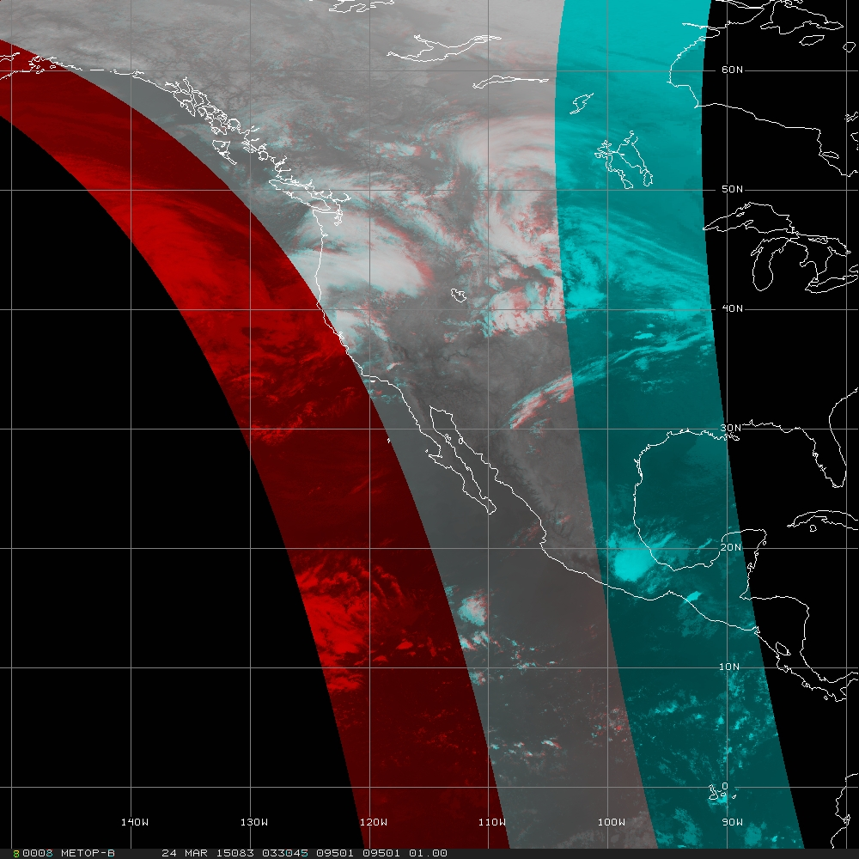
Mixed Satellite Overlap: Metop-A, -B
Tracking using image pairs increases spatial coverage
Adjusting for viewing angle effect (parallax) becomes increasingly more important toward the equator
Quality Control has new challenges
Equator

Slide 9
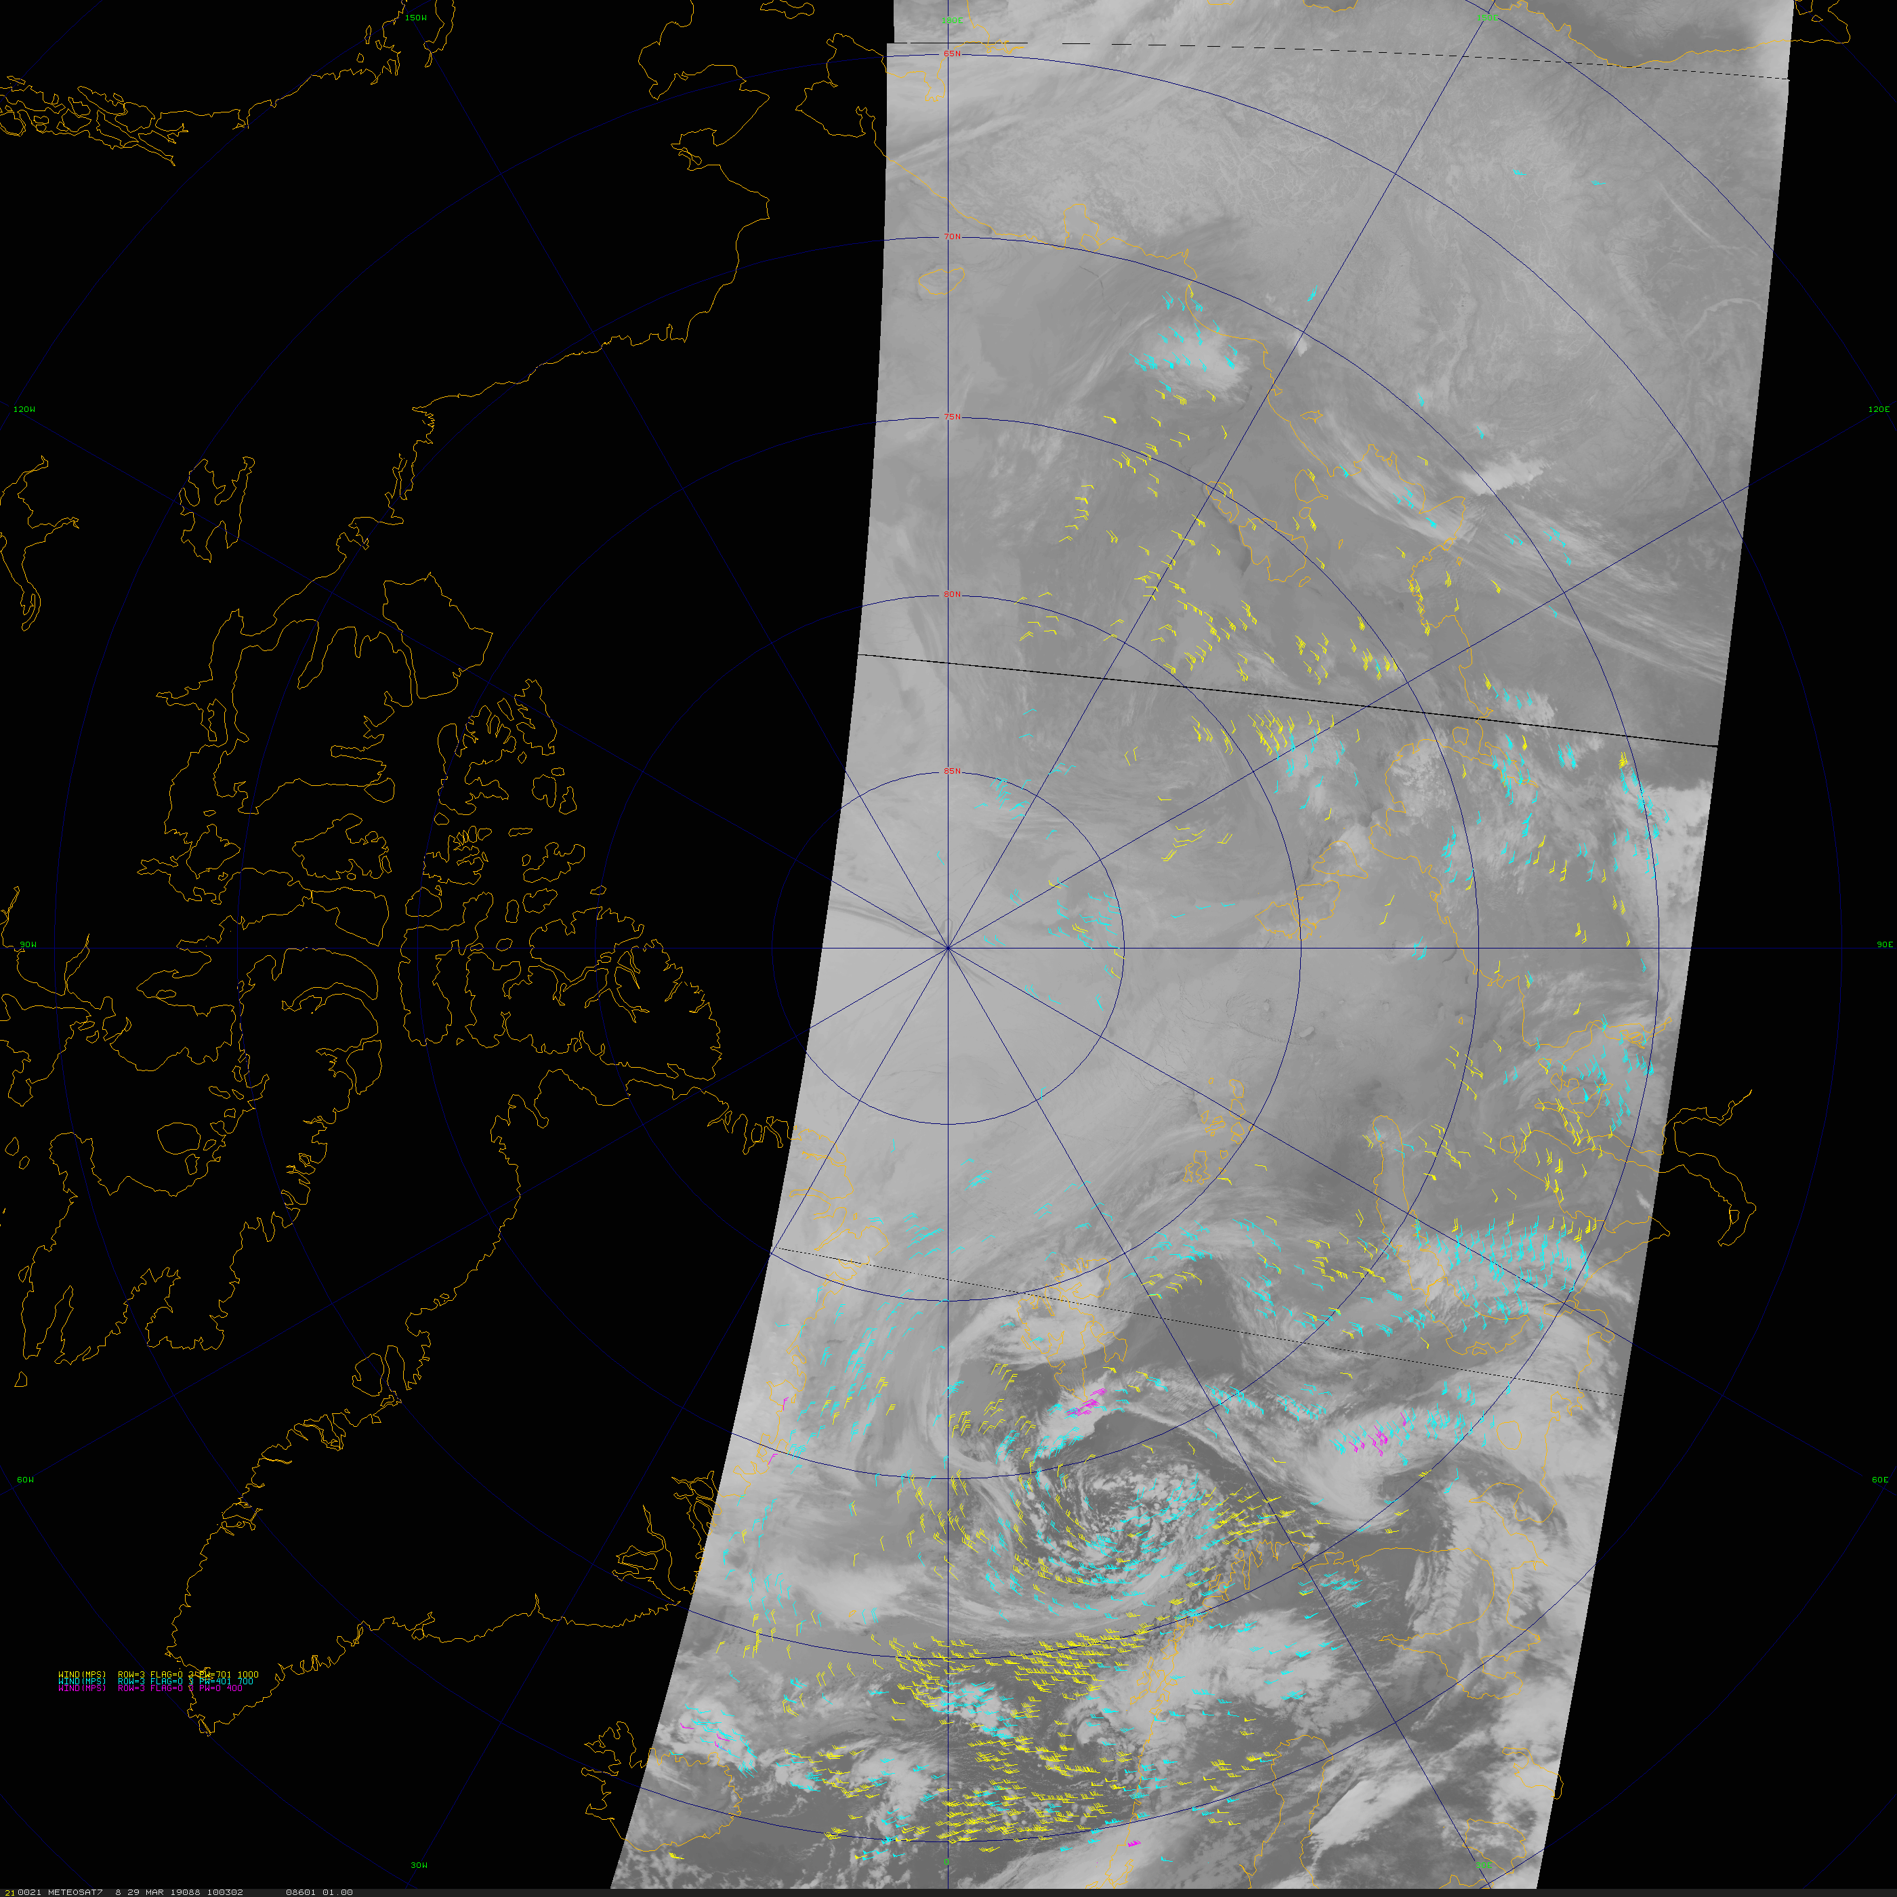
Mixed Satellite Overlap: Metop-A, -B, -C
Three satellites in formation
Time separation approximately 1/3 of 100-minute orbit
What is the term for ‘three in a line’?
Tandem usually refers to: “having two things arranged one in front of the other”
How about: Three aligned or formation of three
French: Trois alignés or formation à trois
Metop-C (10:03 UTC), -B (10:36), -A (11:06) 29 March 2019

Slide 10
What are the Improvements with VIIRS?

Slide 11
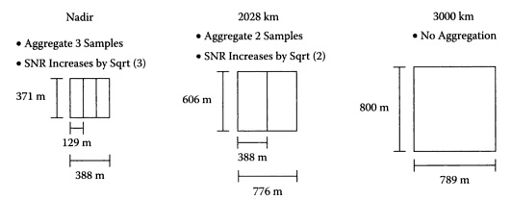
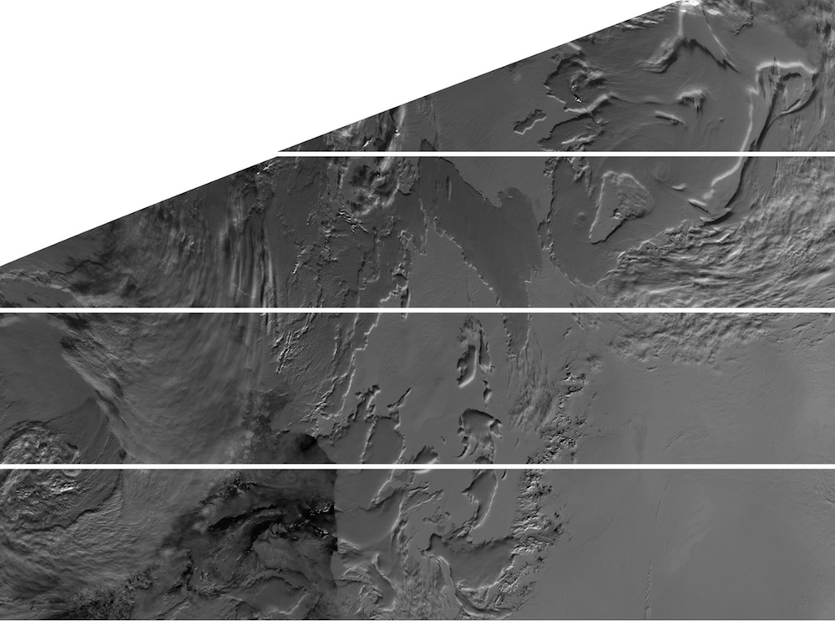
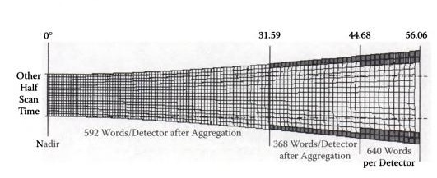
VIIRS: Improved Resolution at Edge of Swath
VIIRS method of aggregating detectors and deleting portions of the scans near the swath edge results in smaller pixels at large scan angles.
For thermal bands, VIIRS is 0.56 km² (0.75 x 0.75 km) at nadir and 2.25 km² at the edge of the swath (0.37 -> 0.8 km for imager bands; 0.74 -> 0.74 km for DNB)
In contrast, AVHRR and MODIS are 1 km² at nadir and 9.7 km² at edge of swath.
Additionally, VIIRS scan processing reduces the bow-tie effect.

Slide 12
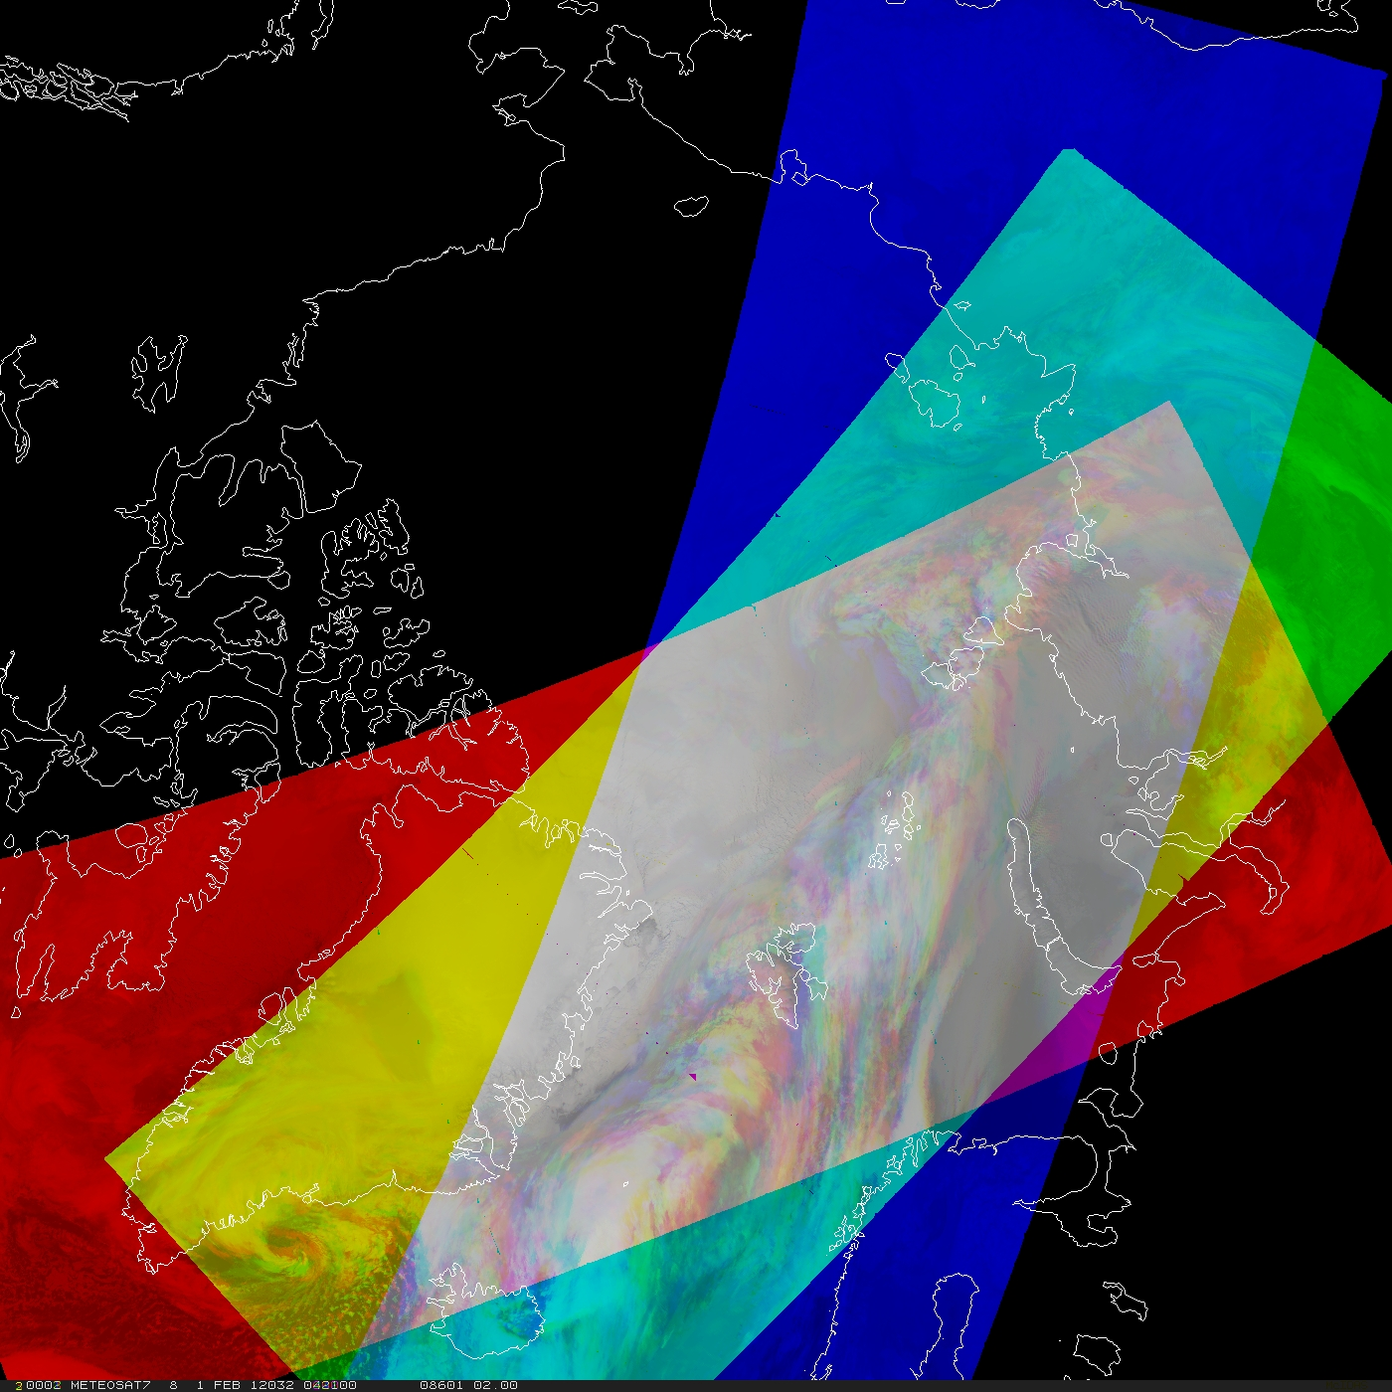
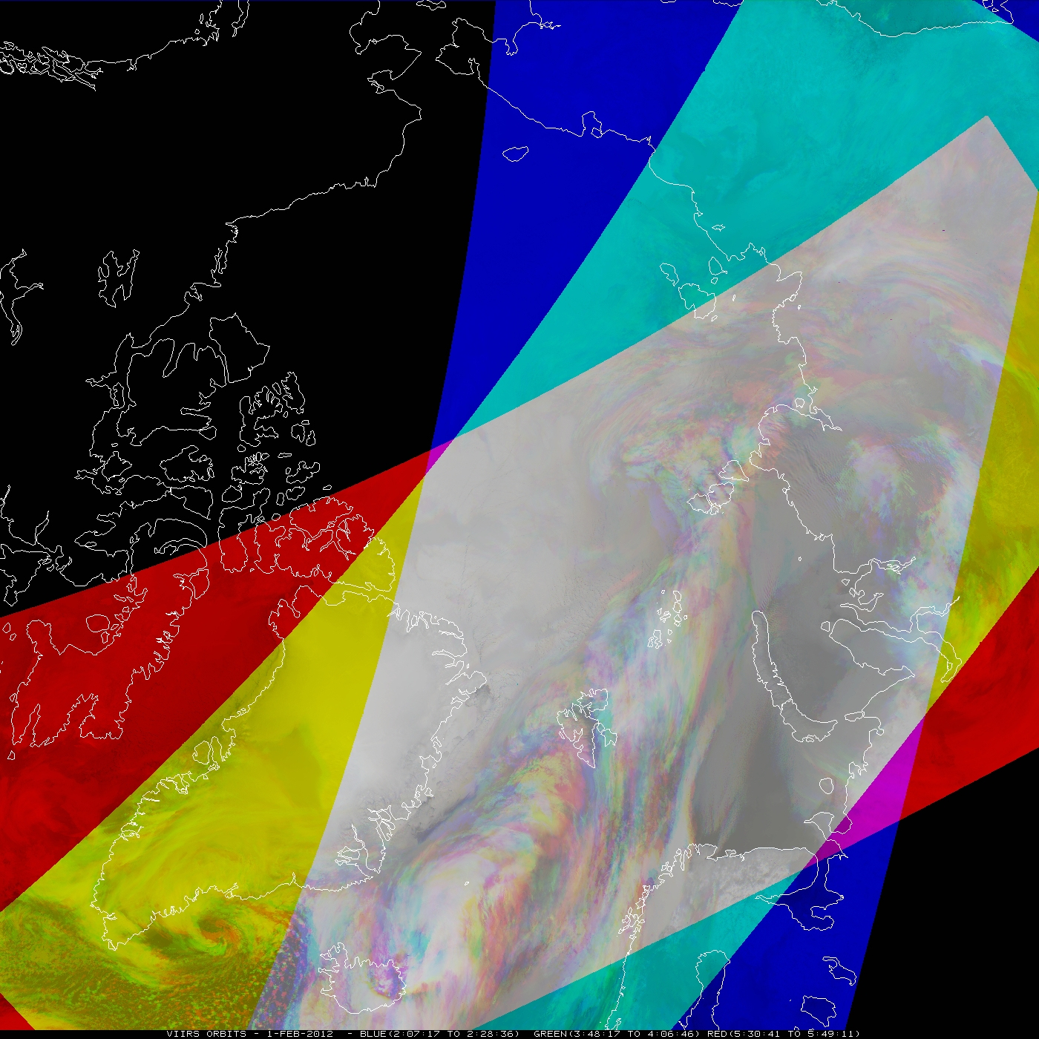
VIIRS Coverage: Wider Swath
VIIRS has a wider swath (3000 km) than MODIS (2320 km), so the coverage will improve and extend further equatorward.
MODIS
VIIRS
A wider swath means more winds with each orbit

Slide 13
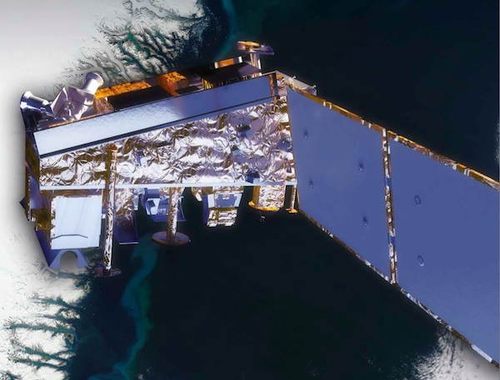
VIIRS Polar Winds
The Suomi National Polar-orbiting Partnership (S-NPP) satellite was launched 28 October 2011.
The “nested tracking” algorithm developed for GOES-R is used for a higher-quality product.
VIIRS provides:
High spatial resolution (375 & 750 m)
Constrained pixel growth toward edge of swath
A wider swath
These instrument and algorithm features result in a larger number of more accurate wind vectors.

Slide 14
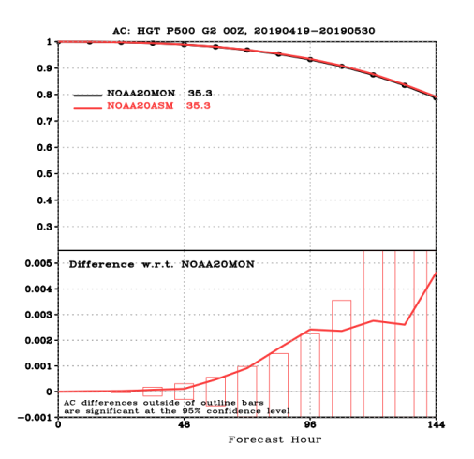
Single-satellite VIIRS Polar Winds Impact
Latest evaluation of NOAA-20 VIIRS winds in NCEP’s GFS/FV3: 19 Apr to 30 May 2019
Overall impact neutral to slightly positive
  Expected as the S-NPP winds were included
Global 500 hPa height Anomaly Correlation statistically significant impact in 72 to 96 hr forecast
NOAA-20 winds are approved to be transitioned to the operational GFS. However, they will continued to be monitored in the near-term due to an upcoming BUFR format change.

Slide 15
What’s next for VIIRS polar winds?
Additional spectral channels:
Shortwave IR (SWIR)
Day/Night Band (DNB)
Tandem winds from image pairs of VIIRS:
Complete latitude coverage (‘global’)
Correcting for parallax
New Quality Control technique

Slide 16
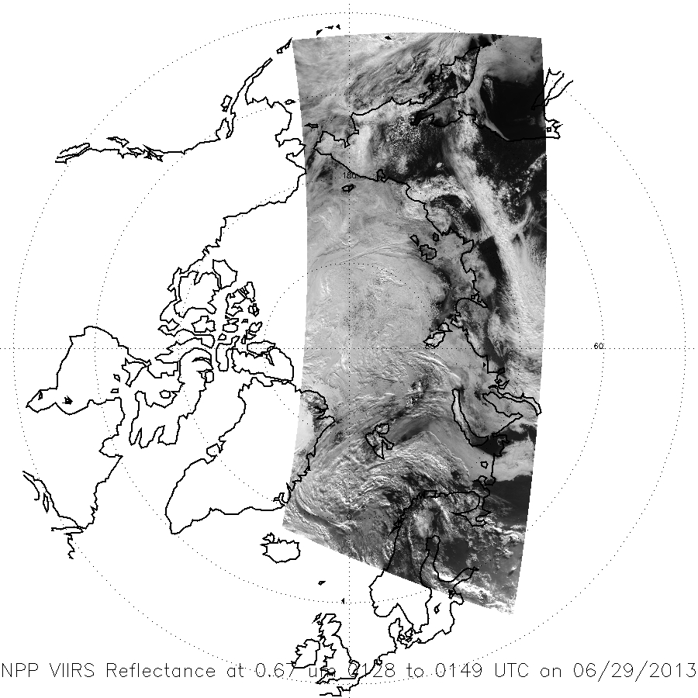
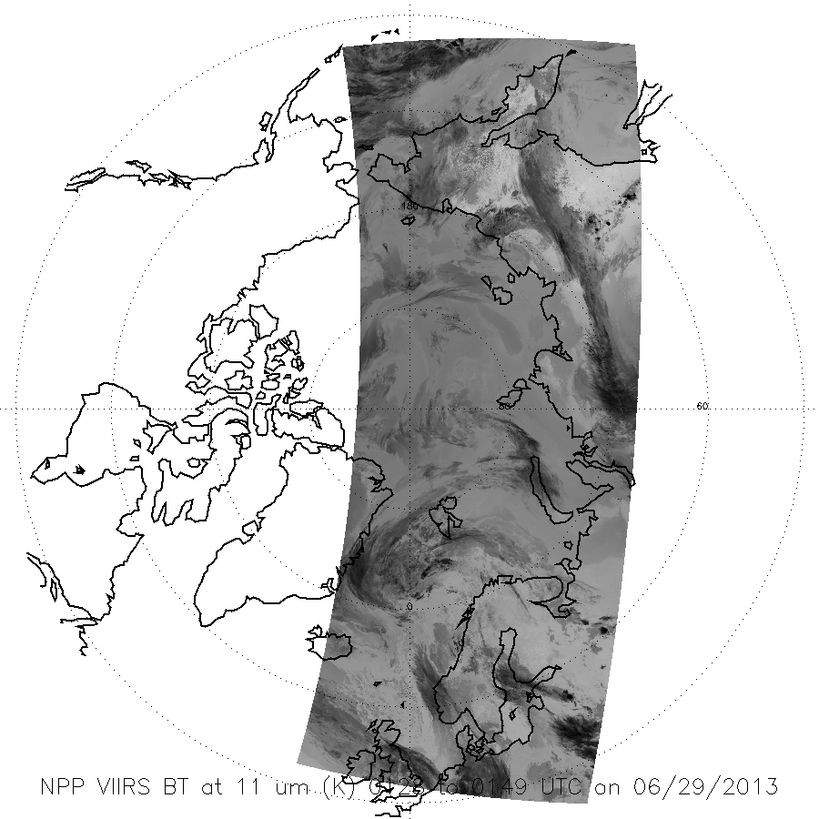
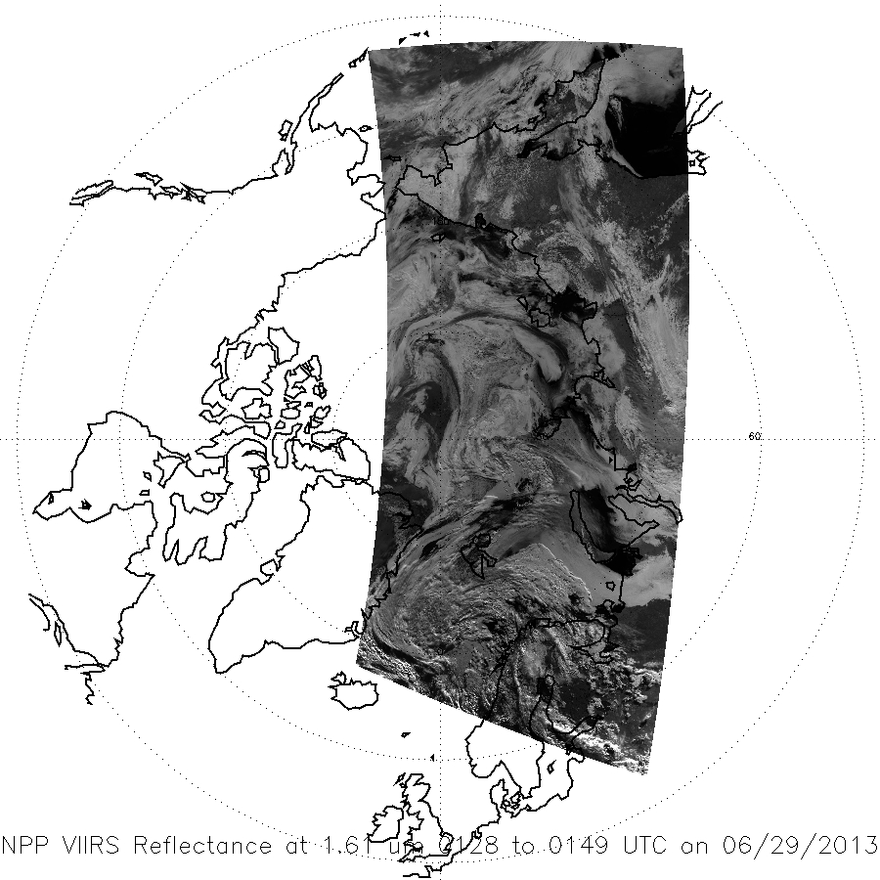
New Spectral Channels: VIIRS and MODIS Winds from the Shortwave Infrared
Vis (0.6 𝜇m)
IR (11 𝜇m)
MODIS
SWIR allows for better tracking of low, liquid clouds
SWIR (2.1 𝜇m)

Slide 17
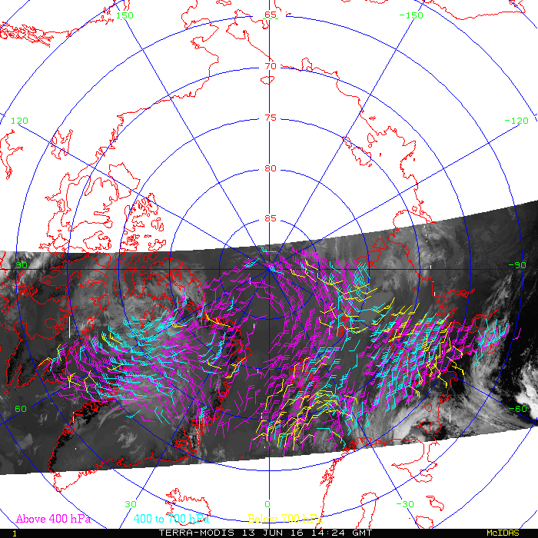
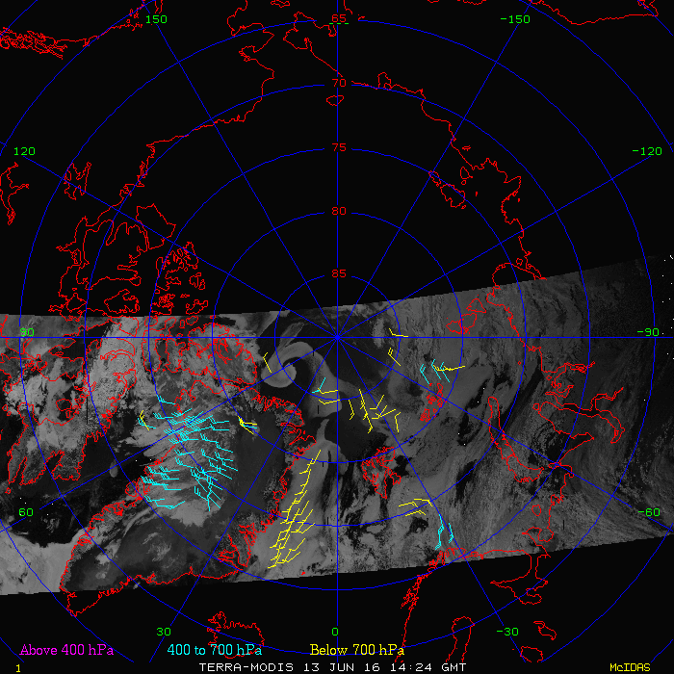
MODIS: SWIR, IR, and Water Vapor Retrieval Examples
WV & IR
SWIR
MODIS
VIIRS
The SWIR band provides more low-level vectors

Slide 18
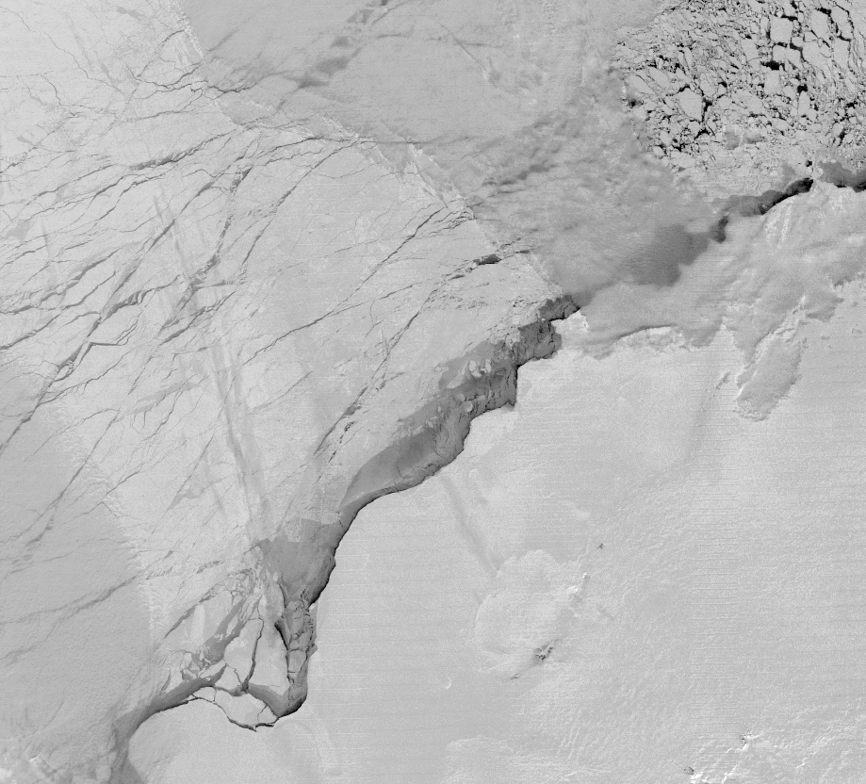
New Spectral Bands: VIIRS Day-Night Band (DNB)
sea ice
thin clouds
The VIIRS Day/Night Band (DNB) provides new possibilities for estimating wind properties at night.
sea ice
VIIRS Day-Night Band (DNB) NCC EDR Albedo, 21-Aug-2013 02:29-02:35
Full Moonlight Night Scene
thin clouds
(Courtesy of CIRA)
Notes:
1330 LTAN orbit.
740 m resolution (constant across the full 3000 km swath).
Calibrated radiance across 7 orders of magnitude radiance range, using 3 stages of dynamically selected gain, sensitive down to ~10⁻⁵ W/m²-sr-µm.
14-bit quantization (vs. 6-bit for the OLS).
Minimal stray light (solar glare) effects compared to OLS.
First opportunity to combine low-light visible with numerous near-IR and thermal-IR bands for multi-spectral applications.
* Lee, T. F., S. D. Miller, F. J. Turk, C. Schueler, R. Julian, S. Deyo, P. Dills, and S. Wang, 2006: The NPOESS/VIIRS day/night visible sensor, Bull. Amer. Meteor. Soc., 87(2), 191-199.

Slide 19
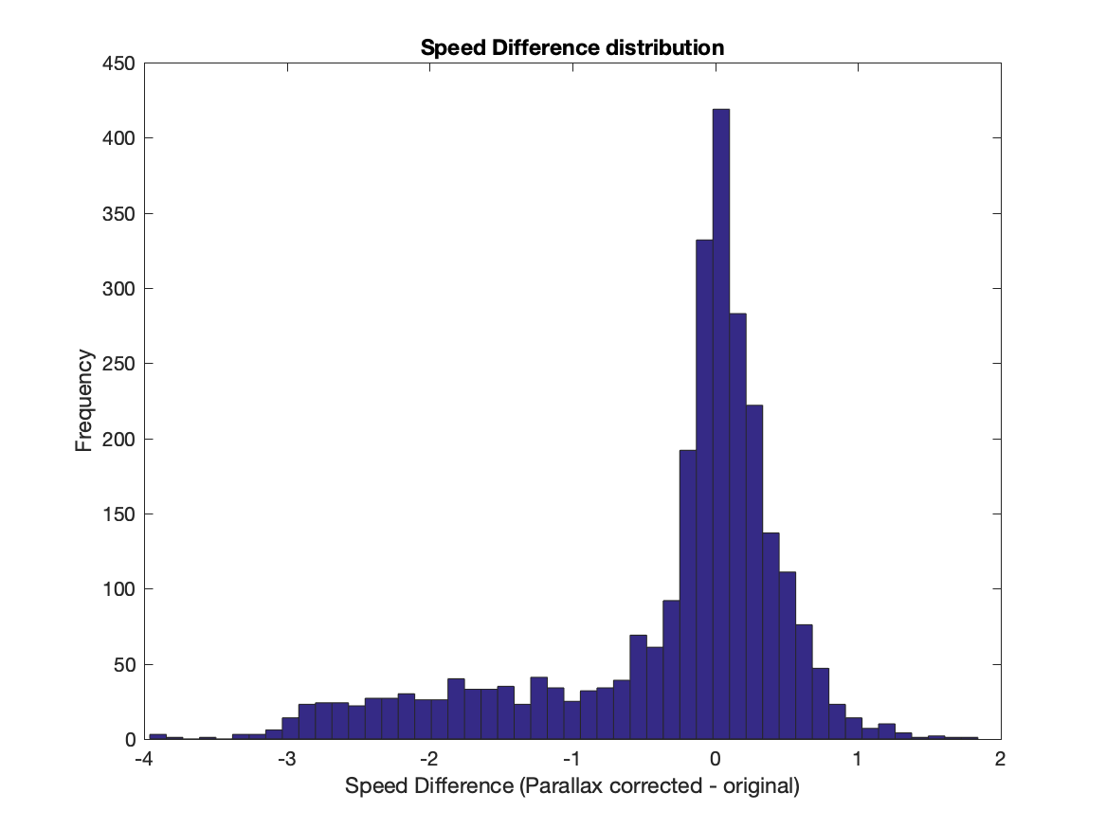
Parallax effects
One time period
Triplet of alternating S-NPP/NOAA-20 VIIRS
2700 vectors
Poleward of 60º latitude
In general, the largest adjustments to wind speed is to reduce the speed

Slide 20
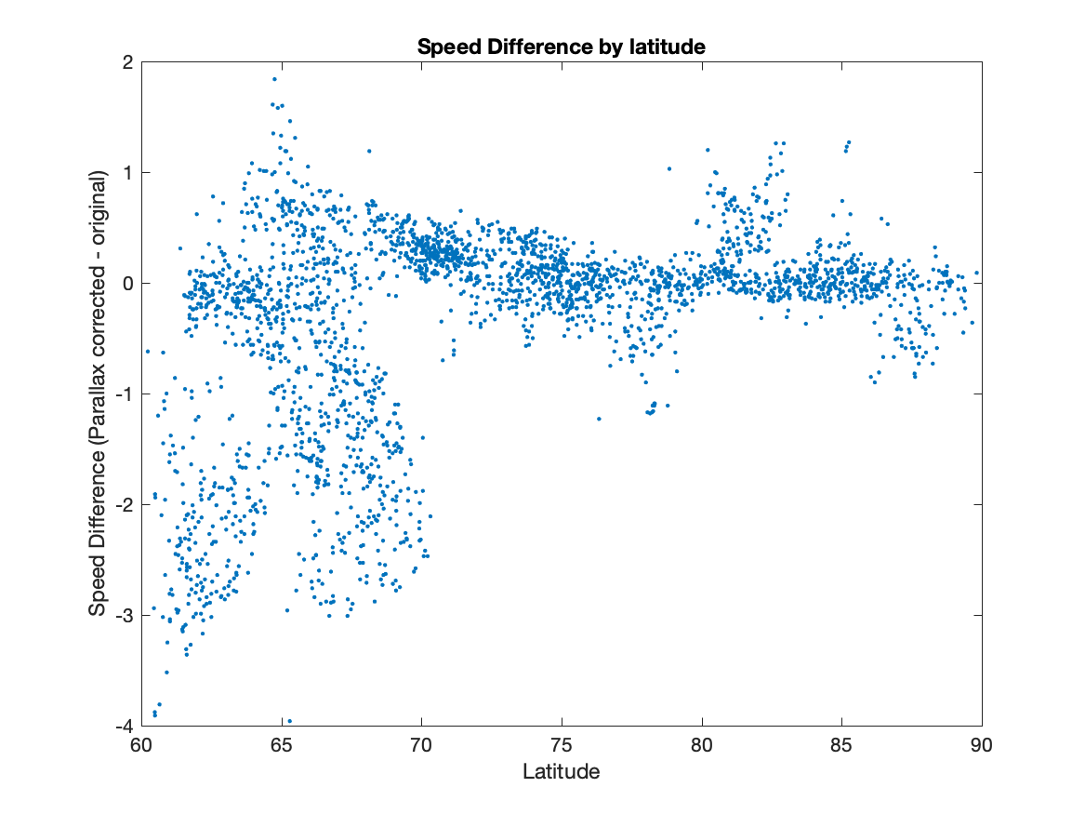
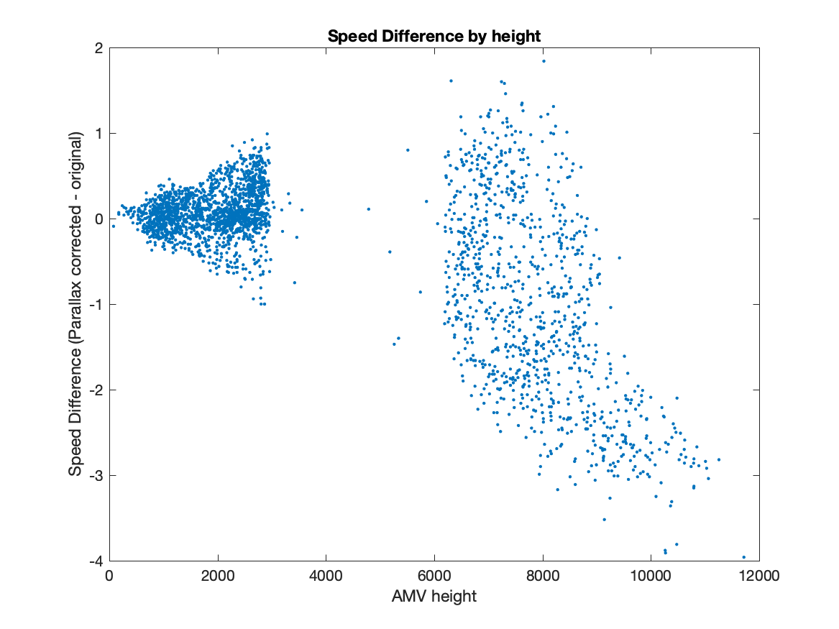
Parallax effects
The further equatorward, the larger the adjustment to the speed (potentially larger viewing angle differences)
The higher the cloud, the larger the adjustment to the speed (with larger viewing angle differences)

Slide 21
Tandem winds: Adaptive Quality Control (AQC)
We will continue to track using triplets of images
Tandem winds: We will report the wind from the 2nd image pair and time-tag with the time of the last image
When there is overlap in the triplet, we will continue to use existing consistency checks for the vector pairs
Tandem winds: When there is not a 1st vector for normal QC use (e.g., lower latitudes), we will use AQC which compares to lower-resolution AMVs from other satellite-derived winds sources (GOES, MODIS, AVHRR).

Slide 22
Questions?

