Slide 1
Comparison of Aeolus winds to AIRS 3D winds David Santek, Brett Hoover, Elisabeth Weisz, Chia Moeller, Hong Zhang Cooperative Institute for Meteorological Satellite Studies (CIMSS)
Presented at SAT meeting 14 Sep 2020 Updated with latest results (slides 20-25) on 11 May 2021

Slide 2
Motivation
Decadal Survey recommends a 3D tropospheric wind mission
Using a space-based LIDAR instrument and/or the use of hyperspectral infrared measurements.
The combination of lidar winds and AMV winds might also provide some advantages where one is used to calibrate the other.

Slide 3
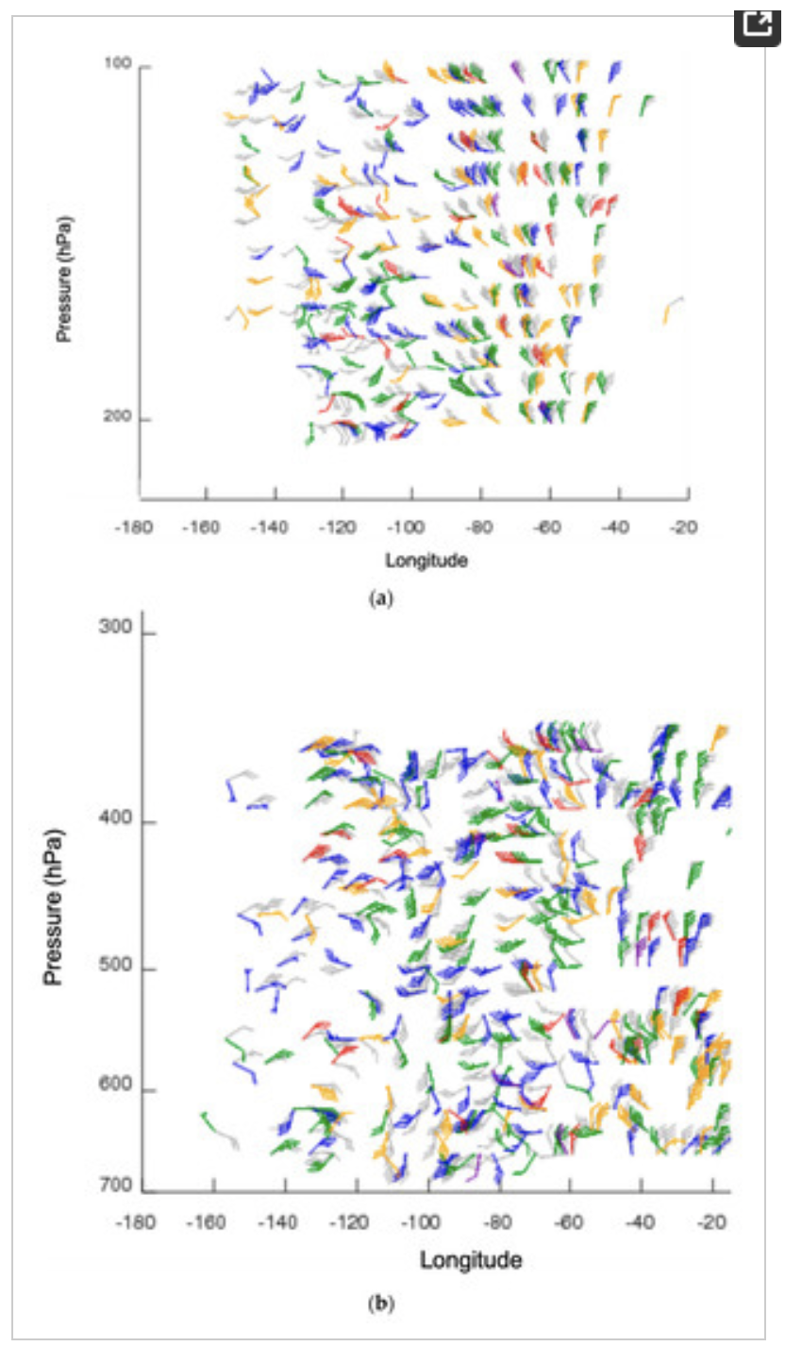
What are 3D winds?
Vertical distribution of wind information in the troposphere and stratosphere. Considering two methods:
Direct measurement using Lidar (Aeolus)
Tracking moisture and ozone features on pressure surfaces (Aqua AIRS retrievals)

Slide 4
Why compare AIRS 3D winds to Aeolus winds?
Validation
They both provide a vertical distribution of winds in clear sky and above cloud
Examine statistical differences between the winds: spatially and vertically
Compare co-located winds to independent data: Rawinsondes, model reanalyses
Are they complementary or redundant?

Slide 5
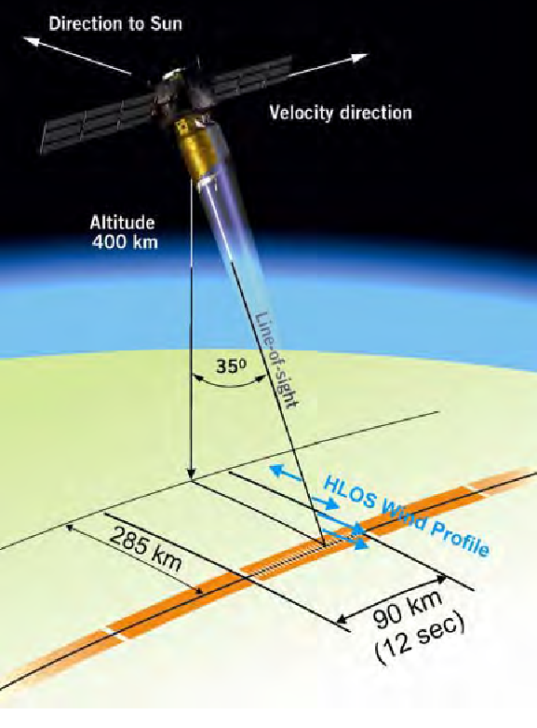
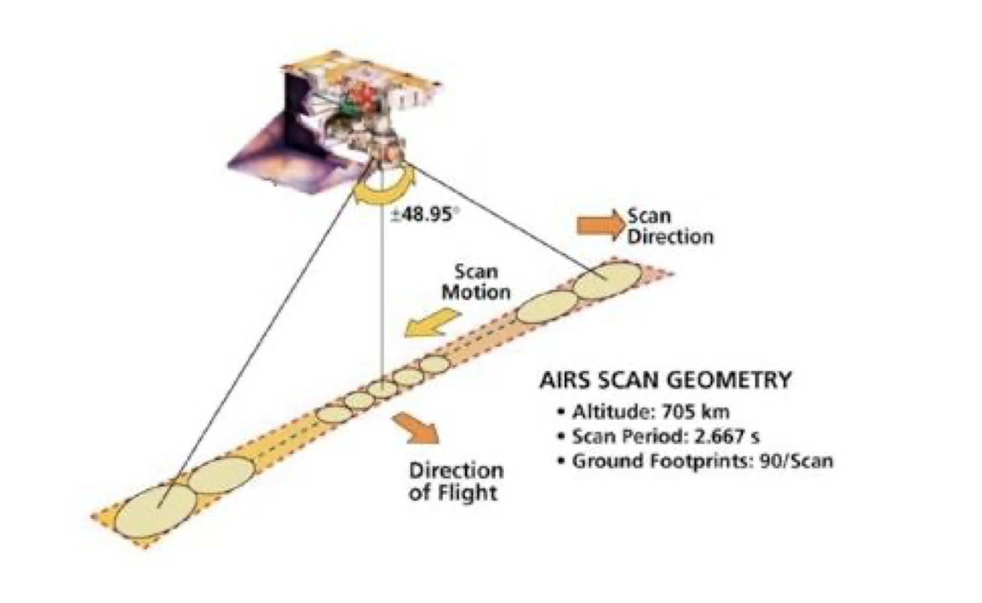
Aeolus vs AIRS
Atmospheric Infrared Sounder (AIRS)
Hyperspectral Infrared instrument
2378 Channels
Results in vertical profiles of temperature, humidity, ozone in the troposphere and stratosphere
Aeolus
AIRS

Slide 6
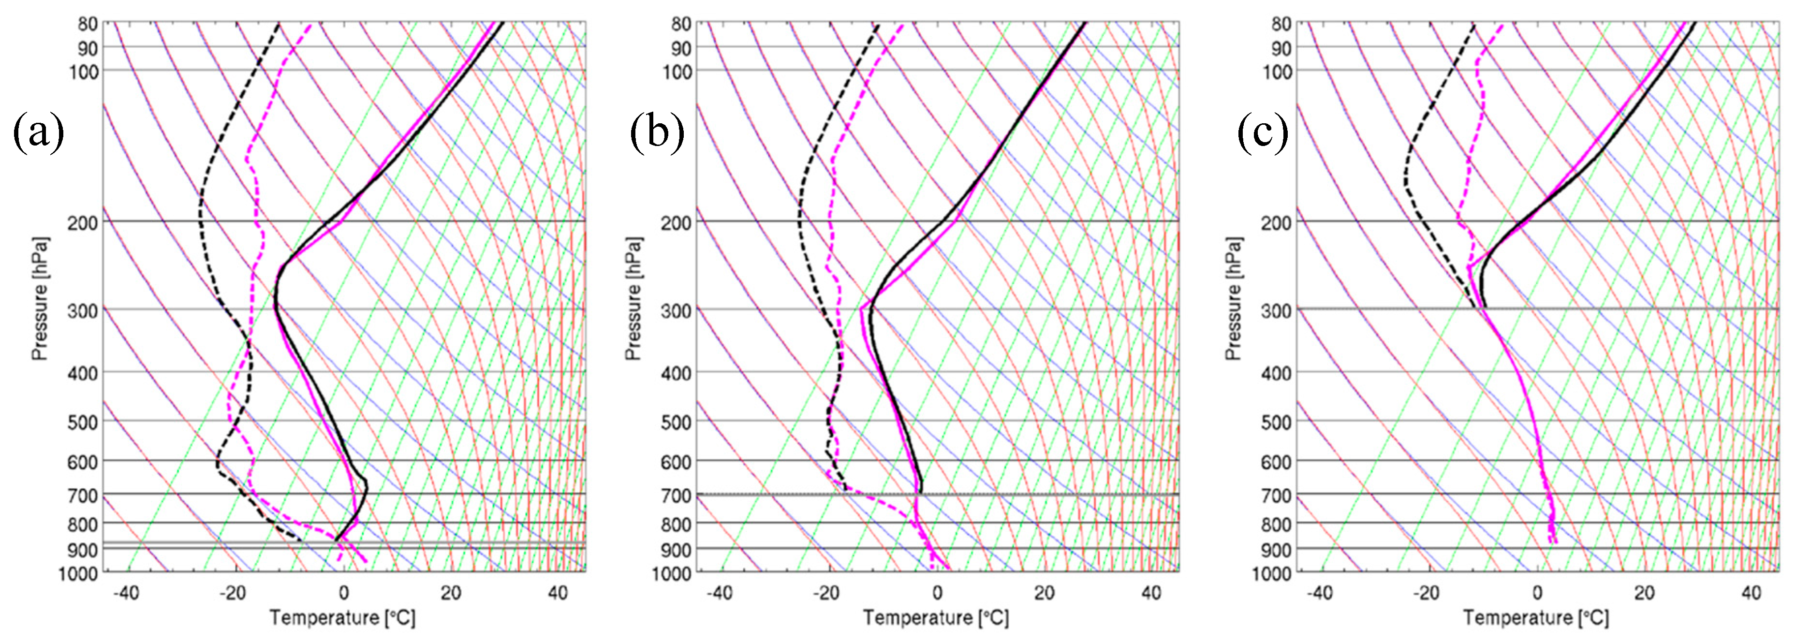
Aeolus vs AIRS
Aeolus: Doppler wind lidar (DWL) instrument. Single line-of-sight instrument, which results in the Horizontal Line of Sight (HLOS) component of the wind.
Mie: Particle (aerosols and clouds) Rayleigh: Molecular (cloud free)
AIRS 3D winds: Winds derived from tracking moisture features (troposphere) and ozone gradients (stratosphere) on pressure surfaces from AIRS retrieved vertical profiles of temperature, humidity, and ozone in clear-sky and above cloud.
Example temperature and dewpoint profiles for clear sky (a), above low cloud (b), above high cloud (c) as compared to the model background. Retrievals (black) and NCEP/GFS (magenta).

Slide 7
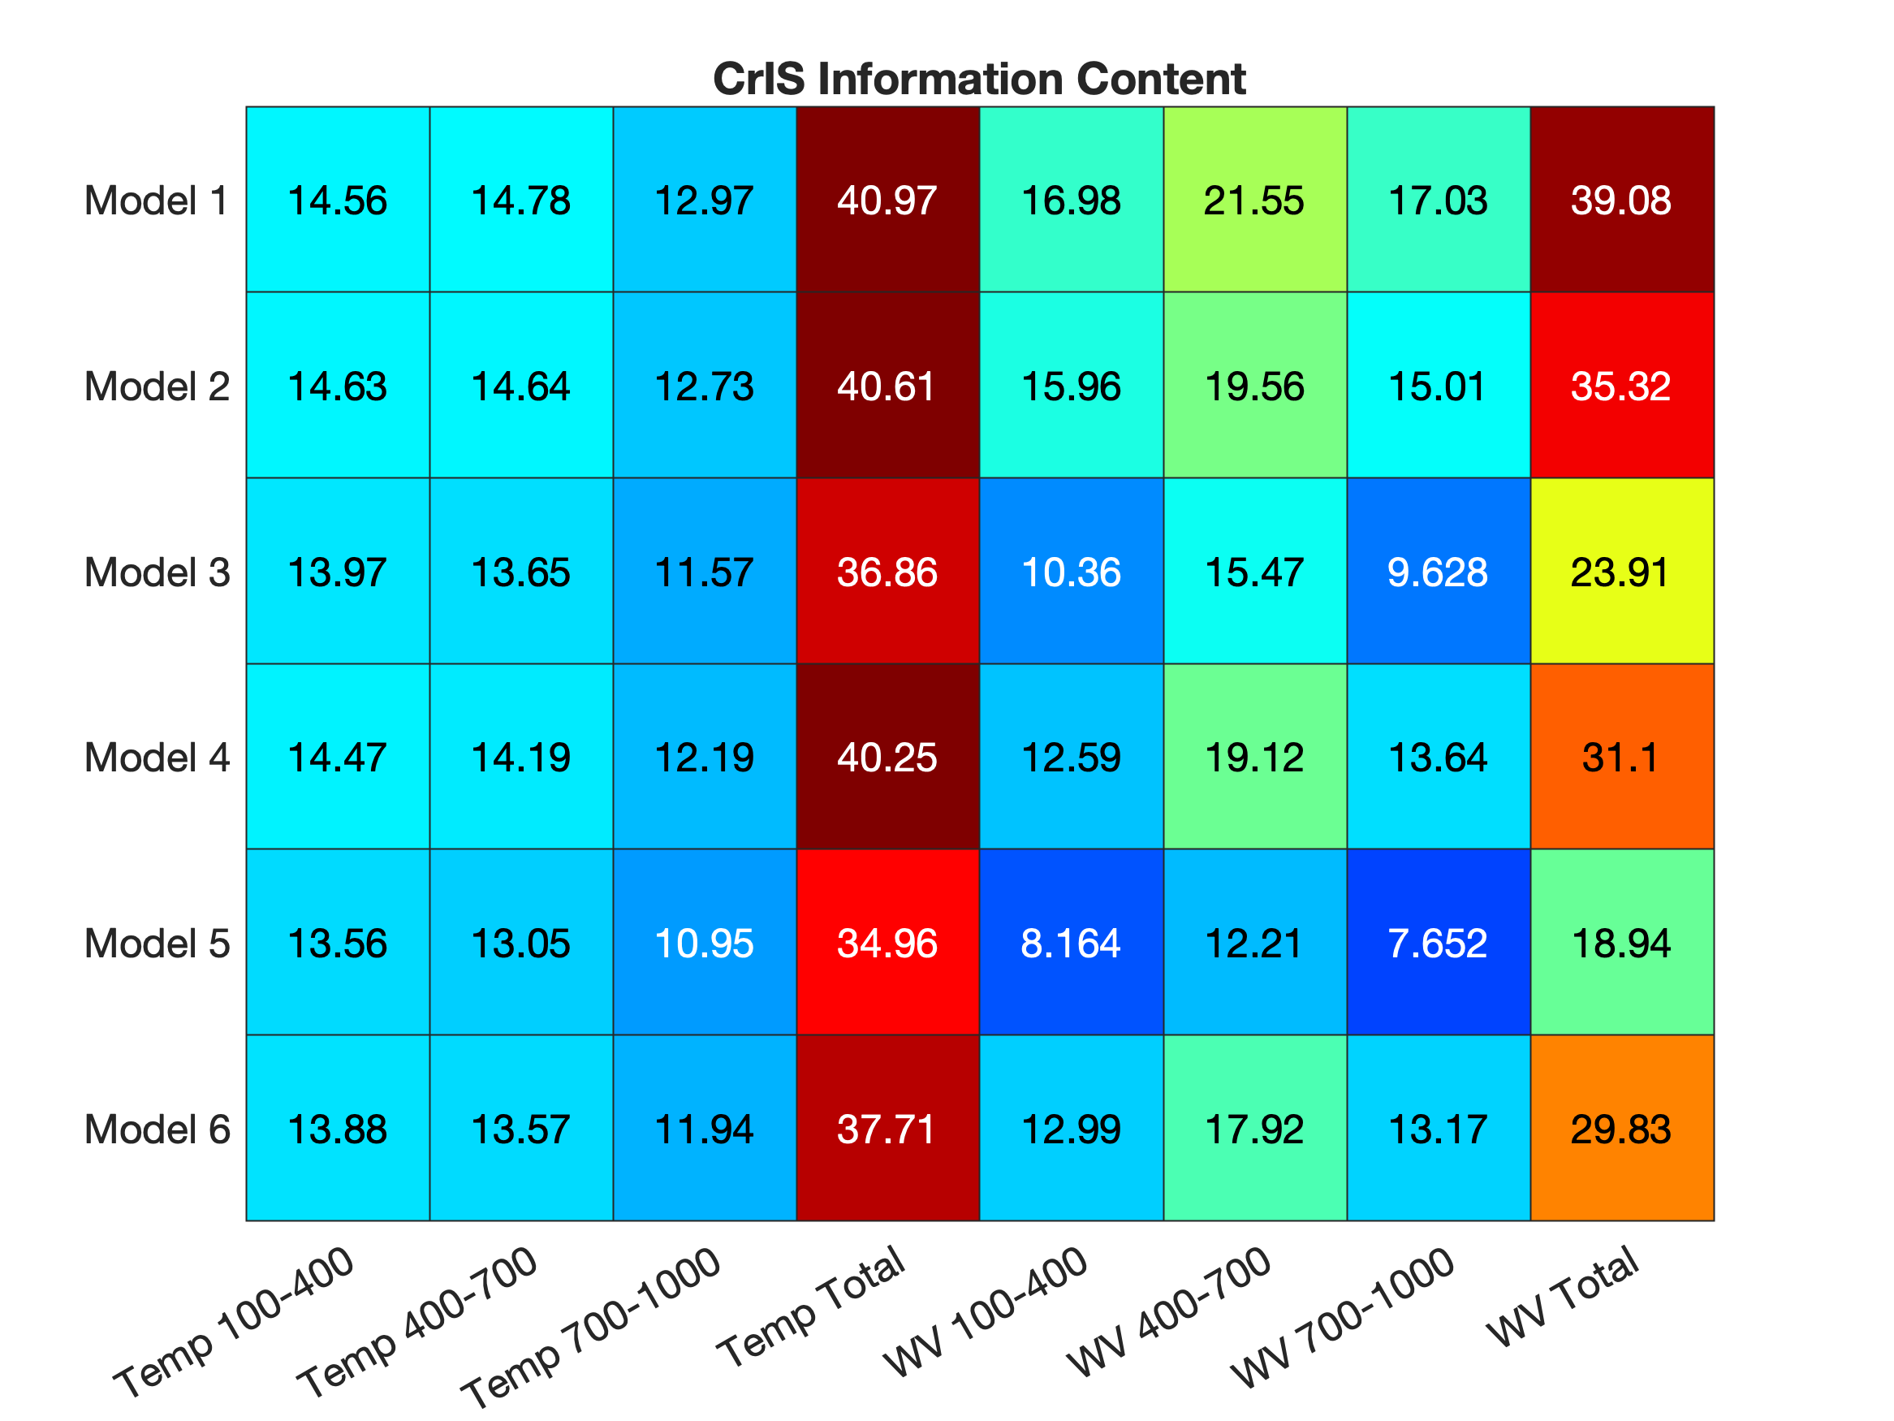
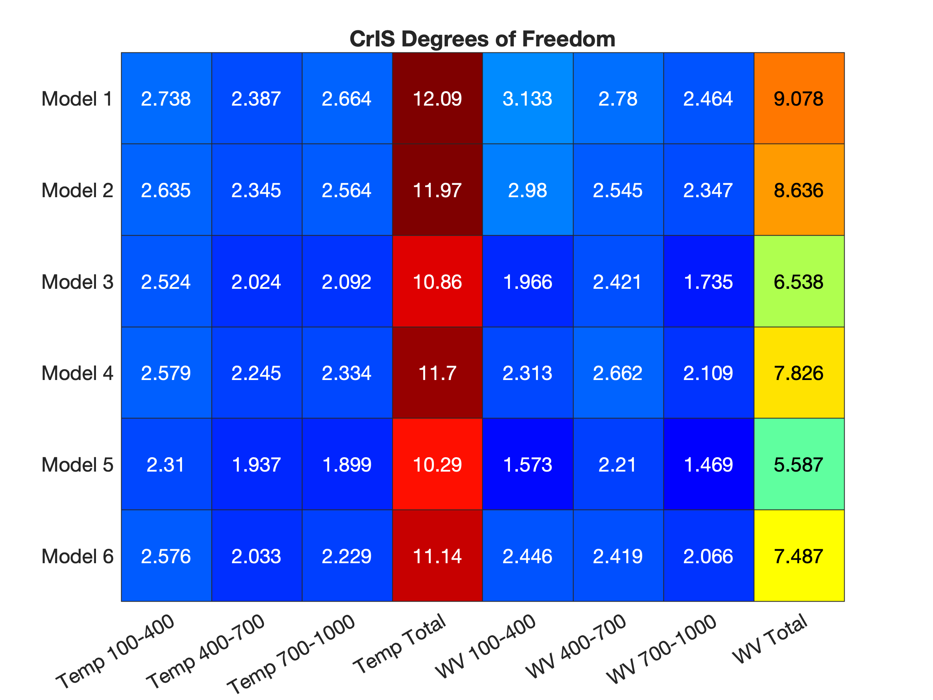
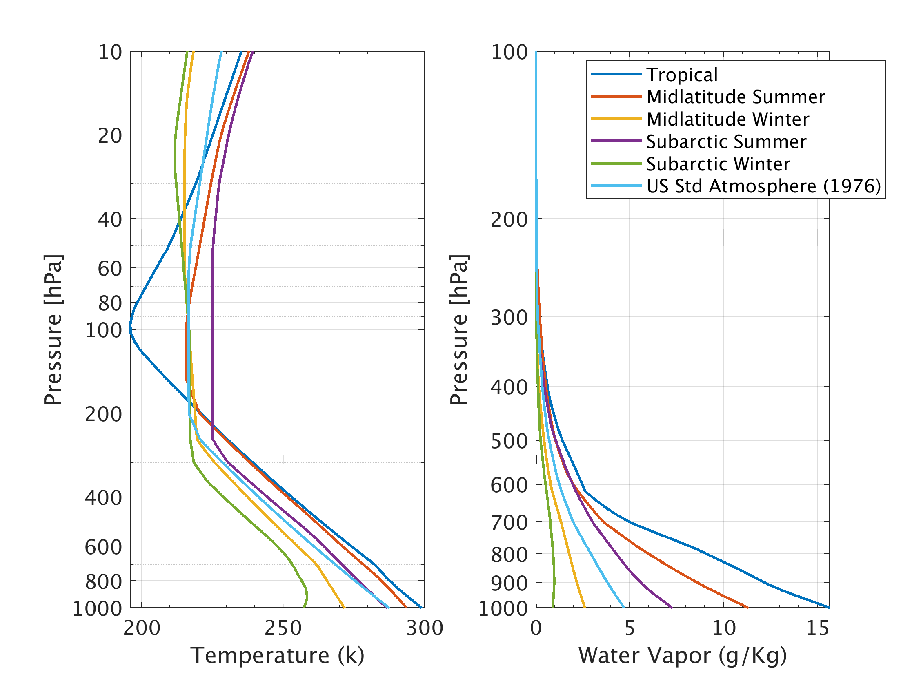
Hyperspectral IR Retrievals Temperature and humidity Information Content
Six Model Atmospheres Temperature and Water Vapor Profiles
Information Content (IC)
Information gained from a measurement
Expressed in ‘bits’
Temperature: ~40 bits Humidity: ~30 bits
Degrees of Freedom (DOF)
Independent pieces of information (shown in pressure layers)
Temperature: >2/layer. Humidity: >2/layer
Tropical
Mid-lat summer
Mid-lat winter
Subarctic summer
Subarctic winter
Standard Atmosphere
Can be compared to other retrievals
ATMS: T and q 6-9 bits (all-sky conditions)
Agrees with T and q retrieval vertical resolution of 1 to 1.5 km (70-100 hPa)

Slide 8
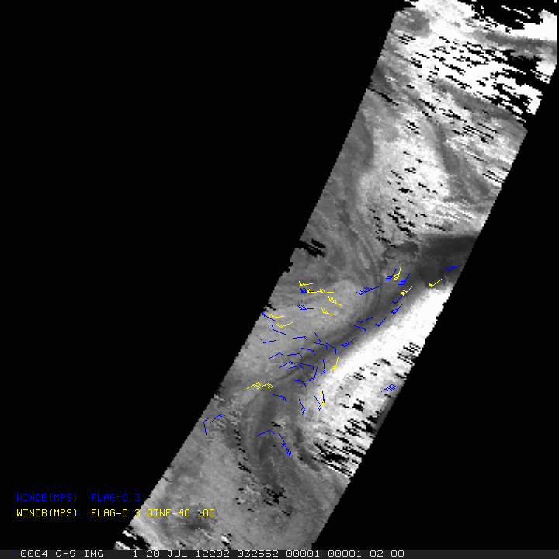
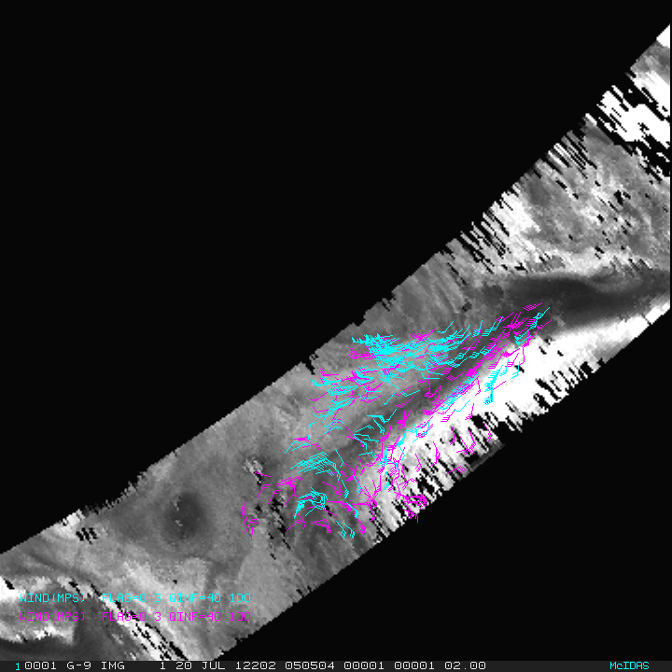
AIRS Atmospheric Motion Vectors (AMVs)
20 July 2012: 0325, 0505, 0643 UTC
AIRS 20 July 2012 0505 UTC
Ozone: 103 to 201 hPa Moisture: 359 to 616 hPa
Wind vectors on 400 hPa pressure surface centered on North Pole
Blue: All winds Yellow: Quality controlled
https://www.mdpi.com/2072-4292/11/22/2597

Slide 9
Comparison of 3D winds
Aeolus winds
Wind component perpendicular to the satellite path
Better vertical resolution
Near-instantaneous
AIRS 3D winds
Total wind
Better spatial coverage
Average motion over 200 minutes
To account for differences
Total wind from AIRS AMVs was adjusted to equivalent HLOS wind (used viewing angle from co-located Aeolus winds)
For each AIRS AMV, co-located Aeolus winds were super-obbed in space and time

Slide 10
Comparisons
Aeolus Rayleigh vs AIRS 3D winds August through September 2019
Only polar regions
Intercomparison
Each compared to rawinsondes
Co-located compared to ERA5 reanalysis

Slide 11
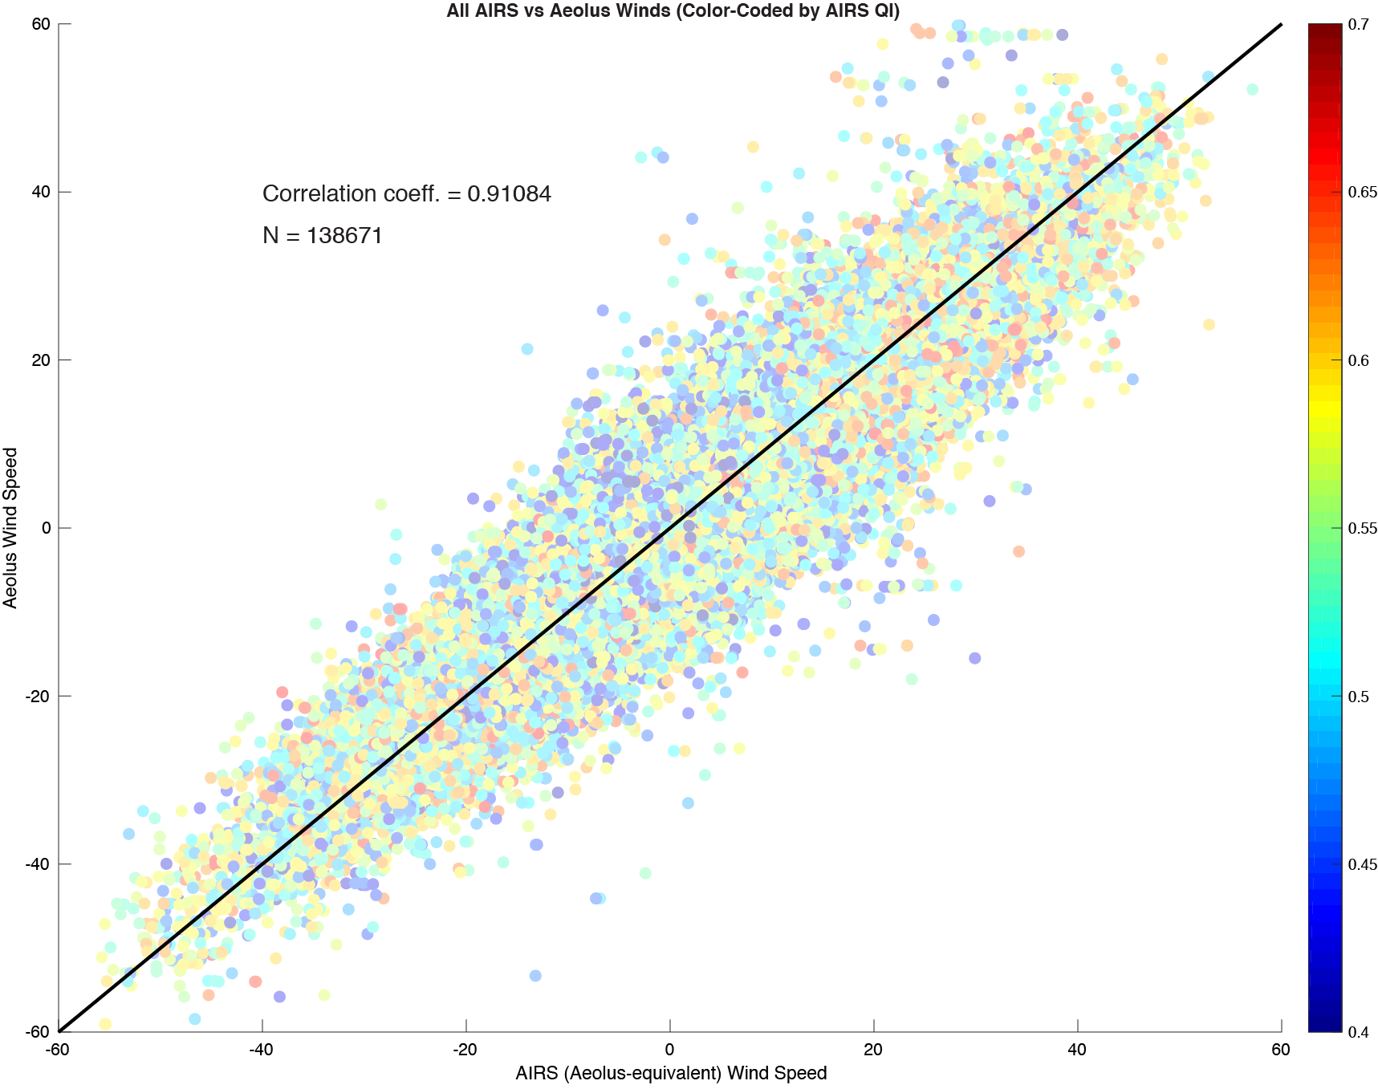
Aeolus Rayleigh vs AIRS HLOS wind speed
N = 138,671
r = 0.91
August through September 2019

Slide 12
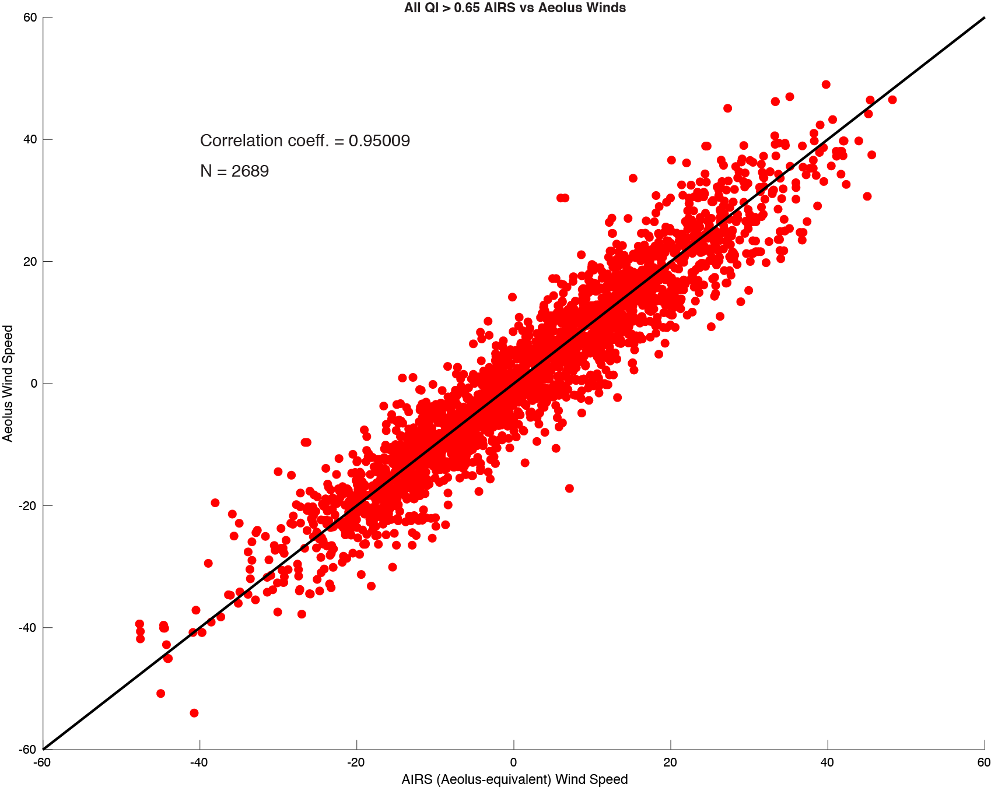
Aeolus Rayleigh vs AIRS HLOS wind speed (only high-quality AIRS AMVs: QI > 0.65)
N = 2,689
r = 0.95
August through September 2019

Slide 13
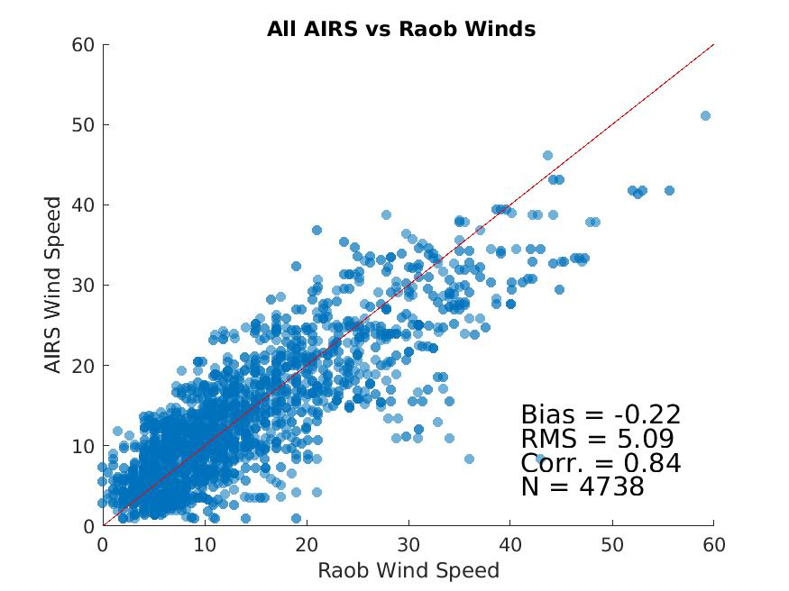
AIRS 3D winds vs rawindsondes
N = 4,738
Bias = -0.22 ms⁻¹
RMSD = 5.09 ms⁻¹
r = 0.84
August through September 2019

Slide 14
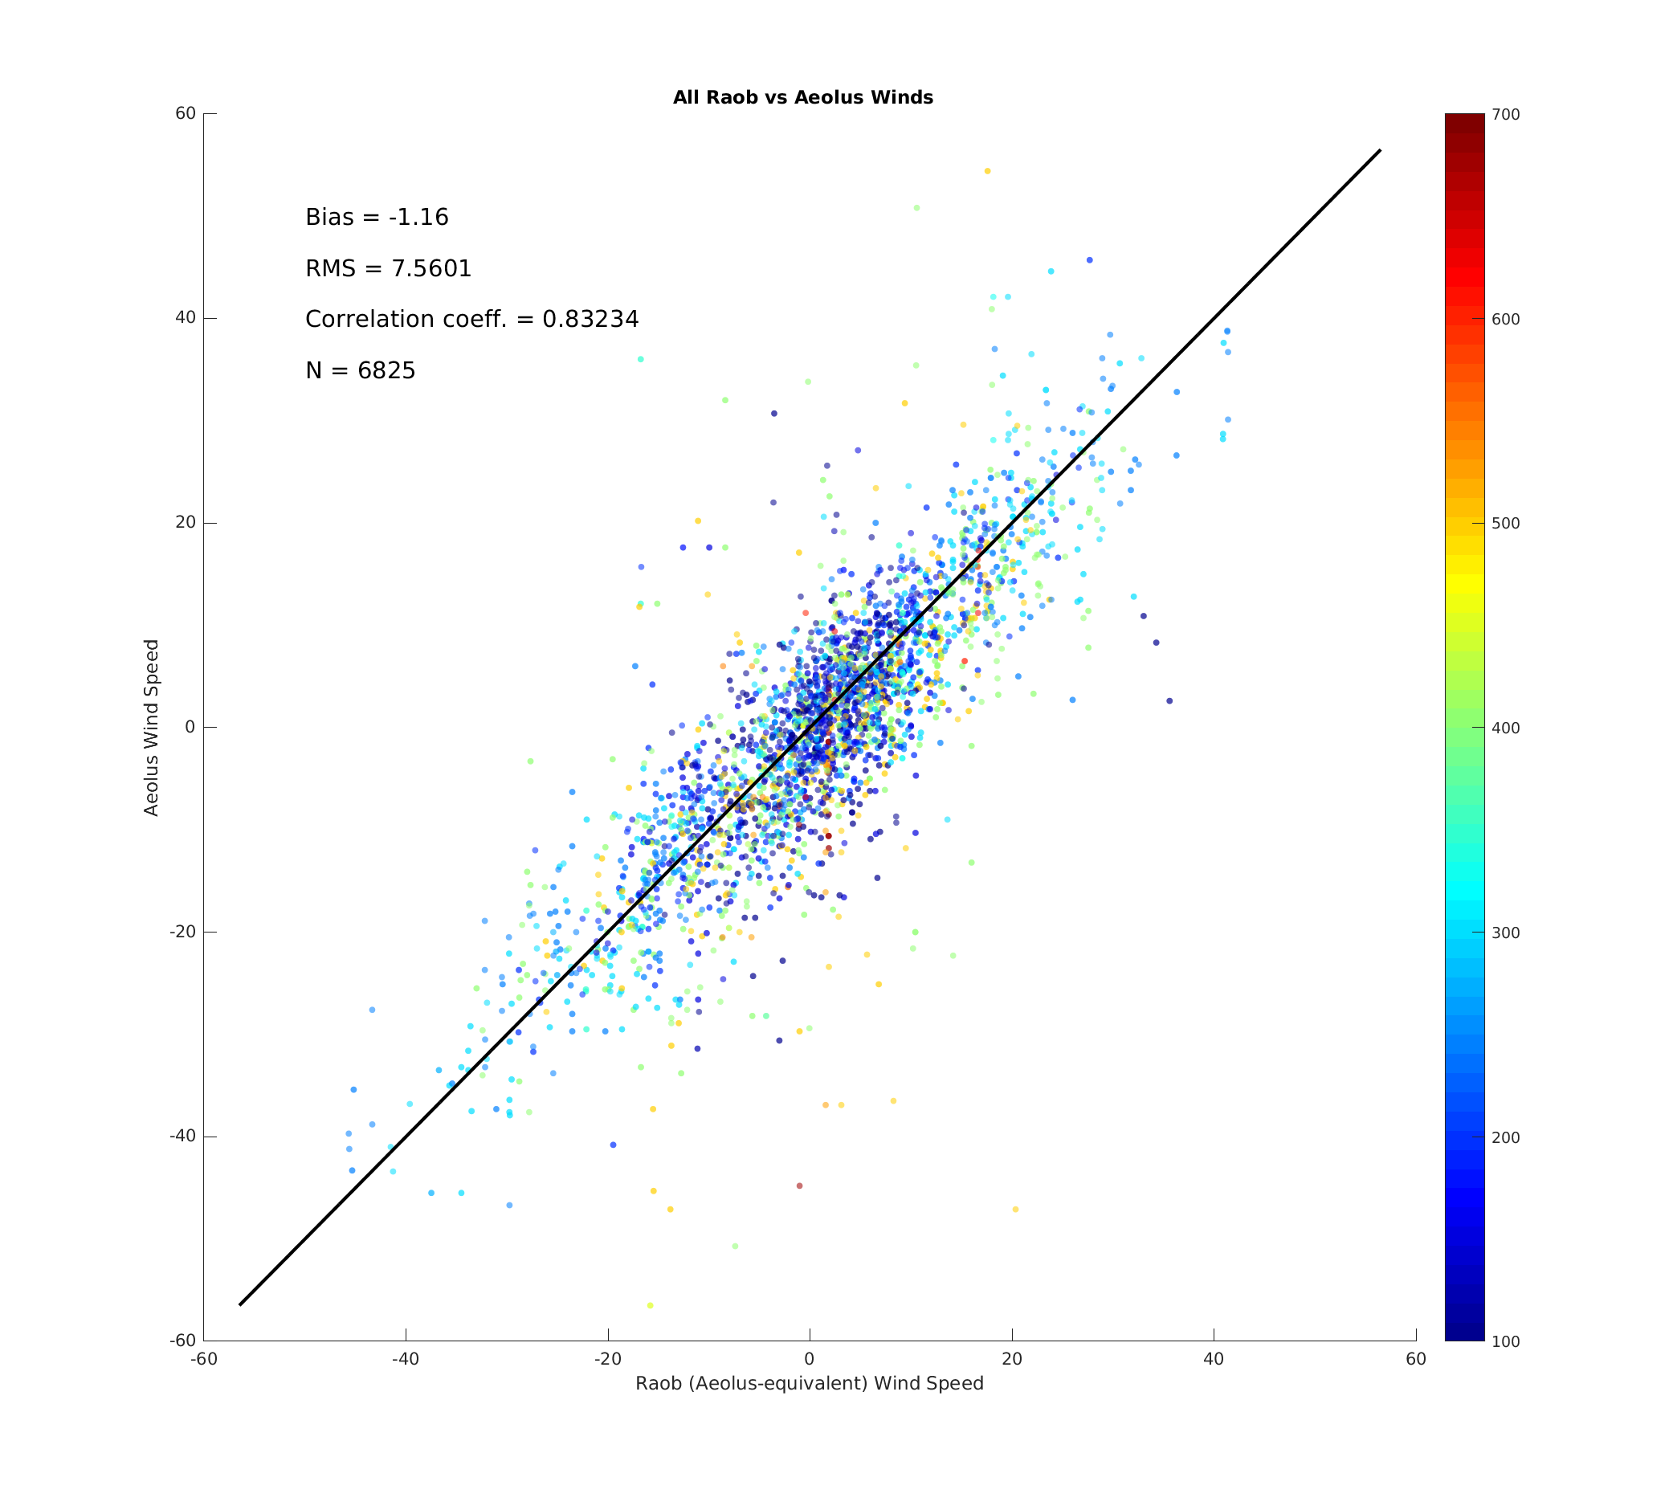
Aeolus Rayleigh vs rawinsondes
N = 6,825
Bias = +0.83 ms⁻¹
RMSD = 7.56 ms⁻¹
r = 0.83
August through September 2019

Slide 15
Comparisons to ERA5
Aeolus Rayleigh and AIRS 3D winds compared to ERA5 for 10 days in summer of 2019
Results in ~36,000 AIRS/Aeolus co-locations
 | AIRS vs ERA5 | Aeolus vs ERA5
Bias | +0.015 ms⁻¹ | -0.265 ms⁻¹
RMSE | 4.61 ms⁻¹ | 5.49 ms⁻¹
Correlation | 0.94 | 0.92
Differences in bias are statistically significant at 95% confidence using a 2-sided student's t-test

Slide 16
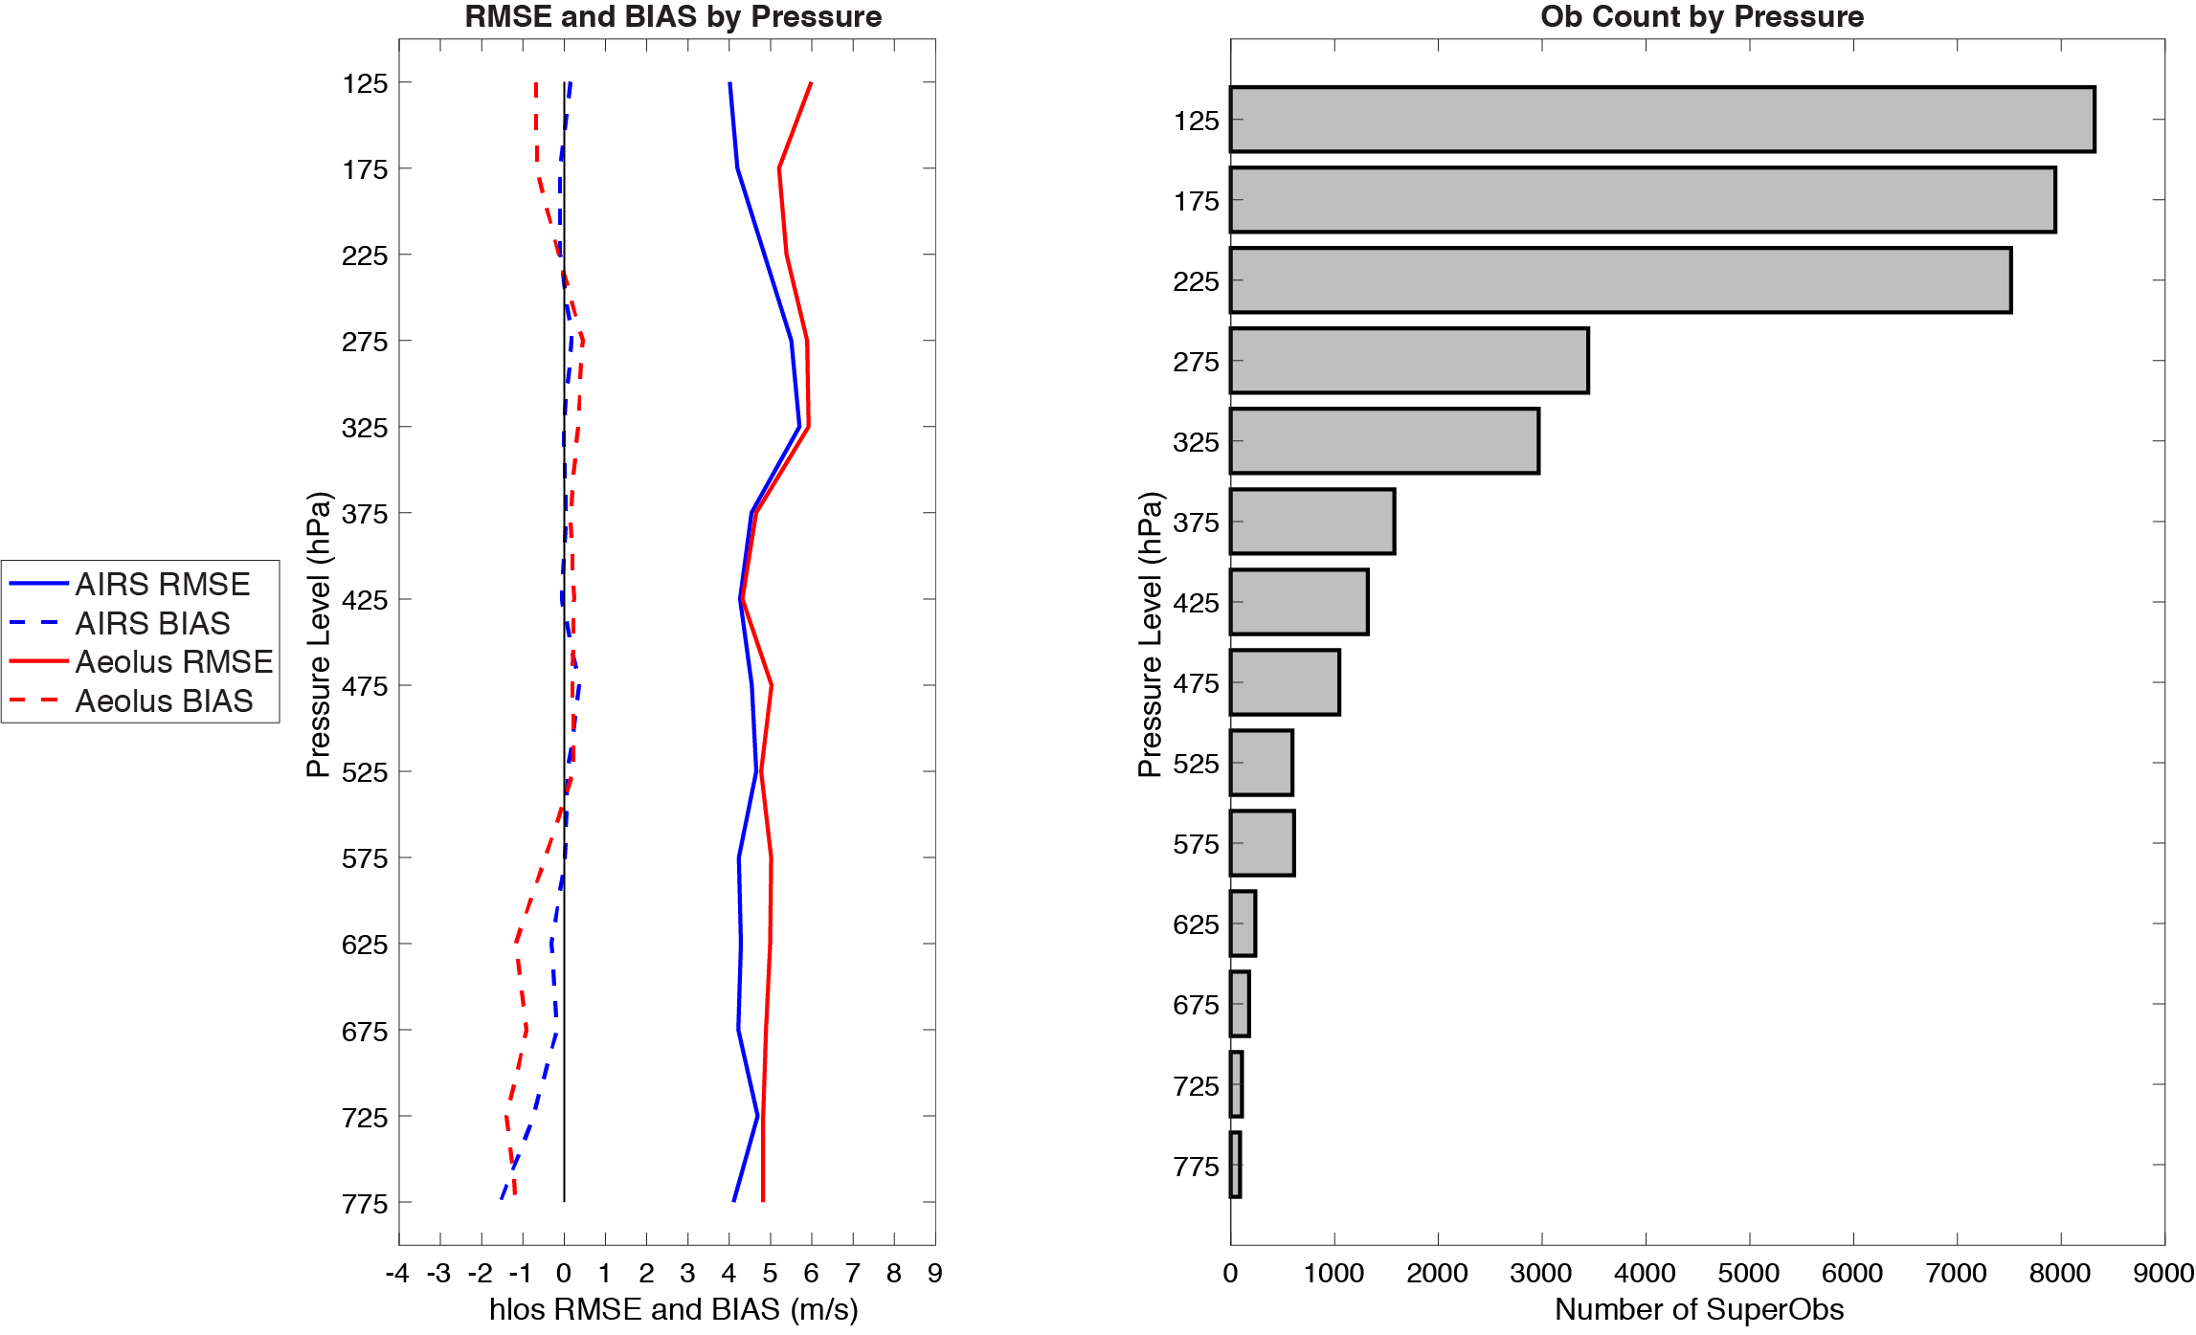
Comparisons to ERA5
AIRS and Aeolus have similar bias and RMSE throughout mid- and upper-troposphere
Largest differences are in the lower troposphere and the stratosphere: AIRS 3D winds compare more closely

Slide 17
Summary
Since there are several inherent differences in the spatial coverage, temporal sampling, and wind measurement this high correlation indicates these two sources of 3D winds may be complementary, with similar quality.
Aeolus vs AIRS HLOS-equivalent wind speed
This helps to justify a combined mission of a DWL with a hyperspectral IR instrument:
DWL gives high-quality 3D profiles of HLOS winds along a path
Hyperspectral IR will provide potentially similar quality total wind with improved horizontal spatial coverage (reduced vertical resolution). Note: Higher resolution hyperspectral instrument needed.

Slide 18
Update
11 May 2021
The original slides 11-16 are updated on slides 20-25
Slide 19 is a restatement of comparisons and co-location thresholds
The update uses the reprocessed Aeolus data with the ESA-recommended QC
Aeolus vs AIRS HLOS-equivalent wind speed

Slide 19
Aeolus vs AIRS winds
AIRS retrieval winds | Aeolus Rayleigh clear-sky
Humidity feature tracking | Molecular motion using Doppler Lidar
Total wind | Horizontal Line of Sight (HLOS) wind component
Better spatial coverage | Better vertical resolution
Average motion spanning 200 minutes | Near instantaneous
Comparisons
August through September 2019
Only polar regions
Intercomparison
Each compared to rawinsondes
Co-located compared to ERA5 reanalysis
Aeolus: Reprocessed and ESA-recommended QC
Account for differences
Total wind from AIRS AMVs was adjusted to equivalent HLOS wind (used viewing angle from co-located Aeolus winds)
For each AIRS AMV, co-located Aeolus winds were super-obbed in space and time
Co-location
Within 100 km (150 km for rawinsondes)
+/- 90 minutes (+/- 60 min. for rawinsondes)
+/- .04 difference in log10 pressures (approx. height)
+/- 60 hPa at 700 hPa
+/- 20 hPa at 200 hPa

Slide 20
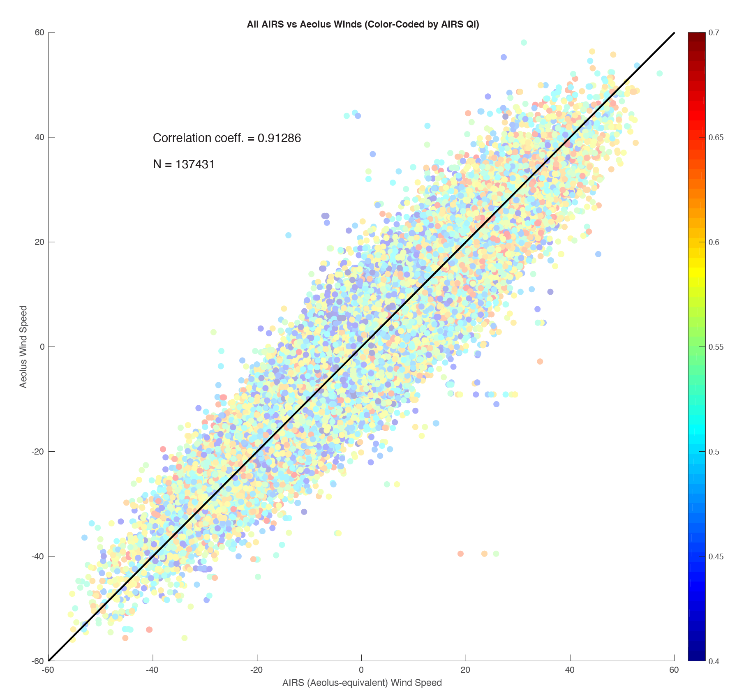
Aeolus Rayleigh vs AIRS HLOS wind speed (update 11 May 2021)
N = 137,431
r = 0.91
All winds color-coded by AIRS quality; polar region
August through September 2019

Slide 21
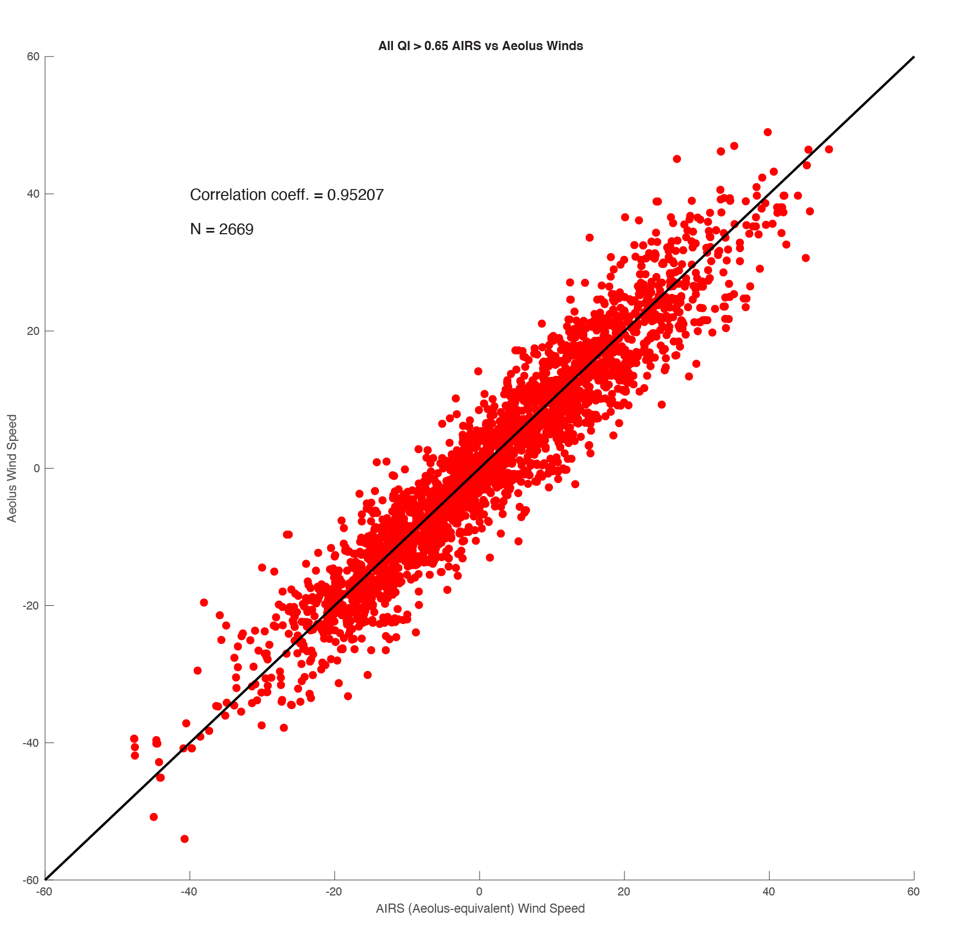
Aeolus Rayleigh vs AIRS HLOS wind speed (only high-quality AIRS AMVs: QI > 0.65) (update 11 May 2021)
N = 2,669
r = 0.95
August through September 2019

Slide 22
AIRS 3D winds vs rawindsondes (unchanged slide 13)
N = 4,738
Bias = -0.22 ms⁻¹
RMSD = 5.09 ms⁻¹
r = 0.84
August through September 2019

Slide 23
Aeolus Rayleigh vs rawinsondes (update 11 May 2021)
N = 6,024
Bias = -1.1 ms⁻¹
RMSD = 5.9 ms⁻¹
r = 0.89
Aeolus vs rawinsonde HLOS-equivalent wind speed color-coded by pressure
August through September 2019

Slide 24
Comparisons to ERA5 (update 11 May 2021)
Aeolus Rayleigh and AIRS 3D winds compared to ERA5 for 10 days in summer of 2019
Results in ~36,000 AIRS/Aeolus co-locations
 | AIRS vs ERA5 | Aeolus vs ERA5
Bias | +0.02 ms⁻¹ | +0.17 ms⁻¹
RMSE | 4.57 ms⁻¹ | 4.52 ms⁻¹
Correlation | 0.95 | 0.95

Slide 25
Comparisons to ERA5 (update 11 May 2021)
AIRS and Aeolus have similar bias and RMSE throughout the entire profile
AIRS and Aeolus wind speed bias (dashed) and RMSD (solid) compared to ERA5

