Slide 1
An Overview of 3D Wind Activities from Hyperspectral IR Sounders at CIMSS
David Santek¹, Jason Otkin¹, Agnes Lim¹, Lidia Cucurull²
¹CIMSS/SSEC/University of Wisconsin-Madison
²NOAA/OAR/ORTA/QOSAP
Workshop on Space-based 3D Winds
19 – 20 February 2025

Slide 2
Acknowledgements
Sharon Nebuda, Dave Stettner, Dagmar Merkova, Chris Velden, Jeff Key, Tim Olander, Brett Hoover, Marek Rogal, Régis Borde, Anne Sophie Daloz, Sophia Reiner, Paul Scudder, Derek Posselt, Andrea Lang, Randy Pauley, Will McCarty, Sid Boukabara, Kevin Garrett, Hong Zhang, Chia Moeller, Scot Rafkin, Kevin Maschhoff, Elisabeth Weisz, Paul Menzel, Tom Rink, T.J. Vandal, Satya Kalluri, Jaime Daniels, Andy Heidinger
Funding
NOAA NA15NES4320001
NASA ROSES NNX11AE97G; NNX14AI77G; 80NSSC18K0984
SSEC Internal

Slide 3
Outline
Background: 3D winds from hyperspectral sounders
  Based on heritage code for geostationary and polar orbiting satellite-derived winds from imagers (e.g., GOES GVAR, MODIS, AVHRR)
AIRS
  Model impact
  Comparison to Aeolus
IASI, ATMS (MiRS)
CrIS
  Single, two, three satellites
  Deep learning/optical flow
NASA Earth Venture proposals (not funded)
  WHISPER
  MISTiC Winds
  Windmapper
Simulated winds
  Nature run
  OSSEs

Slide 4
Heritage product: Polar winds from MODIS

Slide 5
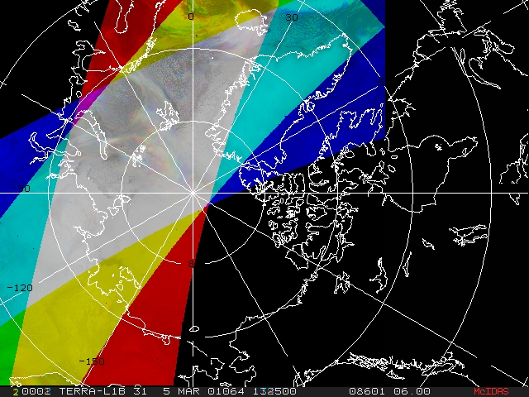
Heritage: MODIS Satellite-derived Polar Winds
Unlike geostationary satellites at lower latitudes, it is not be possible to obtain complete polar coverage at a snapshot in time. Winds must be derived for areas that are covered by three successive orbits. The gray area is the overlap between three orbits.

Slide 6
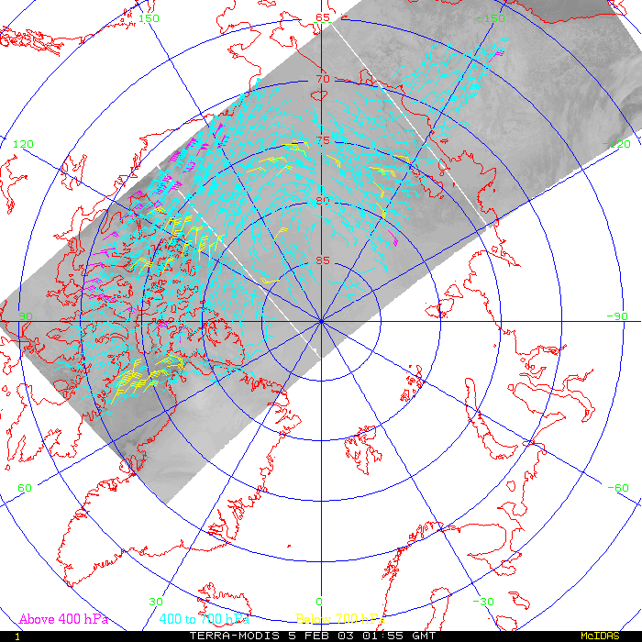
One Day of Arctic Orbits
MODIS band 31 (11 μm)

Slide 7
3D AMVs product:
Tracking humidity and ozone from AIRS retrievals

Slide 8
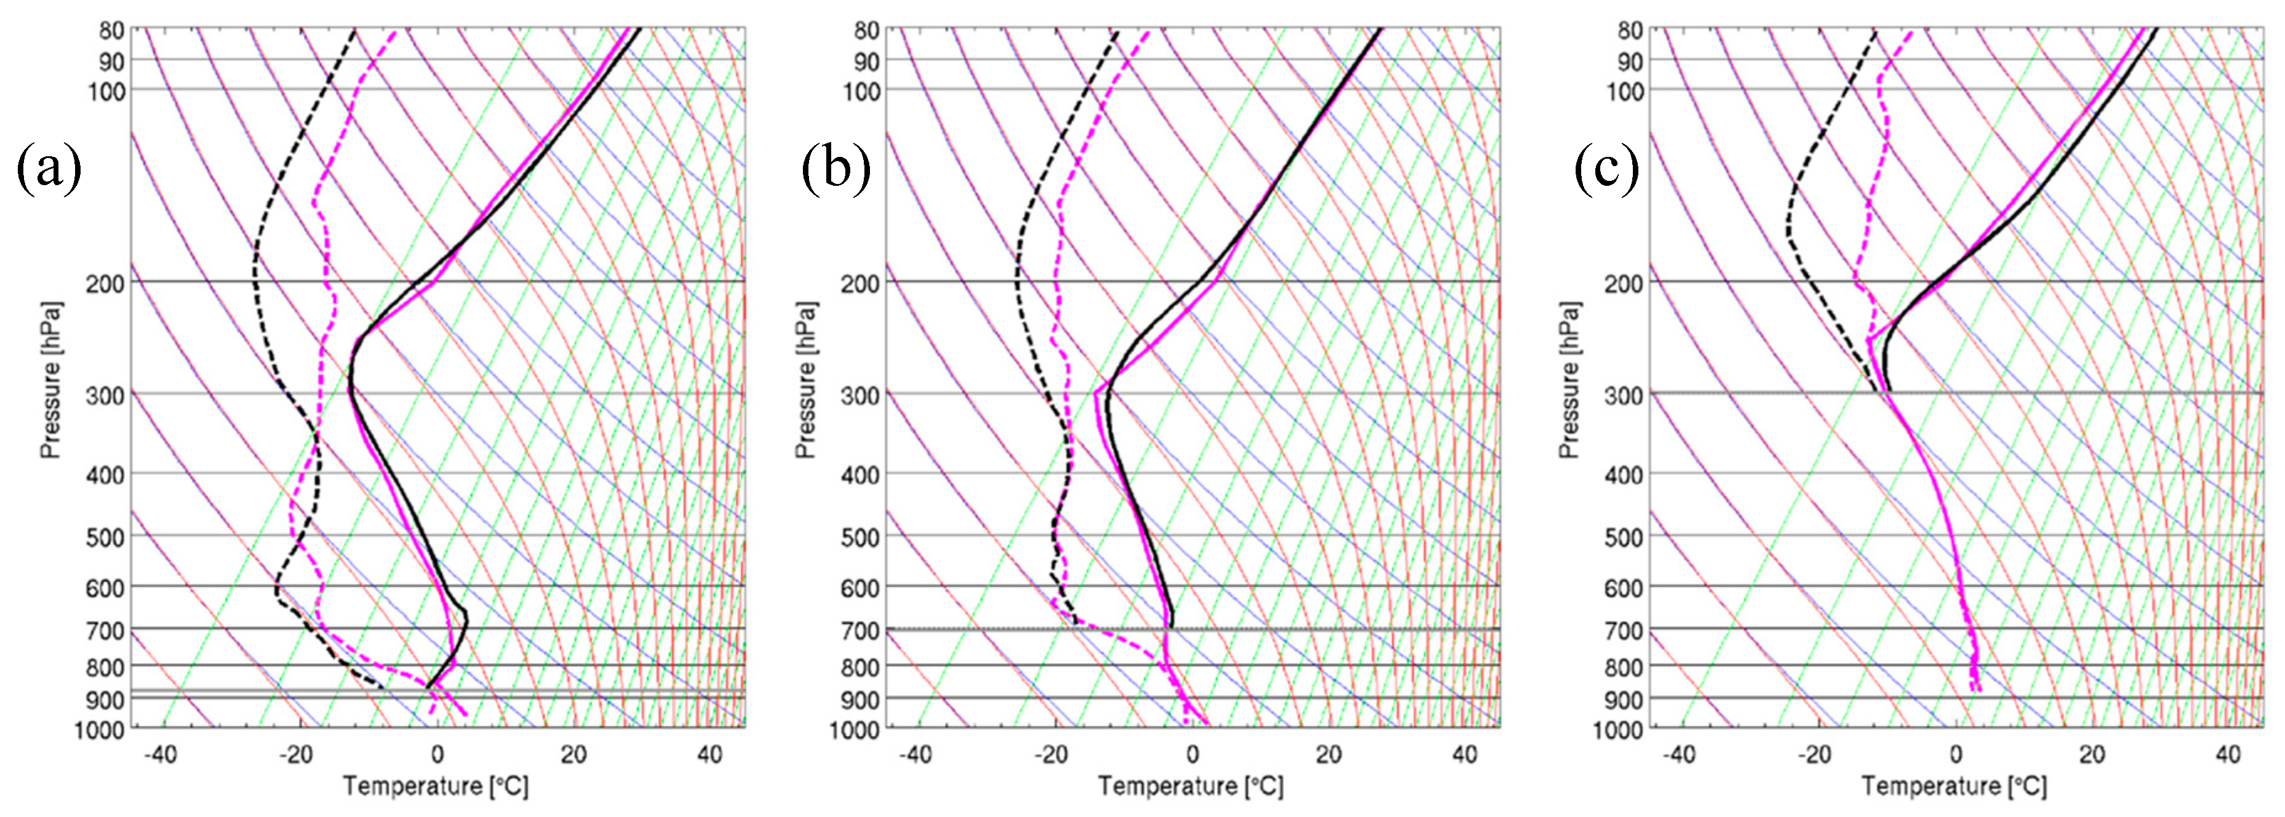
AIRS Retrievals
AIRS 3D winds: Winds derived from tracking moisture features (troposphere) and ozone gradients (stratosphere) on pressure surfaces from AIRS retrieved Single Field of View (SFOV) vertical profiles of temperature, humidity, and ozone in clear-sky and above cloud.
Example temperature and dewpoint profiles for clear sky (a), above low cloud (b), above high cloud (c) as compared to the model background. Retrievals (black) and NCEP/GFS (magenta).

Slide 9
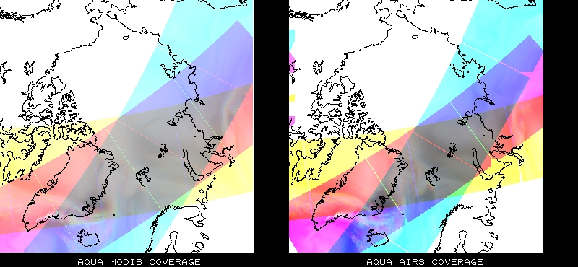
Polar Winds Coverage
MODIS vs. AIRS

Slide 10
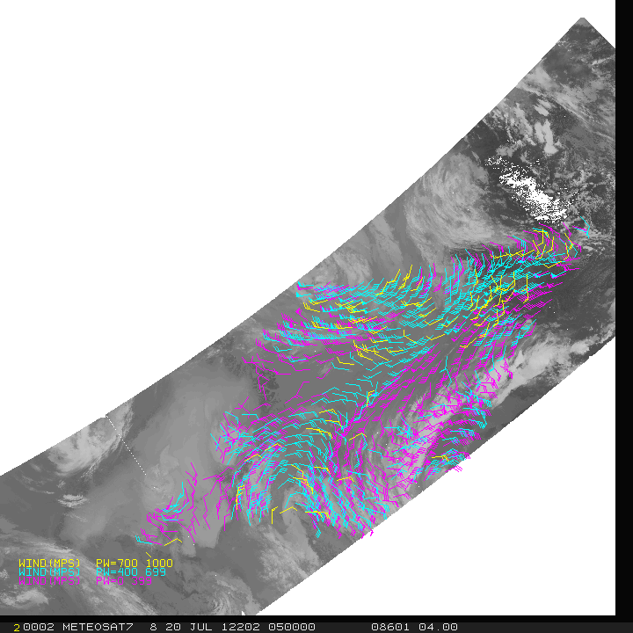
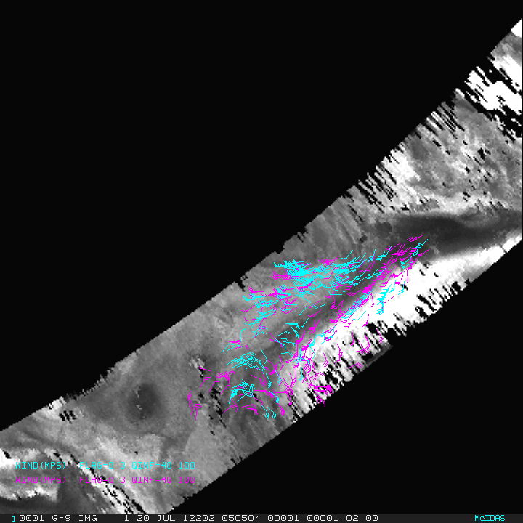
Aqua MODIS AMVs
AIRS Retrieval AMVs at All Levels
AIRS 20 July 2012 0505 UTC
Ozone: 103 to 201 hPa Moisture: 359 to 616 hPa
MODIS 20 July 2012 0551 UTC
Infrared and Water Vapor (including clear sky)

Slide 11
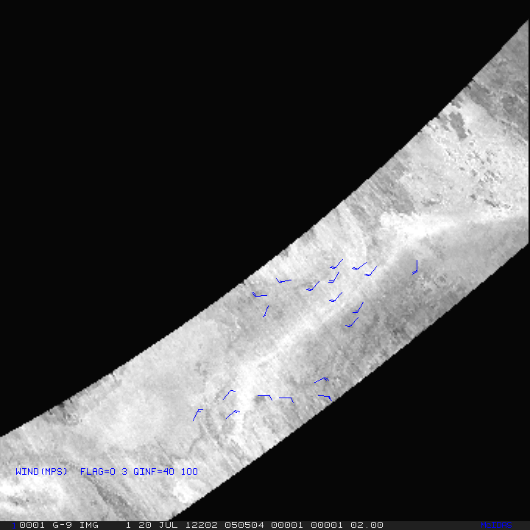
Aqua MODIS AMVs
AIRS Retrieval AMVs at All Levels
AIRS 20 July 2012 0505 UTC
Ozone: 103 to 201 hPa Moisture: 359 to 616 hPa
MODIS 20 July 2012 0551 UTC
Infrared and Water Vapor (including clear sky)

Slide 12
AIRS Retrieval AMVs:
GEOS-5 model assimilation and forecast impact

Slide 13
AIRS winds evaluation
    NASA/GMAO in 2015
AIRS winds extend lower in atmosphere than MODIS winds
Extending even lower in atmosphere is expected using higher resolution instruments (better cloud clearing)
Observation Counts: Histogram of averaged normalized counts for 6-hour cycles for AIRS (red) and MODIS (black) water vapor winds.
May to July 2015
10

Slide 14
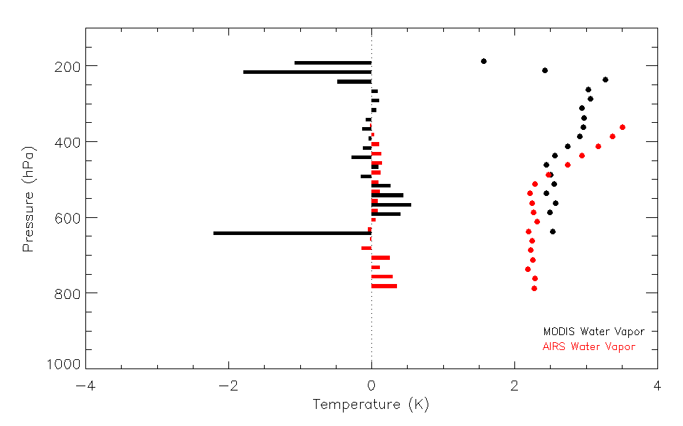
AIRS winds preliminary evaluation
    NASA/GMAO in 2015
AIRS retrieval winds show similar bias and standard deviation as MODIS polar winds, when compared to the model background.
Observation Departures: Mean and standard deviation (ms⁻¹) for AIRS (red) and MODIS (black) water vapor winds May to July 2015
11

Slide 15
Model Experiments
    GEOS-5 Forecast System (reduced resolution)
      GEOS-5 AGCM + GSI analysis (~½° L72)
      3DVar
      6-h assimilation cycle
      7-day forecasts, adjoint-based 24h obs
      Impacts at 00z (dry energy norm, sfc-150 hPa)
    Dates: 14 June – 31 July 2012
    Experiments
      Control
      + AIRS winds
      + AIRS winds - MODIS WV winds
      - AIRS winds - MODIS all winds

Slide 16
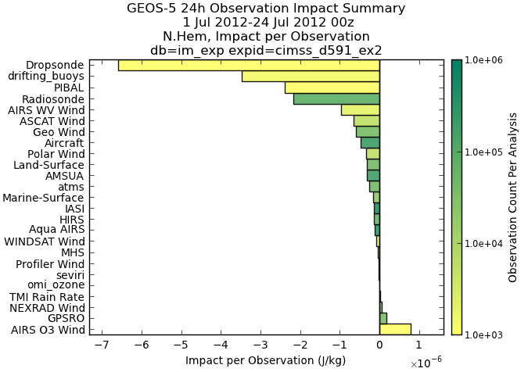
Impact per observation
1 – 24 July 2012 00 UTC

Slide 17
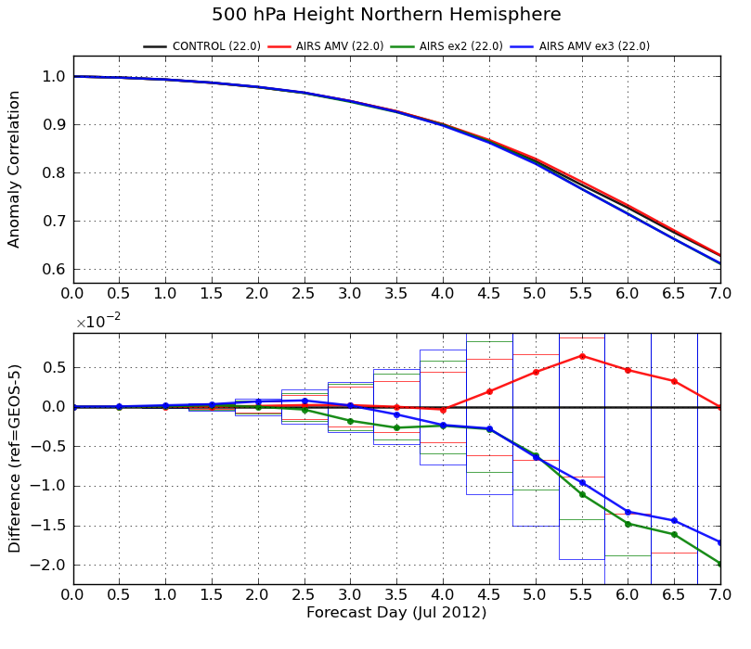
GEOS-5 Forecast Impact: ACC
Two experiments
Control in black.
Red: Addition of AIRS AMVs. Slight improvement after Day 4 (not statistically significant).
Blue: Removal of the MODIS AMVs decreases ACC score:
AIRS AMVs can not offset loss of MODIS AMVs
AIRS AMVs complement the MODIS AMVs
AIRS AMVs are in clear sky or above cloud regions; MODIS AMVs include cloud-tracked features.
500 hPa Northern Hemisphere
1 – 24 July 2012 00 UTC

Slide 18
Comparison of AIRS AMVs to Aeolus:
Intercomparison and to ERA5 Reanalysis

Slide 19


Comparison of IR sounder winds to Aeolus
Decadal Survey recommends a 3D tropospheric wind mission
  Using a space-based LIDAR instrument and/or the use of hyperspectral infrared measurements.
  The combination of lidar winds and AMV winds might also provide some advantages where one is used to calibrate the other.

Slide 20
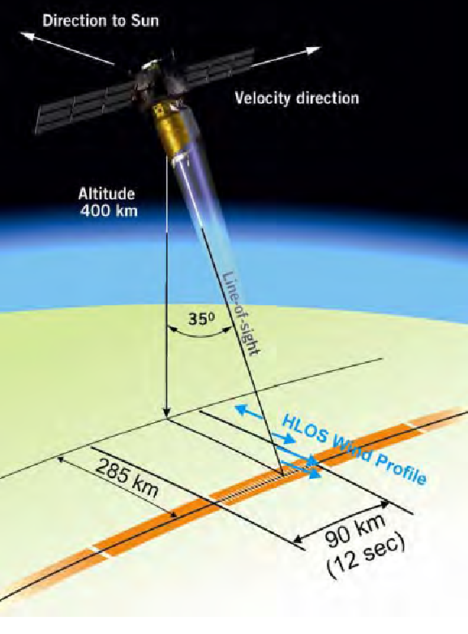
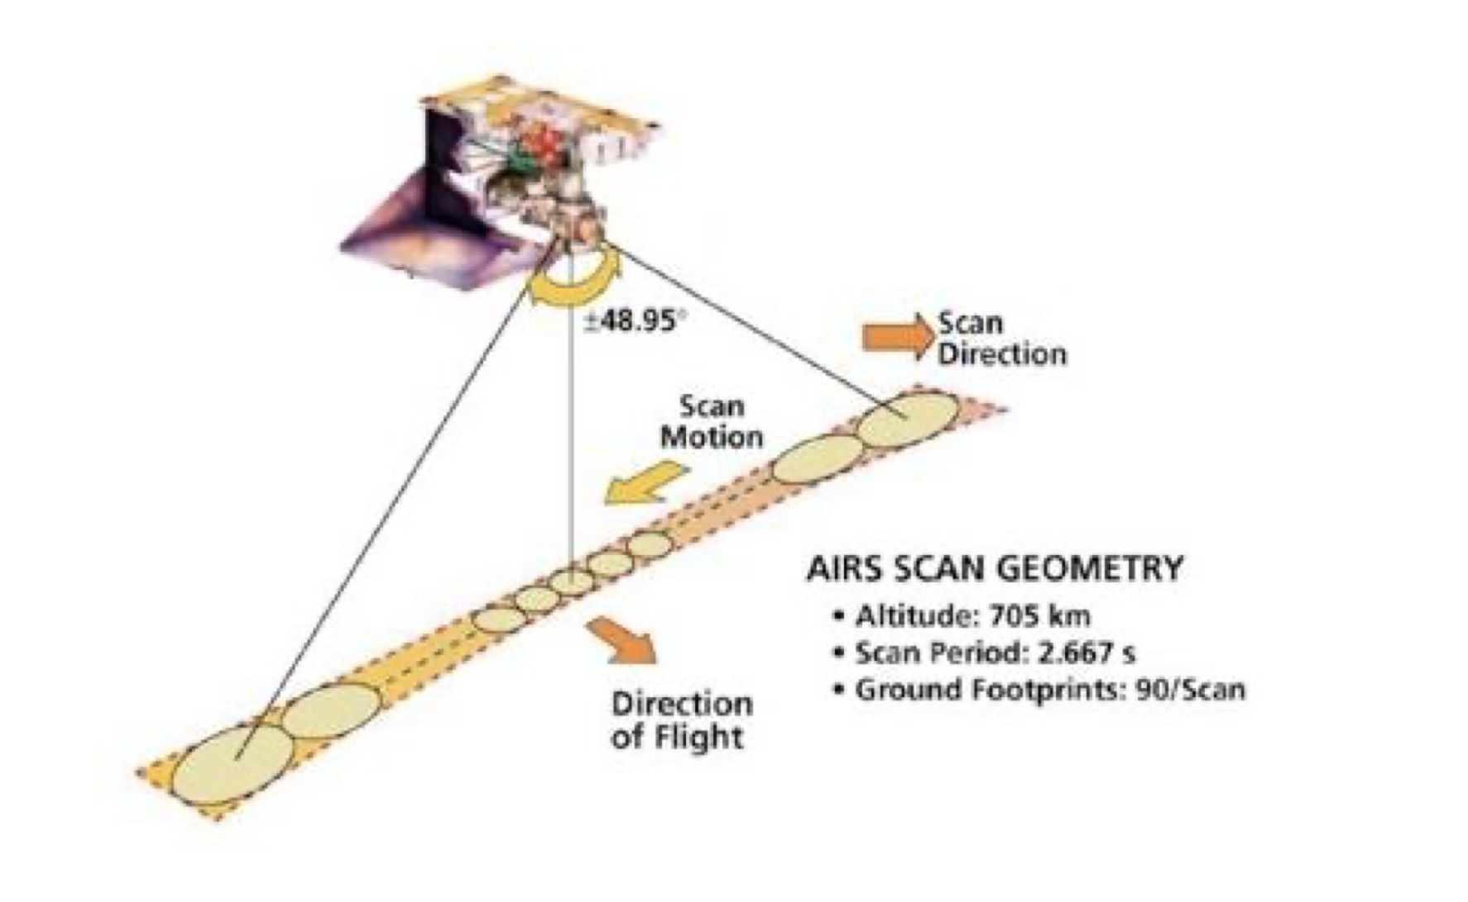
Aeolus vs AIRS
Atmospheric Infrared Sounder (AIRS)
Hyperspectral Infrared instrument
2378 Channels
Results in vertical profiles of temperature, humidity, ozone in the troposphere and stratosphere
Aeolus
AIRS
15th International Winds Workshop: 12-16 April 2021
20

Slide 21
Aeolus vs AIRS winds
AIRS retrieval winds | Aeolus Rayleigh clear-sky
Humidity feature tracking | Molecular motion using Doppler Lidar
Total wind | Horizontal Line of Sight (HLOS) wind component
Better spatial coverage | Better vertical resolution
Average motion spanning 200 minutes | Near instantaneous
Comparisons
August through September 2019
Only polar regions
Intercomparison
Each compared to rawinsondes
Co-located compared to ERA5 reanalysis
Aeolus: Reprocessed and ESA-recommended QC
Account for differences
Total wind from AIRS AMVs was adjusted to equivalent HLOS wind (used viewing angle from co-located Aeolus winds)
For each AIRS AMV, co-located Aeolus winds were super-obbed in space and time
Co-location
Within 100 km (150 km for rawinsondes)
+/- 90 minutes (+/- 60 min. for rawinsondes)
+/- .04 difference in log10 pressures (approx. height)
  +/- 60 hPa at 700 hPa
  +/- 20 hPa at 200 hPa

Slide 22
Aeolus vs AIRS Winds
HLOS Wind Speed
N = 137,431
r = 0.91
Density plot of Aeolus HLOS wind speed vs all AIRS HLOS-equivalent wind speed for August through September 2019.

Slide 23
Comparisons to ERA5
Aeolus Rayleigh and AIRS 3D winds compared to ERA5 for 10 days in summer of 2019
Results in ~36,000 AIRS/Aeolus co-locations
 | AIRS vs ERA5 | Aeolus vs ERA5
Bias | +0.02 ms⁻¹ | +0.17 ms⁻¹
RMSE | 4.57 ms⁻¹ | 4.52 ms⁻¹
Correlation | 0.95 | 0.95

Slide 24
Comparisons to ERA5
AIRS and Aeolus have similar bias and RMSE throughout the entire profile
AIRS and Aeolus wind speed bias (dashed) and RMSD (solid) compared to ERA5

Slide 25
CrIS, IASI, ATMS Retrieval Winds

Slide 26
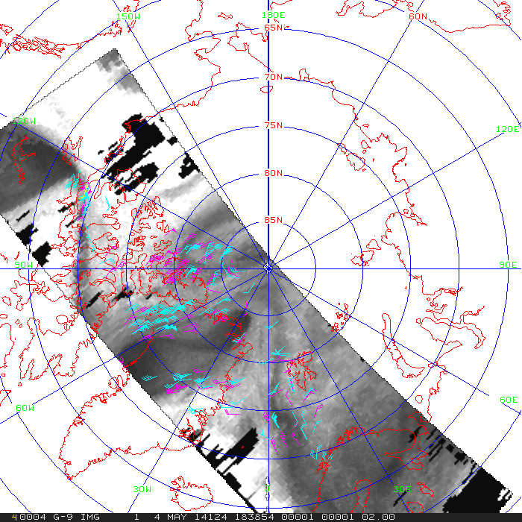
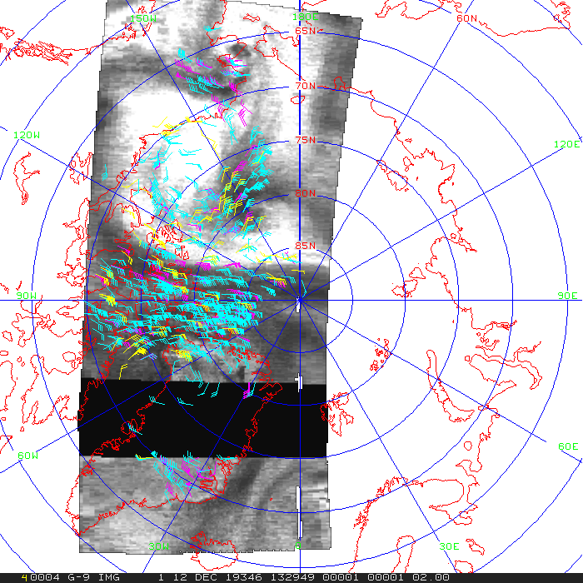
Retrieval AMVs
CrIS
IASI
ATMS
(MIRS)

Slide 27
Comparison of MIRS, AIRS, CrIS AMVs to ERA5
A vertical profile of the speed difference bias (dashed) and RMSD (solid) between MIRS (ATMS), AIRS, CrIS and the ERA5 reanalysis for March 1, 11, 21, 31 in 2020.
A vertical profile of the observation count by pressure level for CrIS (left) and MIRS (right) for March 1, 11, 21, 31 in 2020; from co-location to the ERA5.

Slide 28
Multi-satellite CrIS Retrieval Winds

Slide 29
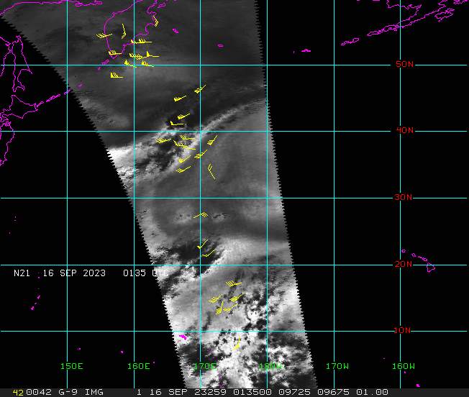
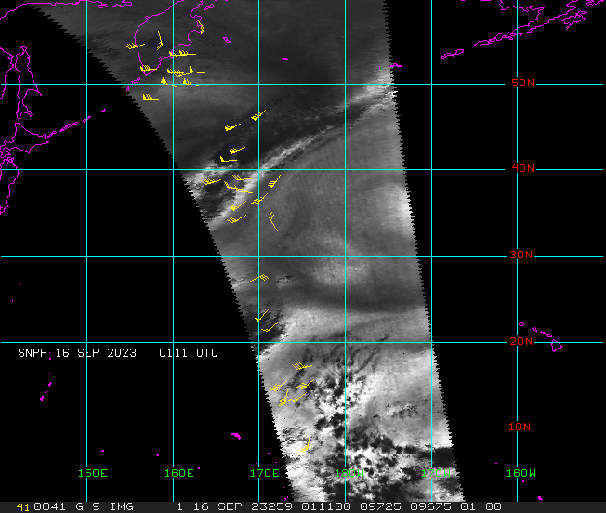
Satellite triad CrIS AMVs
Derive AMVs from humidity fields using single field of view (SFOV) CrIS retrievals, from a satellite triad:
Satellite triad (S-NPP, NOAA-21, NOAA-20) results in coverage at all latitudes
Example on the right showing the 3 passes, separated by ~25 minutes each, with AMVs overlaid
The dark areas are clouds, which need to be masked out
“CIMSS Research Toward Determining Global Three Dimensional Winds by Tracking Features In Temporal Sequences of Polar Weather Satellite Humidity and Ozone Retrievals FY23”
NOAA POC: Satya Kalluri

Slide 30
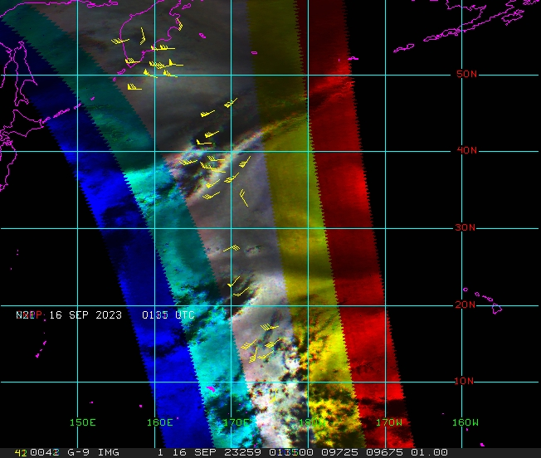
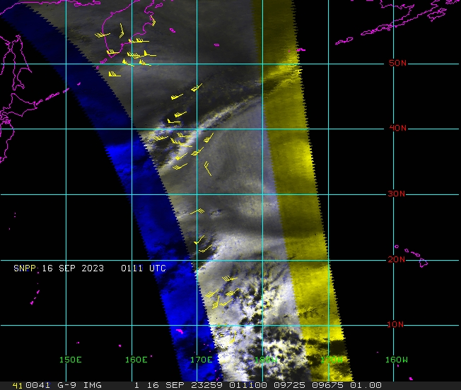
Satellite triad vs doublet CrIS overlap
The 3 swaths (left) are color-coded as RGB; the resulting gray overlap region is where AMVs can be generated. The right panel shows the coverage for 2 swaths, which would double the AMV coverage.

Slide 31
WindFlow:
Deep Learning/Optical Flow AMV Generation
Application to Nature Run humidity grids and CrIS retrievals

Slide 32

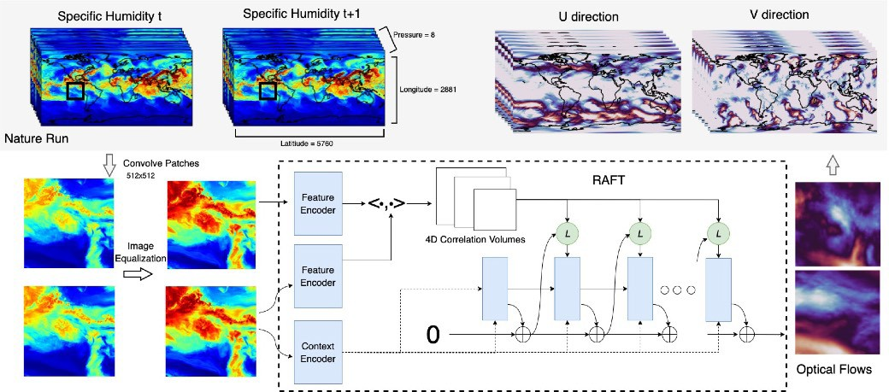
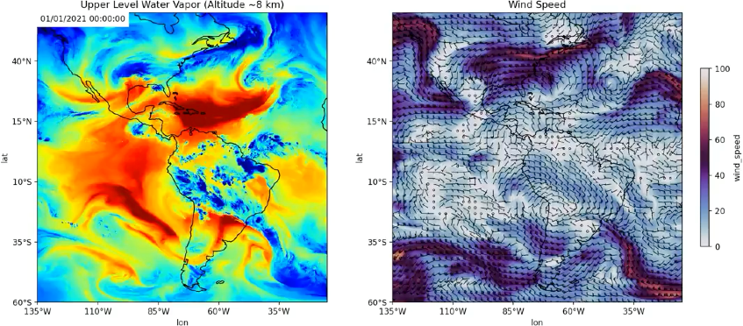
WindF low
ML for Atmospheric Motion Vectors (AMVs)
Extract horizontal motion from sequences of humidity.
Learn from Numerical weather simulations which are widely available as synthetic data. Apply to GEO.
o Flexible choice of optical flow architectures. Results compare four networks where we found RAFT to be the best performing.
Apply to Geostationary satellite data.
Loss = ||Y-F(I₀,I₁)||₁
Vandal et al. (2022) ”Dense Feature Tracking of Atmospheric Winds with Deep Optical Flow.” SIGKDD Proceedings

Slide 33
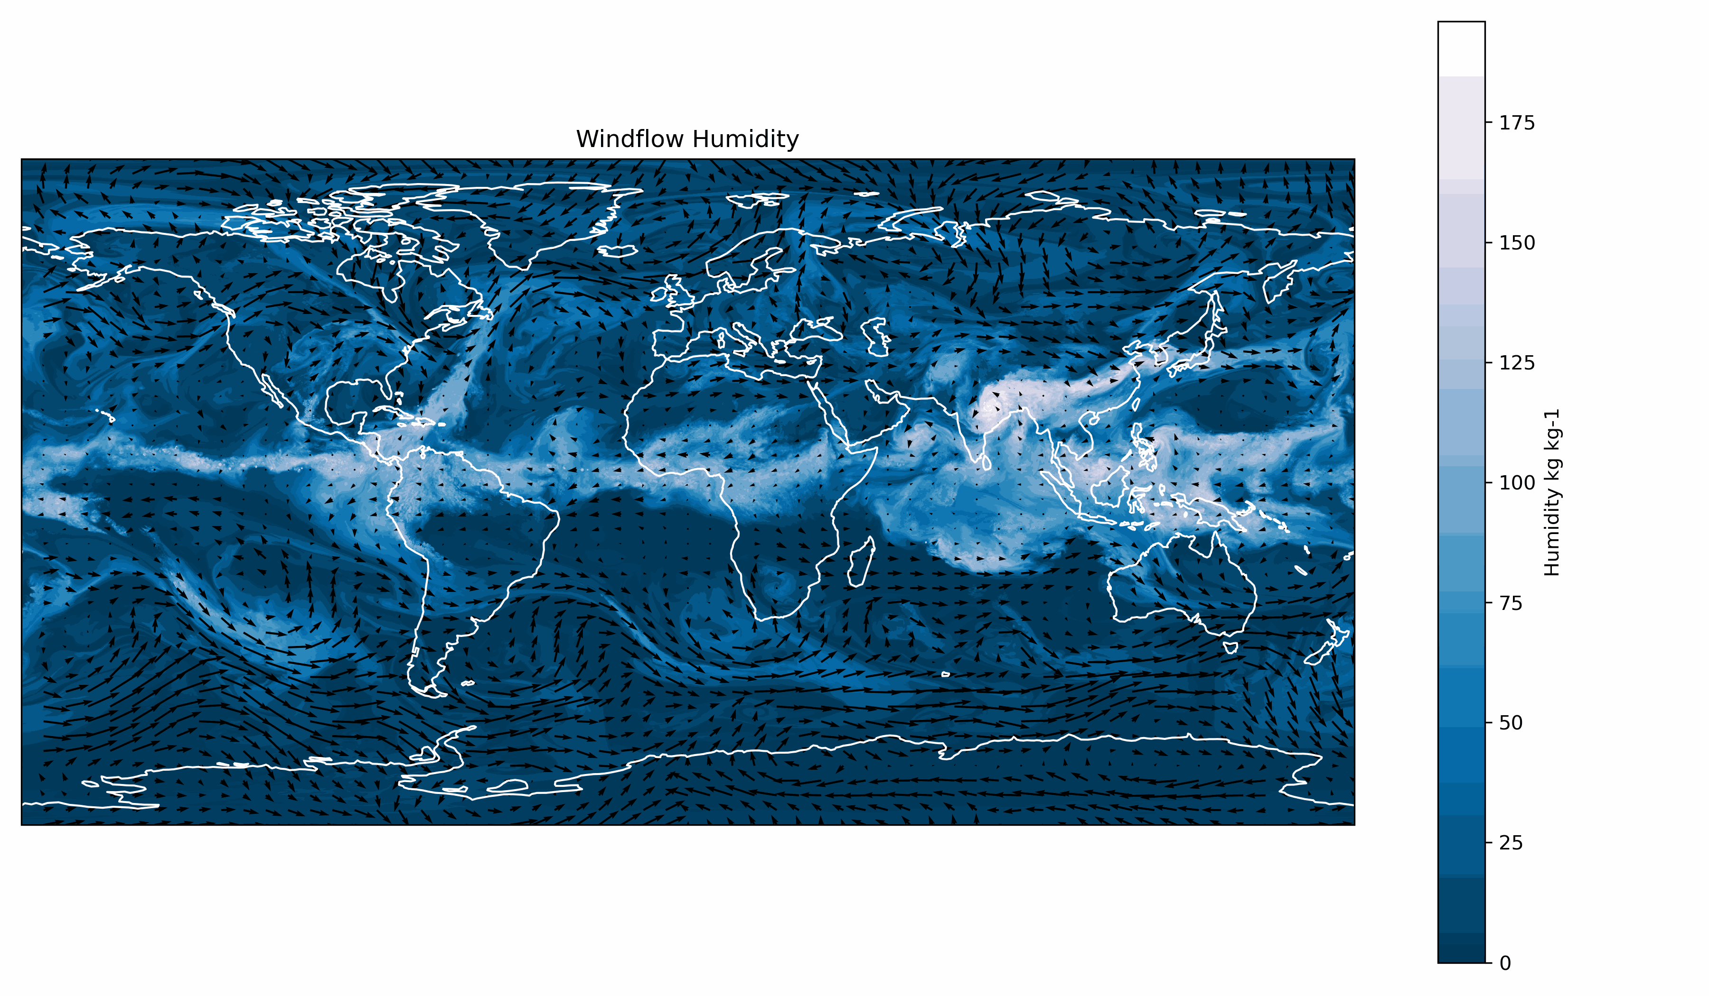
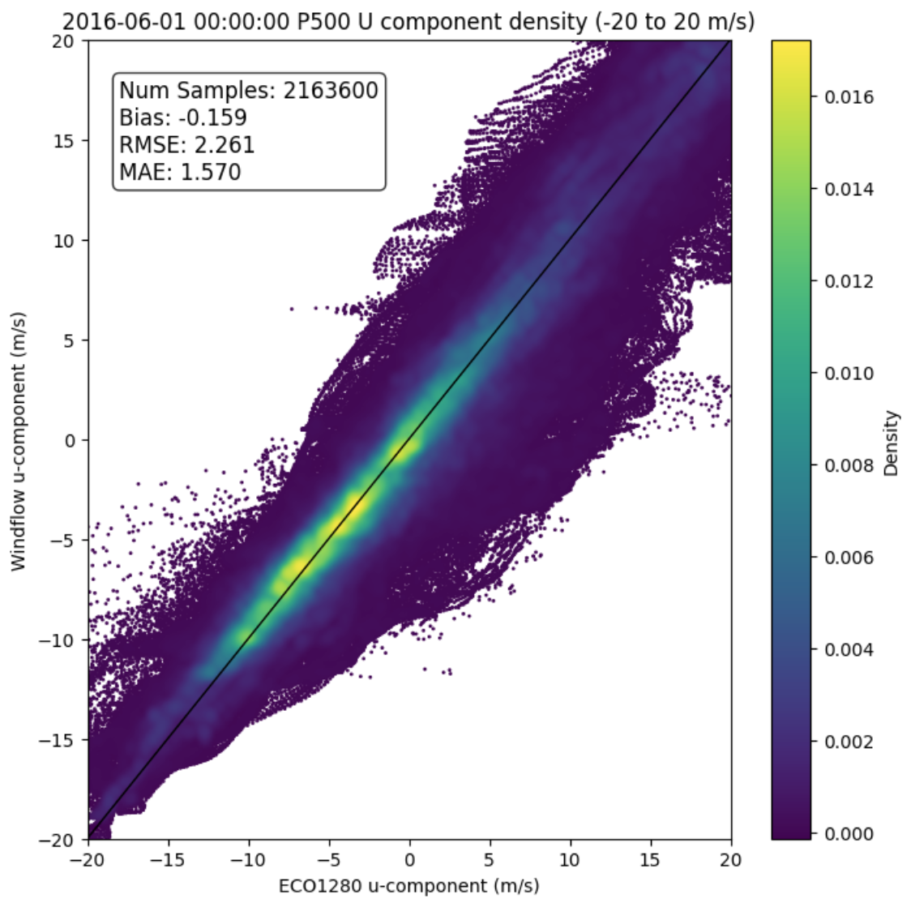
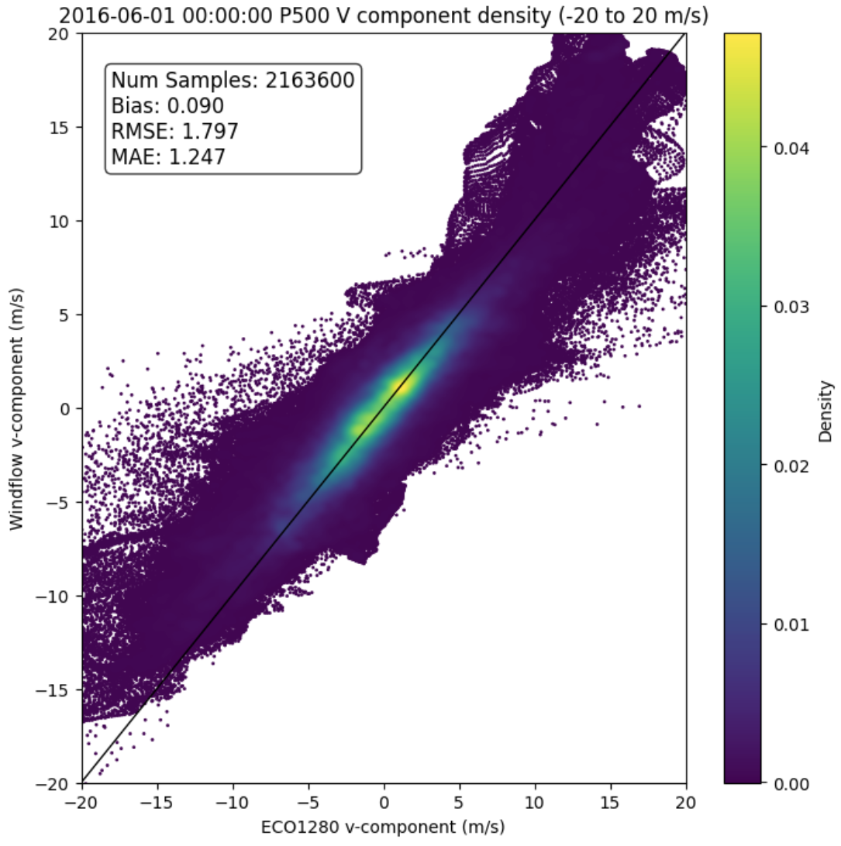
WindFlow AMVs from ECO1280 Nature Run
Above: WindFlow trained with humidity fields from the GEOS-5 Nature Run (G5NR), applied to ECO1280 Nature Run grids.
Right: Derived U & V wind vs truth (ECO1280 wind field).

Slide 34
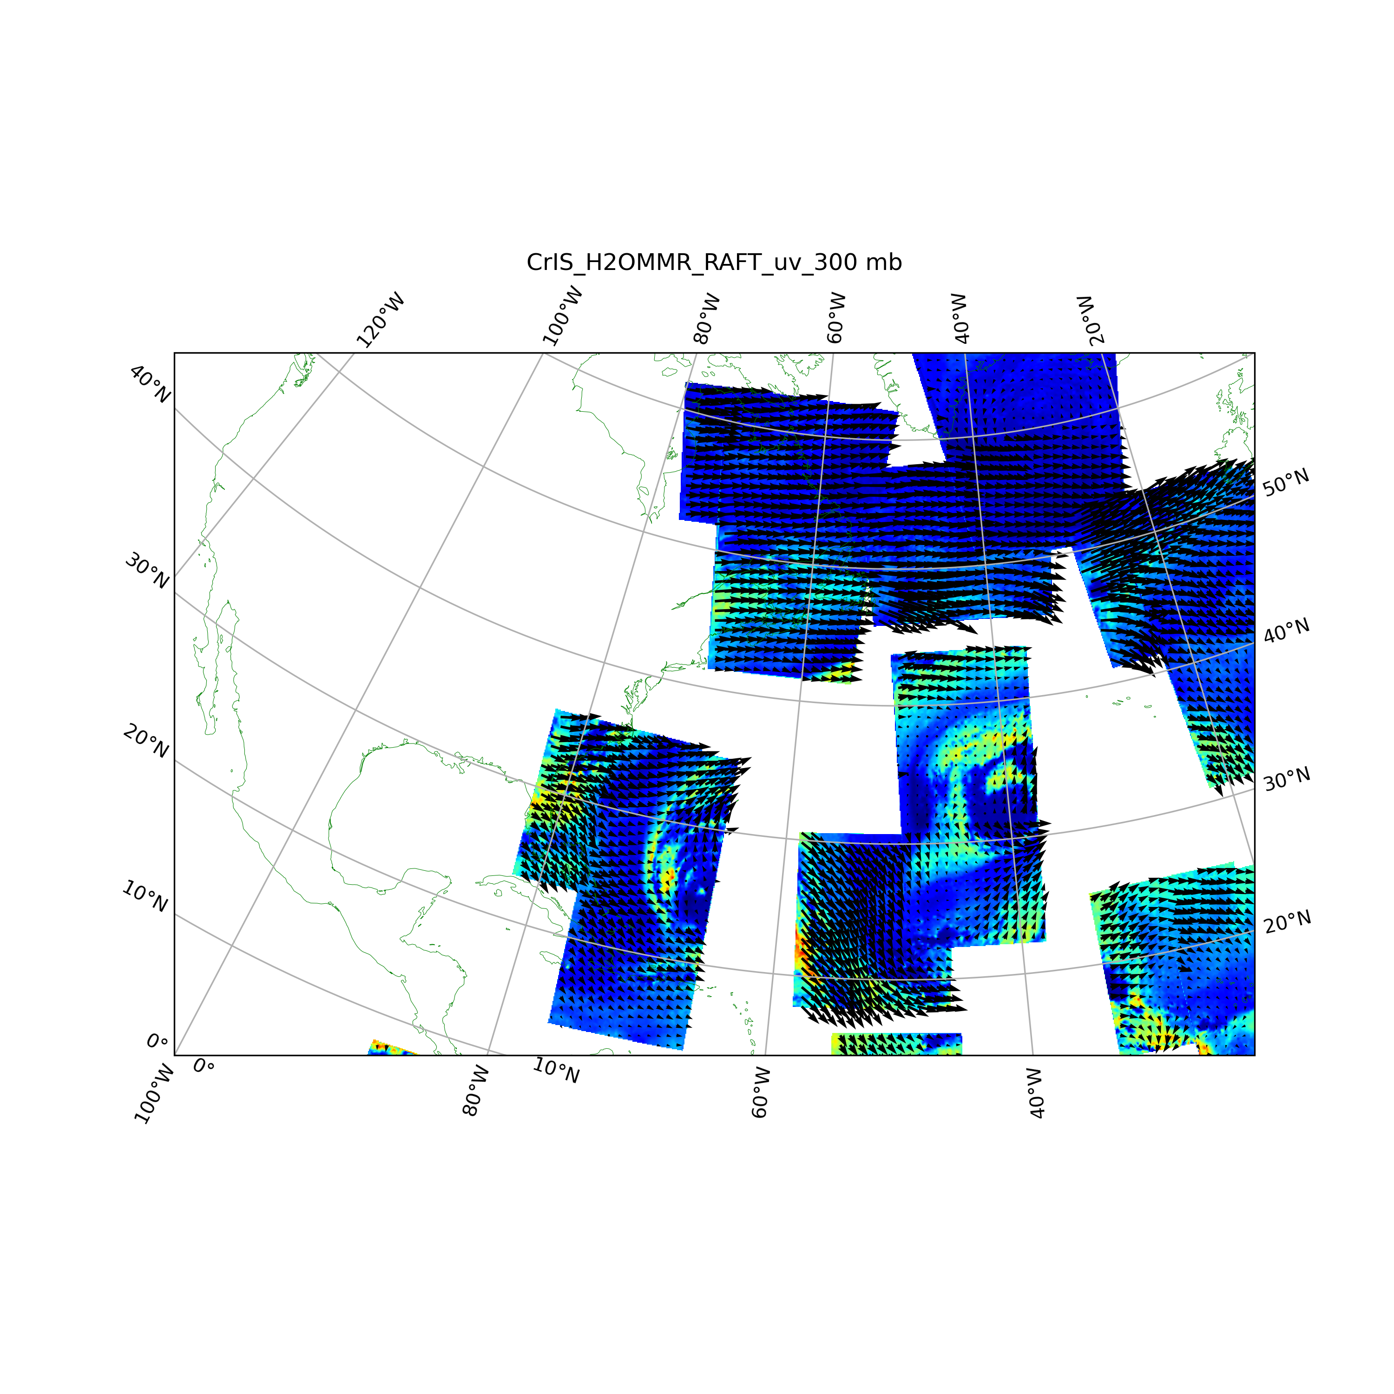
WindFlow: Applied to CrIS humidity retrievals
Used 2 months training of GEOS-5 Nature Run humidity grids
Adapted WindFlow to operate on humidity retrievals

Slide 35
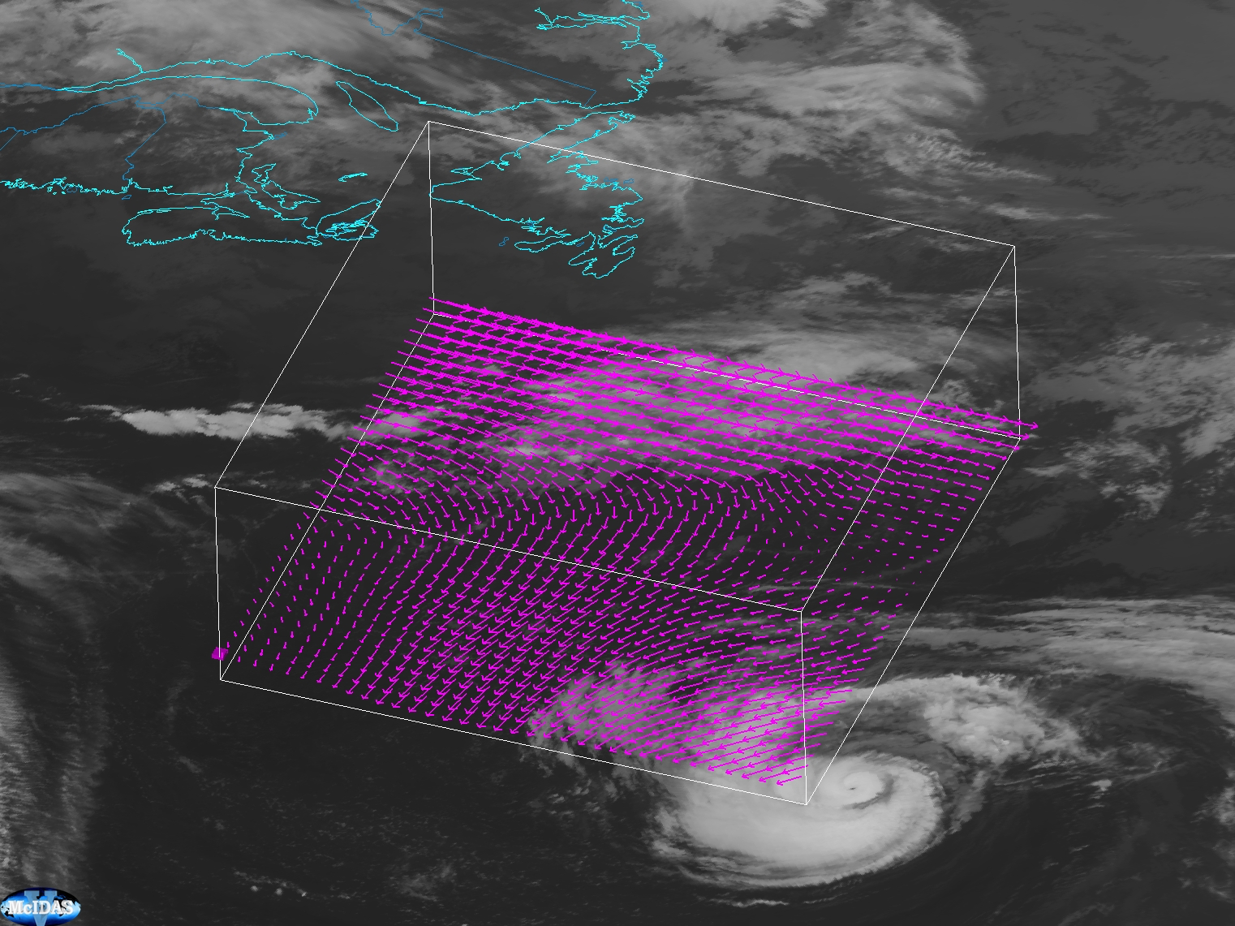
WindFlow CrIS AMVs vertical levels near hurricane

Slide 36
NASA Earth Venture Mission (EVM) Proposals
Participated in two EVM and one ESE proposals; none of these were selected
SmallSat missions with mid-wave IR sounders
  Triplet of satellites flying in formation for deriving winds
WHISPER: Winds Hyperspectral Infrared Sounding Polar Environmental Radiometer
MISTiC Winds: Midwave Infrared Sounding of Temperature and humidity in a Constellation for Winds
WindMapper
Also participated in NOAA Broad Agency Announcement (BAA) studies

Slide 37
Simulated AMVs for future missions:
OSSE studies

Slide 38
Satellite Configuration
A 3-satellite train in each orbit (orbits at 0530, 0930, 1330 local equator crossing time) .
Each satellite train (triplet) spaced no more than 15 minutes apart.
Winds are derived from a time-separated triplet of images (3 satellites with the same ground track).

Slide 39
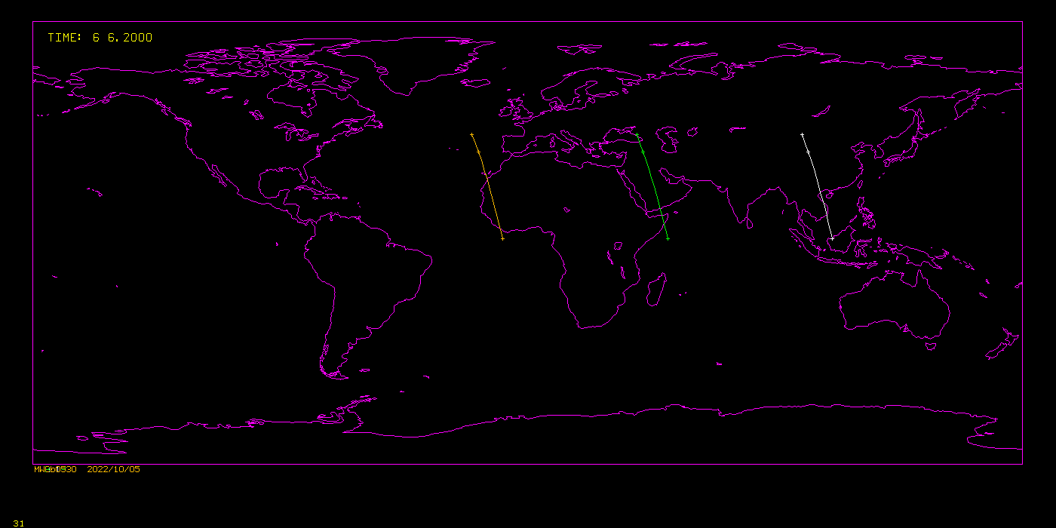
Satellite Configuration
0530
0930
1330
6-hour time window; orbits of 3 satellite trains at 0530, 0930, 1330 local time

Slide 40
Simulation of 3D Passive Winds: ECO1280 Nature Run
Track humidity features in the ECMWF Cubic Octahedral (O1280) grid Nature Run (ECO1280)
Use time-separated triplet of images (Img1, Img2, Img3)
In the center image (Img2), identify potential targets (features) based on 2D humidity gradient
ECO1280 wind field is used as first guess for tracking features
For each target, produce 2 vectors:
  Img2 -> Img1
  Img2 -> Img3
Discard AMV if the u-component or v-component differs from ECO1280 wind field by more than 10 ms⁻¹
Determine feature motion (average the 2 vectors)
Quality control

Slide 41
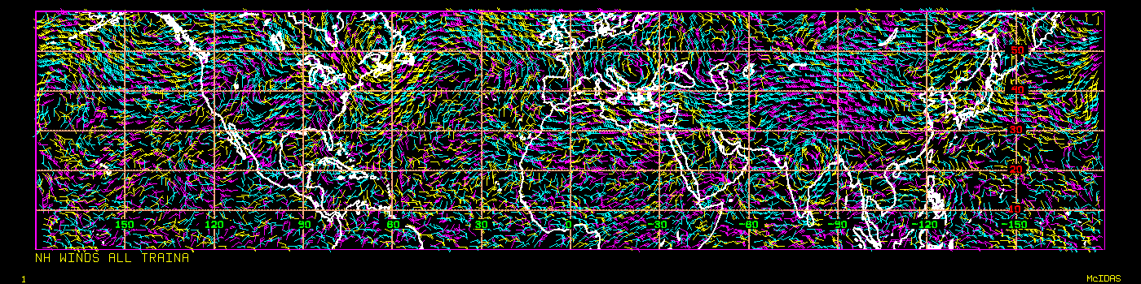
N. Hemisphere Winds Derived from ECO1280 Nature Run
Equator to 60 deg. latitude
All derived winds from Nature Run
0130 to 0430 UTC
Color-coded by height: Low (yellow), Middle (cyan), High (magenta)

Slide 42
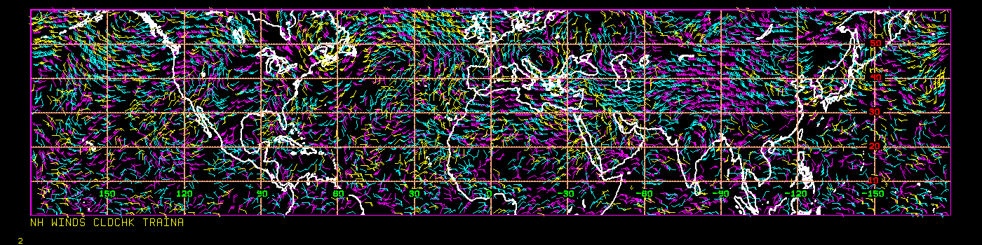
N. Hemisphere Winds Derived from ECO1280 Nature Run
Equator to 60 deg. latitude
All derived winds from Nature Run; screened by clouds
  Note low-level vectors (yellow) greatly reduced; mid-level (cyan) thinned
0130 to 0430 UTC
Color-coded by height: Low (yellow), Middle (cyan), High (magenta)

Slide 43
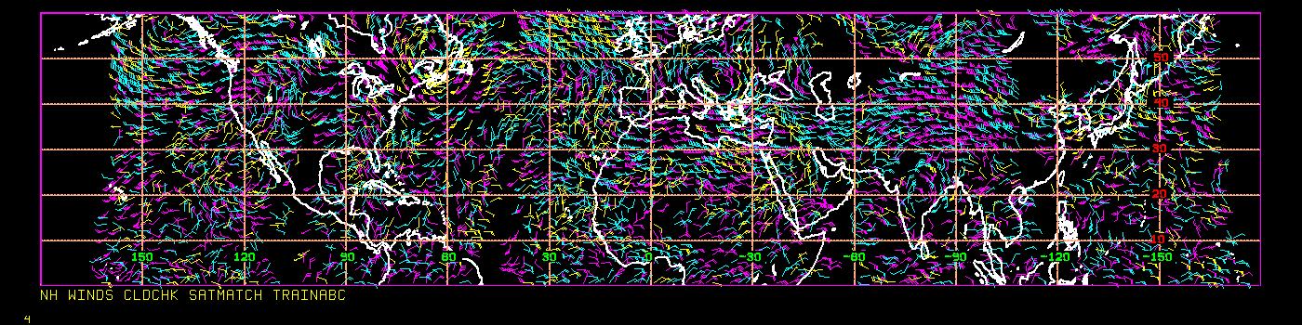
N. Hemisphere Winds Derived from ECO1280 Nature Run
All derived winds from Nature Run; screened by clouds
  Note low-level vectors (yellow) greatly reduced; mid-level (cyan) thinned
Sampled by the three-satellite train configuration (3-hour time window)
0130 to 0430 UTC
Color-coded by height: Low (yellow), Middle (cyan), High (magenta)

Slide 44
Experimental Configuration
Experiment Name | Description
Baseline | 2020 observing system
AMV | Baseline + 8 levels of AMVs
GFS V16.1.3 at reduced resolution
GDAS (C192~50km) and GFS (C384~25km)
128 vertical levels
Hybrid 4DEvVar
80 ensemble members
Spin up period : 00z 1 June to 18z 14 June 2016
Experiment period : 00z 15 June to 00z 31 July 2016

Slide 45
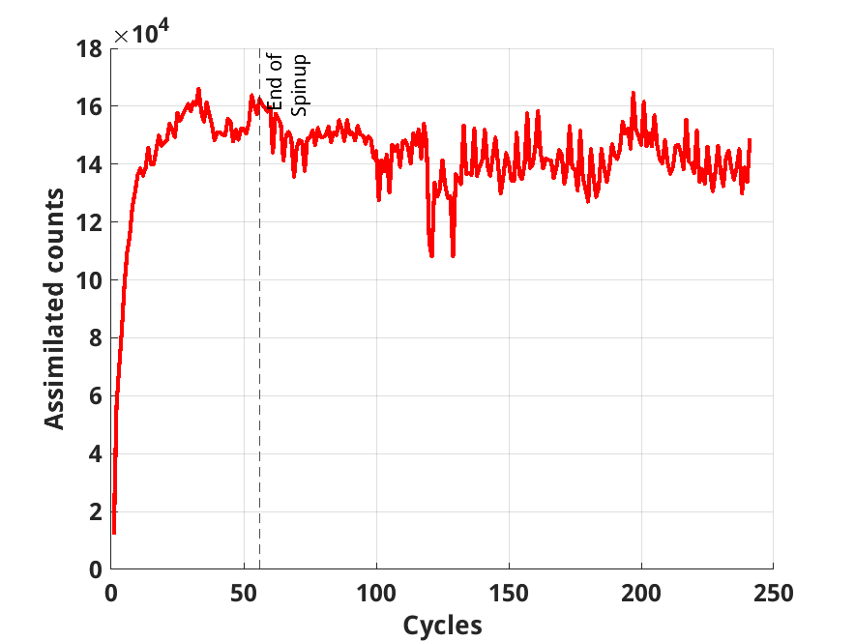
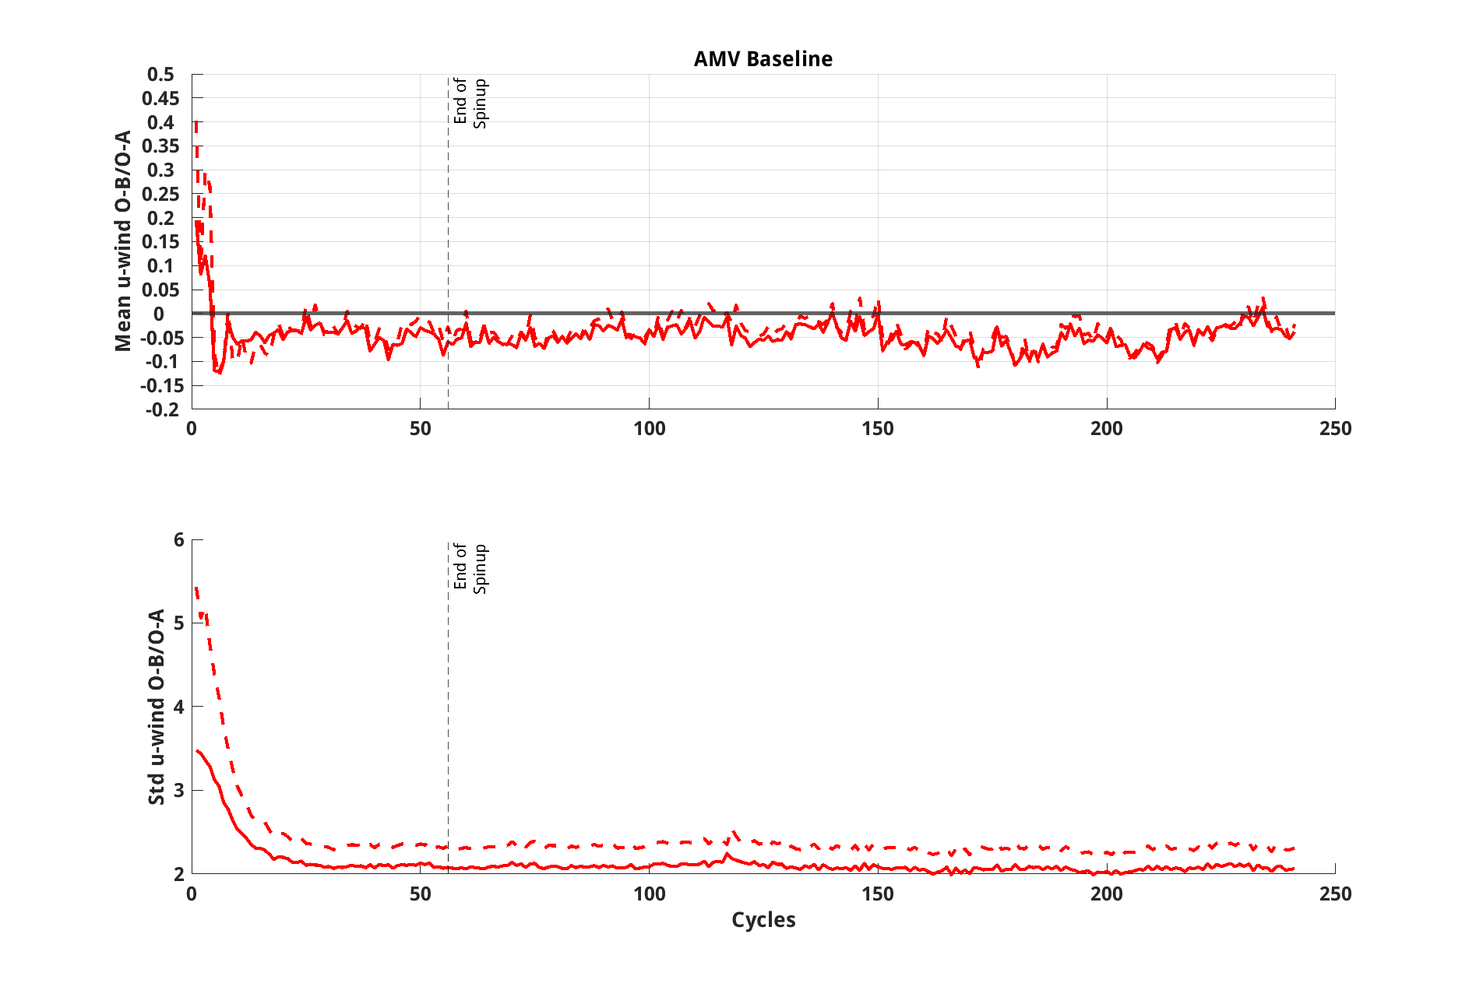
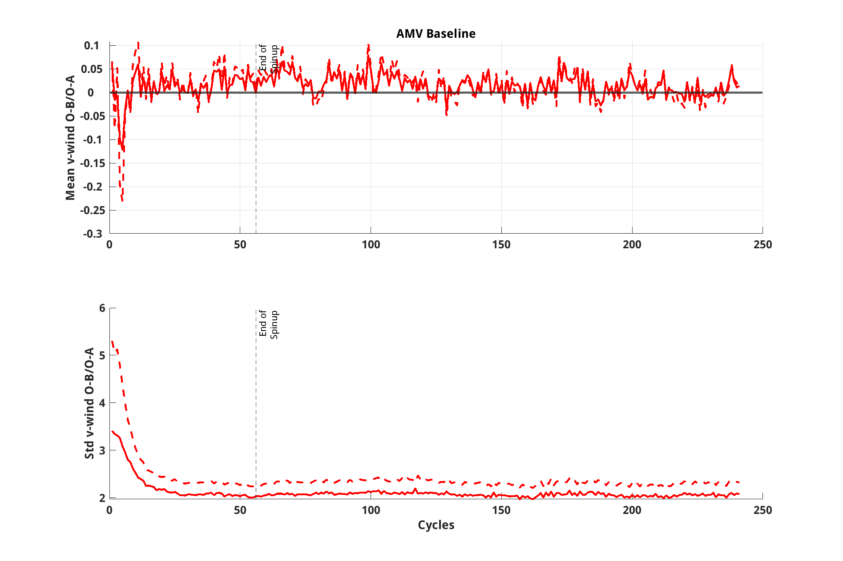
Assimilation Statistics
Counts assimilated ~ 14,000 per assimilation cycle.
U-component wind bias remains steady at ~ -0.05m/s
Assimilated counts per cycle
O-B in dashed line
O-A in solid line
u-component wind
v-component wind

Slide 46
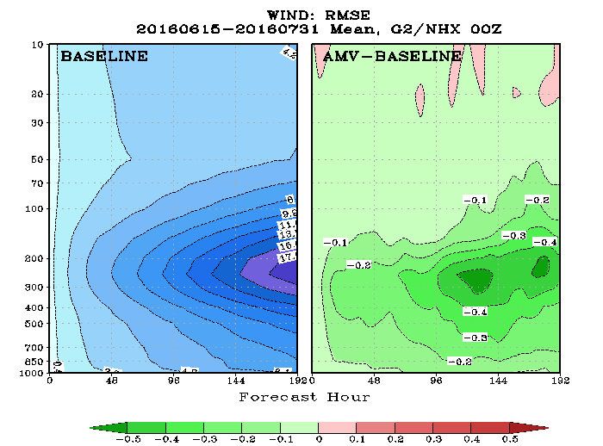
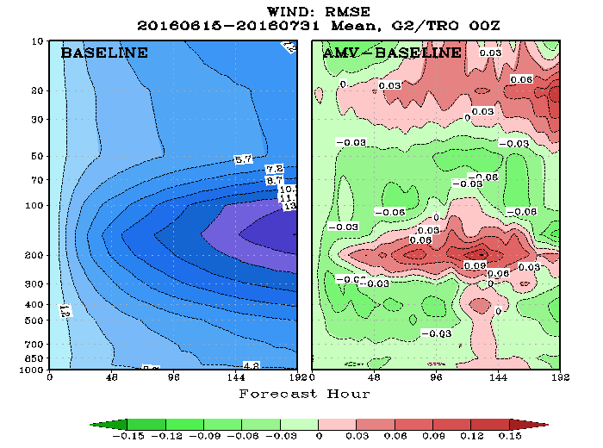
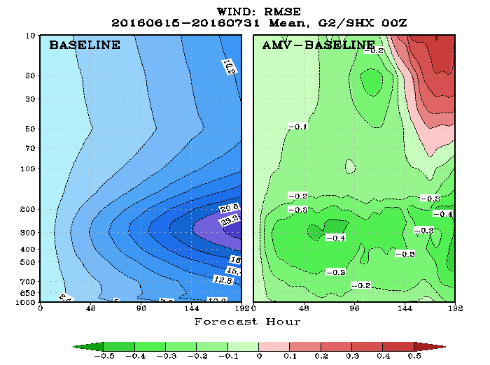
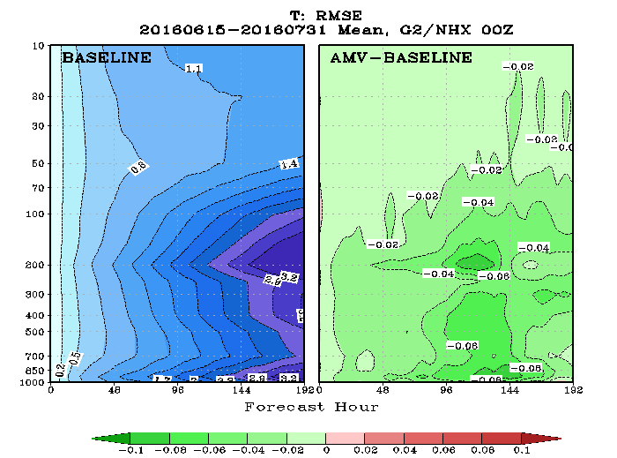
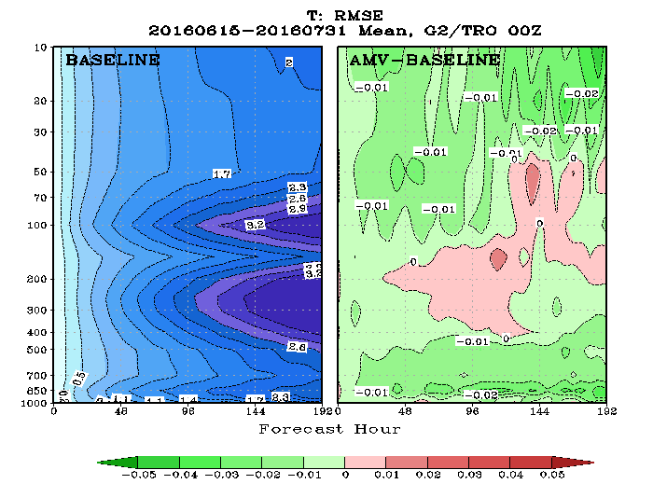
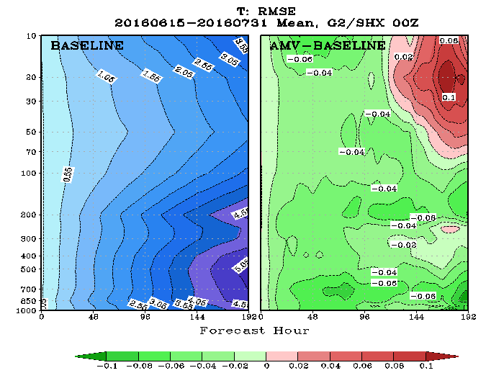
RMSE Cross section
N. Hemisphere
Tropics
S. Hemisphere
Vector Wind
Temp

Slide 47
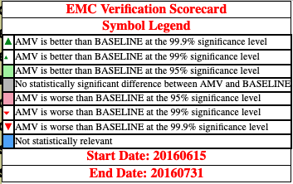
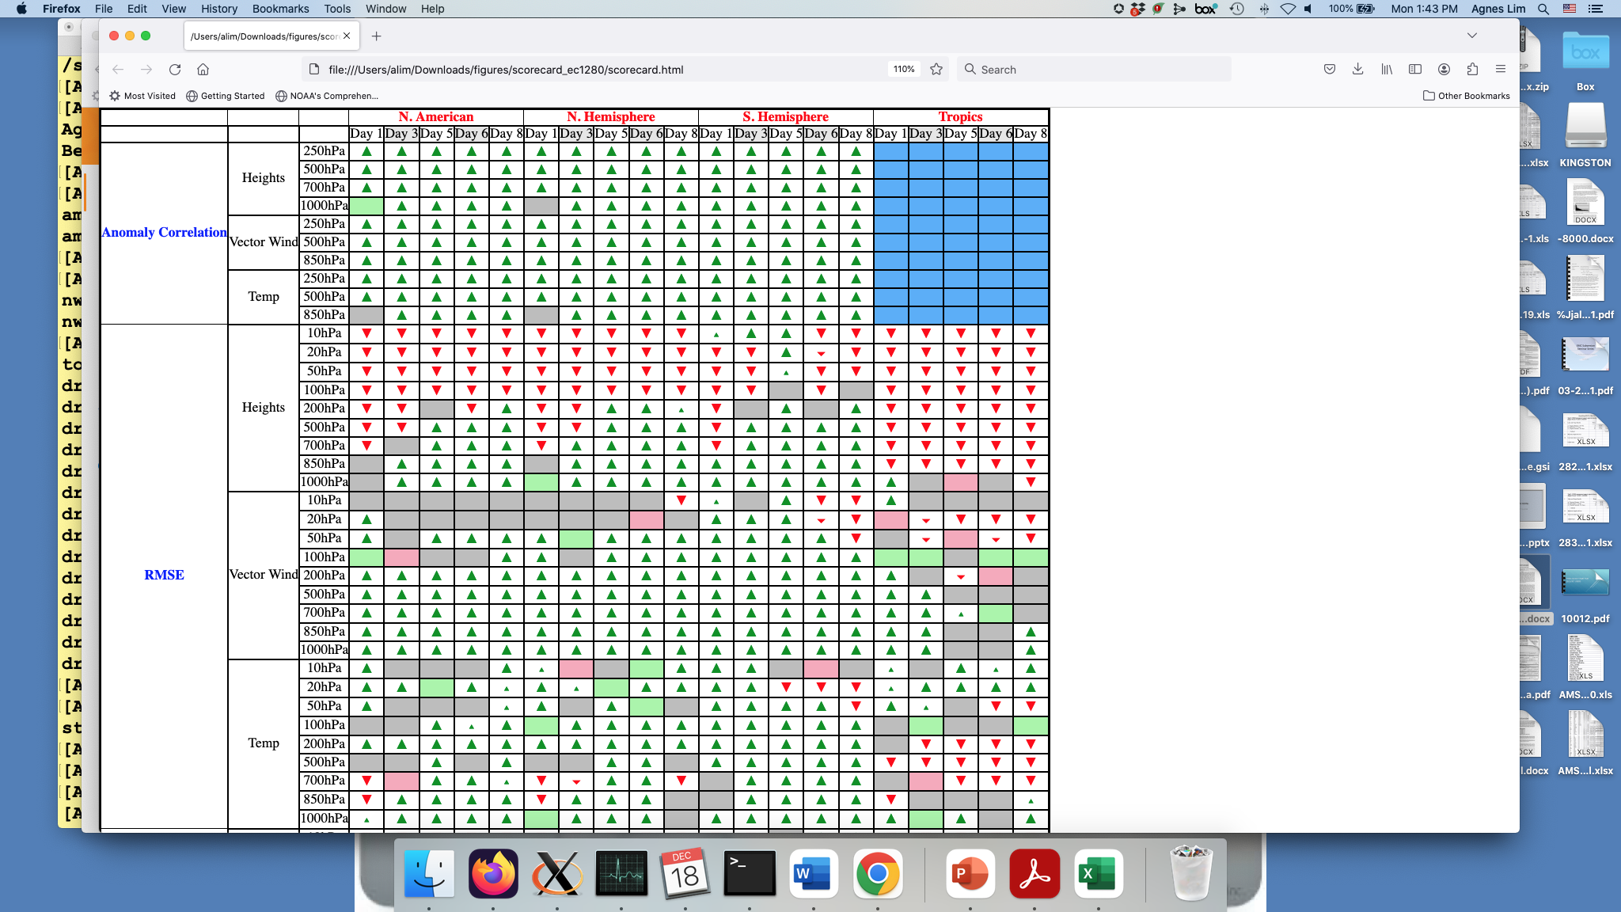
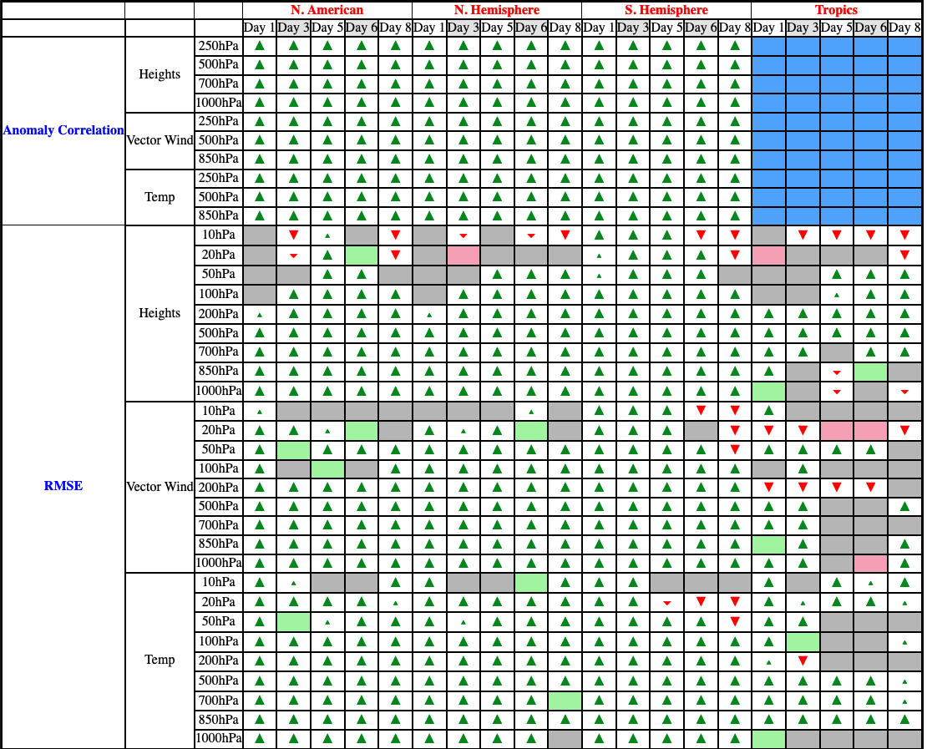
Scorecard
GFS Forecast verification conducted against nature run
GFS Forecast verification conducted against GDAS (self analysis)
Notes:
Bias remove

Slide 48
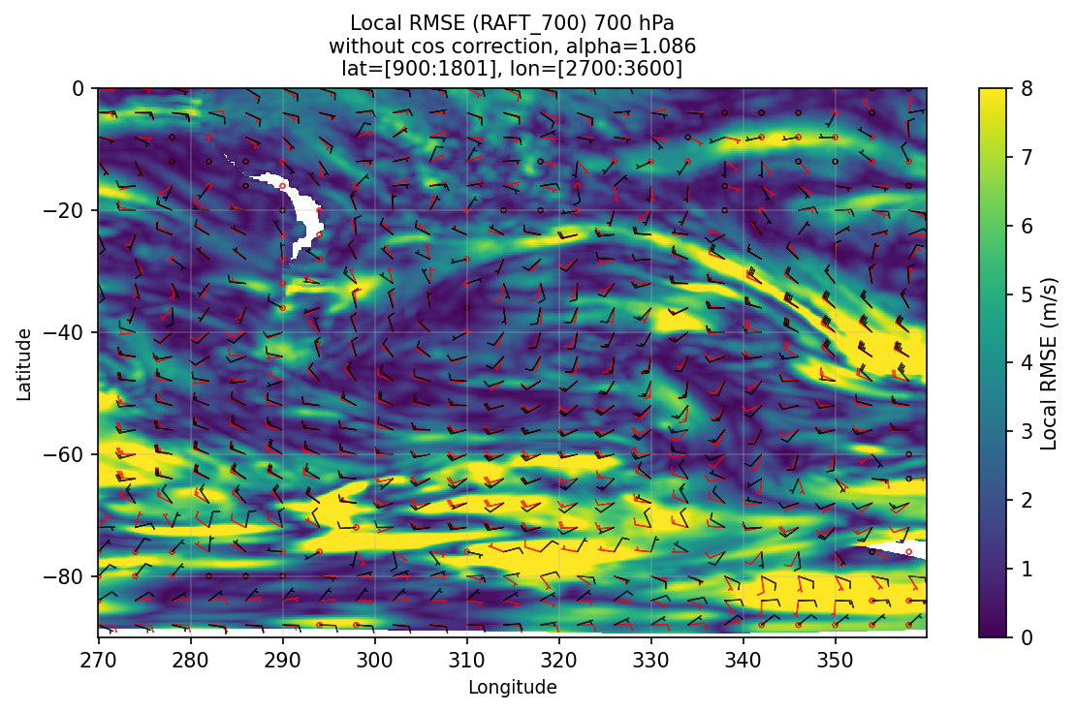
Future
Continuing advancing the use of WindFlow for both CrIS retrieval AMV generation and simulated AMVs for OSSEs.
  Improving the quality control and thinning/super-observations for assimilation and simulated AMV coverage for future missions
  Looking ahead to next generation geostationary sounder (GXS)
Pending proposal that evaluates the tracer effect of direct radiance assimilation vs AMV assimilation
WindFlow AMVs (black) and truth (red) overlaid on the RMSD between the WindFlow and truth vectors.

Slide 49
Questions?
David Santek
dasantek@wisc.edu

