Slide 1
Night Fog Difference (10.3μm – 3.9μm)
Quick Brief
Scott Lindstrom
UW-Madison
SSEC/CIMSS
Notes:
This Quick Brief will describe to you how the 10.3 - 3.9 Brightness temperature Difference, sometimes called the Fog Difference, works. I'm Scott Lindstrom from CIMSS.

Slide 2
Night Fog Difference (10.3μm – 3.9μm)
Quick Brief
10.3 μm – 3.9 μm
Why does it work?
Water Droplets in cloud do not emit 3.9 μm radiation as a blackbody would
Stratus Cloud Made up of Water Droplets
Can the satellite determine if the stratus is actually fog? Not really!
Notes:
At night, the useful 3.9 micron signal reaching the satellite is entirely driven by emission from the Earth, either from the Earth's surface, or in this case from a cloud. A stratus cloud made up of water droplets does not emit 3.9 radiation as a blackbody would. That is to say: it emits less radiation at 3.9 microns than a blackbody.

Slide 3
Night Fog Difference (10.3μm – 3.9μm)
Quick Brief
10.3 μm – 3.9 μm
Why does it work?
Water Droplets in cloud emit 10.3 μm radiation more nearly as a blackbody would
Stratus Cloud Made up of Water Droplets
Can the satellite determine if the stratus is actually fog? Not really!
Notes:
That same cloud is also emitting 10.3 micron radiation...and it's emitting that radiation more nearly like a blackbody.

Slide 4
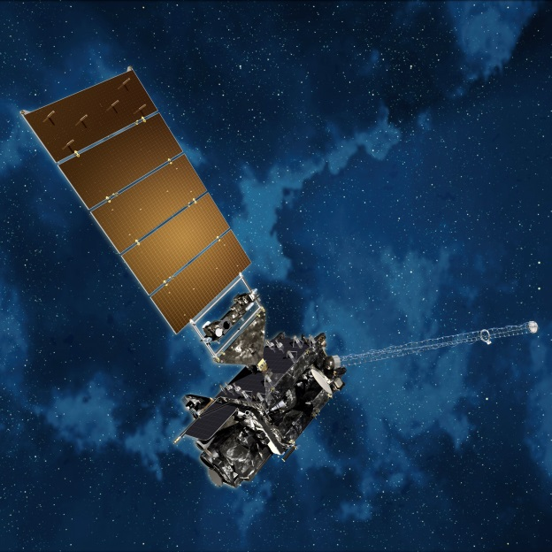
Why does it work?
Night Fog Difference (10.3μm – 3.9μm)
Quick Brief
3.9 μm radiation is detected by satellite,
those counts are converted to a brightness
temperature assuming blackbody emission
The inferred temperature is cooler than it would have been had the emission followed that of a blackbody
Notes:
The satellite detects both the 3.9 micron and 10.3 micron radiation, and the radiance counts are then converted back to a temperature -- with the assumption that the emitting surface emitted as a blackbody. This isn't the case for 3.9 micron radiation, so the inferred temperature is colder.

Slide 5
Why does it work?
Night Fog Difference (10.3μm – 3.9μm)
Quick Brief
10.3 μm radiation is detected by satellite,
those counts are converted to a brightness
temperature assuming blackbody emission.
The inferred temperature is close to what it is because the emission followed that of a blackbody
Notes:
Radiation at 10.3 microns has been emitted by the cloud droplets in a manner similar to a blackbody. The computed temperature is therefore warmer -- and close to the actual emitting temperature.

Slide 6
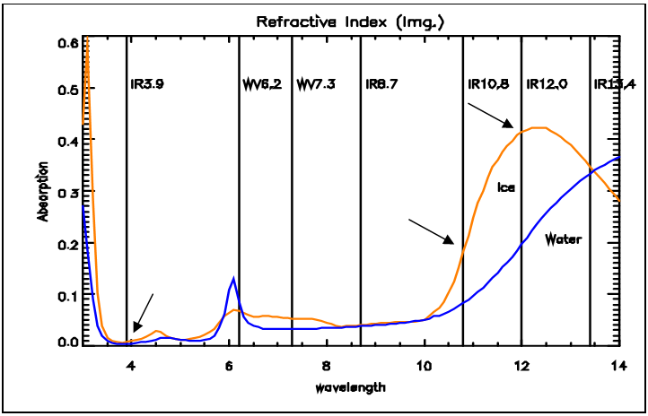
What about thin clouds of ice? These also have a signal in the Fog Difference
Night Fog Difference (10.3μm – 3.9μm)
Quick Brief
Image Source
There is more absorption of upwelling radiation at wavelengths > 10 μm than at 3.9 μm. Cirrus clouds will appear warmer at 3.9 μm than at 10.3 μm because of this transmitted radiation
Notes:
So far we've talked about clouds made up of water droplets. What if you have ice clouds. They show up well in the Fog Difference channel as well, although that's not a signal you'll look for if you're forecasting fog / stratus development.
Some of the radiation that leaves the surface is absorbed by clouds, and that absorption is a function of wavelength. Most of the 3.9 micron radiation will transmit through a thin ice cloud. Some of the 10.3 micron radiation will be absorbed -- and then re-emitted at a cooler temperature. Thus the Brightness Temperature sensed by the satellite will be warmer at 3.9 microns than at 10.3 microns because more surface energy (which is usually a warmer surface) is reaching the satellite.

Slide 7
Sub-Pixel Effect
Night Fog Difference (10.3μm – 3.9μm)
Quick Brief
3.9 μm is more sensitive to the warm part of a partly cloud pixel; 10.3 μm is more sensitive to the cold part of a partly cloudy pixel.
Image Source
Bottom Table: % of pixel that is cloudy, 3.9 μm Brightness Temperature (BT), 10.7 μm BT.
Notes:
There is also a sub-pixel effect that influences the brightness temperature if the cloud does not cover the entire pixel. (This effect is also important for fire detection). The 3.9 micron detector will be affected more of the warm part of the pixel and the 10.3 micron detector will be affected more by the cold part of the pixel.
The chart shows the detected brightness temperature and the percent cloudiness in the pixel. Note the Shortwave Temperature is uniformly warmer.
These three difference effects should all be considered when viewing the Brightness temperature Difference field. For Stratus Clouds that are widespread, only the first effect, the emissivity difference is important.

Slide 8
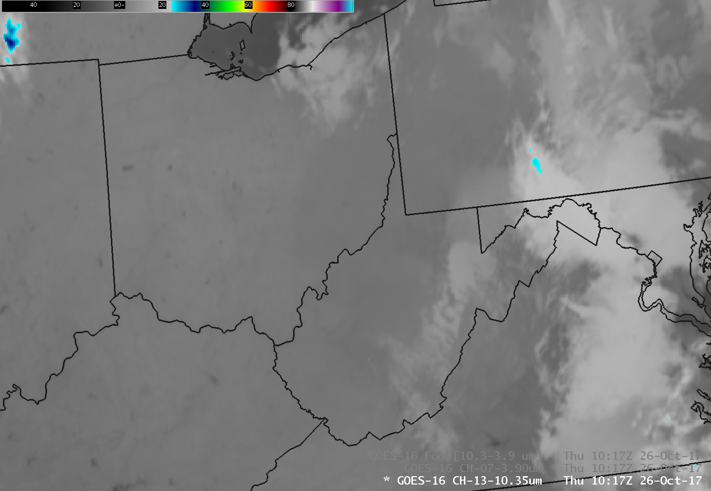
Night Fog Difference (10.3μm – 3.9μm)
Quick Brief
10.3 μm
Clean Window
Notes:
Here's a clean window image that shows low clouds over Ohio, Pennsylvania and West Virginia. It's difficult to discern the low clouds, isn't it, especially if you're unfamiliar with geography!?
I will next show the 3.9. I have adjusted the AWIPS bounds of the 3.9 to match the 10.3; by default, the warmest 3.9 temperature is 127 C, vs. 55 C for 10.3. Use a procedure to do this automatically if you are using 3.9 and 10.3, and their differences, to find Stratus.

Slide 9
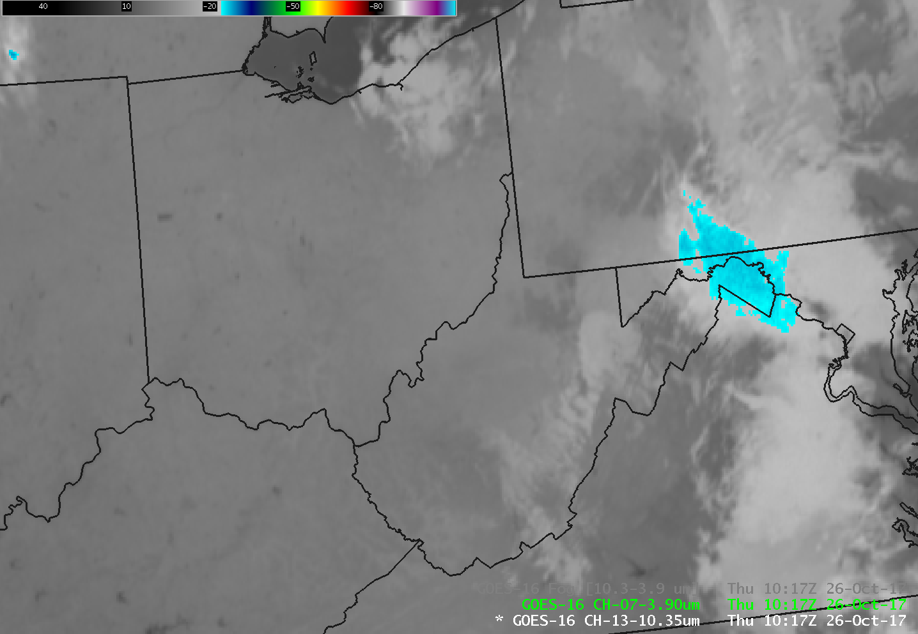
Night Fog Difference (10.3μm – 3.9μm)
Quick Brief
3.9 μm
Shortwave IR
Notes:
The 3.9 micron image shows slightly brighter -- cooler -- clouds over regions of low clouds/stratus. Thin Cirrus is slightly warmer because of surface 3.9 micron energy propagating through the cloud more effectively than 10.3 micron energy.

Slide 10
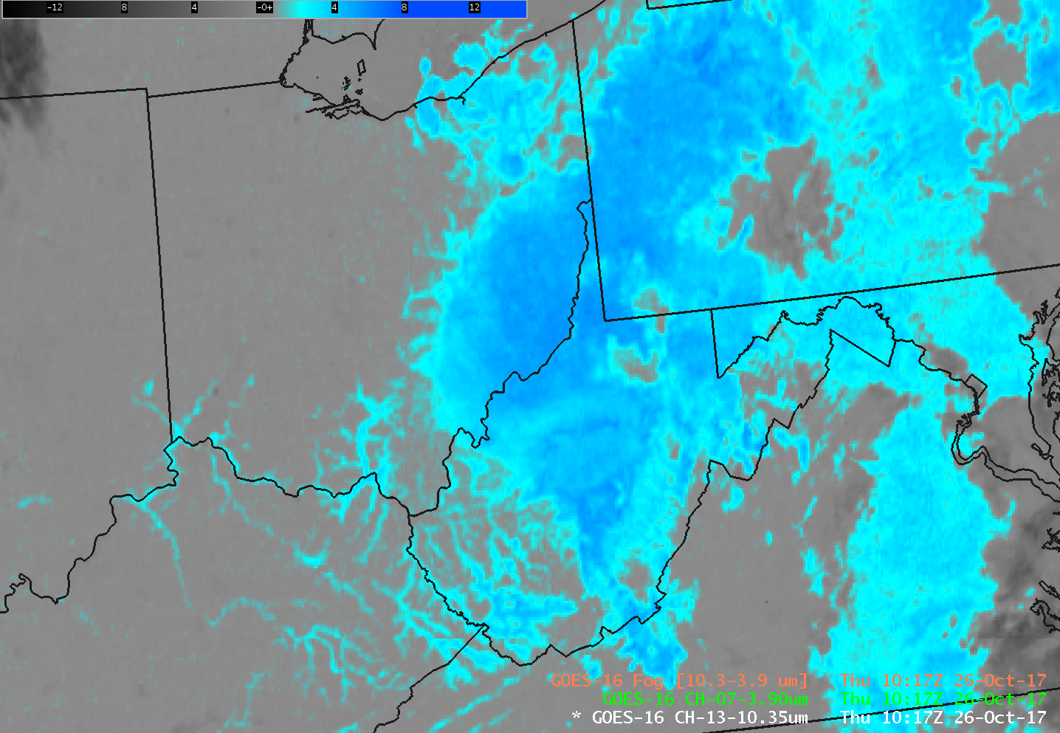
Night Fog Difference (10.3μm – 3.9μm)
Quick Brief
BTD Field
Notes:
Here is the brightness temperature difference field, with the default blue enhancment. Stratus clouds are occurring throughout the hollow of Appalachia, and more widespread fog/stratus is over southeastern Ohio and Pennsylvania. Cirrus clouds are black.
Is the blue region where you expected to see fog/stratus?
Visibility restrictions -- i.e., fog v. stratus -- are difficult to discern from the satellite. A stratus deck and a fog bank can both look the same from the satellite point of view.
Cloud must be sufficiently thick for this brightness temperature difference field to operate. Ellrod posited at least 50-100m thick.

Slide 11
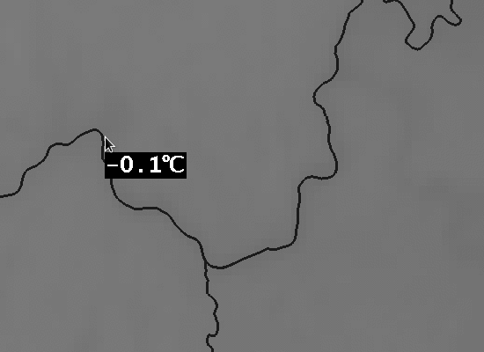
Night Fog Difference (10.3μm – 3.9μm)
Quick Brief
Notes:
Here is a zoomed-in image over southeast Ohio, northeast Kentucky and western West Virginia. This is the Clean Window with the default enhancment. Where's the fog?

Slide 12
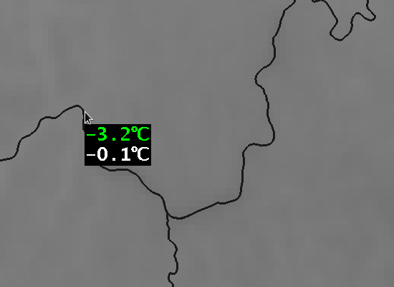
Night Fog Difference (10.3μm – 3.9μm)
Quick Brief
Notes:
If you compare it to -- by toggling with -- the 10.3 microns, you start to see where it might be. Note the Temperature differences between the two. Clean Window is in white, Shortwave IR (3.9 microns) is in green, colder.

Slide 13
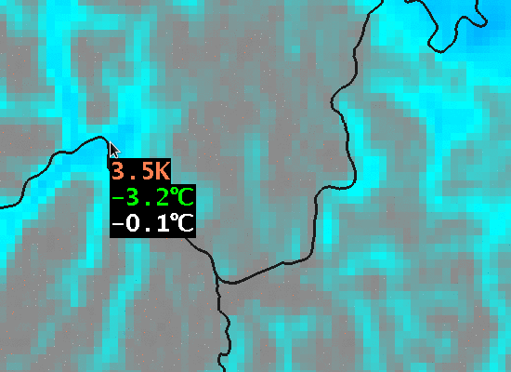
Night Fog Difference (10.3μm – 3.9μm)
Quick Brief
Notes:
And here's the brightness temperature difference field (with some rounding!!). The Stratus clouds -- that may or may not be extending to the surface -- are very apparent.
Note that an overlying cirrus deck renders this stratus detection impossible.

Slide 14
Night Fog Difference (10.3μm – 3.9μm)
Quick Brief
What happens during the Day?
3.9 μm radiation from the sun, reflected off Clouds or the ground, increases the amount of 3.9 μm radiation detected by the satellite, and the Fog Difference flips sign, from positive to negative.
Can give a signal about updraft strength in convection (small ice crystals reflect solar radiation more strongly than large ice crystals) – but you need a different color curve! This BTD is part of the Cloud Convection RGB
Notes:
What happens during the day?
3.9 micron radiation from the Sun is reflected strongly off of clouds (and off the surface); more 3.9 micron radiation is thus detected by the satellite, and the inferred 3.9 micron brightness temperature will be a lot warmer. This alters the sign of the brightness temperature difference.
The amount of reflectance can be controlled by particle size. For example, small ice crystals at the top of a strong updraft are much more highly reflective of 3.9 micron radiation than larger ice crystals at the top of a weak updraft. You'll need a color curve that is different from the default to highlight this difference that is exploited in the Cloud Convection RGB.

Slide 15
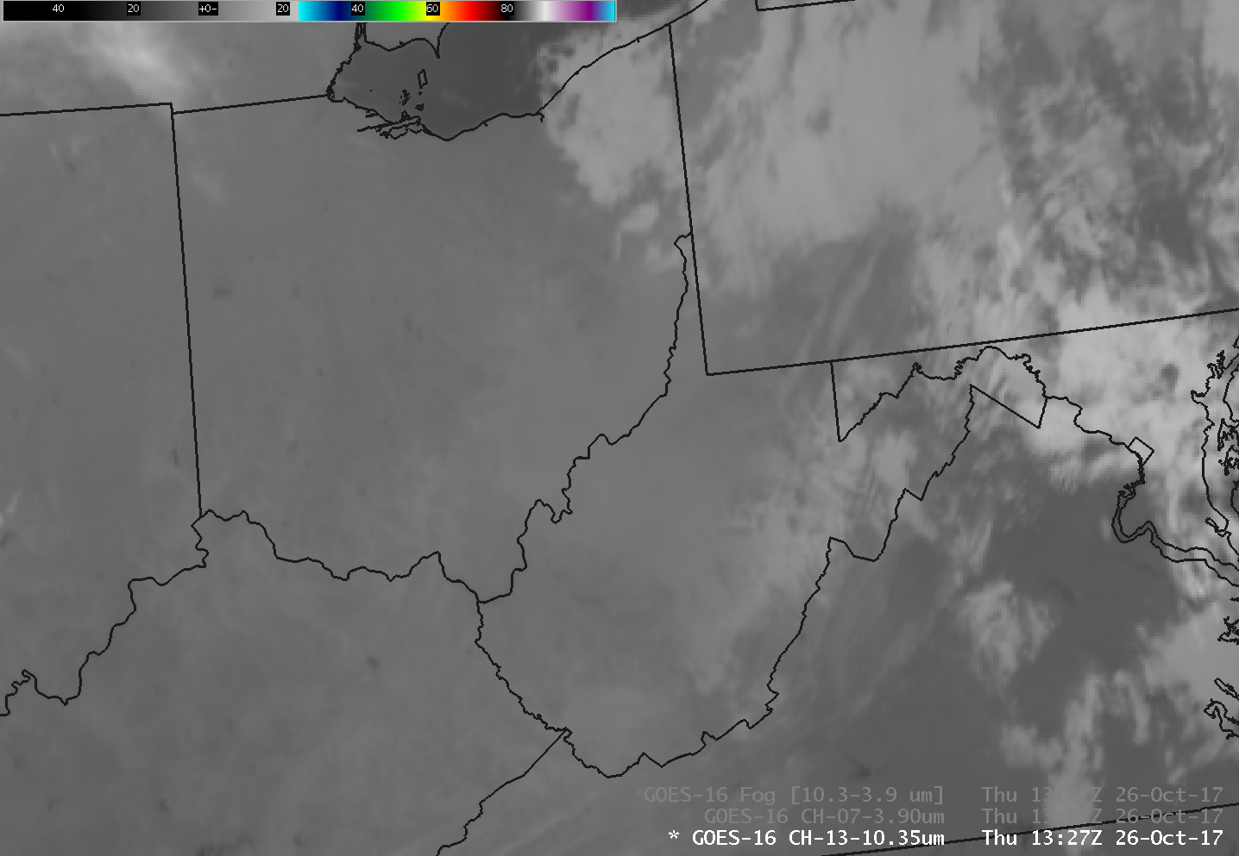
Night Fog Difference (10.3μm – 3.9μm)
Quick Brief
10.3 μm
Clean Window
Notes:
Here's a 10.3 micron brightness temperature field from after sunrise, a little bit later than the previous one, over Appalachia. It looks similar to the earlier image 10.3 micron image.

Slide 16
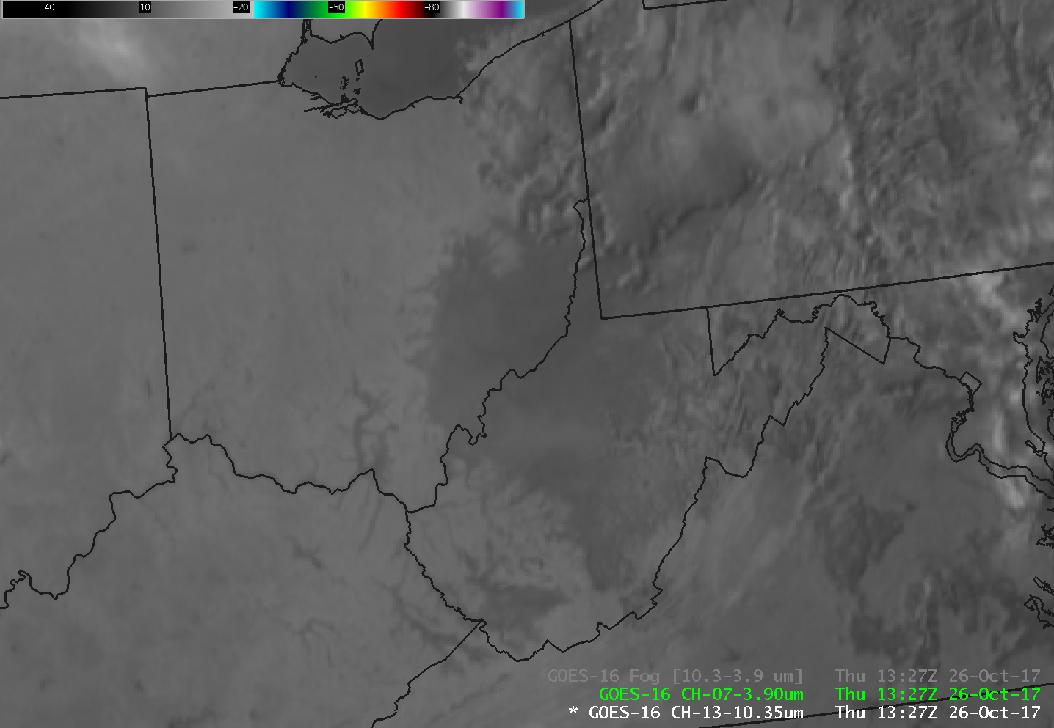
Night Fog Difference (10.3μm – 3.9μm)
Quick Brief
3.9 μm
Shortwave IR
Notes:
But the 3.9 micron looks much warmer. The cloud fields appear dark, warmer, because solar radiation is reflecting off of them and that extra solar 3.9 radiance is inferred as a warmer emitting surface.

Slide 17
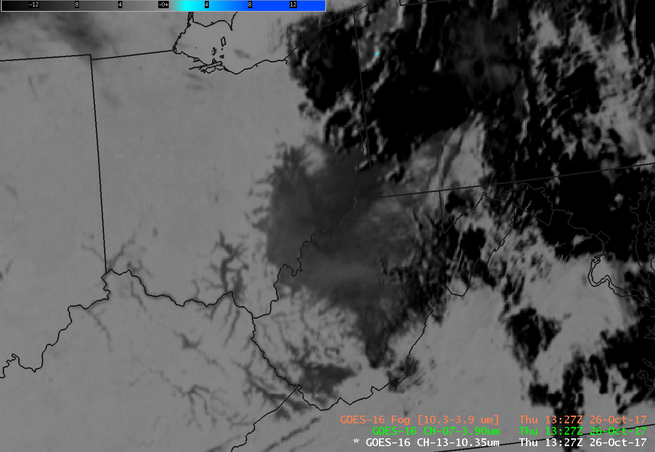
Night Fog Difference (10.3μm – 3.9μm)
Quick Brief
BTD Field
Notes:
So the brightness temperature difference field looks black/grey now, instead of blue. Fog and stratus are still enhanced -- because reflectance over the cloud is greater than over adjacent clear regions.

Slide 18
Night Fog Difference (10.3μm – 3.9μm)
Quick Brief
Emissivity drives the Brightness Temperature difference (BTD) over low clouds at night
Reflectivity drives the BTD over clouds during the day
During the Night to Day transition, the color of the low clouds in the default enhancement will change dramatically (from blue to black) as the reflective component increases
Absorption of upwelling radiation is greater at longer wavelengths than at shorter, so the BTD shows warmer temperatures at shorter wavelength at night.
There is also a sub-pixel effect that influenced the BTD for partly-cloudy pixels.
A similar BTD with a different color curve is available during the daytime.
Notes:
You've reached the end of this Quick Brief on the Fog Difference field (10.3 micron - 3.9 micron). Thanks for listening!

