Slide 1
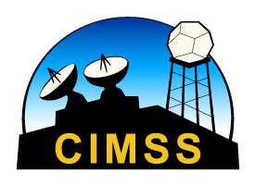
GOES17 Data Fusion
Scott Lindstrom UW CIMSS Tim Schmit NOAA/ASPB
Elizabeth Weisz UW CIMSS Paul Menzel UW CIMSS
August 2019
Notes:
This training will help you understand Data Fusion, a technique for filling in missing data on GOES-17 when the ABI sensor saturates because of instrument heating.

Slide 2
The Problem
GOES-17 Loop Heat Pipe does not operate to spec
ABI detectors will warm up, may saturate, and cool down during night time at certain times of year around Equinoxes.
When the ABI changes temperature, biases are introduced. These biases are mitigated by Predictive Calibration (there is separate training on that)
During saturation, when data are lost, Data Fusion can supply some information
Notes:
The Advanced Baseline Imagery (ABI) on GOES-R includes a Loop Heat Pipe that moves heat away from the sensor. On GOES-17, the Loop Heat Pipe does not operate at full capacity, allowing solar forcing to heat the ABI instrument. It changes temperature, which is a calibration challenge, and the individual sensors ultimately saturate. The calibration challenge is mitigated by Predictive Calibration. Fusion supplies information when the ABI detectors saturate.

Slide 3
Notes:
The blue line in this figure shows the predicted peak daily focal plane temperature on GOES-17. If the Loop Heat Pipe functioned properly, this value would be mostly steady. During some times of the year, centered on the Equinoxes, the sun is positioned so that it shines directly into the ABI at night, causing warming. Horizontal black lines show predicted temperature values at which individual bands start to lose integrity as the ABI warms (band detection will saturate completely at temperatures slightly warmer than the black line). Bands 13 and 14, at top, are affected by the heating only during about a week of the year. Bands 10, 12 and 16, at the bottom, will be affected for much longer: weeks of data at each band are lost annually. The other infrared bands, 8, 9 11 and 15 show outages in between the two extremes.

Slide 4
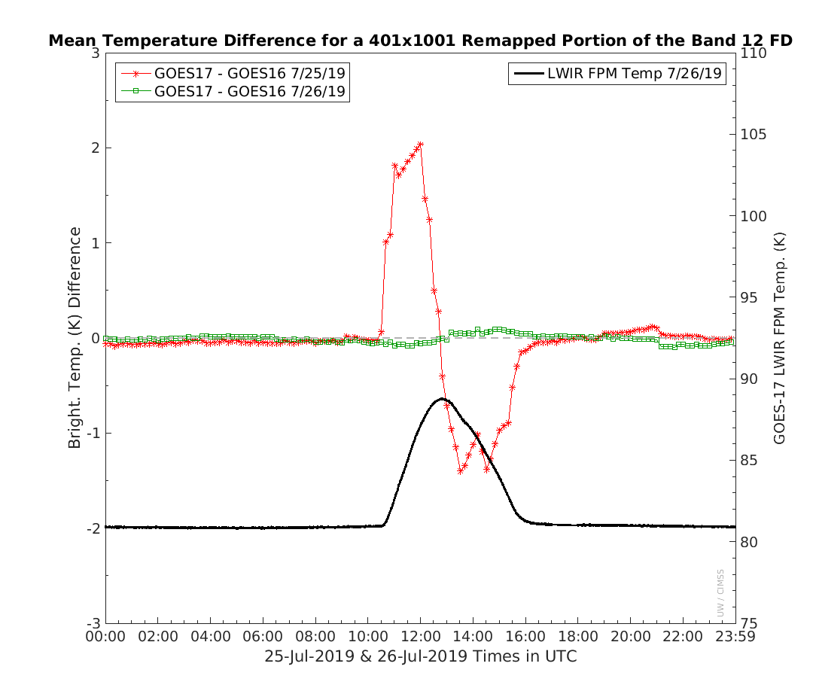
Differences without predictive cal
Differences with predictive cal
Imagery courtesy Mat Gunshor
Notes:
THis figure shows improvement brought about by Predictive Calibration. The figure compares Band 12 in late July -- at the start of the Fall Equinox heating period (and before Band 12 saturates). The red line shows the difference between the mean GOES-16 and GOES-17 band 12 brightness temperature values in a region on the equator on 25 July 2019 -- before Predictive Calibration. The green line shows much smaller differences on 26 July 2019 -- after Predictive Calibration was implmented in the GOES-17 Ground System.

Slide 5
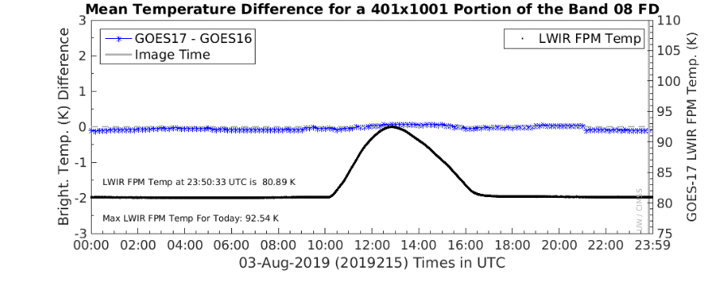
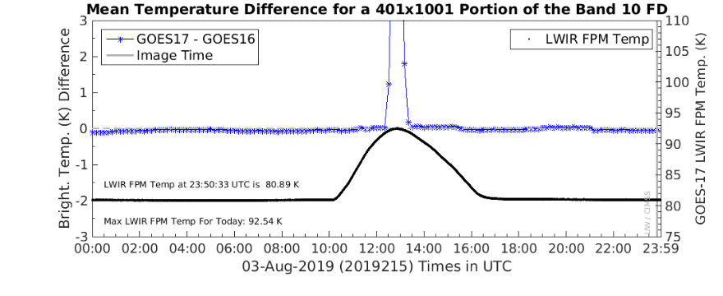
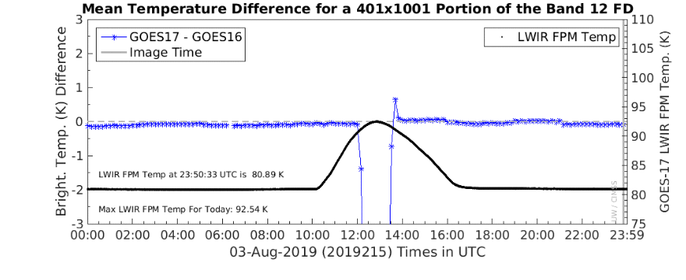
6.19 μm
Here are comparisons for 3 August 2019 – Band 8, Band 10 and Band 12. Band 8 is not being affected, yet, at this time by the warming of the Loop Heat Pipe, shown by the black line. Note that Band 12 – at the bottom – is affected for more of the time than Band 10. Missing data during the times of saturation can be replaced with Data Fusion products
Note that there is very little bias around the times of saturation for Bands 10 and 12 – this is because of Predictive Calibration.
7.34 μm
9.61 μm
Notes:
Excess Heating in the ABI affects different bands differently. In this image fro August 3rd, Band 8, on top, is not yet saturating -- difference values between the two satellites are small. Band 10, in the center, is saturating for some times, and so is Band 12, at the bottom. The number of missing times is different for each band.

Slide 6
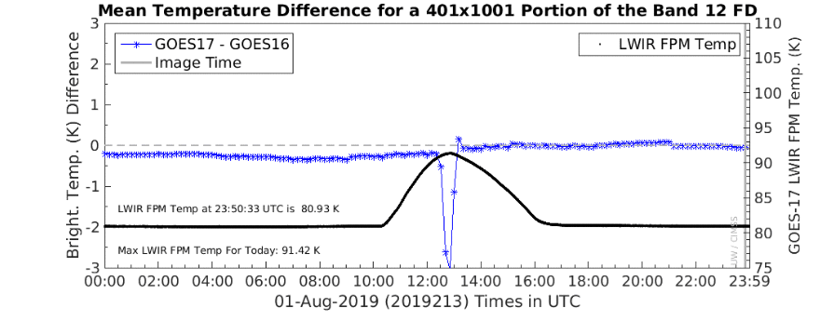
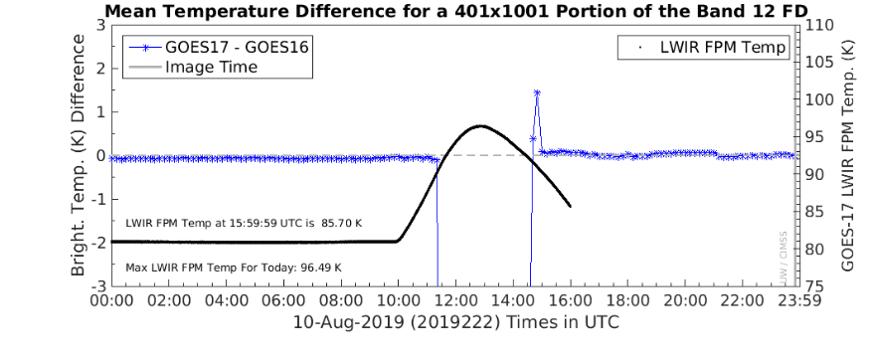
01 August
This compares Band 12 at 01 August – when saturation is just beginning, to 3 and 10 August. Big changes will happen from day to day. . Missing data during the times of saturation can be replaced with Data Fusion products
Band 12 is part of the Airmass RGB, thus that RGB’s character would be changing from day to day during this short time
03 August
9.61 μm
10 August
Notes:
Here we see how the steady increase in the maximum Focal Plane temperature from 01 August -- at 91.42 K -- to 10 August -- at 96.49 K -- causes more and more data to be lost in Band 12. On August 1st, perhaps 3 image scenes are lost; that increases rapidly so that by 10 August, more than 2 hours are lost!

Slide 7
24 hours
Onset and duration of saturation varies by band and day
eclipse
Imagery courtesy Fred Wu
Notes:
This image -- I call it the Watermelon Plot -- , from Fred Wu, compares data outages -- in red -- due to saturated sensors during the Spring 2019 Equinox heating season. Green regions show good data, Blue and orange show data that are affected by warming but still useable. Band 10 -- in the center -- shows the longest outages during the 24-hour dayspans plotted, and also the first and last affects as you get closer to Equinox in February and farther from Equinox in May. Band 11, in contrast, has much less data loss. The beneficial effects of eclipse -- when the ABI slips into the Earth's shadow are also obvious.

Slide 8
Band Outages
For Example: On 13 August 2019
Band 12 was unuseable : 1120 – 1510 UTC
Band 16 was unuseable : 1120 – 1440 UTC
Band 10 was unuseable : 1130 – 1430 UTC
Band 8 was unuseable : 1150 – 1400 UTC
Band 9 was unuseable : 1150 – 1350 UTC
Notes:
When can you expect to see no data if you don't use Fusion? Here's an example from inspection of data in AWIPS for a day in August. As August progressed, the times that data became unuseable were longer and longer. You will see similar outages in February, April and October.

Slide 9
How does Data Fusion Work
Before Focal Plane warming, establish a relationship between Band 13 (one of two bands relatively unaffected by the warming) and other bands, such as Band 10. Then, when Band 10 is saturated, use the values at Band 13 to back out what the value of Band 10 should be given the relationship established before the heating.
Data Fusion was developed by Elizabeth Weisz, Paul Menzel and others at UW-Madison CIMSS
Notes:
The fusion approach for restoring the missing data starts from the last full set of infrared radiances known to be well calibrated at time t0. Then at subsequent times, when cooling issues cause missing or bad data in the other spectral bands, the IRW band 13 measurement for a given pixel is linked via a k-d tree search to the five best matching time t0 IRW band 13 measurements. The other spectral band measurements associated with these five matches from time t0 are then averaged to estimate a restored value for each missing ABI IR spectral band at time t for that pixel. Thus, the fusion of data from one time to another is accomplished.

Slide 10
What Data Fusion does and does not supply
It does not provide information about Clear Air Turbulence that develops during Loop Heat Pipe outages: that phenomenon is not detected in longwave IR bands
It does not provide precise quantitative information from the missing bands ; Data Fusion fields should not be used in RGBs, nor in Level 2 products
It does provide qualitative information about the missing bands. The accuracy of the information in the missing bands decreases with time. The rate of that decrease depends on how well correlated the bands are.
In general, cloudy radiances are more correlated and therefore more accurate in fused images than clear radiances
Notes:
Fusion is using the clean infrared window. It does have limits. For example, if Clear Air Turbulence develops, it won't be observed in longwave IR bands, so its presence will also not be in the Fusion Water Vapor Imagery. Errors from Fusion do increase with time, depending on how well-correlated bands are with the clean window. Cloudy radiances are better correlated than clear ones. Errors in Data Fusion products mean that Data Fusion imagery should not be used in RGBs nor in Level 2 products. It is provided to give a guess of how the image would look based on its previous relationship to the clean window.

Slide 11
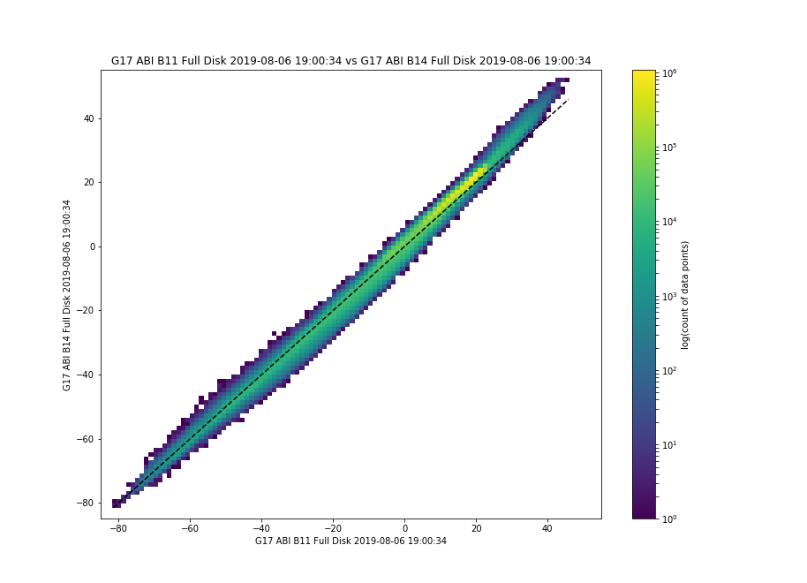
Why does Data Fusion work?
Infrared bands can be highly correlated!
If you use Band 13 information to predict what Band 11 is doing, you might do an okay job – the two bands are well correlated.
ABI Band 13 Brightness Temperature 1900 UTC 6 August 2019
(Figure created with SIFT)
ABI Band 11 Brightness Temperature 1900 UTC 6 August 2019
Notes:
Band 13 and Band 11 are very well correlated. Fusion should work well with Band 11.

Slide 12
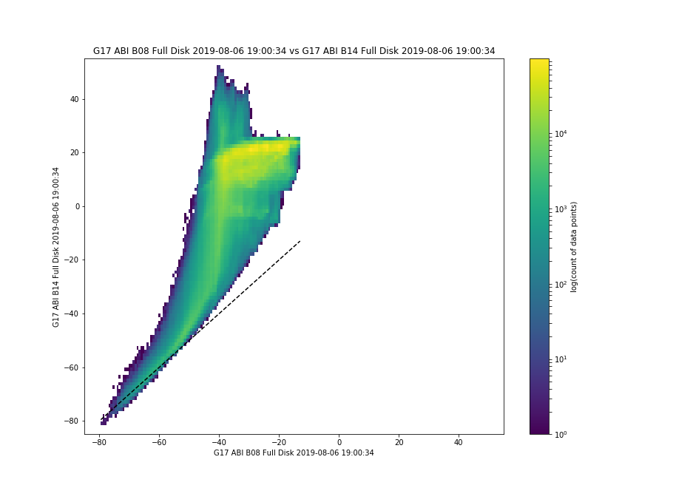
Why does Data Fusion struggle?
Infrared bands might not be well-correlated!
If you use Band 13 information to predict what Band 10 is doing, you might struggle – the two bands are well correlated only at cold cloud tops
ABI Band 13 Brightness Temperature 1900 UTC 6 August 2019
(Figure created with SIFT)
ABI Band 10 Brightness Temperature 1900 UTC 6 August 2019
Notes:
Band 13 and Band 10, in contrast, are not very well correlated, except at cold cloud tops. Fusion errors will be larger in Band 10 than in Band 11.

Slide 13
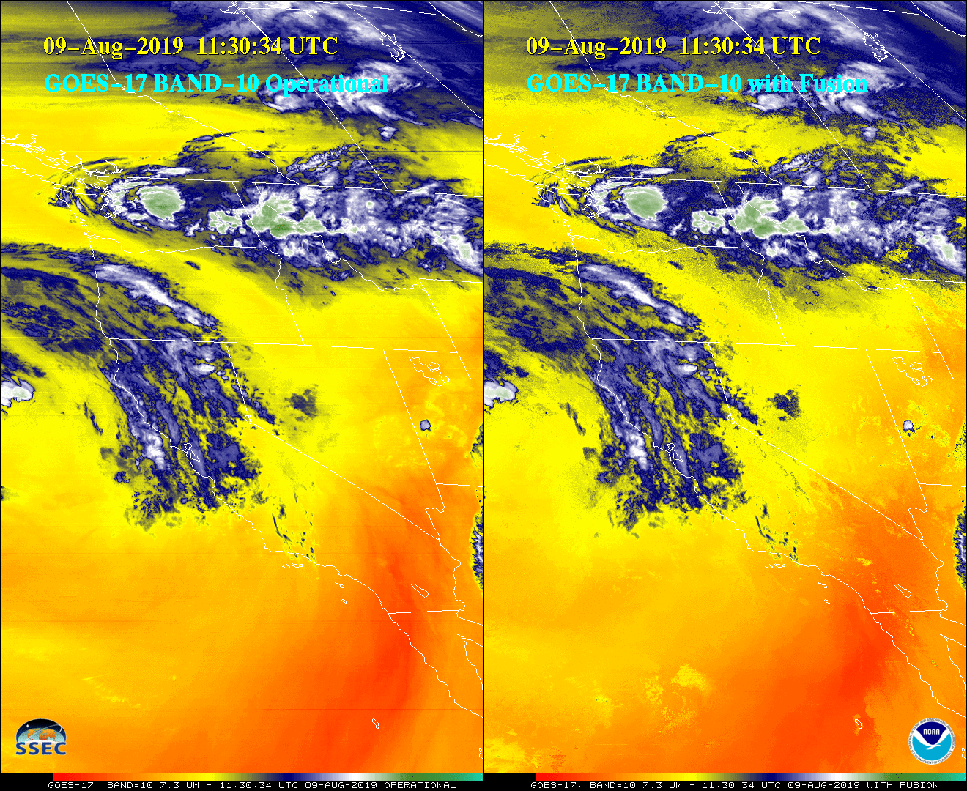
Imagery courtesy Jim Nelson and Tim Schmit
Notes:
Here's the start of a series of imagery showing the operational GOES-17 Band 10 on the left, and the data fusion version on the right. Overall there is good agreement -- but a keen eye will quickly start to find differences. Some are subtle, some aren't.

Slide 14
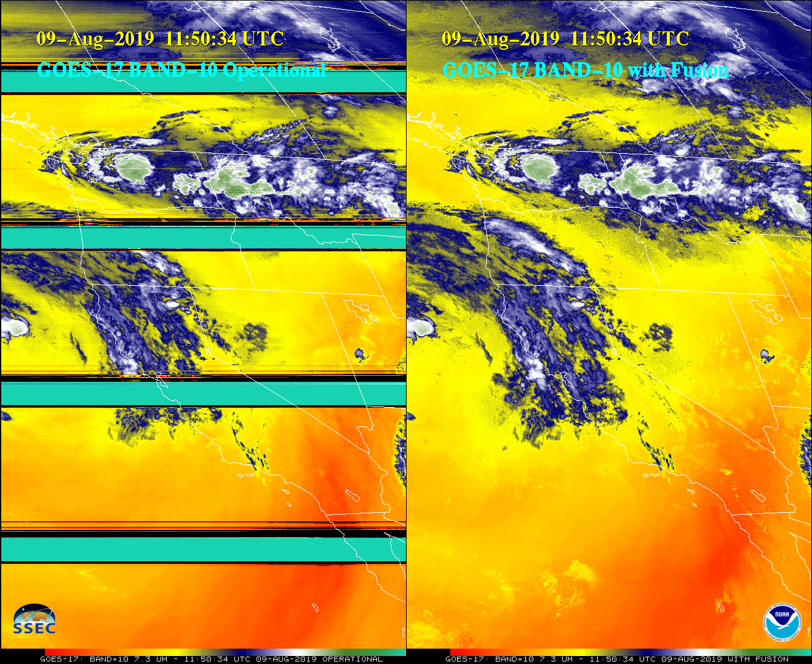
Imagery courtesy Jim Nelson and Tim Schmit
Notes:
20 minutes later, GOES-17 Band 10 starts to saturated. This is when fusion is going to be useful to maintain a signal.

Slide 15
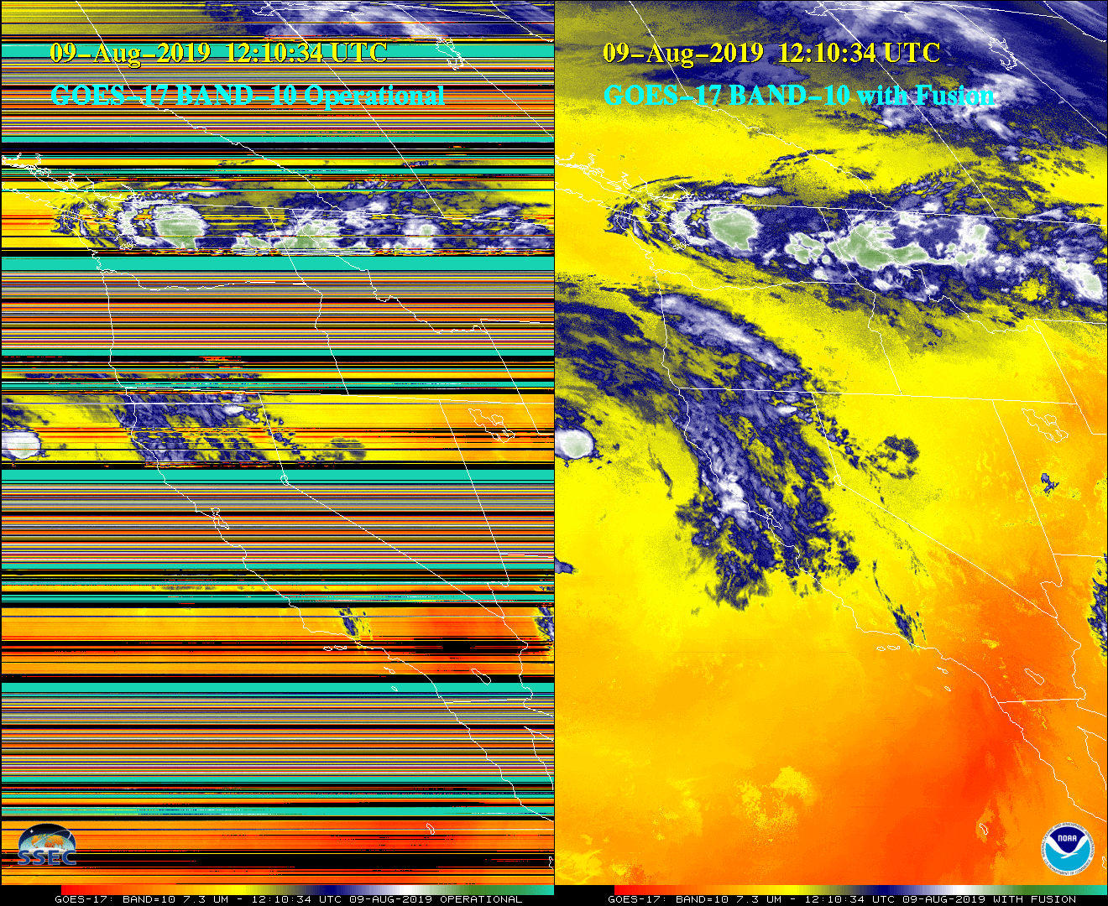
Imagery courtesy Jim Nelson and Tim Schmit
Notes:
20 minutes after that, even more saturation!

Slide 16
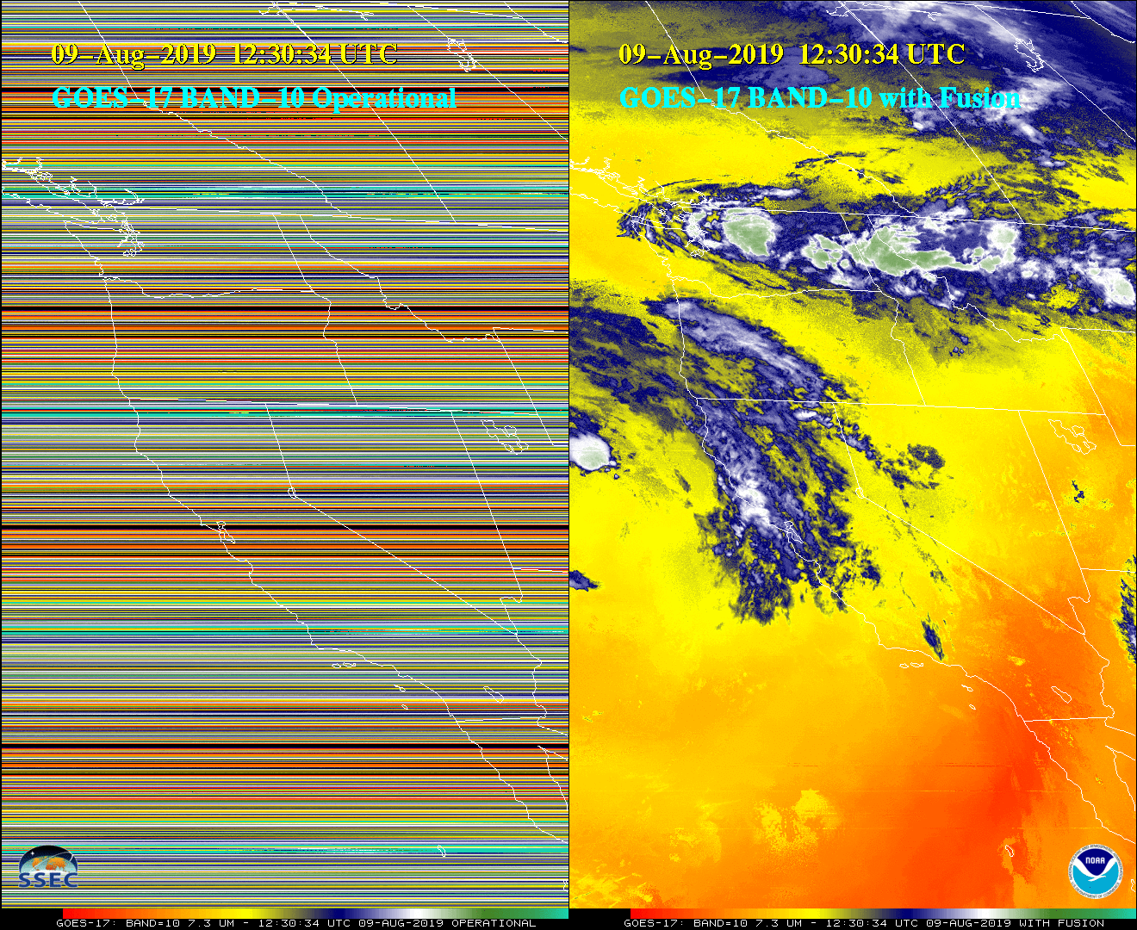
Imagery courtesy Jim Nelson and Tim Schmit
Notes:
ANd by 1230 UTC on this day, the operational GOES17 Band 10 field is unuseable. But Fusion -- that is using the clean window and its earlier relationship between Band 13 and Band 10 -- is producing a signal.

Slide 17
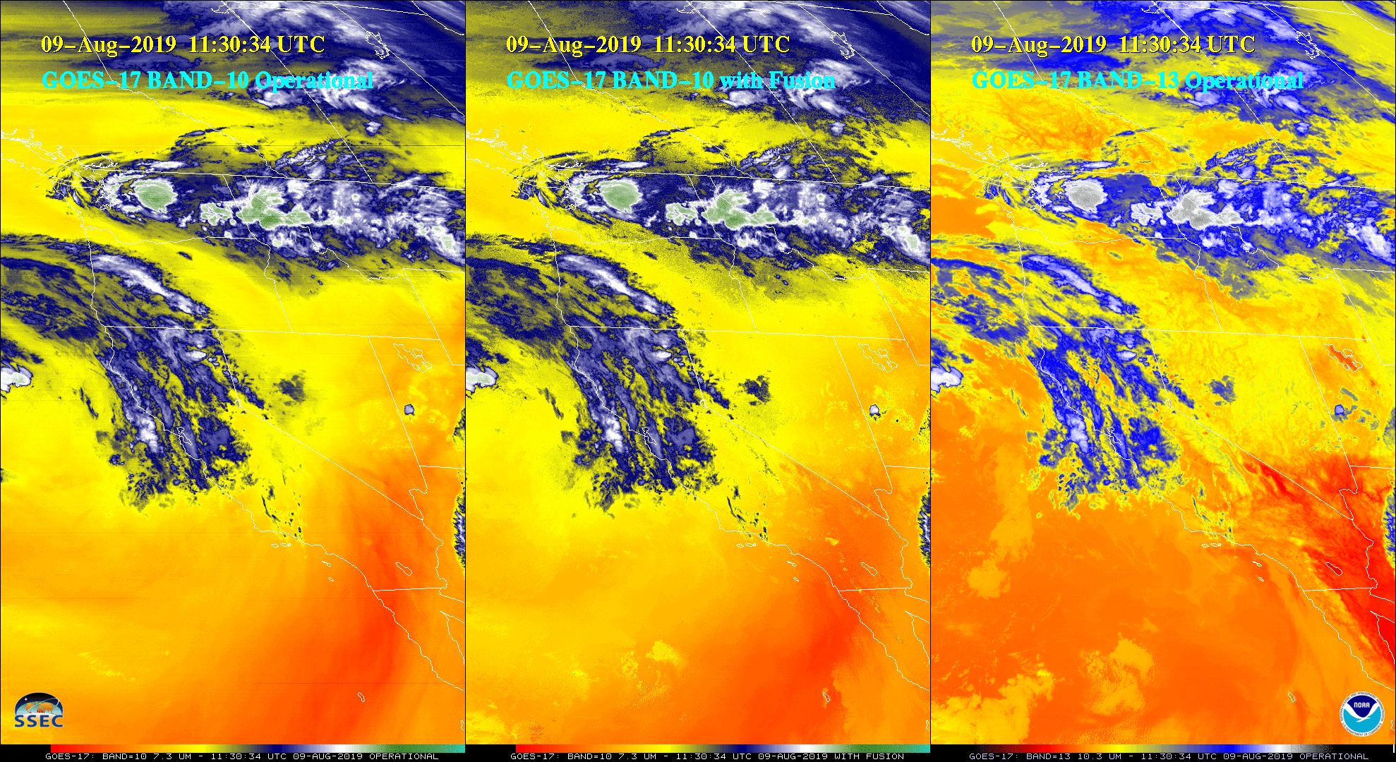
This shows Band 13 on the right – used to create the fusion image. There are features in Band 13 that show up in the Band 10 image – some of the features are circled in green.
Note: Color Enhancement in right-hand image (Band 13) is different
Imagery courtesy Jim Nelson
Notes:
Artifacts in the Fusion field, shown in the middle, can be traced to the Band 13 field. The best correlation between Band 10 and Band 13 is at the cold cloud tops, so that is where the smallest errors should be.
The Band 13 clean infrared window image shown here -- on the right -- has a different enhancment than the two other images that are water vapor.

Slide 18
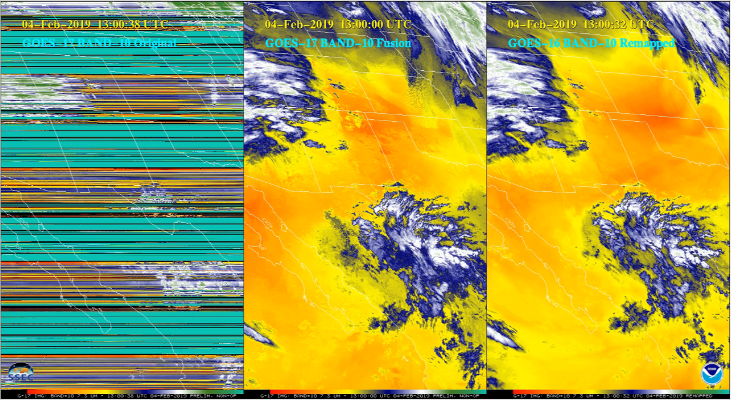
GOES-17 ABI Mitigation – Imagery Fusion
Work by E. Weisz and P. Menzel (CIMSS) and T. Schmit (STAR) 1445 UTC 04 Feb 2019
Signature of low clouds can show up in Fusion Data – because it’s in IR Window – but it doesn’t belong in water vapor imagery
Notes:
Here's another example, from February 2019. Fusion water vapor imagery includes structures that exist in the infrared window channels that are not present in the water vapor imagery.

Slide 19
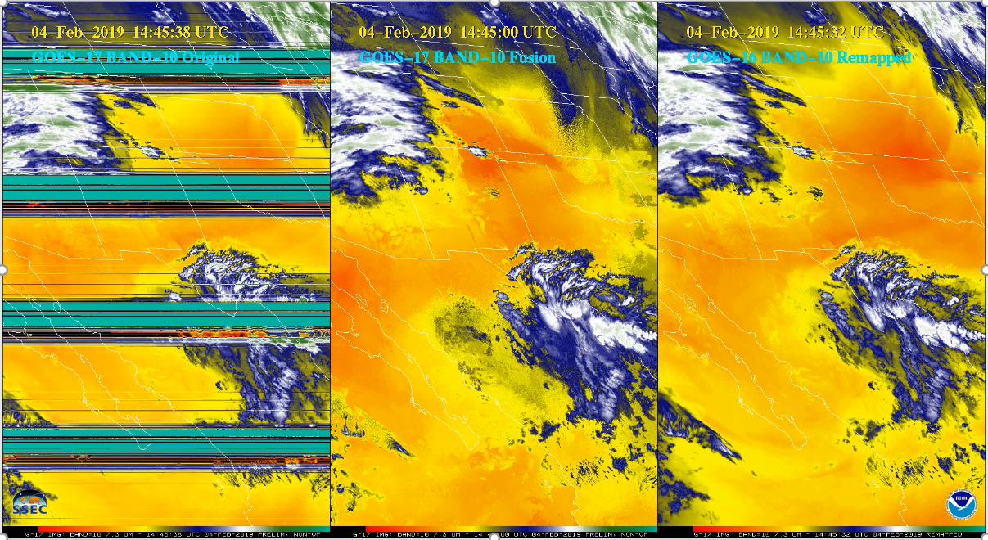
GOES-17 ABI Mitigation – Imagery Fusion
Work by E. Weisz and P. Menzel (CIMSS) and T. Schmit (STAR) 1300 UTC 04 Feb 2019
Signature of low clouds can show up in Fusion Data – because it’s in IR Window – but it doesn’t belong in water vapor imagery
Notes:
AS little later -- you can still see that feature in the Data Fusion product. It's not in either the GOES-17 or GOES-16 water vapor channel image.

Slide 20
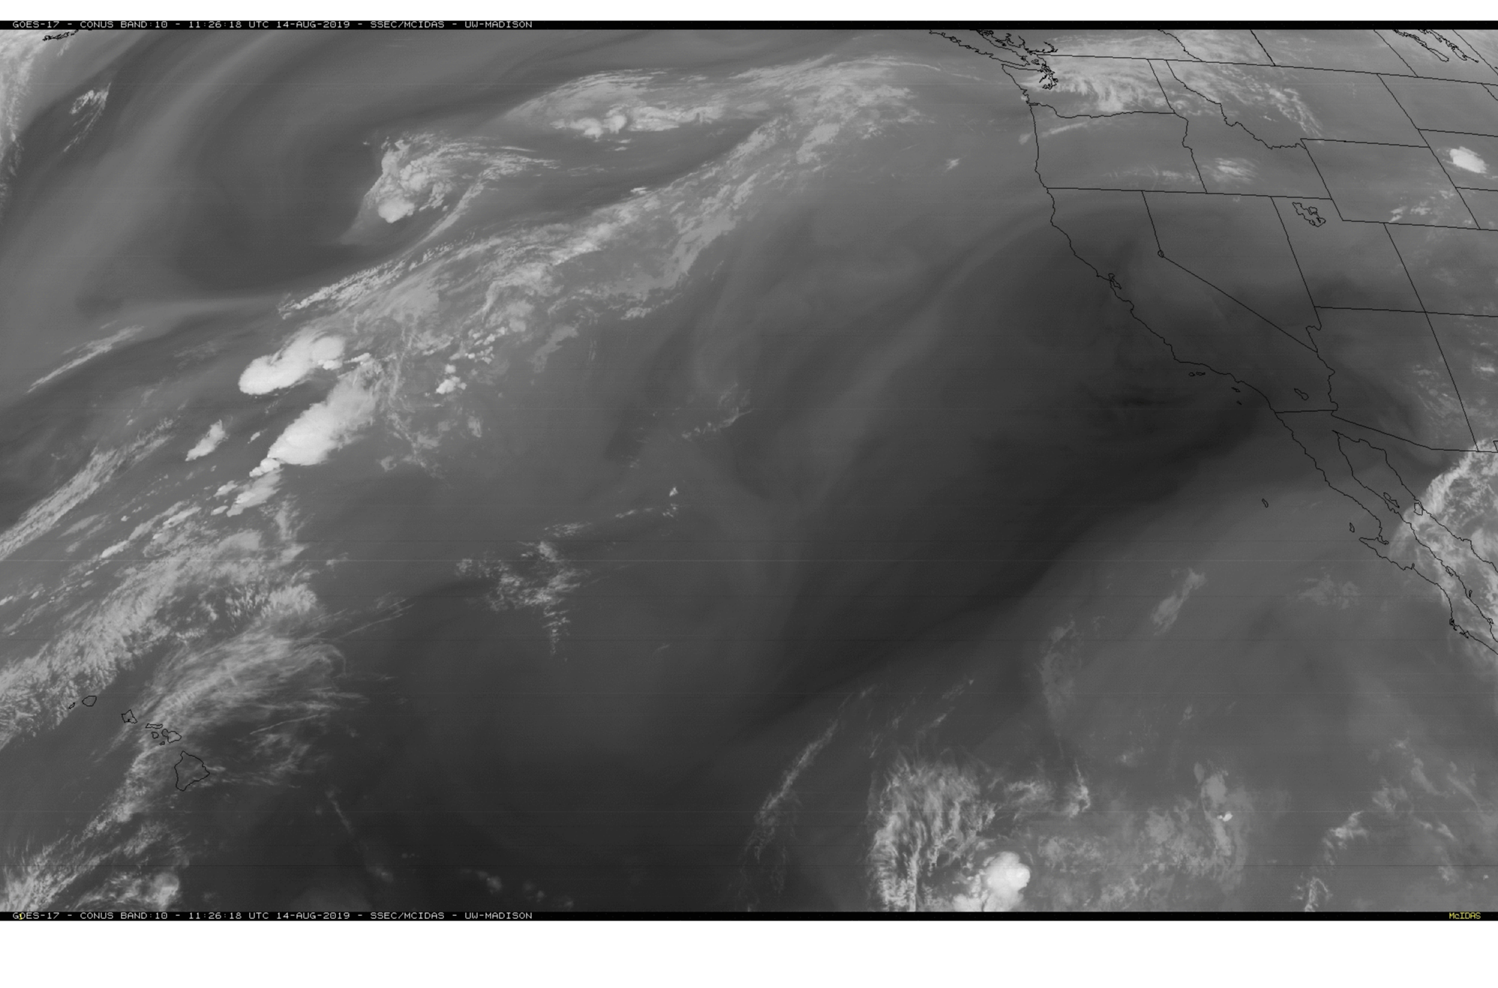
GOES-17 PACUS view, 14 August 2019, 1126 UTC
You can see Loop Heat Pipe Heating Artifacts (striping) in this image
Notes:
This is a GOES-17 Low-Level Water Vapor image -- the PACUS sector -- from 1126 UTC on 14 August, just as Fusion products are starting to be generated. The next image will be the data fusion image.

Slide 21
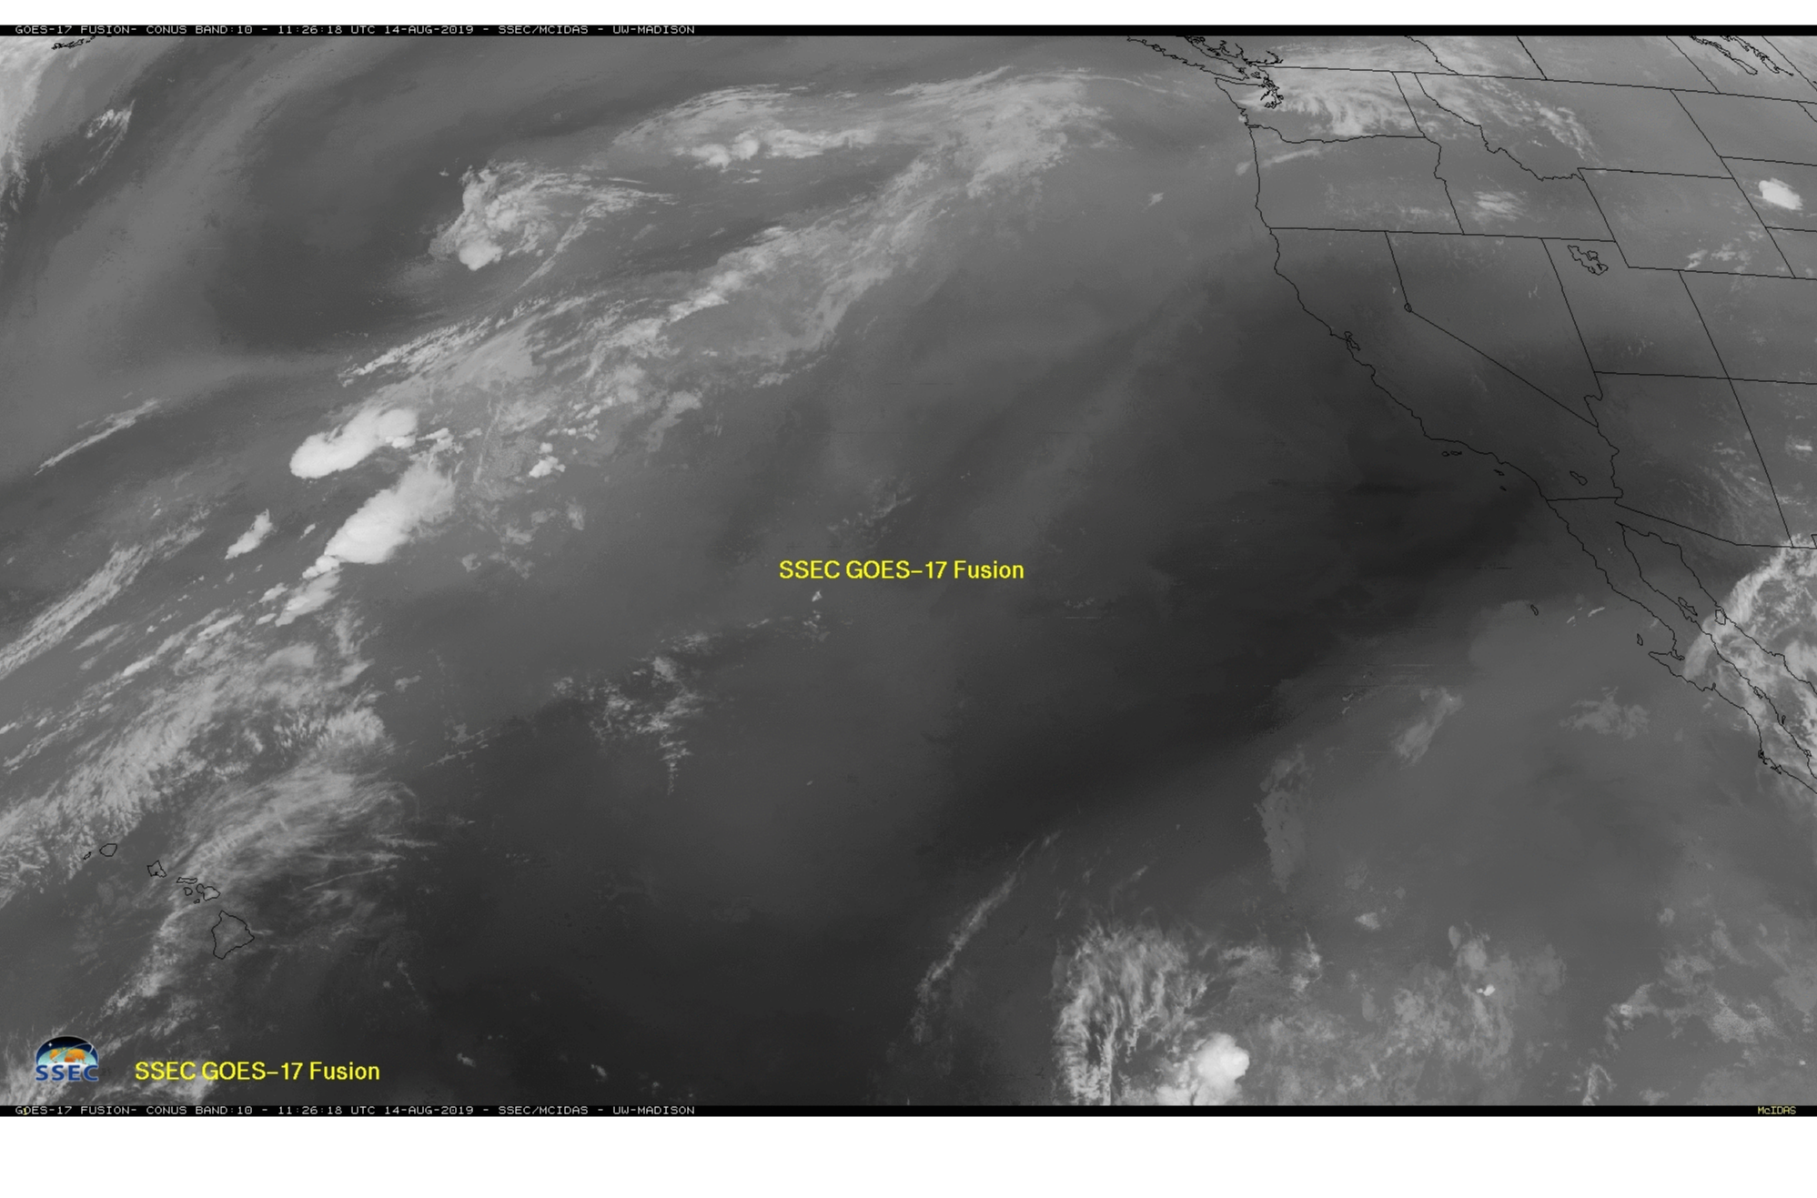
GOES-17 PACUS view, 14 August 2019, 1126 UTC
Data Fusion image; toggle between this scene and the previous one;
you’ll see great similarity over clouds, differences in clear skies
Notes:
You will note differences between the two images, especially in clear regions. Cold cloud tops, however, are approximated very well.

Slide 22
GOES-17 PACUS view, 14 August 2019, 1306 UTC
Saturation renders the image useless
Notes:
An hour and 40 minutes later, during the peak in the heating of the ABI, the Band 10 detectors have saturated, and you get no information.

Slide 23
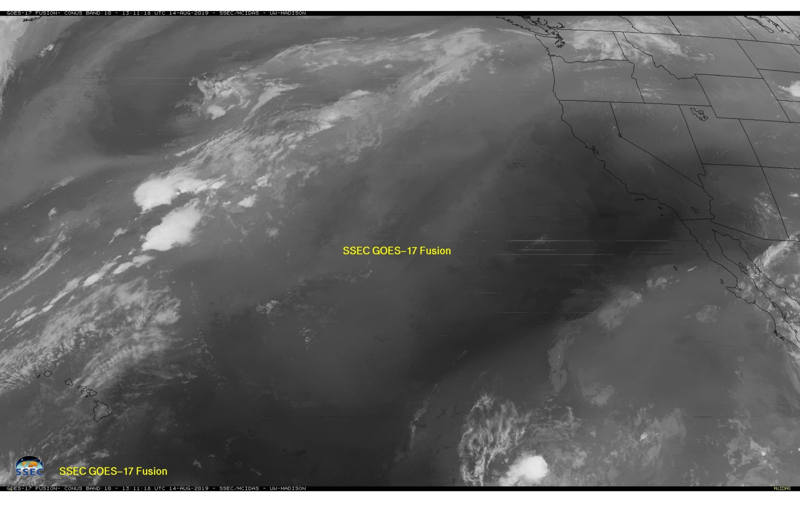
GOES-17 PACUS view, 14 August 2019, 1306 UTC
Data Fusion allows an image
Notes:
Data Fusion for the same time depicts a plausible -- but not perfect -- evolution of the field. Again, expect the cold cloud tops to be best represented.

Slide 24
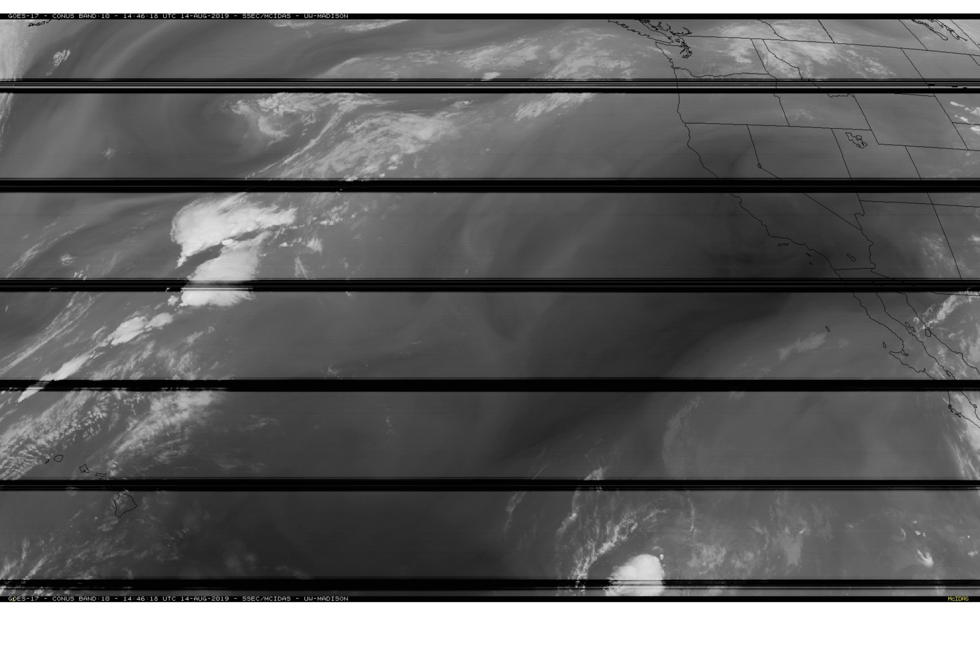
GOES-17 PACUS view, 14 August 2019, 1446 UTC
Striping persists as the ABI Instrument cools down, coming out of saturation
Notes:
Here's the first Band 10 image as the ABI detectors emerge from the saturated period. What does data fusion look like at this time? Differences between this scene and the next will show good correlation in the cloud tops, and larger differences at warmer (darker for this enhancement) brightness temperatures.

Slide 25
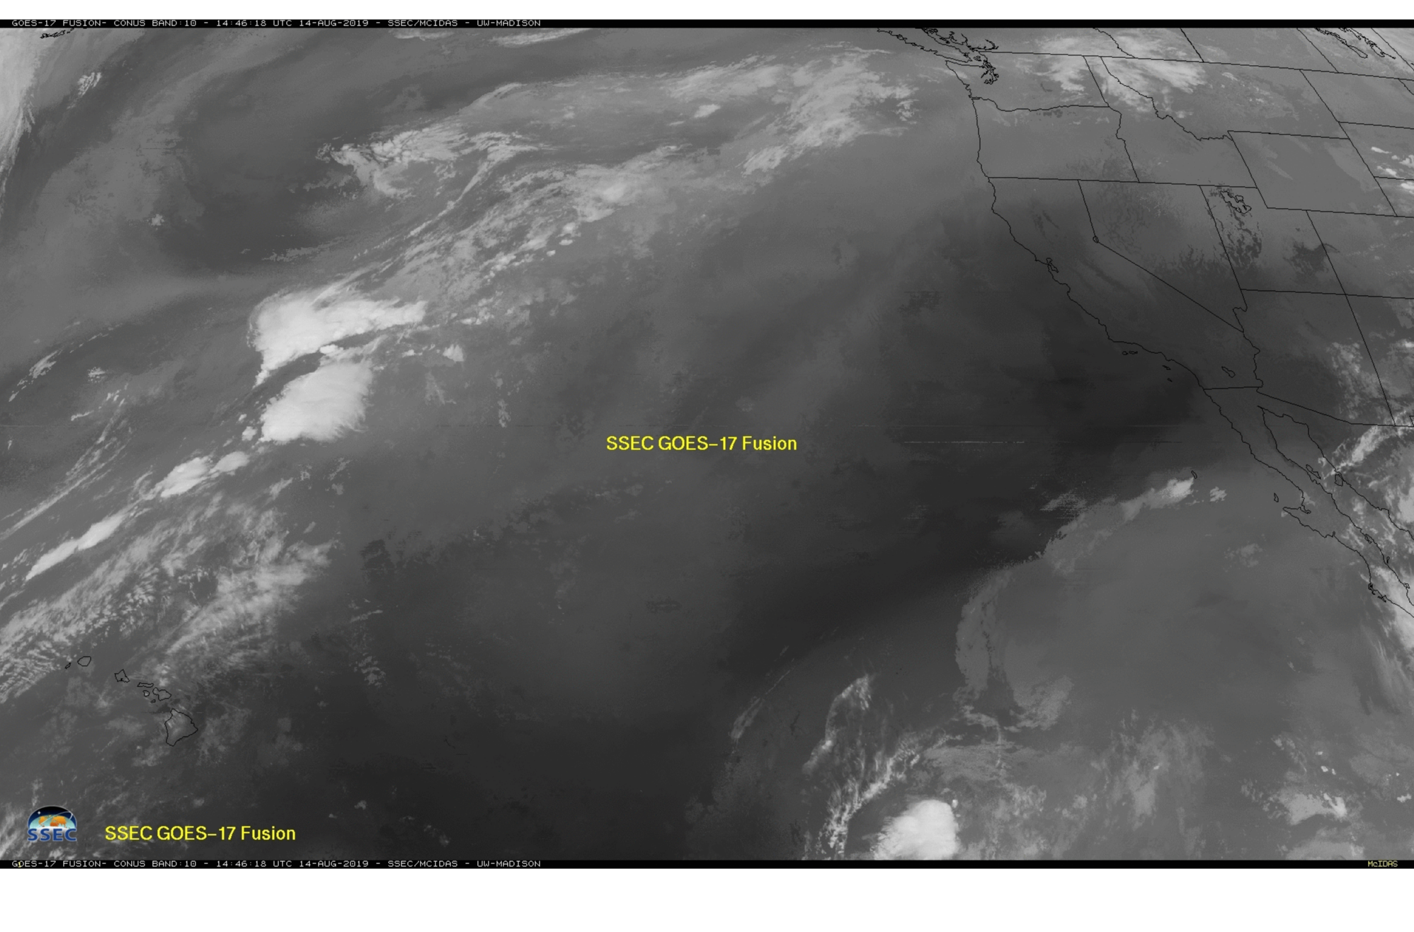
GOES-17 PACUS view, 14 August 2019, 1306 UTC
Data Fusion for the same time: some aspects of the field don’t match the actual field
But cold cloud tops look pretty good!
Notes:
Here is Data Fusion for the same time. Toggle between this image and the previous. Cold cloud tops are captured pretty well. There are differences at warmer brightness temperatures.

Slide 26
Realtime Fusion Imagery (only available on certain day/times when G-17 FPM is hot and flagged)
https://www.ssec.wisc.edu/data/geo/#/animation?satellite=goes-16-17-comp&end_datetime=latest&n_images=48&coverage=mollweide&channel=10-fusion&image_quality=gif&anim_method=javascript
Only Band 10
Mollweide projection
https://www.ssec.wisc.edu/data/geo/#/animation?satellite=goes-17-fusion
ABI IR bands: 8-12, and 15-16.
Notes:
You can find Realtime Fusion imagery at these links. The one on top combines Band 10 from GOES-17 and GOES-16 and it shows most of the Pacific and Atlantic oceans and the Americas. The one at the bottom shows individual bands.

Slide 27
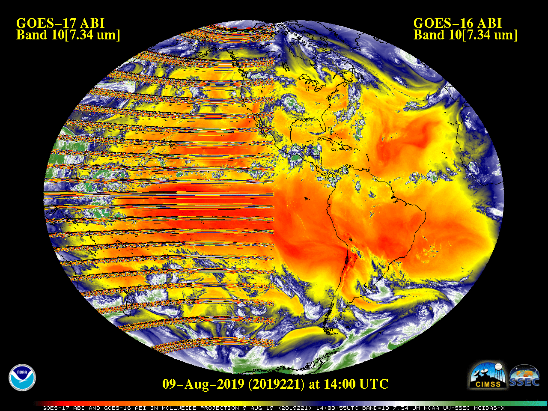
Imagery courtesy Tim Schmit

Slide 28
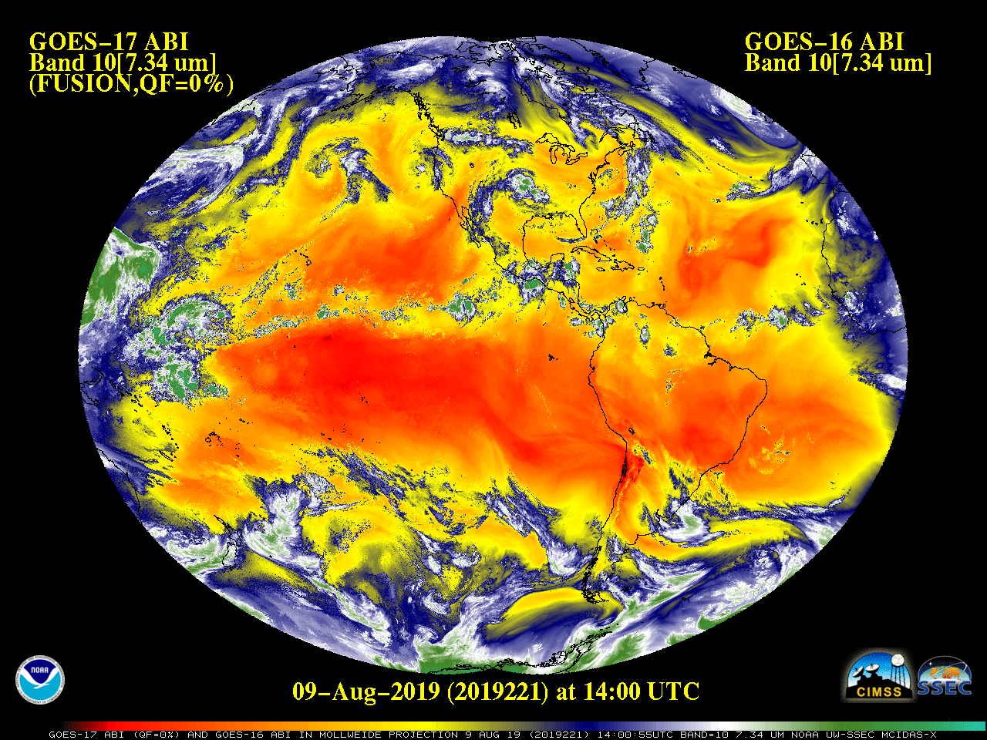
Fusion Data is best-looking at Full Disk; as you look at smaller and smaller features, you will see artifacts related to features in Band 13. Fusion does give you a great large-scale qualitative look at the image however.
Imagery courtesy Tim Schmit
Notes:
ANd here's what it looks like with Data FUsion. Data FUsion looks best for large-scale features.

Slide 29
Summary
Data Fusion fills in times where some infrared channels have saturated and show no data
Bands 13 and 14 very rarely saturate
A relationship between Band 13 and all other IR bands can be established before saturation occurs
When saturation later occurs at the other bands, the pre-determined relationship between them and Band 13 can be used to estimate the fields in the missing bands
Fusion Data are available online: https://www.ssec.wisc.edu/data/geo/#/animation (then choose GOES-17 Fusion under Satellite / Product
Notes:
Some concluding thoughts. Fusion Data fills in missing data from individual bands by relating the clean window infrared channel to the band that becomes missing. This relationship is determined when all bands are well-calibrated. Then, when the satellite band saturates, that established relationship can be used to infer what the saturated band would be detecting based on the values in the clean window band.

