Slide 1
Vertical Profile of Temperature and Moisture ; Total Precipitable Water
GOES-R Series Training
10th International Conference on Urban Climate
August 6-10 2018
Notes:
Changes:
Added CIRA Central America site http://rammb.cira.colostate.edu/ramsdis/online/rmtc.asp

Slide 2
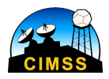
Contributors
Scott S. Lindstrom
University of Wisconsin-Madison Cooperative Institute for Meteorological Satellite Studies (CIMSS)
Jun Li
UW-Madison CIMSS
Tim Schmit
NOAA/ASPB/CIMSS

Slide 3
Agenda
GOES-R Baseline Products related to Moisture
How are LAP products created?
Water Vapor channels on ABI
Clear Sky v. All Sky
Weighting Functions
Water Vapor v. Total Precipitable Water
Where to find Data on-line ; Where to find Products on-line
NOAA CLASS, McIDAS-V
Polar Satellite products that do similar things for moisture and stability monitoring

Slide 4
Objectives of the Lesson
At the end of today You Will
Understand how GOES-16 Baseline Moisture products (T/q profiles, Convective Stability Parameters, Total Precipitable Water) are created
Understand better how to use these parameters every day
Know where to find the parameters on-line
Know how to display the parameters

Slide 5
There is no Sounder on GOES-R
There is considerable overlap between legacy GOES Sounder Channels and GOES-R Infrared Spectrum
Present GOES Sounder is Spectrally Superior to GOES-R
GOES-R is spatially superior to GOES Sounder
Pixel resolution: 2 km on GOES-R, 10 km on Present GOES Sounder
GOES-R scans full disk, GOES Sounder scans small region in Northern Hemisphere
GOES-R is temporally superior to GOES Sounder (FD every 15 minutes v. Small Region of NH every hour)
However, retrieved LAP FD Data were designed to be created hourly, CONUS half-hourly, MESO every 5 minutes (as discussed here: http://www.goes-r.gov/resources/docs/GOES-R_GS_FPS.pdf )
Notes:
GOES-R ABI channels have considerable spectral overlap with GOES-13/-14/-15 Sounder data, so ABI information can be used in lieu of the sounder which is necessary because there is no sounder on GOES-R. ABI also has better spatial resolution than the GOES Sounder - 2 km vs. 10 km. ABI scans the Full Disk much more quickly than the GOES Sounder, which scans only part of CONUS every hour. In the GOES-R era when ABI data are flowing, LAP products will be created hourly in the FD domain, half-hourly in the CONUS domain and every 5 minutes in the mesoscale domains.

Slide 6
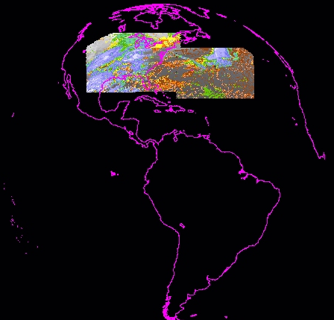
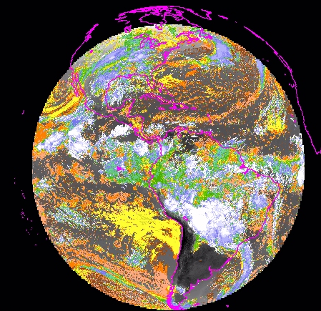
Much improved spatial coverage (at more times) with ABI over the current Sounder
Legacy GOES Sounder coverage in one hour
ABI in 15 minutes
CIMSS
Notes:
ABI provides more data than the GOES Sounder both spatially and temporally. This image compares the near-global coverage for ABI LAP products (up to 67 degrees local zenith angle) to current GOES Sounder. LAP products give far better spatial coverage more frequently than the GOES Sounder.

Slide 7
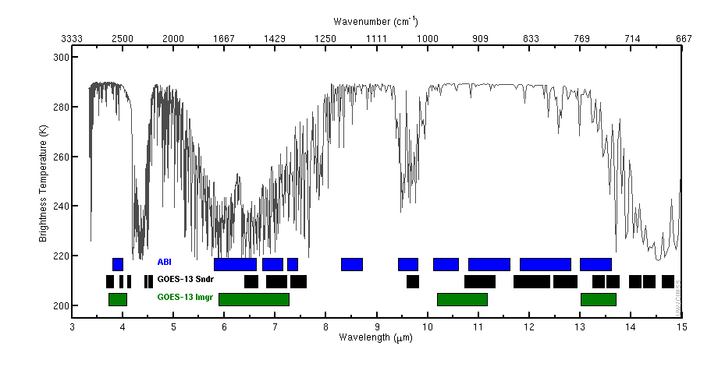
This figure shows channels for ABI, GOES-13 Sounder and GOES-13 Imager
3.9
6.2 7.0 7.4
8.4
9.7
10.3
11.2
12.3
13.3
4.4
3.7 4.1 4.6
6.5
7.5
9.7
11.0 12.0 12.7 13.4 14.1 14.7
4.0 4.5
7.0
13.7 14.3
3.9
6.5
10.7
13.3
Notes:
This slide depicts the channels present on the GOES-R ABI, on the present GOES Sounder, and on the present GOES Imager. The present GOES Sounder does a better job of sensing temperature because of the abundance of CO2 channels around 4-4.5 microns, and around 14.4 microns. ABI and GOES Sounder do have similar moisture-sensing channels, as shown here, so moisture retrievals from ABI and the GOES Sounder are similar. ABI channels are spectrally broad (compared to the more narrow GOES Sounder spectrum)…thus, ABI retrievals will smooth over features that have small vertical scales. The GOES Sounder with its more spectrally narrow windows is better able to resolve such features. There are two channels on ABI that aren't on the GOES Sounder: 8.4, which is in a region where SO2 absorption can be important and 10.3, the clean window channel.

Slide 8
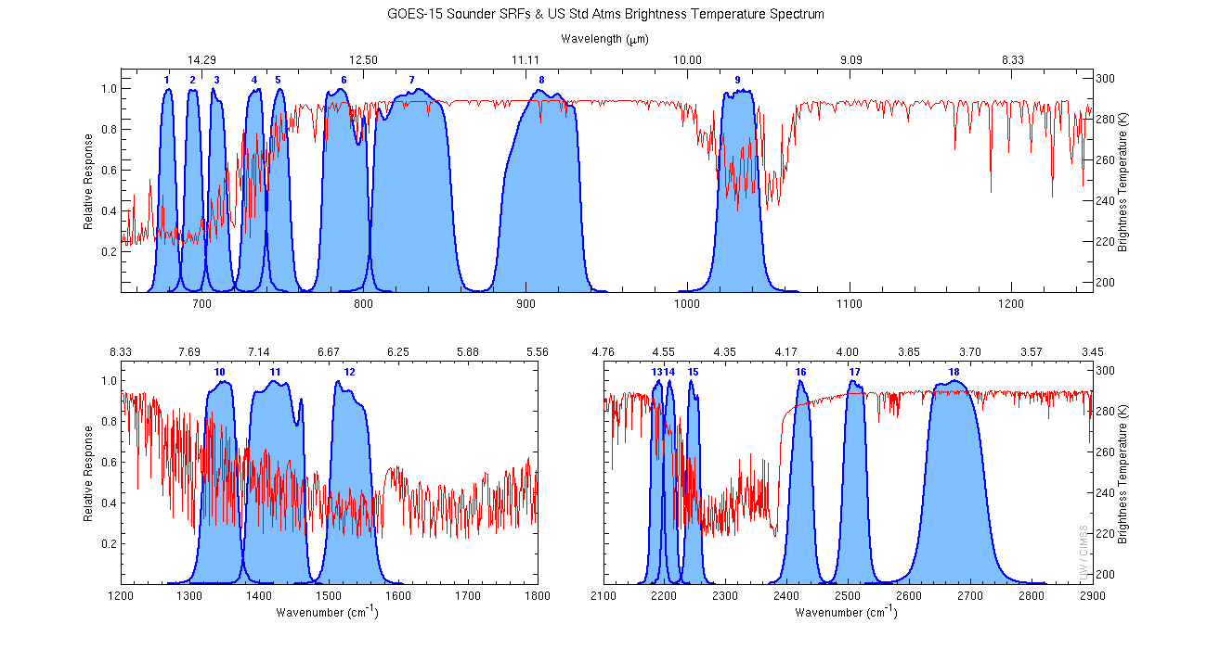
GOES-15 Sounder Spectrum
14.7
14.1
13.4
14.4
13.7
12.7
12.0
11.0
9.7
7.4
7.0
6.5
4.6
4.5
4.4
4.1
4.0
3.7
Notes:
This shows the spectral response function for the GOES-15 Sounder channels (which are very similar to GOES-13) on top of the brightness temperature spectrum drawn in red. Where that spectrum is not near 1, absorption by gases is occurring: Ozone around 9.7 micron, water vapor around 6.5 microns, and CO2 aounrd 4.4 and 14.4 microns. As noted on the previous slide, GOES Sounder has many channels longer than 13.4 microns and between 4 and 4.5 microns, and those CO2 channels help the Sounder's Temperature sounding abilities.

Slide 9
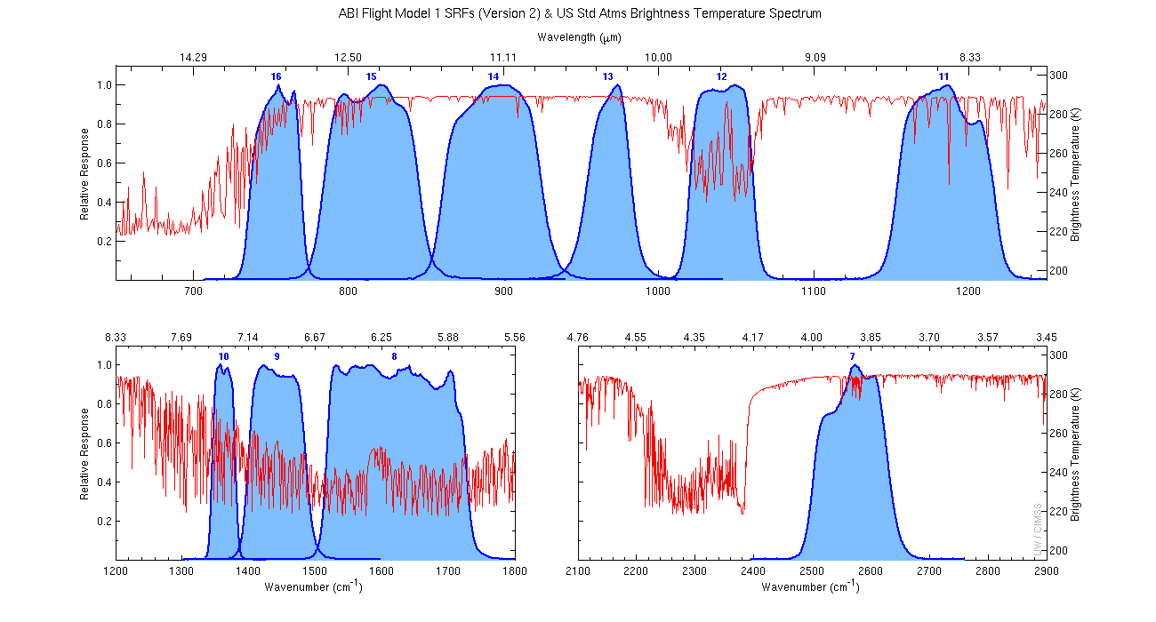
GOES-R Advanced Baseline Imager Spectrum
13.3
12.3
11.2
10.3
9.6
8.4
7.3
6.9
6.2
3.9
Notes:
ABI does not have those CO2 channels. It does have fairly broad channels in the water vapor absorption region, however, so that moisture can be sensed with about the same abililities as the GOES Sounder.

Slide 10
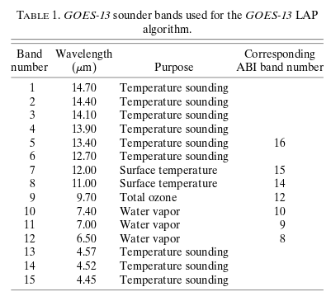
Text Summary of previous slide
Note: ABI has fewer temperature channels than current GOES Sounder
Water vapor channels are equivalent on the two instruments
Conclusion: GOES-Sounder better measures tropospheric temperature. Moisture measurements are similar
Notes:
This summarizes the previous slides. ABI and GOES Sounder have similar water vapor channels, GOES Sounder has more temperature sounding channels.

Slide 11
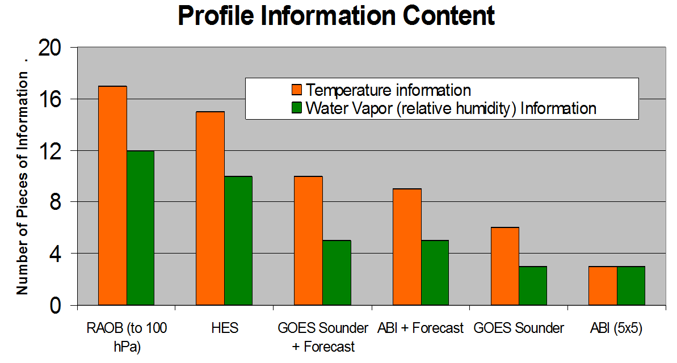
Sounder vs. ABI
The moisture content is similar between the ABI and the current GOES Sounder.
ABI is not a sounder – it has limited temperature information in the vertical so ABI retrievals need to use the NWP forecast as a background field.
Notes:
To increase information, ABI data are used in concert with model simulations. How many layers of information do you have when you use only ABI? Not many. But by using Forecast information and GOES-R ABI data, you can get information comparable to that from forecast + GOES Sounder: about 5 layers in moisture. Temperature information from ABI is not as good as from the Sounder. A Hyperspectral sounder such as HES, which was removed from GOES-R as a cost-savings move, would have given even more layers of information.

Slide 12
Algorithms: Regression & Physical Retrieval
Uses all (IR) wavelengths > 3.9 μm (But not 3.9 μm, to avoid solar contamination)
Uses ABI Clear Sky Mask for Clear/Cloudy identification
Clear Sky: LAP Baseline Algorithm
Regression: Numerical Model Output that is temporally and spatially interpolated to Fields of Regard (FORs) and Least Squares related clear sky ABI Radiances and Forecast Profiles
Physical Retrieval: Compares observed radiances to those calculated in forward Radiative Transfer Model, minimizes the difference in the profile – iteratively adjusts temperature and moisture.
Cloudy Sky: GOES-R Risk Reduction (R3) algorithm
Regression: Numerical Model (GFS) Output that is temporally and spatially interpolated to Fields of Regard (FORs), and Least Squares related cloudy sky ABI Radiances and Forecast Profiles
Non-retrieval area: filled with first guess (GFS)
Generally Available
Note: Not Generally Available
Notes:
temperature information that is missing in the GOES-16 ABI compared to the Sounders of the past is incorporated into Baseline and All-Sky products by using GFS information as a starting point in the regression. Legacy Atmospheric Profiles incorporate both a regression and a retrieval. The regression uses best-fit coefficients designed to give the best match (statistically) between the radiances and the temperature/moisture profiles. Then the observed radiances are compared to those generated in a Radiative Transfer Model, and the retrieval minimizes the difference in the profile.

Slide 13
GOES-16 ABI All-Sky LAP Profiles
5x5 Pixel fields of view (~ 10km)
The All-Sky products combine GFS Information and ABI IR band radiances in Cloudy Regions
Use baseline cloud mask to distinguish clear from cloudy (Baseline products are clear sky only)
All-Sky Clear Sky Pixels: Baseline algorithms
But All-Sky Clear Retrieval includes surface information from RAP
Cloudy Sky Pixels: Cloudy Retrieval Algorithm Used
All-Sky Cloudy Retrieval includes surface information from RAP
GFS Used where Cloudy Retrieval does not converge
Precision of LAP Clear Sky
LI 6.5 K ; CAPE 2500 J/kg ; TPW 3 mm
Cloud Type variable tells you whether you have a Clear Sky answer vs. a Cloudy answer vs. the GFS First Guess.
Products are available every 30 minutes
Notes:
GOES-16 LAP Profiles use 5x5 Pixel fields of view -- nominally 10km resolution at the sub-satellite point. Training on the Baseline Product is available at the link that goes to the Satellite Foundational Course for GOES-R .
The All-Sky version of the LAP Products uses GFS as a first guess, and clear sky and cloudy retrievals give information in clear and cloudy regions respectively. If both Clear and Cloudy Retrievals fail, the GFS solution falls out as the retrieval. The Cloud Type variable tells you which value is plotted.
These products are available at HWT every 30 minutes.

Slide 14
Why do you want All Sky Products?
Convective Instability might be building in regions where clouds are present

Slide 15
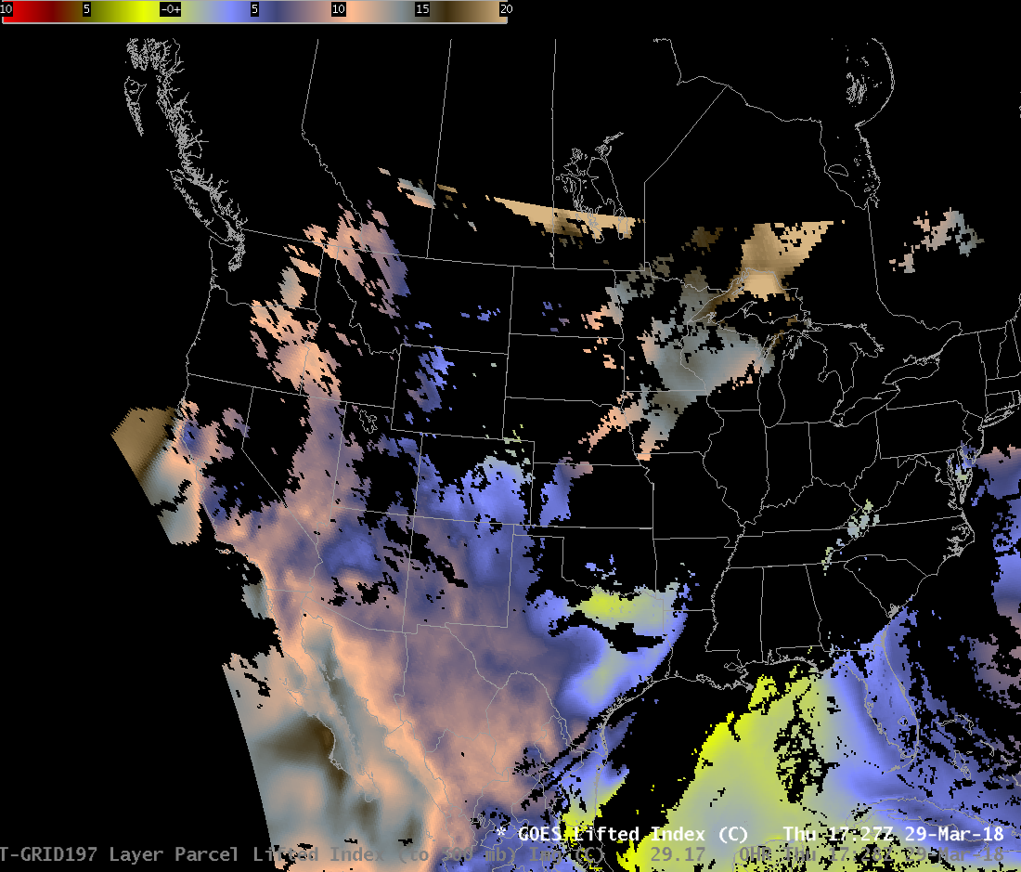
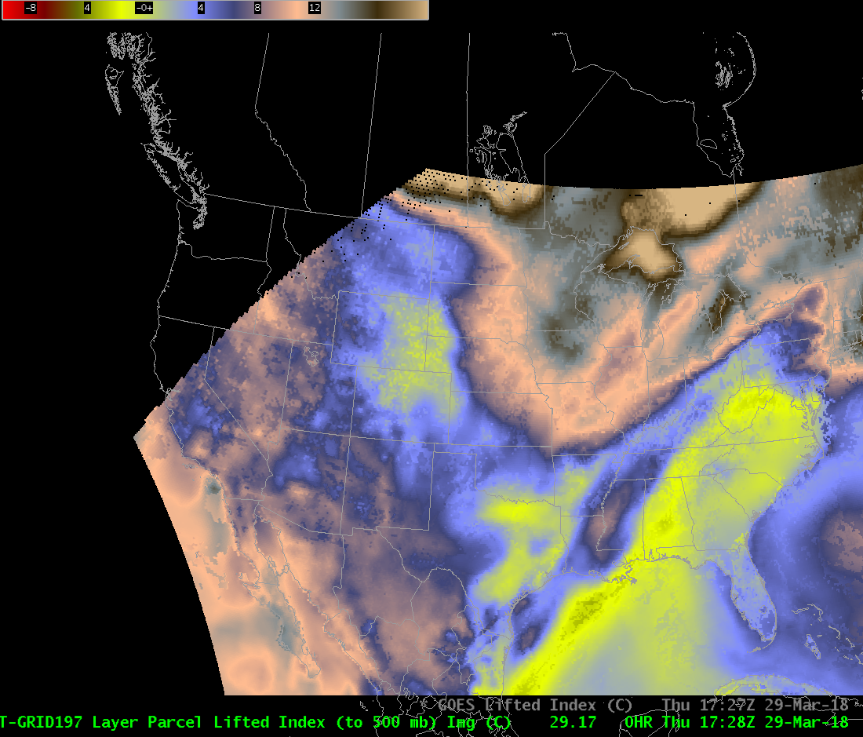
Baseline and All Sky Lifted Index
Baseline
All Sky
The All-Sky versions have been tested at HWT, but in general are not available.
You have to use your innate meteorological knowledge (or other datasets) to fill in the gaps
Notes:
This figure compares Baseline Lifted Index and AllSky Lifted index on a different day.
Baseline LI also has no values in cloud skies. The inset shows that All Sky products have values from the Clear Algorithm (purple), the Cloudy Algorithm (Orange) and the GFS (Grey). Load up the Cloud Type Grid as an image to recreate this scene.
LI can be handy to use because it tells you something about the stability too, not just the instability!

Slide 16
Clear-Sky v. All-Sky
For now – only Clear Sky Products (the Baseline) are generally available

Slide 17
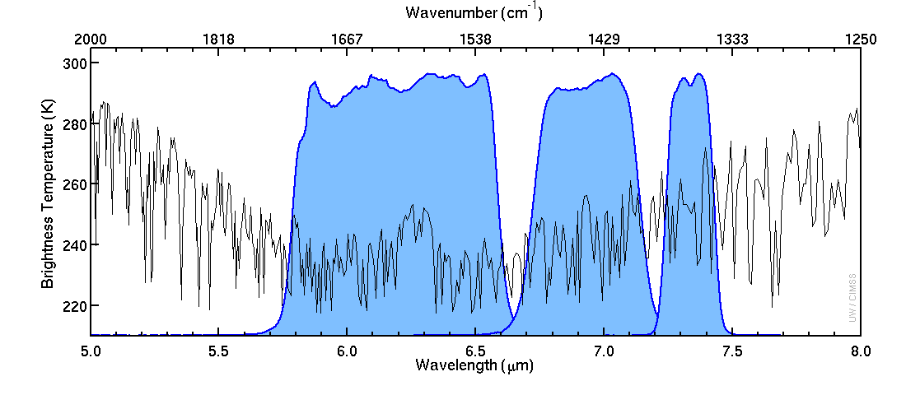
Water Vapor Spectral Response Functions
Blue Region: part of spectrum sensed by satellite
warm
6.19 μm
6.95 μm
7.34 μm
Brightness Temperature (K)
cold
Band 8
Band 9
Band 10
Black Line: Satellite-sensed temperature above the US Standard Atmosphere in Clear Skies
Notes:
Let’s zoom in on the Water Vapor part!

Slide 18
What can Water Vapor tell you?
6.19 μm
“Upper-level
Water Vapor”

Slide 19
What can Water Vapor tell you?
7.34 μm
“Low-Level
Water Vapor”
At what level in the atmosphere are those brightness temperatures occurring?
That’s what Weighting Functions can tell you!

Slide 20
Are there any Questions / Comments?
I put this slide in here so if I’m on a roll speaking wise, this interrupts me
Ask a question!

Slide 21
Weighting Functions tell you where information originates
http://cimss.ssec.wisc.edu/goes/wf
Includes Mexican and Canadian stations

Slide 22
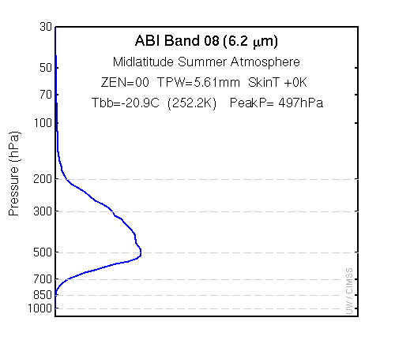
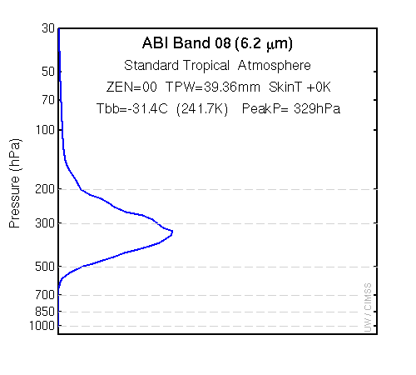
Consider Theoretical Atmospheres
Dry Atmosphere: More information to satellite originates from lower in the atmosphere

Slide 23
Weighting Functions in Theoretical Atmospheres
http://cimss.ssec.wisc.edu/goes/wf/examples/abi.html

Slide 24
Weighting Functions in Theoretical Atmospheres
http://cimss.ssec.wisc.edu/goes/wf/examples/abi.html
Band
Atmosphere
Skin Temperature
Adjustment
Zenith Angle
Column Moisture

Slide 25
Band 7, Standard Tropical Atmosphere

Slide 26
Band 8, Standard Tropical Atmosphere

Slide 27
Band 9, Standard Tropical Atmosphere

Slide 28
Band 10, Standard Tropical Atmosphere

Slide 29
Band 11, Standard Tropical Atmosphere

Slide 30
Band 12, Standard Tropical Atmosphere

Slide 31
Band 13, Standard Tropical Atmosphere

Slide 32
Band 14, Standard Tropical Atmosphere

Slide 33
Band 15, Standard Tropical Atmosphere

Slide 34
Band 16, Standard Tropical Atmosphere

Slide 35
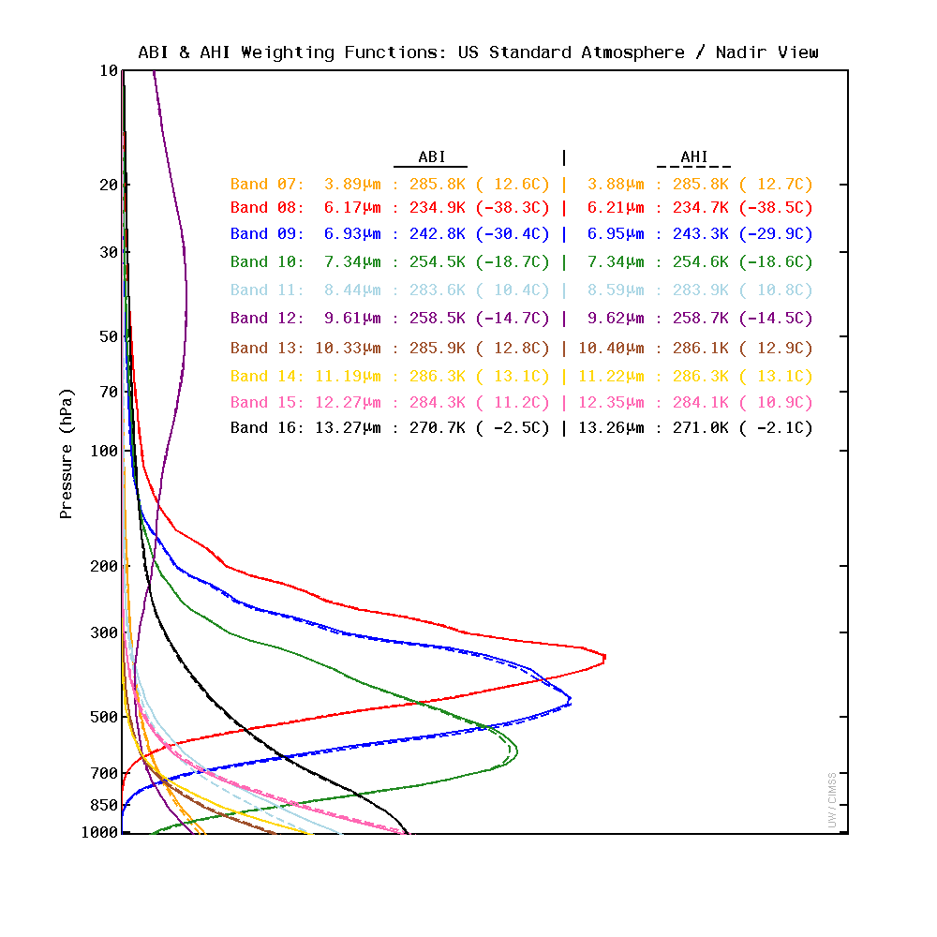
All the Weighting Functions on one slide
All 10 IR channels on
ABI and AHI

Slide 36
Did you notice?
Most ABI Channels are window channels – they see the surface. There isn’t a lot of temperature information in the mid-troposphere from ABI Channels.
This is different from the GOES-13/-14/-15 Sounder that had CO2 channels around 4.5 μm and 14.4 μm
Water Vapor channels give information about temperature and moisture in mid-troposphere.
Ozone Channel gives upper-tropospheric/stratospheric temperature information
CO2 channel gives information about lower troposphere

Slide 37
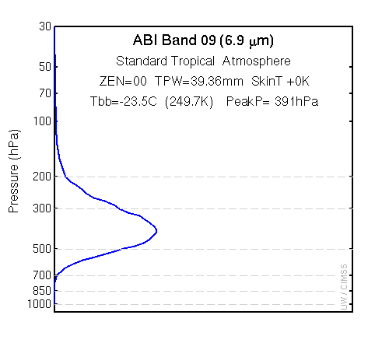
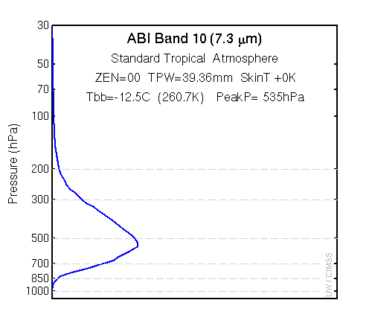
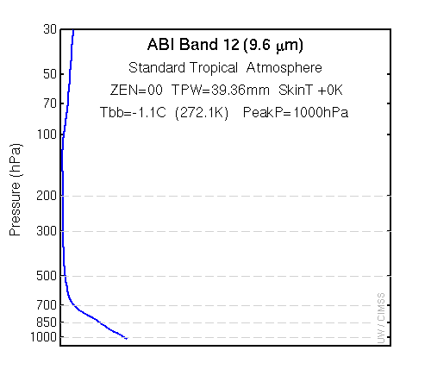
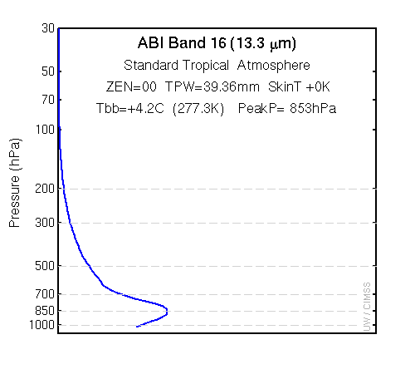
Did you notice?
CO₂ Channel gives some
information in lower troposphere
Ozone Channel gives some
information in stratosphere
3 Water Vapor Channels give mid-tropospheric information

Slide 38
What happens if you warm the surface?
http://cimss.ssec.wisc.edu/goes/wf/examples/abi.html
Looking at the effects in Bands 7, 8, 10, 13, 15
(3.9 μm, 6.2 μm, 7.3 μm, 10.3 μm, 12.3 μm)
Still the Standard Tropical Atmosphere, but Skin Temperature has been boosted by 10 K
How will this change the computed brightness temperature?

Slide 39
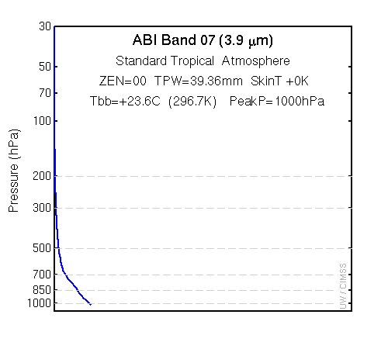
Band 7
Change in Skin Temperature means a big change in Brightness Temperature

Slide 40
Band 8
Change in Skin Temperature but no change in Brightness Temperature

Slide 41
Band 10
Change in Skin Temperature but no change in Brightness Temperature

Slide 42
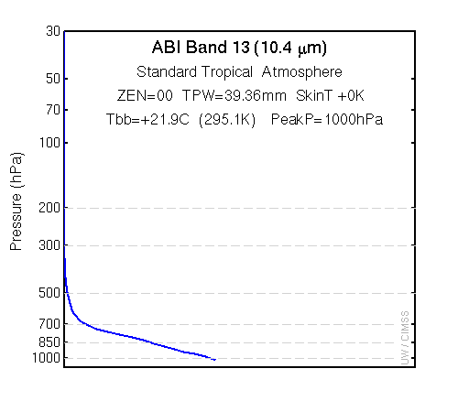
Band 13
Change in Skin Temperature means some change in Brightness Temperature
not as big a change as at 3.9

Slide 43
Band 14
Change in Skin Temperature means a small change in Brightness Temperature

Slide 44
Change in Zenith Angle
http://cimss.ssec.wisc.edu/goes/wf/examples/abi.html
Zenith Angle
of 0º and 45º

Slide 45
Band 7

Slide 46
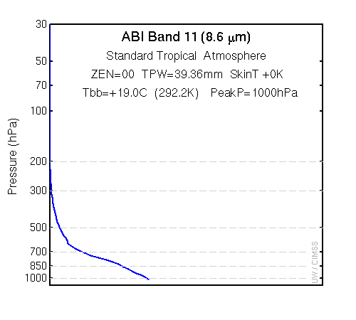
Band 12

Slide 47
Band 16

Slide 48
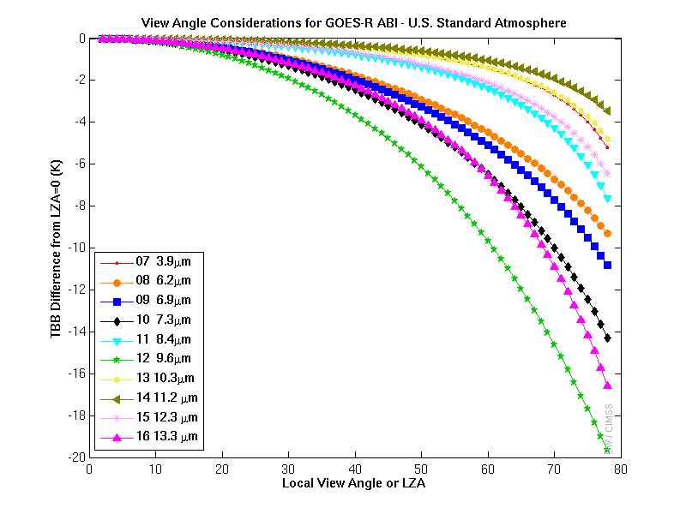
Change in Brightness Temperature vs. Angle
6.19 μm
6.9 μm
7.3 μm
13.3 μm
9.6 μm
Legacy Profiles only go to a Local Zenith Angle of 67

Slide 49
For Water Vapor: What level for the information?
Dry Atmosphere: Information comes from lower in the atmosphere
Far from sub-satellite point: Information comes from higher in the atmosphere
Longer Wavelength: Information comes from lower in the atmosphere
When is the Water Vapor channel a window channel? In a very dry atmosphere – especially over terrain!
Baseline Algorithms that use ABI information know all of this!

Slide 50
Water Vapor
What does the GOES-16 ABI water vapor distribution tell you about moisture in the atmosphere?

Slide 51
Water Vapor and Moisture

Slide 52
Water Vapor and Moisture
Moist
Note that values do not extend to the edge

Slide 53
Water Vapor and Moisture

Slide 54
LAP Specs
Created with a 5x5 footprint to match 10-km GOES Sounder Resolution
Requirements: Hourly (Full Disk), half-hourly (CONUS) or every 5 minutes (Mesoscale domain) (Reality: 15 minutes (FD), 5 minutes (CONUS), 1 minute (Meso) – that is, with every scan!)
GFS Information is used as a first guess
Data produced up to Solar Zenith Angle of 67º (Just Poleward of the Arctic Circle)
Vertical Resolution: 3-5 km
Accuracy (How close to correct?)
RH : ~20%; LI 2 K ; CAPE 1000 J/kg ; TPW 1 mm
Precision (How close to repeatable?)
RH : ~20%; LI 6.5 K ; CAPE 2500 J/kg ; TPW 3 mm
The Baseline Product is Clear Sky Only. An Experimental ‘All-Sky’ Product has been developed
Notes:
Legacy Atmospheric Profiles are created with an ABI footprint of 5x5 pixels so there are 25 ABI pixels in each LAP footprint. LAP products have spatial resolutions similar to present the GOES Sounder. Values are created hourly over the Full Disk Domain, every 30 minutes in the CONUS domain, and every 5 minutes for MESO scans. The first guess fields used in creating Legacy Atmospheric Profiles are from the GFS forecast. The accuracy of the products is noted at the bottom. Similar to GOES Sounder DPI products available now, LAP Products are Clear-Sky only - but an All-Sky product that is valid in clear and cloudy regions has been developed.

Slide 55
Regression and Retrieval
Regression uses static coefficients that give the best statistical relationship between observed temperature/ moisture/ozone/emissivity/surface temperature given GFS first guess. This creates a first guess field for a Radiative Transfer Model (RTM)
Retrieval minimizes the difference between First guess (Regression) and RTM driven by observations directly.
For more details see ATBD link at end of training
Notes:
The first step to produce Profiles: A Regression that uses coefficients that were trained to give the best statistical relationship between observed temperature, moisture, surface temperature & emissivity and ozone. First guess: GFS data. Then the retrieval uses a radiative transfer model; differences between the regression values and RTM values are minimized during the retrieval step. Further technical details are available in the Advanced Theoretical Basis Document linked at the end of the this training.

Slide 56
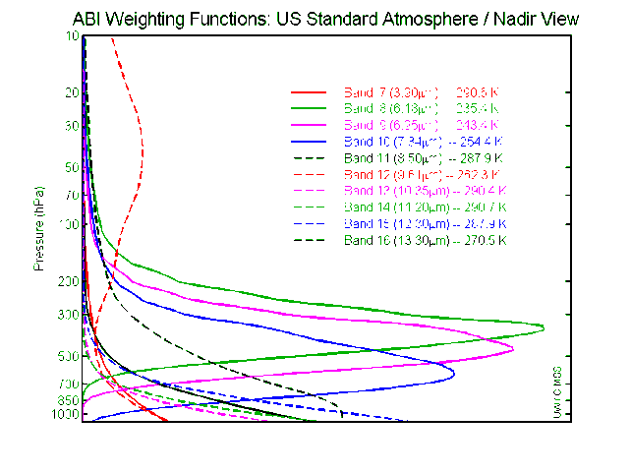
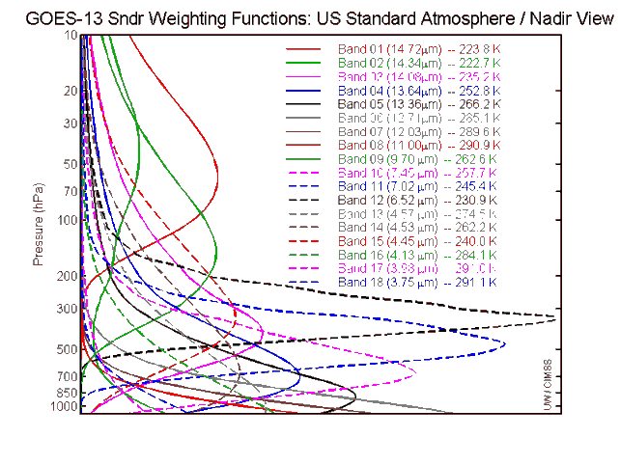
LAP Limitations
LAP and derived products are available over “clear” Fields of Regard (FORs), meaning 20 (out of 25) or more clear Fields of View (FOV)
ABI IR band emissivities are from a monthly dataset. Temporal variability is negligible in those datasets.
Surface roughness and skin temperature are assumed homogeneous
The iterative physical retrieval is computationally expensive; an increase in FOR width could be necessary for large region processing
Forecast temperature is hard to improve with ABI because ABI channels do not sense temperature at many different levels
Weighting functions tell you where information originates
GOES-R ABI
GOES-NOP Sounder
Notes:
Clear-Sky LAP Products are only produced when at least 20 of the 25 fields of regard (in the 5x5 pixel set) have clear fields of view.
Other specs on LAP generation are listed on this slide.
Weighting functions for the GOES-R ABI show few peaks above the surface, LAP profiles therefore struggle to improve on the GFS representation of temperature. There is mid-tropospheric moisture information in ABI in the form of three water vapor channels. Thus there is improvement in the moisture field, as we'll see shortly.

Slide 57
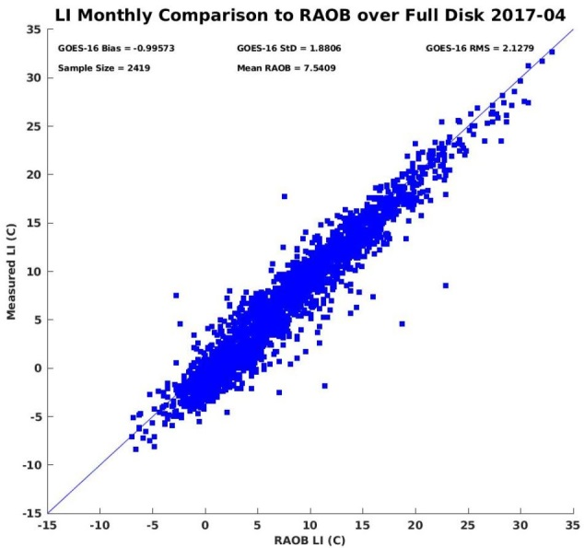
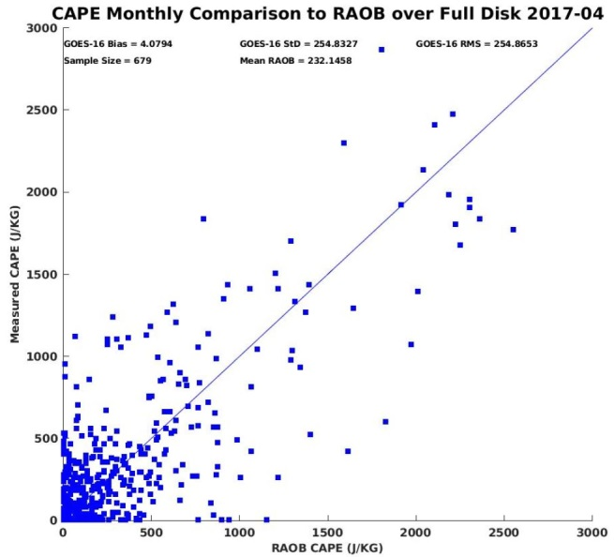
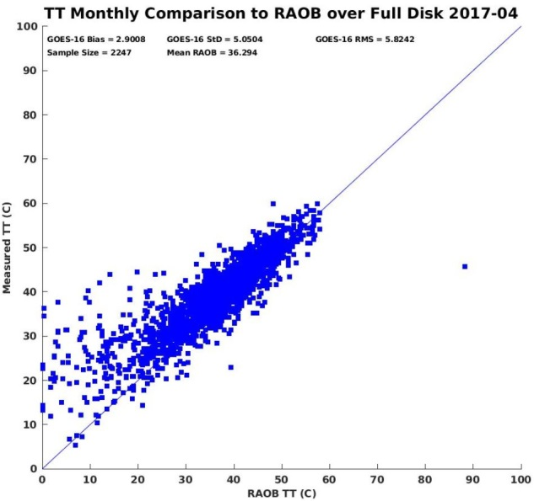
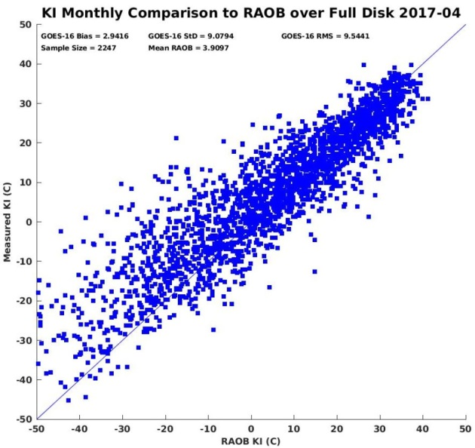
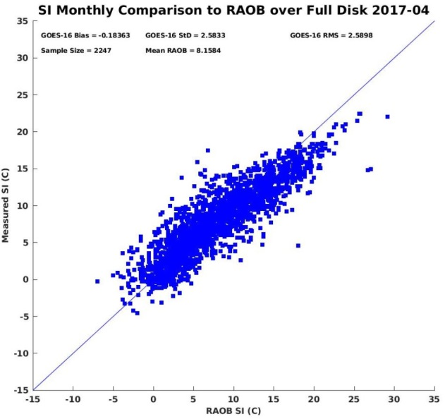
LAPS Profile Values compared to Radiosonde data – April 2017
LI
CAPE
TT
Accuracy: -1.00
Precision: 1.88
Sample Size: 2419
Accuracy: 4.08
Precision: 254.83
Sample Size: 679
Accuracy: 2.90
Precision: 5.05
Sample Size: 2247
KI
SI
Values might have errors – but the gradients and changes with time are consistent
Accuracy: 2.94
Precision: 9.08
Sample Size: 2247
Accuracy: -0.18
Precision: 2.58
Sample Size: 2247
Notes:
These plots compare Derived Stability Indices (DSI) -- Lifted, CAPE, Total Totals, K and showalter -- to values computed from RAOBS over CONUS in April 2017. There may be differences between LAPs values and RAOB values, but bias is low, so information about gradients and temporal changes will be consistent.

Slide 58
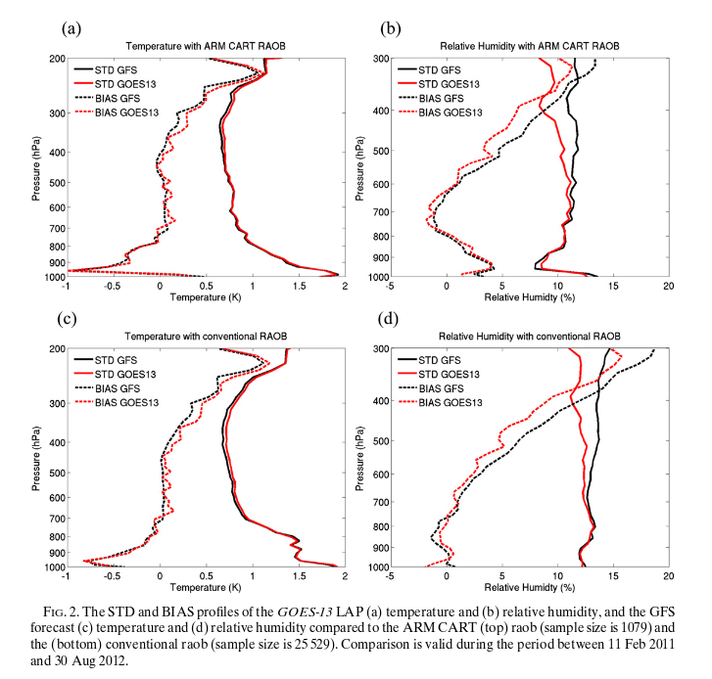
Bias Corrections
Satellite Retrievals do not improve temperature
because temperature is already very accurate
Satellite Retrievals do improve moisture between
700-300 mb – where observations occur
Notes:
LAP Temperature profiles -- on the left -- offer no significant improvement over GFS. Bias and Standard deviations are mostly the same. A conclusion might be: Temperature in GFS is well-predicted
There are improvements - lower bias - for moisture however, shown on the right. That improvement is mostly in the middle/upper troposphere where observations of water vapor are taken by the satellite.

Slide 59
Bias Corrections
Satellite Retrievals do not improve temperature
because temperature is already very accurate
Satellite Retrievals do improve moisture between
700-300 mb – where observations occur
(Think about Water Vapor Weighting Function!)
(And the number of water vapor channels!)
Notes:
How do you know that’s where the observations in the WV channel are valid? Because the weighting function for those channels tells you that.

Slide 60
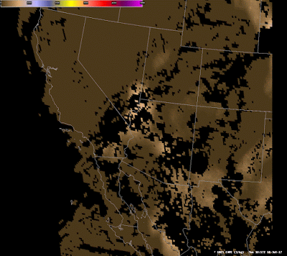
What is good about LAP Profiles
Gradients, Changes in Values
LAP data has been tested extensively at the Hazardous Weather Testbed held each Spring at the Storm Prediction Center
http://goesrhwt.blogspot.com/search/label/GOES-R%20LAP

Slide 61
How can you use Derived Stability Products?
Things happen along the edges – at gradients. This has been documented at the Hazardous Weather Testbed many times
If you are in a region of few surface observations, data from CAPE, or LI, or TPW can give you a guess on the surface dewpoint distribution
Time Tendencies are useful: How quickly is the atmosphere destabilizing?

Slide 62
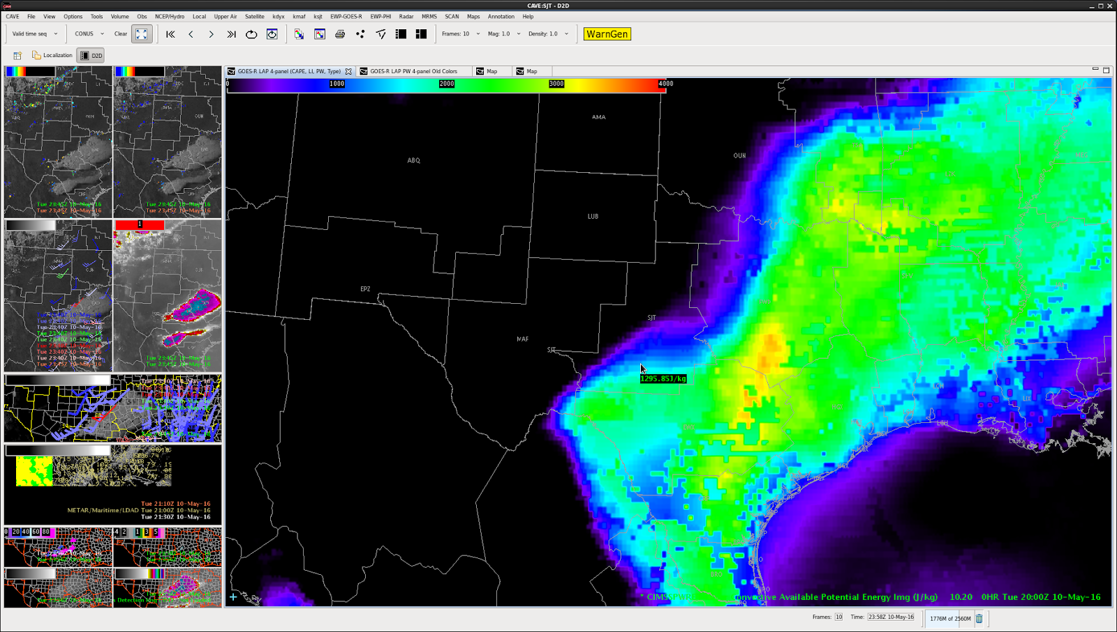
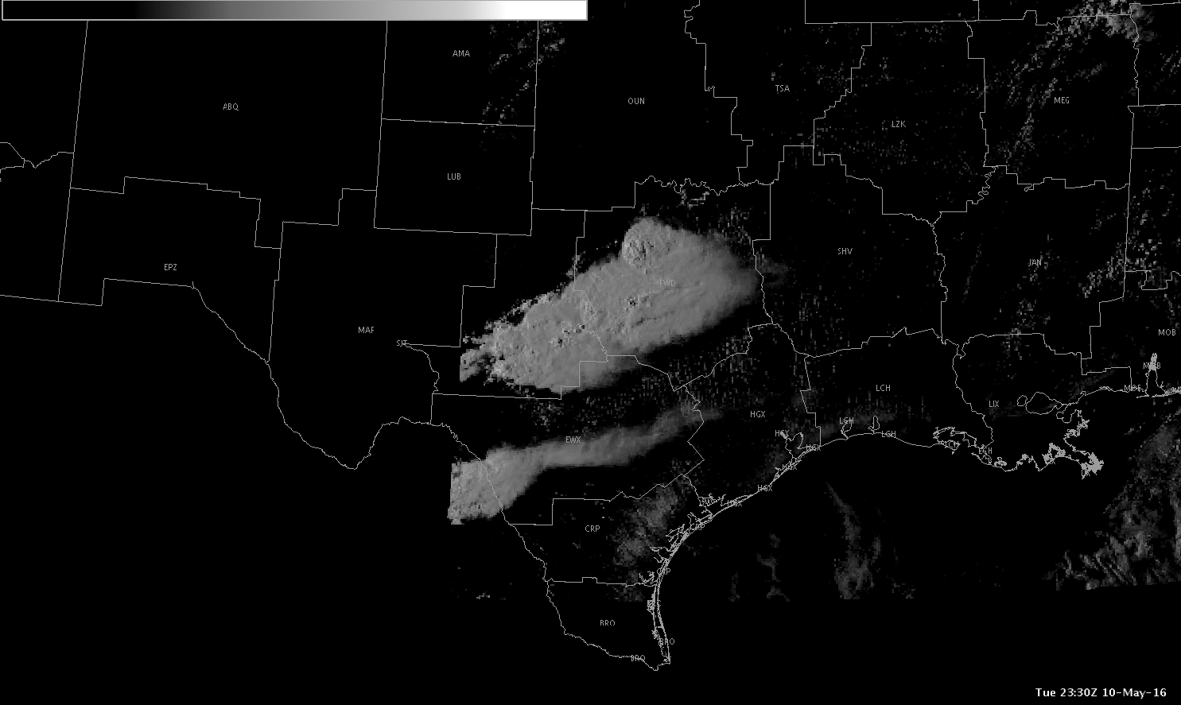
How can you use Derived Stability Products?
Focus on the Gradients
2000 UTC
CAPE (All-Sky)
2330 UTC
Notes:
There are many examples at the goesrhwt blog that document the development of convection along the gradient of CAPE. Be alert to that possibility.

Slide 63
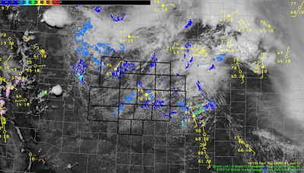
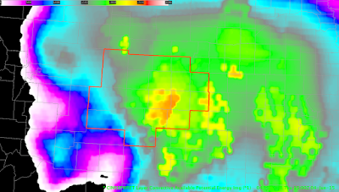
How can you use Derived Stability Products?
Not many observation sites in this CWA. LAP CAPE estimates what surface observations might be
Notes:
If your WFO has no surface observation sites, perhaps you can use All-Sky LAP data to approximate the surface conditions in a region without observations. There is likely a dewpoint gradient at the surface here, and All-Sky products do include surface information in the form of RAP data that are used in the All-Sky regression and retrieval.

Slide 64
GOES-16 Profiles of Moisture in AWIPS
Vertical Profiles of Temperature /Moisture from 0600 to 1700 UTC on 30 July 2018
CAPE analyses from SPC ended up around 2000 J/kg
LAP CAPE didn’t show any gradients

Slide 65
What weather occurred?
Visible Imagery shows convective development over southern WI as the GOES-16 Soundings destabilized

Slide 66
03 August 2018

Slide 67
03 August 2018

Slide 68
03 August 2018

Slide 69
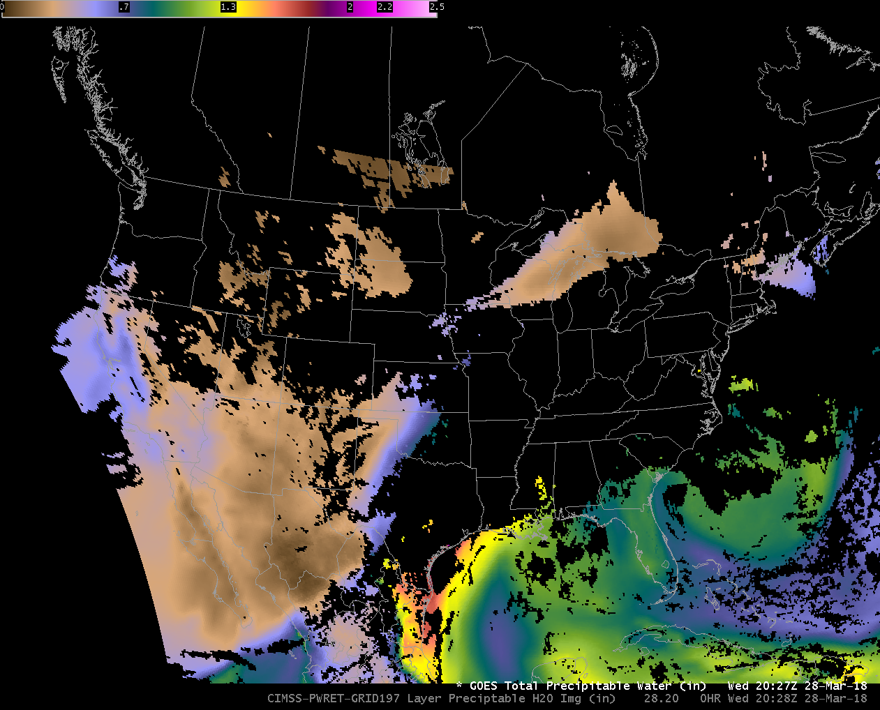
GOES-16 ABI Baseline TPW
Of course: Clear Sky Only!
Notes:
The baseline Product is Total precipitable Water, and here it is over CONUS at 2027 UTC on 28 March 2019. The Baseline product includes no information where the clear sky mask identifies clouds. But you still have moisture information about where deep moisture might be, and especially where dry air is.

Slide 70
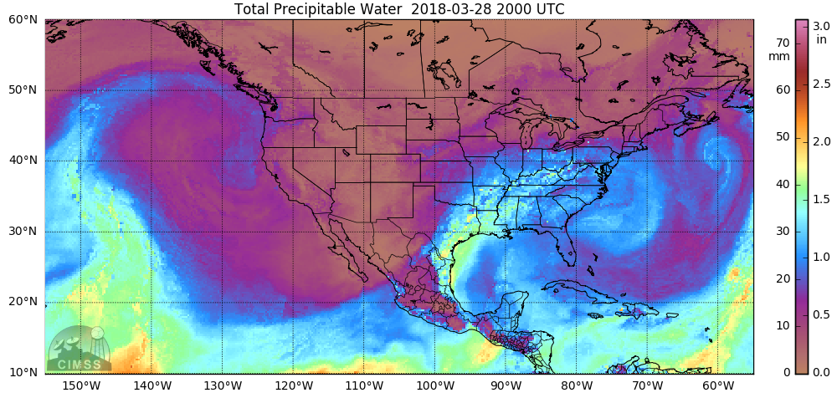
Microwave TPW Products see through clouds
MIMIC TPW
Notes:
MIMIC Microwave-only polar-orbiter TPW also shows similar features.

Slide 71
Discussion / Questions
Next up: How to find Data

Slide 72
GOES-16 Data Sources

Slide 73
Data Sources

Slide 74
Data Sources

Slide 75
Data Sources

Slide 76
Data Sources

Slide 77
Data Sources

Slide 78
Data Sources

Slide 79
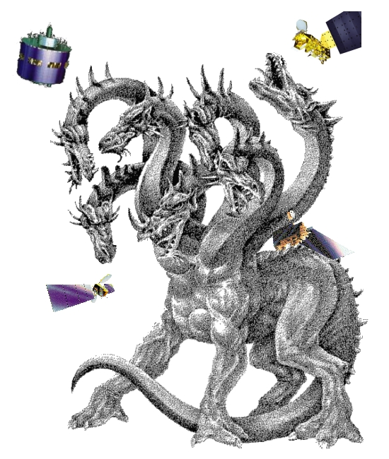
Once you get the email….
Download the netCDF file and display it
McIDAS-V
HYDRA
AWIPS

Slide 80
Legacy Atmospheric Profile data online
http://soundingval.ssec.wisc.edu

Slide 81
Imagery at soundingval.ssec.wisc.edu

Slide 82
Lifted Index from soundingval site
What does this suggest?
A corridor of instability
Where should we look for convective development?

Slide 83
GOES-16 ABI Band 2
2242 UTC
2 Aug 2018

Slide 84
GOES-16 ABI Band 2
0042 UTC
3 Aug 2018

Slide 85
Region Plots at soundingval.ssec.wisc.edu

Slide 86
Daily Comparison to actual data

Slide 87
Validation at a point compared to Radiosondes

Slide 88
There are other sources for Vertical Profiles
NOAA-Unique Combined Atmospheric Processing System (NUCAPS) Soundings
Combines CrIS and ATMS data (Suomi-NPP and NOAA-20)
Combines IASI and MHS/AMSU data (MetOp-A and MetOp-B)
CrIS and IASI are Atmospheric Sounders (1000s of channels) that view different levels in the atmosphere – vs Imagers that view through the atmosphere)
MIRS (Microwave Integrated Retrieval System) Soundings

Slide 89
NUCAPS data
NOAA-Unique Combined Atmospheric Profiling System
Combines CrIS data and ATMS data (on Suomi NPP and NOAA-20)
Training Video
Link to vertical profiles from NOAA/OSPO (on a US/Mexico Map)
Link to horizontal maps of NUCAPS variables

Slide 90
NUCAPS Sounding Points online

Slide 91
NUCAPS Sounding Points

Slide 92
You can find other NUCAPS data online as well

Slide 93
Choose NUCAPS Gridded Temperature
Daily composites of NUCAPS levels at approximately mandatory levels

Slide 94
NUCAPS Granules are available
What I haven’t found yet:
Horizontal maps of gridded convective parameters
These will be in AWIPS at some point in the future

Slide 95
MIRS data
Microwave Integrated Retrieval System
Microwave Data unaffected by Clouds (but it has limited spatial resolution)
Many different moisture-related variables are available, and these are global analyses.
Daily MIRS plots

Slide 96
MIRS data here

Slide 97
MIRS Temperature Plots
From Different Satellites

Slide 98
MIRS Moisture Profiles
From Different Satellites

Slide 99
MIRS Moisture Profiles
From Different Satellites

Slide 100
Microwave-derived Total Precipitable Water
You can also view layers

Slide 101
Microwave-derived Total Precipitable Water
700-850 mb

Slide 102
NOAA/NESDIS Blended TPW
GOES Sounder
Microwave Data
GPS

Slide 103
NOAA/NESDIS Percent of Normal TPW
This is very handy – when you see yellow you often see flooding!

Slide 104
Points of Contact
Scott Lindstrom
scott.lindstrom@noaa.gov
608 263 4425

Slide 105
Summary
GOES-R Baseline Products include estimates of moisture and stability
Total Precipitable Water; CAPE; LI
Because ABI is an Imager – not a Sounder – Baseline Products incorporate model data to allow a better representation of the satellite-observed atmosphere
There isn’t a lot of mid-tropopsheric temperature information in the ABI
Moisture information in the ABI is comparable to the legacy Sounder
Sounders on Polar Orbiters have far better vertical resolution, and the observations are not model-constrained!

Slide 106
Summary, part II
Baseline Products can be found online
http://soundingval.ssec.wisc.edu
NOAA Class for historical data
There are many ways to find Polar Orbiter estimates of moisture online
Thank you for your attention
Questions?
scott.lindstrom@noaa.gov

Slide 107
Acronyms
ABI | Advanced Baseline Imager
AIT | Algorithm Integration Team
AOS | Advanced Orbiting Systems
AWIPS
BDP | Big Data Project
CBU | Consolidated Backup
CCSDS | Consultative Committee for Space Data Systems
CMI | Cloud Moisture Imagery
DADDS | DCS Administration and Data Distribution System
CFDP | CCSDS File Delivery Protocol
CICS-NC | NOAA Cooperative Institute for Climate and Satellites – North Carolina
CIMSS | Cooperative Institute for Meteorological Satellite Studies

Slide 108
Acronyms
CIP | Critical Infrastructure Protection
CLASS | Comprehensive Large Array-data Stewardship System
DRO | Direct Readout
DVB-S2 | Digital Video Broadcasting
DCS | Data Collection System
DoD | Department of Defense
EIRP | Equivalent Isotropically Radiated Power
EOC | Edge of Coverage
ESPC | Environmental Satellite Processing Center
ESPDS | Environmental Satellite Processing and Distribution System

Slide 109
Acronyms
EXIS | Extreme Ultraviolet and X-ray Irradiance Sensors
FEC | Forward Error Correction
FEP | Front End Processor
GLM | Geostationary Lightning Mapper
GNC-A | GEONETCast Americas
GOES | Geostationary Operational Environmental Satellites
GRB | GOES Rebroadcast
GVAR | GOES Variable
G/T | Antenna gain-to-noise-temperature
GTS | Global Telecommunication System (GTS)
HRR | Handover Readiness Review
JPSS | Joint Polar Satellite System
KPP | Key Performance Parameter

Slide 110
Acronyms
HRIT/EMWIN | High Rate Information Transmission/ Emergency Managers Weather Information Network
LNA | Low Noise Amplifier
LZSS | Level Zero Storage System
NESDIS | National Environmental Satellite, Data, and Information Service
NHC | National Hurricane Center
NOAA | National Oceanic and Atmospheric Administration
NSOF | NOAA Satellite Operations Facility
NWS | National weather Service
OSPO | Office of Satellite and Product Operations
PDA | Production Distribution and Access
PLT | Post Launch Test
PUG | Product Definition and Users’ Guide
PS-PVR | Peer Stakeholder – Product Validation. Reviews

Slide 111
Acronyms
NDE | NPP Data Exploitation
PLPT | Post Launch Product Testing
QC | Quality Control
SCMI | Sectorized Cloud and Moisture Imagery
SEISS | Space Environment In-Situ Suite
S-NPP | Suomi National Polar-orbiting Partnership
SSEC | Space Science and Engineering Center
SUVI | Solar Ultraviolet Imager i
WCDAS | Wallops Command and Data Acquisition Station
XPI | Cross-Polarization Interference

