Slide 1
Cloud Phase Difference (11.2 μm – 8.4 μm)
Quick Brief
Contributor:
Scott Lindstrom
UW Madison SSEC/CIMSS
Notes:
This Quick Brief will describe why the 11.2 micrometer – 8.4 micrometer Cloud Phase Brightness temperature Difference works and how you can user it. I'm Scott Lindstrom from CIMSS.

Slide 2
Cloud Phase Difference (11.2 μm – 8.4 μm)
Quick Brief
There are three main physical effects that influence this brightness temperature difference field
Different amounts of water vapor absorption at the two wavelengths (in clear skies)
Different amounts of absorption by clouds at the two wavelengths
Different influence on the brightness temperature at 11.2 μm (colder part of the pixel is important) and 8.4 μm (warmer part of the pixel is important)
Notes:
There are three main reasons that brightness temperatures at 8.4 and 11.2 might differ. Some apply to clear skies and the water vapor in the atmosphere, and some are influenced by clouds - or cloud fraction.

Slide 3
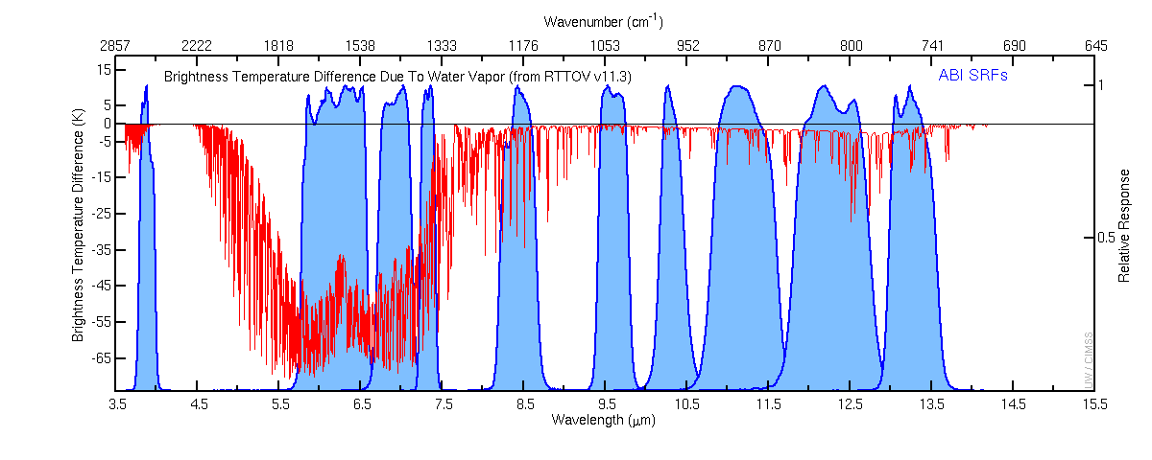
Cloud Phase Difference (11.2 μm – 8.4 μm)
Quick Brief
US Standard Atmosphere (1976) Brightness Temperature Difference Caused By Removing Water Vapor (H₂O)
Band 11
Band 14
8.44 μm
11.2 μm
Figure: Mat Gunshor, CIMSS
More H₂O vapor absorption at 8.4 μm than at 11.2 μm
Notes:
This figure (from Mat Gunshor at CIMSS) shows differences in satellite-sensed brightness temperatures between the US Standard Atmosphere and a similar atmosphere with no water vapor in it. Every infrared ABI band is shown here(the blue shaded regions) and they're affected to some degree. There is more water vapor absorption in Band 11 (8.4 micrometers) than at 11.2 micrometers - meaning that in the presence of water vapor, brightness temperatures should be colder at 8.4 micrometers than at 11.2 micrometers.

Slide 4
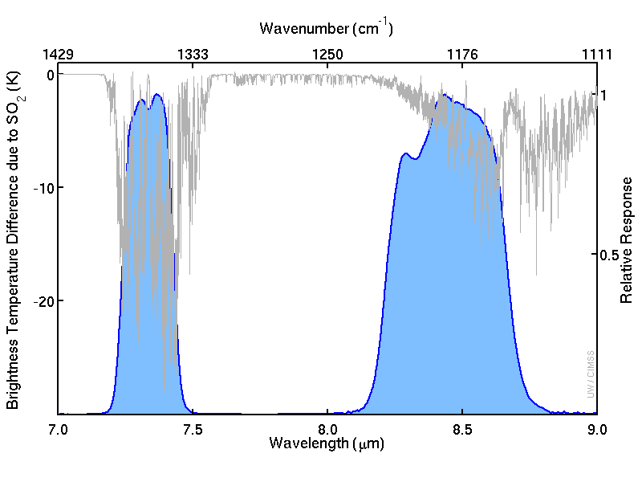
Cloud Phase Difference (11.2 μm – 8.4 μm)
Quick Brief
Band 10
7.3 μm
Band 11
8.4 μm
Figure: Mat Gunshor, CIMSS
Notes:
This figure (also from Mat Gunshor, CIMSS) shows brightness tempereature differences between a US Standard atmosphere and a similar atmosphere that is rich in SO2, that is, sulfur dioxide. The 8.4 micrometer channel was placed on GOES-R in part because it has sensitivity to Sulfur Dioxide - a gas that can be emitted from volcanoes. Sulfur Dioxide also absorbs energy around 7.3 micrometers. So - when a volcanic eruption occurs, a signal in the 8.4 micrometer band can be present - but be careful! There is also water vapor absorption occurring, and volcanoes emit water vapor too. Long experience with satellite monitoring can help a VAAC satellite meteorologist interpret the signal.

Slide 5
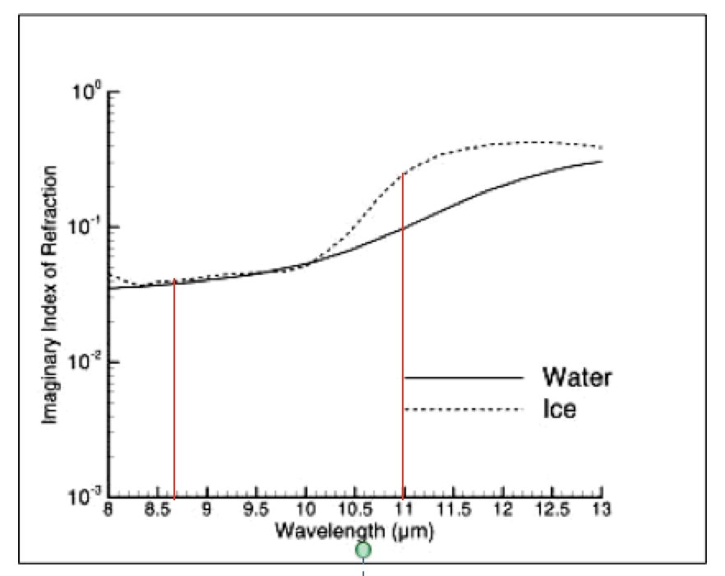
Cloud Phase Difference (11.2 μm – 8.4 μm)
Quick Brief
More absorption of upwelling 11.2 μm (than 8.4 μm) energy by clouds
More absorption at 11.2 μm means less warmer energy from close to the surface makes it through the thin cloud.
absorption
Notes:
Energy moving up through ice clouds (and to a lesser extent through water clouds) is affected differently at the two wavelengths. There is less absorption at 8.4 micrometers, meaning more radiation from lower, warmer parts of the atmosphere penetrate a thin cloud. Thin cirrus and thin stratus will absorb more upwelling 11.2 micrometer energy, and then re-emit it from higher, colder levels. In regions of thin clouds, 11.2 micrometer brightness temperatures will be colder than 8.4 micrometer brightness temperatures.

Slide 6
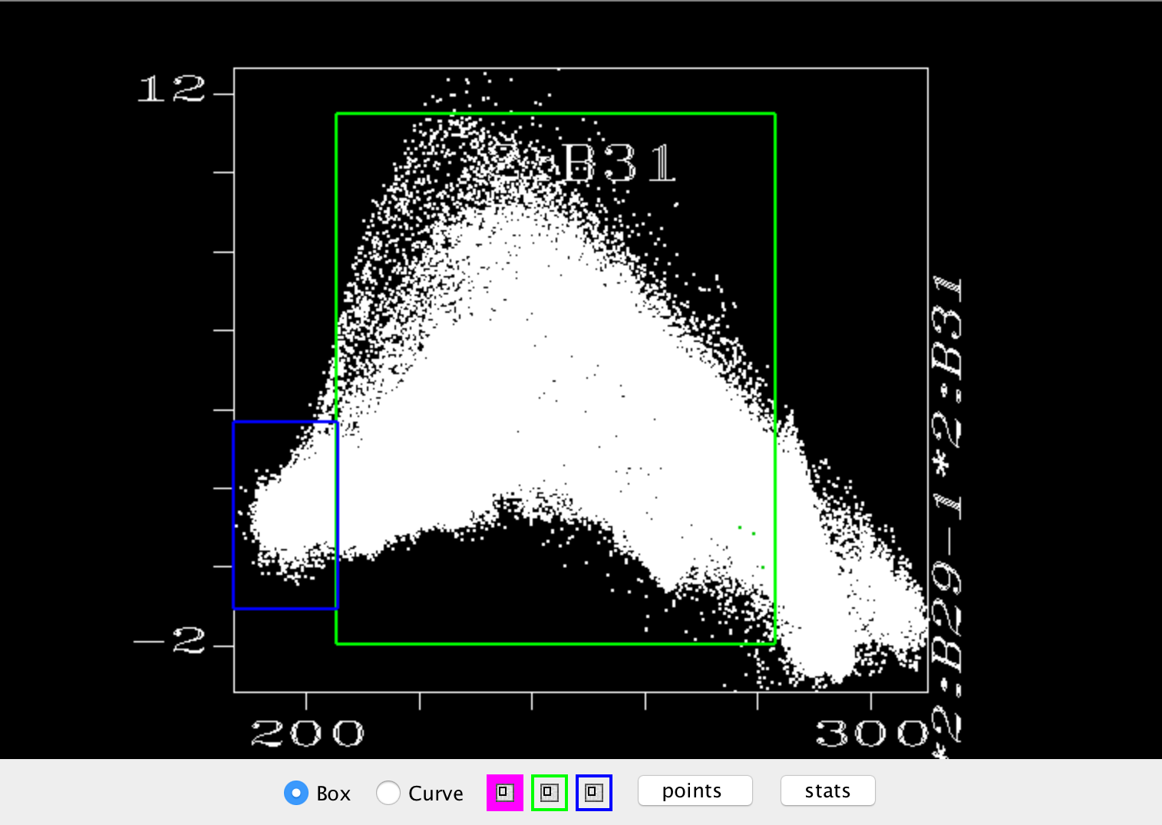
Cloud Phase Difference (11.2 μm – 8.4 μm)
Quick Brief
Blue Region: Thick Ice Clouds
T_{8.4} > T₁₁
Green Region: Thin Ice Clouds
Red Region: Water Clouds
Important: This is the inverse of the AWIPS definition!
8.4 μm – 11 μm Brightness Temperature Difference
0
11 μm Brightness Temperature
Notes:
One other effect is important: Field of view effects, or sub-pixel effects. If a cloud is not opaque (that is, if it does not uniformly cover the entire pixel), then there are warm and cold parts of the pixel that are emitting energy. The 11.2 micrometer sensor is more sensitive to the colder part of the pixel, and the 8.4 micrometer sensor is more sensitive to the warmer part of the pixel. The shows up in this figure. For thick ice clouds, at the left - in the blue box -, the effect of absorption is important. For clouds made up of water only -- the red box where temperatures exceed freezing -- water vapor absorption differences are more important. But in the green box, field of view considerations are strongly influencing the brightness temperature difference and the 8.4 micrometer brightness temperature will be much warmer than the 11.2 micrometer brightness temperature.

Slide 7
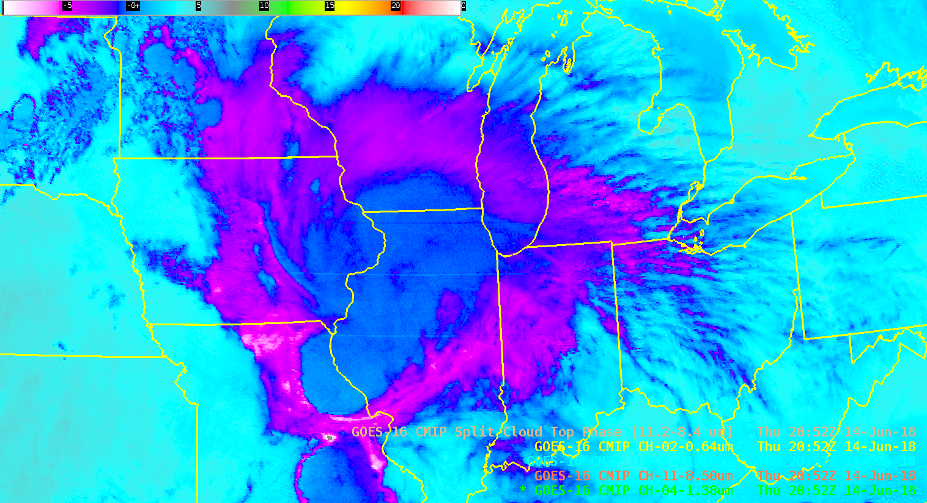
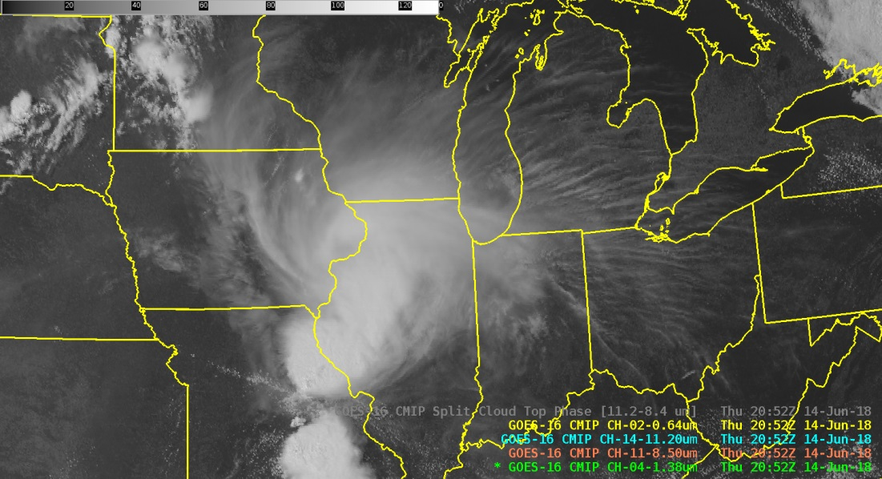
Cloud Phase Difference (11.2 μm – 8.4 μm)
Quick Brief
Notes:
This example from AWIPS shows a decaying MCV over the midwestern USA, with an extensive cirrus shield.
The thickest part of the cirrus shield has small negative values (with small positive or near-zero values over the active convection over northeast Missouri).
Small negative values arise because there is less absorption of 8.4 micrometer energy from lower in the atmosphere that moves up through the cirrus. There is more absorption of 11.2 micrometer energy, and re-emission from higher colder parts of the atmosphere. Thus 11.2 - 8.4 is negative.
The thinner cirrus over Wisconsin and Michigan has even larger negative values because in addition to the absorption differences, there is also the subpixel effect that means the 8.4 is warmer than the 11.2 brightness temperature.

Slide 8
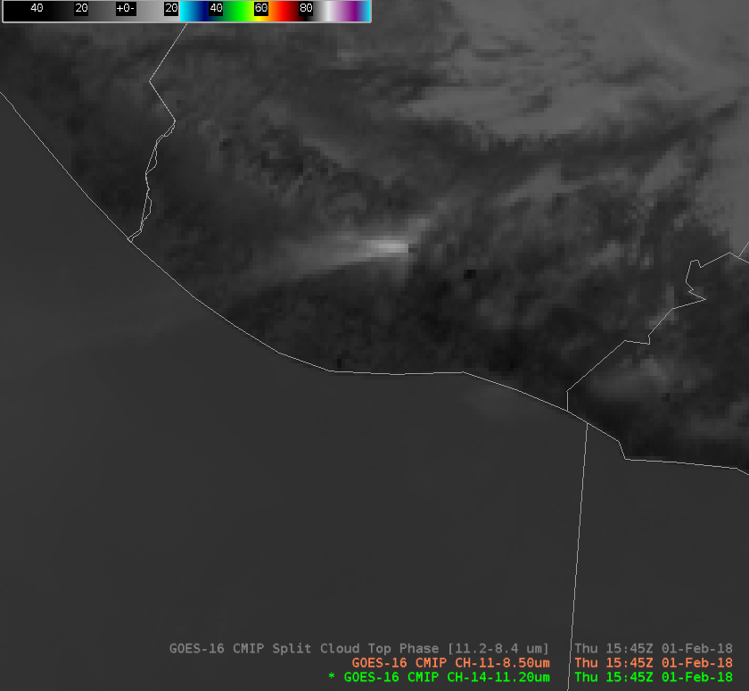
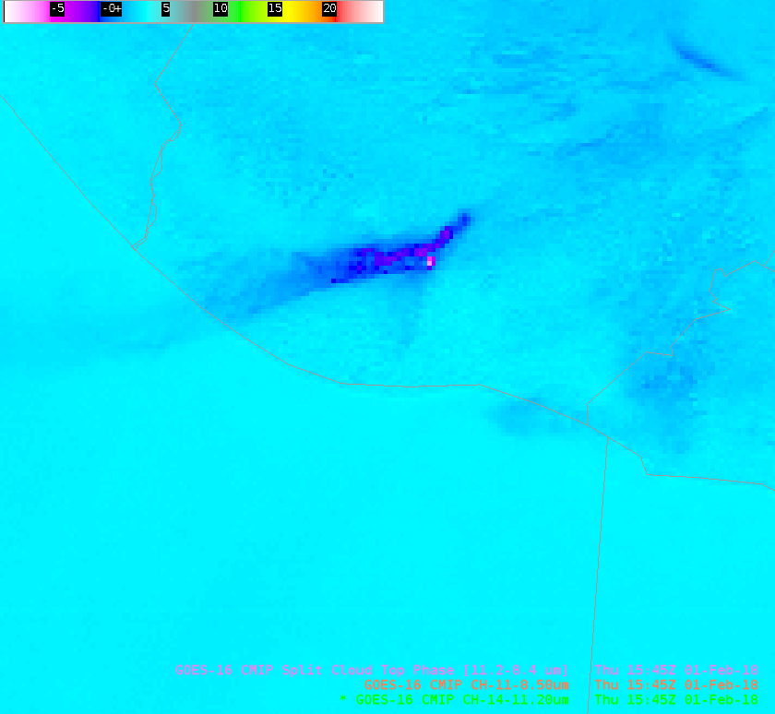
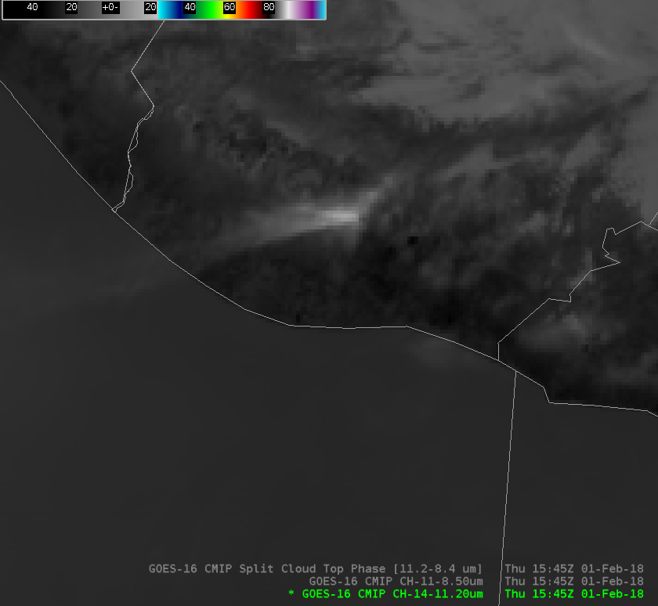
Cloud Phase Difference (11.2 μm – 8.4 μm)
Quick Brief
8.4 μm
11.2 μm
Notes:
Here is the cloud phase brightness temperature difference over a volcanic eruption in Guatemala. Interpreting this signal is a challenge because of the competing influences of SO2 and water vapor.

Slide 9
Cloud Phase Difference (11.2 μm – 8.4 μm)
Quick Brief
Summary
8.4 μm and 11.2 μm are both window channels
For ice clouds in general, greater absorption of energy by ice crystals in the 11.2 μm channel (vs. 8.4 μm) results in somewhat colder 11.2 μm temperatures, and thus slightly negative values in the difference imagery
For thin ice clouds, additional sub-pixel effects cause 11.2 μm brightness temperatures to be much colder than 8.4 μm temperatures, leading to greater negative values in the imagery.
For water clouds, greater absorption of energy by water vapor in the 8.4 channel results in colder 8.4 μm temperatures and thus positive values in the imagery (in clear skies).
This channel difference can be viewed alone or in combination with other visible and infrared channels for better scene interpretation. It is also used for derived products in AWIPS such as "Cloud Top Phase", as well as being part of the Ash and Dust RGBs
Due to SO2 absorption at 8.4 μm, this channel difference can help detect volcanic eruption plumes, but should be used carefully, in combination with other methods
Notes:
Some summary thoughts are shown here. This concludes the Quick Brief on the Cloud Phase Brightness Temperature Difference product. Thanks for listening.

