Slide 1
Derived Motion Winds
Quick Brief
Scott Lindstrom and Scott Bachmeier
UW-Madison
Cooperative Institute for Meteorological Satellite Studies
Notes:
This Quick Brief will describe how Derived Motion Winds are created, and how they can be used. I'm Scott Lindstrom from CIMSS.

Slide 2
Derived Motion Winds
Quick Brief
Derived Motion Winds use these 5 channels from the ABI
Visible (0.64 μm)
Upper-Level Water Vapor (6.19 μm)
Mid-Level Water Vapor (6.95 μm)
Low-Level Water Vapor (7.3 μm)
Long-wave Infrared (11.2 μm)
Created for Full Disk Imagery (every 60 minutes)
Created for CONUS Imagery (every 15 minutes)
Created for Mesoscale Imagery (5 minutes)
Notes:
Derived Motion Winds are created using 5 of the 16 bands of the GOES-R series Advanced Baseline Imager (visible, all 3 water water vapor, and the infrared window band). Derived winds are created once per hour for the Full Disk domain, every 15 minutes for the CONUS domain and every 5 minutes for the Mesoscale domain.

Slide 3
Derived Motion Winds
Quick Brief
A set of 3 sequential images is used
An analysis of wind target motions is performed (going both forward and backward in time) for 5x5 pixel areas nested within a 15x15 pixel Target Scene.
A cluster analysis algorithm then determines a Dominant Motion Vector for the entire Target Scene
A height value is assigned to the Dominant Motion Vector, using the ABI Cloud Height Algorithm
Notes:
3 sequential images as used to calculate derived motion winds. , Wind target motions are analyzed (going both forward and backward in time) For 5x5 pixel areas nested within a 15x15 pixel Target Scene. A cluster analysis algorithm then determines a single Dominant Motion Vector for the entire 15x15 Scene. Finally, the ABI Cloud Height Algorithm product is used to assign a height value this Dominant Motion Vector.

Slide 4
Derived Motion Winds
Quick Brief
Derived Motion Winds are continually compared to rawinsondes, aircraft data and model fields to compute verification statistics
Changes to the winds algorithms result from these comparisons, leading to improved accuracy
If height assignment is too high: slow DMW bias
If height assignment is too low: fast DMW bias
Better methods of DMW assimilation lead to improvements in NWP model performance
Notes:
Derived Motion Winds are continually compared to winds from rawinsondes, winds from aircraft and model esimates of winds to assess their quality. Verification statistics derived from these comparisons lead to algorithm changes that improve the accuracy of satellite winds. Proper assimilation of DMWs improves performance of NWP models.

Slide 5
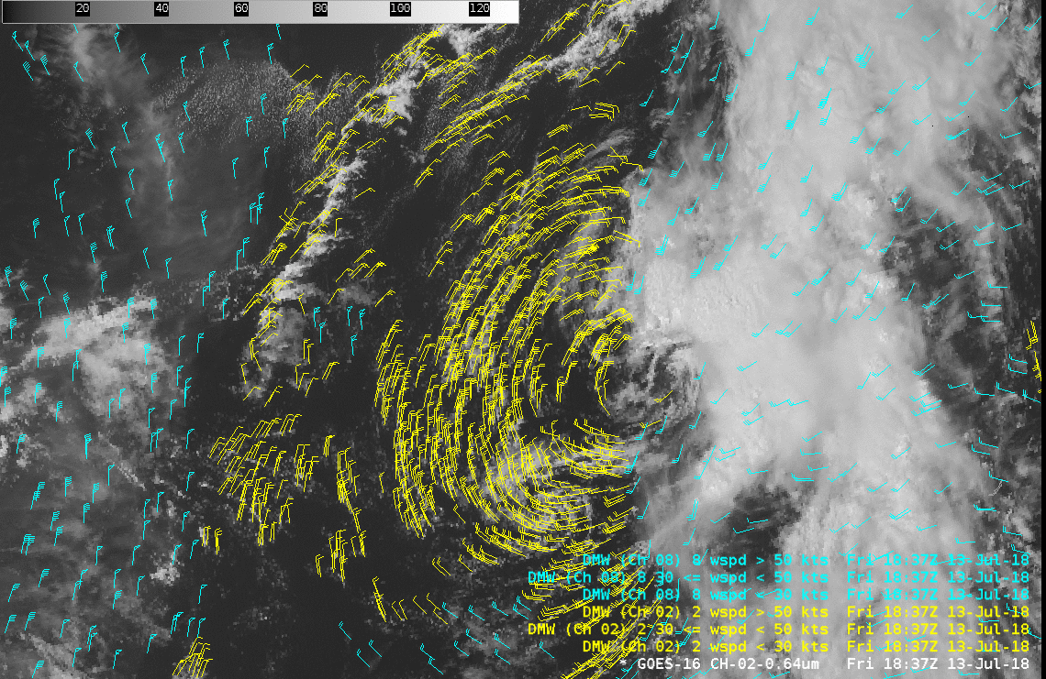
Derived Motion Winds
Quick Brief
Remnants of Hurricane Beryl (13 July 2018)
Link to
Blog Post
Notes:
Here is an example of the complimentary coverage provided by combining the low-level Visible winds in yellow (calculated using 0.5-km resolution Band 2 0.64 micrometer images) and mid/upper-tropospheric Water Vapor winds in cyan (calculated using 2-km resolution Band 8 upper-level water vapor 6.19 micrometer images) for the remnants of Hurricane Beryl off the US East Coast. The Visible winds clearly highlighted the low-level circulation center, while Water Vapor winds indicated the presence of a trough aloft (whose axis was just to the west of the LLCC).

Slide 6
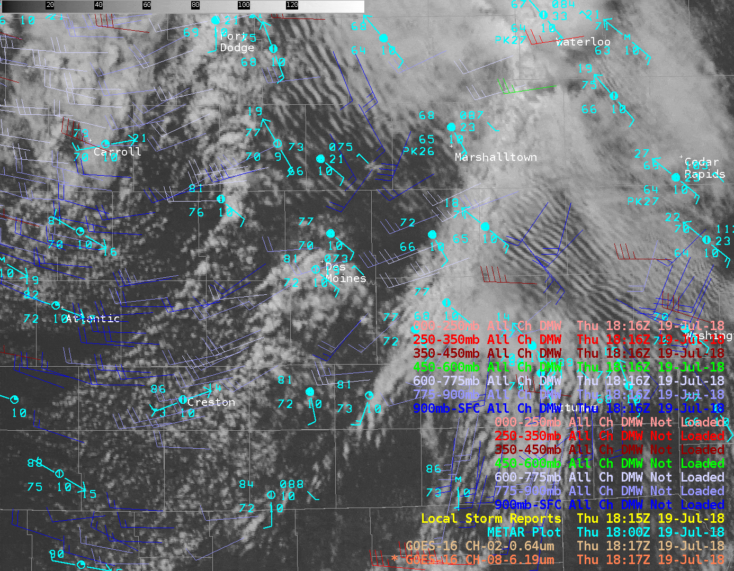
Derived Motion Winds
Quick Brief
Tornado outbreak in central Iowa (19 July 2018)
Link to
Blog Post
Notes:
In this example (taken from the Satellite Liaison Blog), Derived Motion Winds helped to diagnose the presence of enhanced 0-1 km Low-Level shear (around 16 knots) and 0-6 km Deep-Layer shear (around 49 knots) in the pre-storm environment shortly before an outbreak of tornadic convection across central Iowa.

Slide 7
Derived Motion Winds
Quick Brief
Summary
Derived Motion Winds are calculated using 5 ABI bands:
- Band 2 (Visible, 0.64 µm)
- Band 8 (Upper-level Water Vapor, 6.2 µm)
- Band 9 (Mid-level Water Vapor, 6.9 µm)
- Band 10 (Low-level Water Vapor, 7.3 µm)
- Band 14 (Longwave Infrared, 11.2 µm)
Coverage area (refresh rate): Full Disk (60 minutes), CONUS (15 minutes), Mesoscale (5 minutes)
Accuracy compares well with RAOB/Aircraft/Models
Proper assimilation improves NWP model performance
Applications: model verification, mesoscale feature identification/tracking, diagnosis of wind shear
Notes:
How can you use Derived Motion Wind vectors? Use them to view shear in the pre-storm environment. Or to diagnose the accuracy of model winds.
Here are some reminders of what you've just heard. This is the end of the Quick Brief on Derived Motion Winds - thanks for listening!

