Slide 1
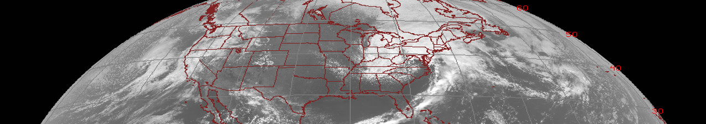



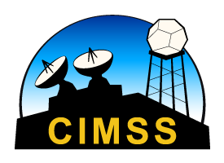
Fire Detection and Characterization Algorithm (FDCA)
Quick Brief
Scott Lindstrom
UW-Madison
SSEC/CIMSS
Notes:
This Quick Brief will describe the Fire Detection and Characterization Algorithm. I'm Scott Lindstrom from CIMSS.

Slide 2
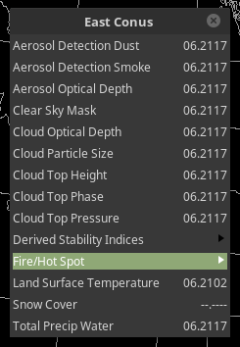
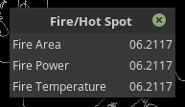
FDCA
Quick Brief
Three products comprise FDCA
  Fire Temperature
  Fire Power
  Fire Area
Products are available in AWIPS under Fire/HotSpot tab
Notes:
FDCA is under Derived Products under the GOES-16 or GOES-17 menus. Here's the CONUS menu, and Fire/Hot Spot includes - Fire Area, Fire Power and Fire Temperature. If you are familiar with the Wild Fire - Advanced Biomass Burning Algorithm (WF-ABBA), FDCA is the extension of that algorithm to the better spectral space of AHI (Himawari-8 and -9) and ABI (GOES-16 and GOES-17) data.

Slide 3
FDCA
Quick Brief
Products are not computed for all GOES-R Domains (valid as of Summer 2018)
  Full Disk: Every 15 minutes
  CONUS: Every 5 minutes
  Meso: Not Computed
    So, if you want to monitor a fire at 1-minute time-steps, you must rely on the 3.9 μm channel, or on the Fire Temperature RGB that is derived using 3.9 μm information.
Notes:
As of 2018, FDCA products are computed for every full disk (every 15 minutes) and for every CONUS (every 5 minutes) image. FDCA is not computed over Mesoscale domains.

Slide 4
FDCA
Quick Brief
Which ABI Channels are used to detect fires
  3.9 μm (‘Shortwave Infrared’)
  11.2 μm (‘Longwave Infrared’)
    Algorithm requires a 4 K difference between the Shortwave and Longwave channels (and this threshold can be even bigger depending on the time of day)
  0.64 μm and 12.3 μm channels are used for cloud clearing
  0.64 μm also used for background temperature estimates
Also needed: Surface Type knowledge, Total Precipitable Water
Notes:
Fire/Hot Spot Detection exploits the different fire signal in shortwave and longwave infrared channels, and it uses the 3.9 and 11.2 micrometer channels (Bands 7 and 14). In addition, visible (0.64 micrometer) and dirty window (12,3 micrometers) channels (bands 2 and 15) are used for cloud clearing because the fire/hot spot algorithm does not use the baseline Clear Sky Mask Product. The visible imagery also helps in estimating the background temperature. Total precipitable water and surface type are also used in these products to help characterize how the fire signal might be modulated by the atmosphere.

Slide 5
FDCA
Quick Brief
As the surface temperature increases, the peak of the Planck function shifts toward shorter wavelengths, so the radiance increases more rapidly at ~4 µm than ~11 µm. Different brightness temperature responses in these two infrared windows and background conditions are used to estimate sub-pixel fire size, temperature and fire radiative power (FRP).
The Planck function: Describes emitted energy at a given temperature and wavelength.
Radiance: A measure of the emitted energy.
Brightness Temperature: The temperature sensed by the detector, it is wavelength dependent and not the same as the bulk temperature of the surface or fire.
Notes:
The physics of fire detection are addressed on this slide. As a fire develops, hotter temperatures associated with the fire preferentially emit shorter wavelength energy, and the change in Radiance from cold surface to hot fire is much greater at shorter wavelengths. 3.9 micrometer is used rather than, say, 5 micrometers, where the change is greatest, because absorption of energy (by water vapor) occurs at around 5 micrometers.

Slide 6
FDCA
Quick Brief
Fires are sub-pixel entities!
Typically, a difference in brightness temperatures between the two infrared windows arises from reflected solar radiation, surface emissivity differences, and water vapor attenuation. This normally results in brightness temperature differences of 2-4 K.
Larger differences occur when one part of a pixel (p) is substantially warmer than the rest of the pixel (1-p). The hotter portion will contribute more radiance (energy) in shorter wavelengths than in the longer wavelengths.
Pixel
p
1-p
Notes:
Fires are sub-pixel entities, but the differences in emitted energy values can be detected at different wavelengths, leading to a quantitative estimate of the size, temperature and power of the fire.

Slide 7
FDCA
Quick Brief
Should you care about all three products?
  Fire Temperature, Area and Power are all used in Smoke Modeling
  Variations the products tell you something about the evolution of the ongoing fire
Notes:
You might not use all three products as a forecaster at a WFO - but changes in the values have a meaning that is easy to interpret. The values from FDCA are also used in Smoke Modeling.

Slide 8
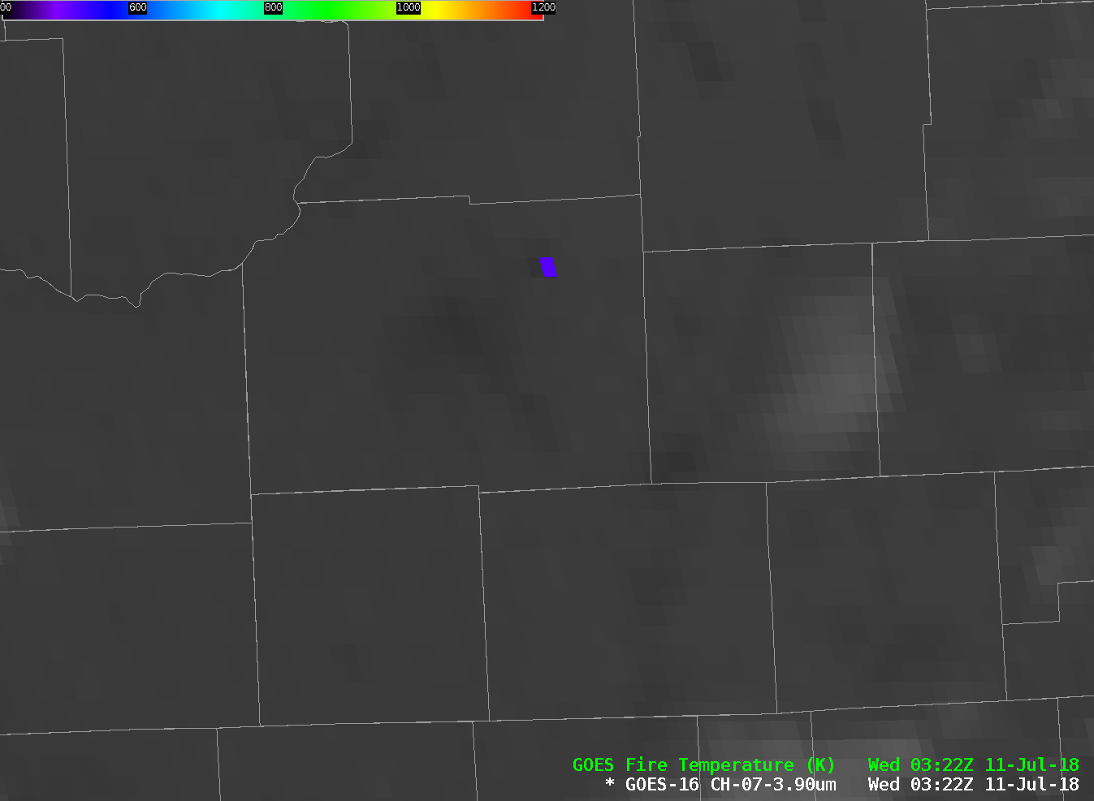
FDCA
Quick Brief
Here’s one pixel in the FDCA Fire Temperature (nominal 2-km resolution at nadir!)
How big do you think this fire is?
Notes:
Here’s one pixel over Sun Prairie WI late in the day on 10 June 2018. What does this information mean? A fire is in progress. This is actually the result of a gas main explosion that leveled a city block – at a time when clouds prevented a view of the surface. But the subsequent fire persisted until clouds cleared.

Slide 9
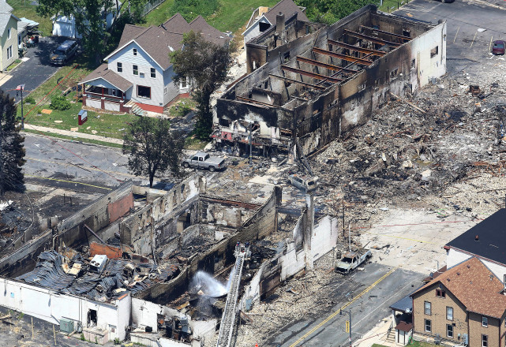
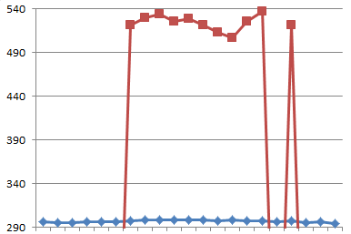
FDCA
Quick Brief
0.0225 km²
Not a big fire area
0.0225 km² is 5 acres
Notes:
It was not a big fire. But GOES-16 was able to view it. Note that because the fire was contained by walls, and at a high latitude, some of the emitted energy probably did not make it to the satellite.

Slide 10
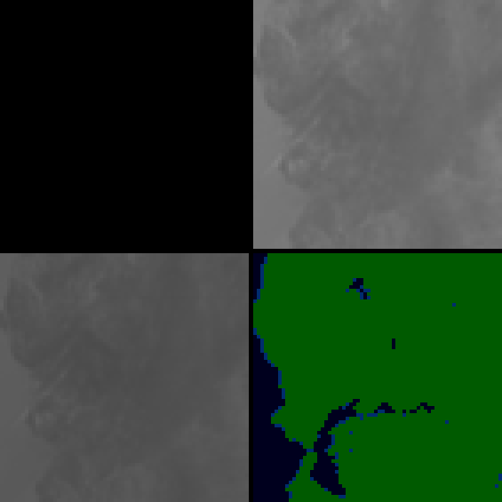

FDCA
Quick Brief
9:37 PDT
(4:37 UTC) October 8, 2017
0.64 μm
3.9 μm
11.2 μm
Notes:
Here's an example of a quickly developing fire over Napa Valley California. It demonstrates why 5-minute imagery is important. At 0437 UTC, no fire is apparent.

Slide 11

FDCA
Quick Brief
9:42 PDT
(4:42 UTC) October 8, 2017
0.64 μm
3.9 μm
11.2 μm
Notes:
5 minutes later, two different hotspots have become visible in the 3.9 micrometer data.

Slide 12

FDCA
Quick Brief
9:47 PDT
(4:47 UTC) October 8, 2017
0.64 μm
3.9 μm
11.2 μm
Notes:
5 minutes after tha, the spots are even hotter, and FDCA has identified a processed fire – that would show up in AWIPS Fire Temperature and Fire Area and Fire Power – and a high Possibility fire – that would show up only in Fire Power.

Slide 13

FDCA
Quick Brief
9:52 PDT
(4:52 UTC) October 8, 2017
0.64 μm
3.9 μm
11.2 μm
Notes:
AT 0952 UTC, 10 minutes after first being detected by the 3.9 micrometer channel, two fires are identified.

Slide 14

FDCA
Quick Brief
9:57 PDT
(4:57 UTC) October 8, 2017
0.64 μm
3.9 μm
11.2 μm
Notes:
At 0957 they continue to intensify

Slide 15

FDCA
Quick Brief
10:02 PDT
(5:02 UTC) October 8, 2017
Within 20 minutes of first becoming apparent, the fire has grown markedly and saturated the sensor
0.64 μm
3.9 μm
11.2 μm
Notes:
By 1002 UTC, the hotter fire has saturated the sensor. Fires can grow very big, very hot, very fast. The FDCA can allow for early detection of rapidly growing fires, which detection can be used to heighten situational awareness including communication to first responders.

Slide 16
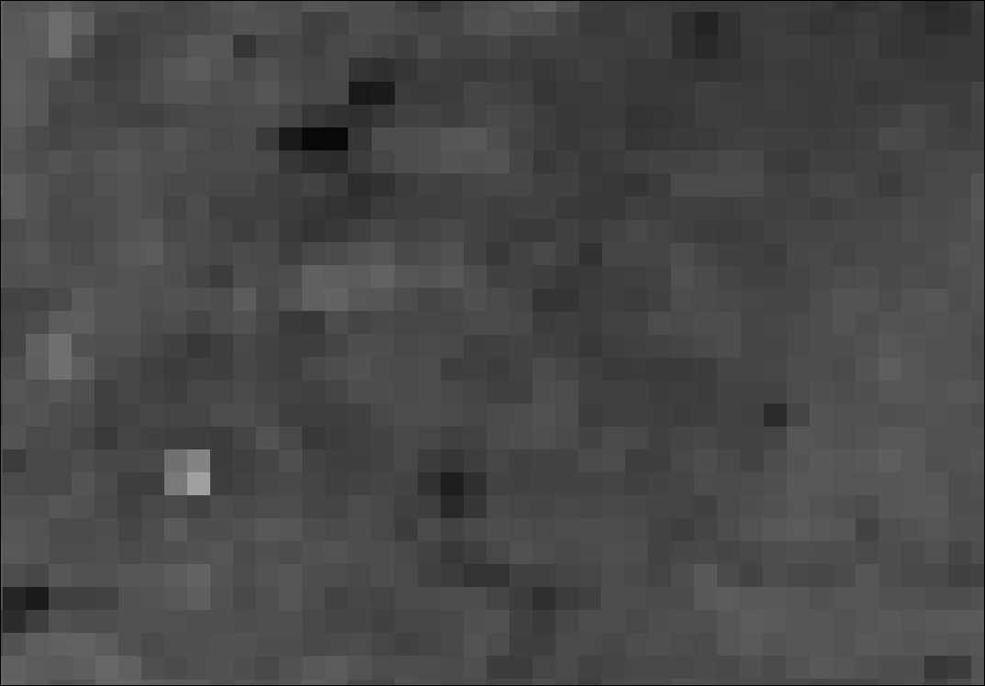
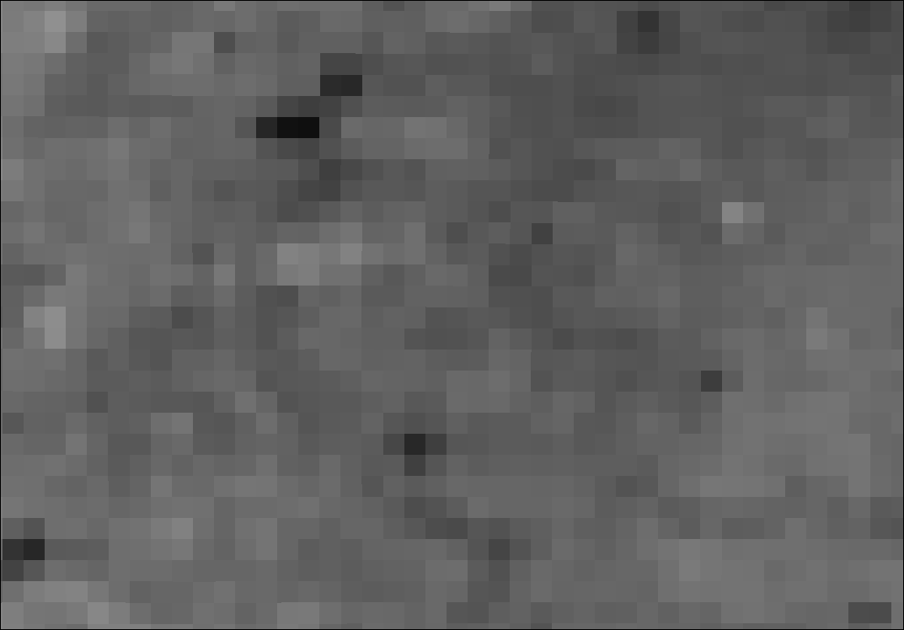
FDCA
Quick Brief
Two fires: a larger one in the lower left that barely reaches the minimum threshold for quantitative detection, and the structure fire in the upper right that exceeds background by ~ 1 K. These meso scans would not have FDCA computed…you’d have to rely on the 5-minute CONUS: Would these small fires still be around?
16:42:22 UTC
16:50:22 UTC
Oklahoma, 6 March 2018, 16:30-16:59 MESO1 scan, 1-minute imagery
Notes:
Here are two fires that do not meet the requirements to be detected by FDCA – but they are present. One of these (on the right) is a single house fire – yet GOES-16 views it!

Slide 17
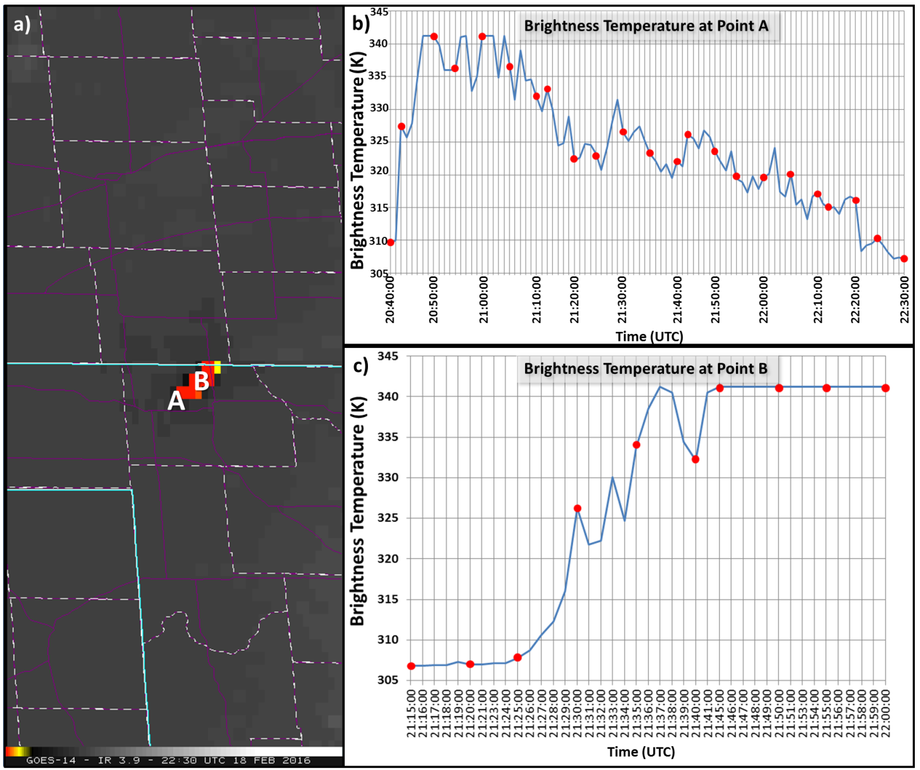
FDCA
Quick Brief
The graphs at right show one-minute brightness temperature traces (in blue) along with 5-minute values (in red). For rapidly-evolving fires, 5-minute imagery can miss changes, but FDCA values are not computed for MESO sectors with 1-minute information.
(Source)
1-minute trace
5-minute points
Notes:
Fires vary on very small times scales, but FDCA as of summer 2018 is only computed at CONUS time scales – every 5 minutes. To monitor smaller time scales, request a mesoscale domain to capture the changes at 1-minute timesteps!

Slide 18
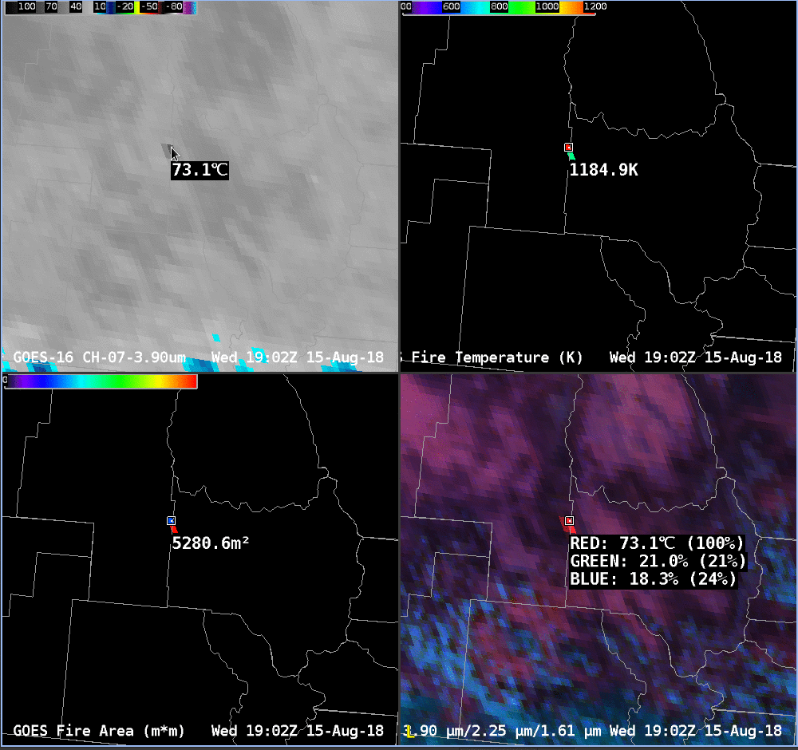
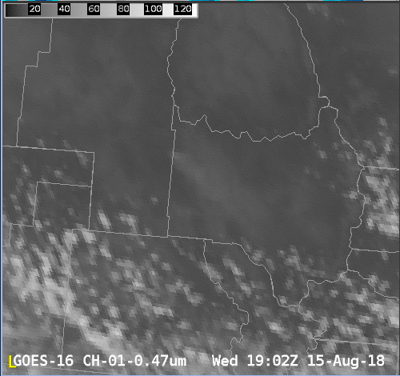
FDCA
Quick Brief
In reality, there are many ways to detect a fire using GOES-R. Single Channel Band 7, FDCA products, Visible Imagery, RGBs including the Fire RGB (shown) or True Color imagery
Notes:
Fire/Hot Spot detection is just one way to view fires. You can also use the 3.9 micrometer channel, a visible channel (Blue Visible at 0.47 micrometers is shown) to see smoke or the Fire RGB that is available in AWIPS, a blend of Bands 7, 6 and 5 (3.9, 2.24 and 1.61 micrometers). The visible image, of course, is daytime only.

Slide 19
FDCA
Quick Brief
FDCA products quantitatively estimate fire properties
They are most easily interpreted with a good knowledge of surface properties: Is there something on the surface that will burn?
Keep in mind that view angles from the satellite influence detectability (terrain can get in the way)
ATBD at GOES-R.gov for more information
Thanks to Chris Schmidt, UW-Madison CIMSS, for review!
Notes:
This concludes the Quick Brief on the Fire Detection and Characterization Baseline Product. Some final points are listed here. Thanks for listening!

