Slide 1
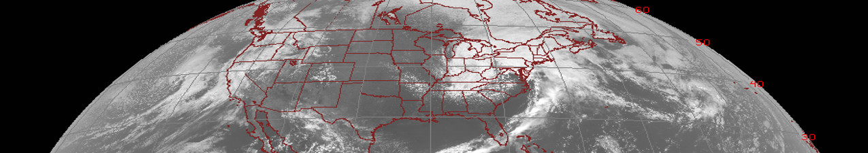



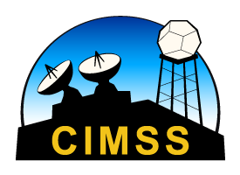
Legacy Atmospheric Profiles
Quick Brief
Scott Lindstrom
UW-Madison
SSEC/CIMSS
Notes:
This Quick Brief will describe to you how Legacy Atmospheric Profiles (of temperature and moisture) can be used. I'm Scott Lindstrom from CIMSS.

Slide 2
Data created via a Regression and a Retrieval
Legacy Atmospheric Profiles
Quick Brief
Baseline Products are Clear Sky only. All-Sky Products are available online here
Regression uses static coefficients that give the best statistical relationship between observed temperature/ moisture/ ozone/emissivity/surface temperature given GFS background. This creates a first guess field for a Radiative Transfer Model (RTM)
10-km resolution, created for every FD/CONUS/MESO image
Retrieval minimizes the difference between First guess (Regression) and RTM driven by observations directly.
For more details see ATBD link at end of training
Notes:
Legacy Profiles are designed to replace GOES Sounder products. As with the GOES Sounder product, Legacy Profile products in AWIPS are not available where skies are cloudy -- but an All Sky product is available online. Profiles have a 10-km horizontal resolution (vs. the 2-km ABI Infrared resolution) and they are created for every FD, CONUS and Meso image. Legacy Profiles are created using a Regression that provides a first guess (using a GFS background) for a Retrieval that is driven by the observations.

Slide 3
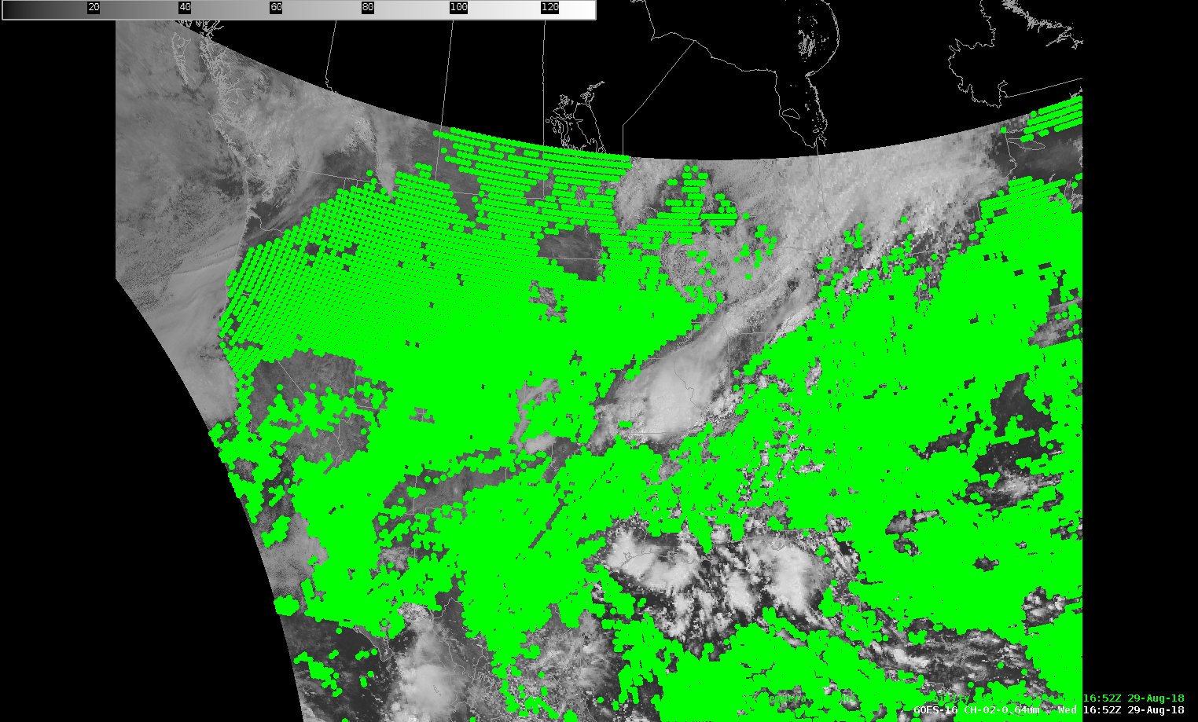
Sounding Locations are not provided in cloudy regions
Legacy Atmospheric Profiles
Quick Brief
Note how the soundings are more spread out farther from the sub-satellite point
Notes:
Profiles are not created in cloudy regions. Note also that sounding locations are spread out as you move far from nadir. That 10-km horizontal resolution is at nadir, the sub-satellite point.

Slide 4
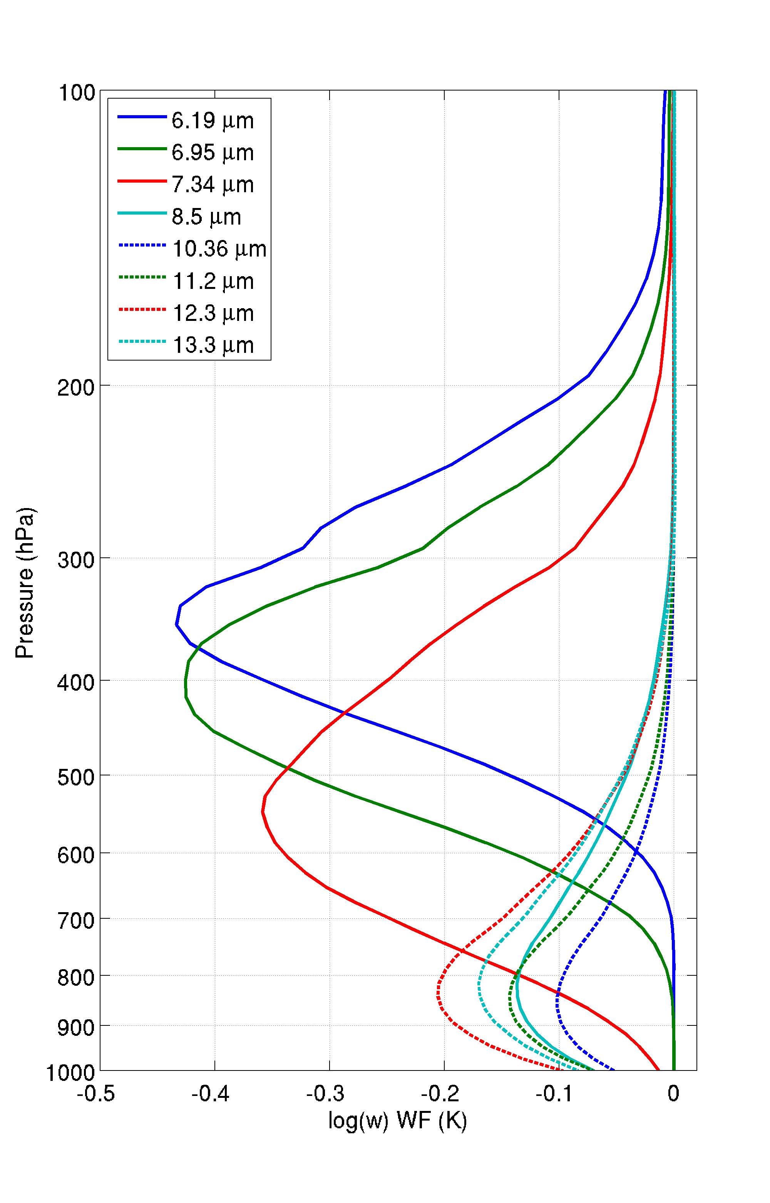
LAP Information
Legacy Atmospheric Profiles
Quick Brief
For a US Standard Atmosphere
LAP and derived products are available over “clear” Fields of Regard (FORs), meaning 20 (out of 25) or more clear Fields of View (FOV)
ABI IR band emissivities are from a monthly dataset. Temporal variability is negligible in those datasets.
Surface roughness and skin temperature are assumed homogeneous
GFS Forecast tropospheric temperatures are hard to improve with ABI because ABI channels do not sense temperature at many different levels
Notes:
The vertical origins of Information content in the ABI channels is depicted by the Weighting Function at right. Moisture information comes from 3 Water Vapor channels. Most temperature information is coming from the near-surface. Mid- and upper-tropospheric temperature observations are not available from ABI channels.

Slide 5
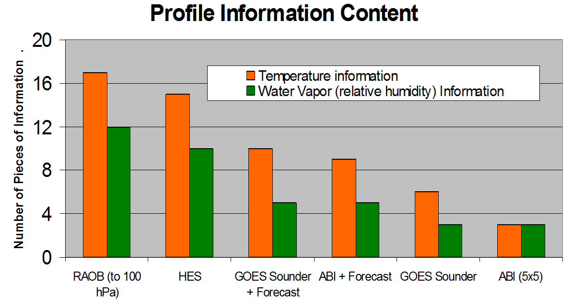
Legacy Atmospheric Profiles
Quick Brief
Why combine ABI data with a model background? Because the ABI is not a Sounder, and we want vertical levels!
Notes:
Here’s why data from the GFS are used. Compare the number of vertical levels from just the ABI – at right – to, say, RAOBs or a high-resolution sounder, on the left. You can improve the number of layers of information by supplementing ABI information with model Forecast output. 9-ish layers of temperature and 5-ish layers of moisture. (Better than 3 from ABI alone!)

Slide 6
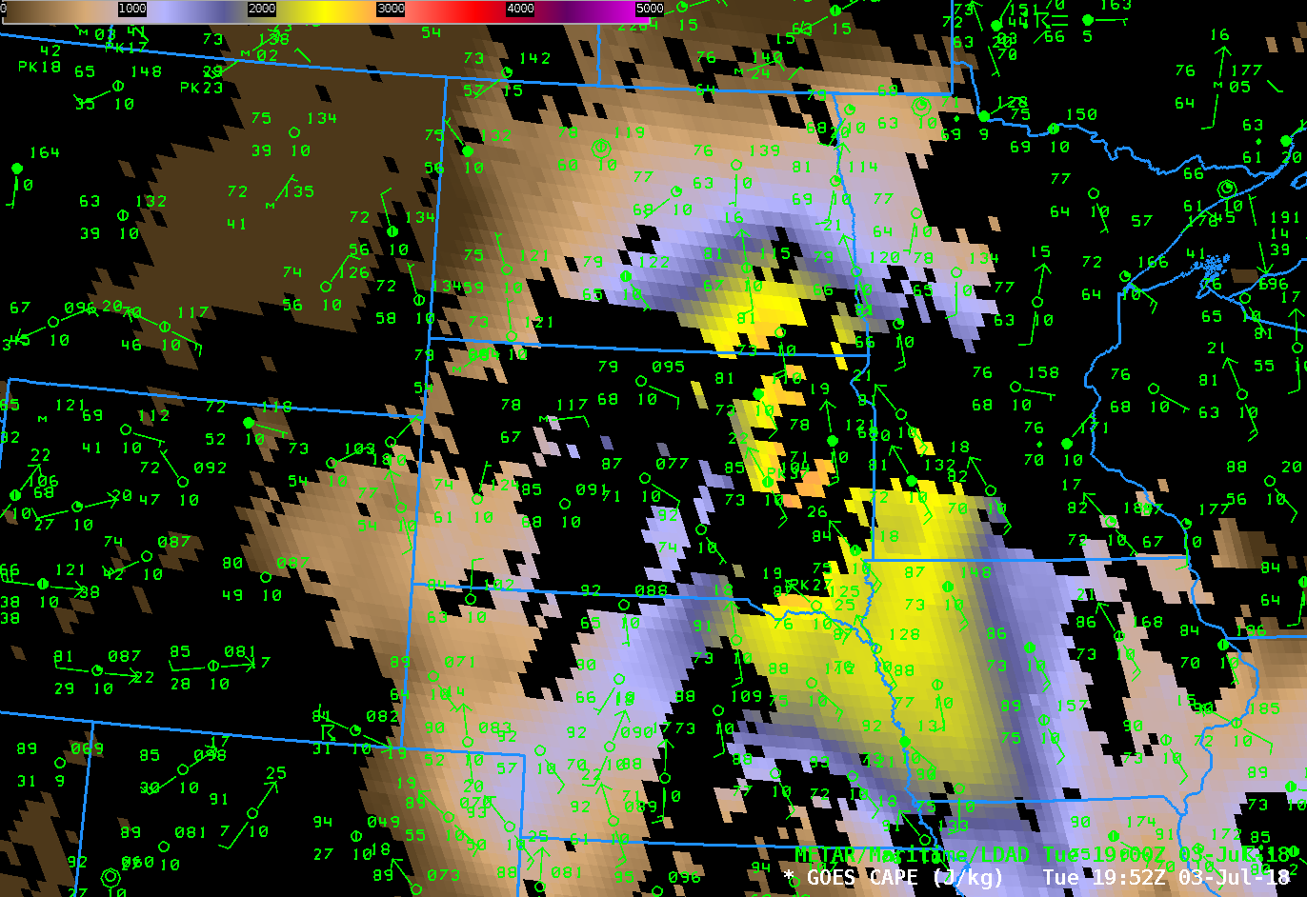
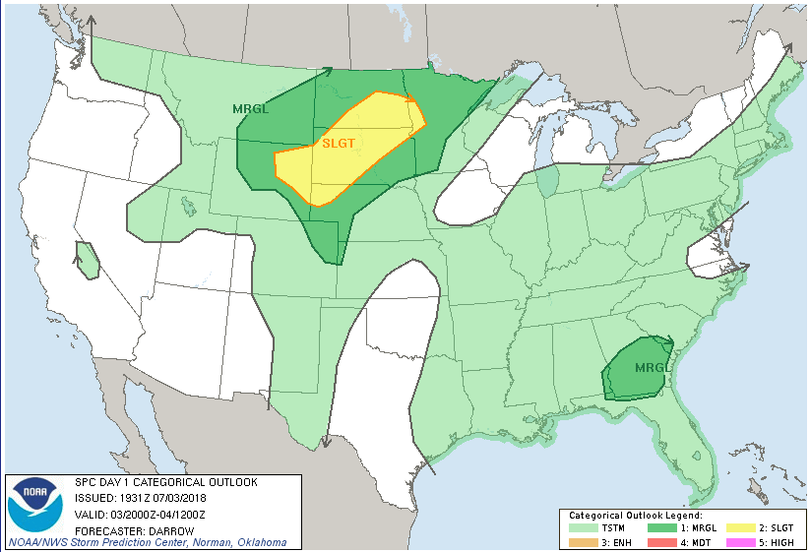
DPI CAPE at 1952 UTC on 3 July 2018
Legacy Atmospheric Profiles
Quick Brief
Black regions: Missing data because of clouds
Note how the surface dewpoint and CAPE gradients align.
Above: SPC Outlook from 2000 UTC on 3 July 2018
Notes:
This shows LAP CAPE from AWIPS. This is the Clear Sky product that is baseline (Not the All Sky product available online). Nevertheless, there is information, in particular over the Dakotas. Note how the CAPE values and surface Dewpoints align. A nose of higher CAPE overlaps with the Slight Risk. Convection on this day did developed in the central Dakotas along the gradient of CAPE.

Slide 7
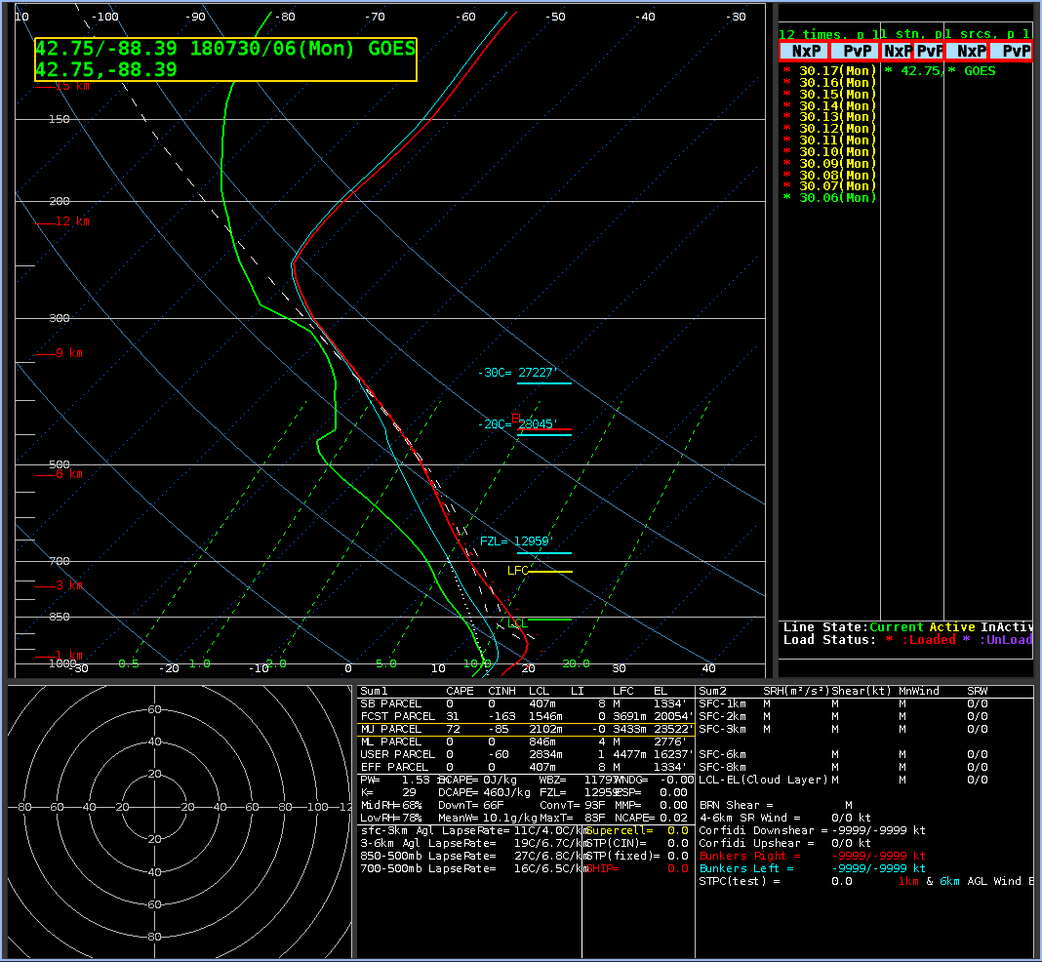
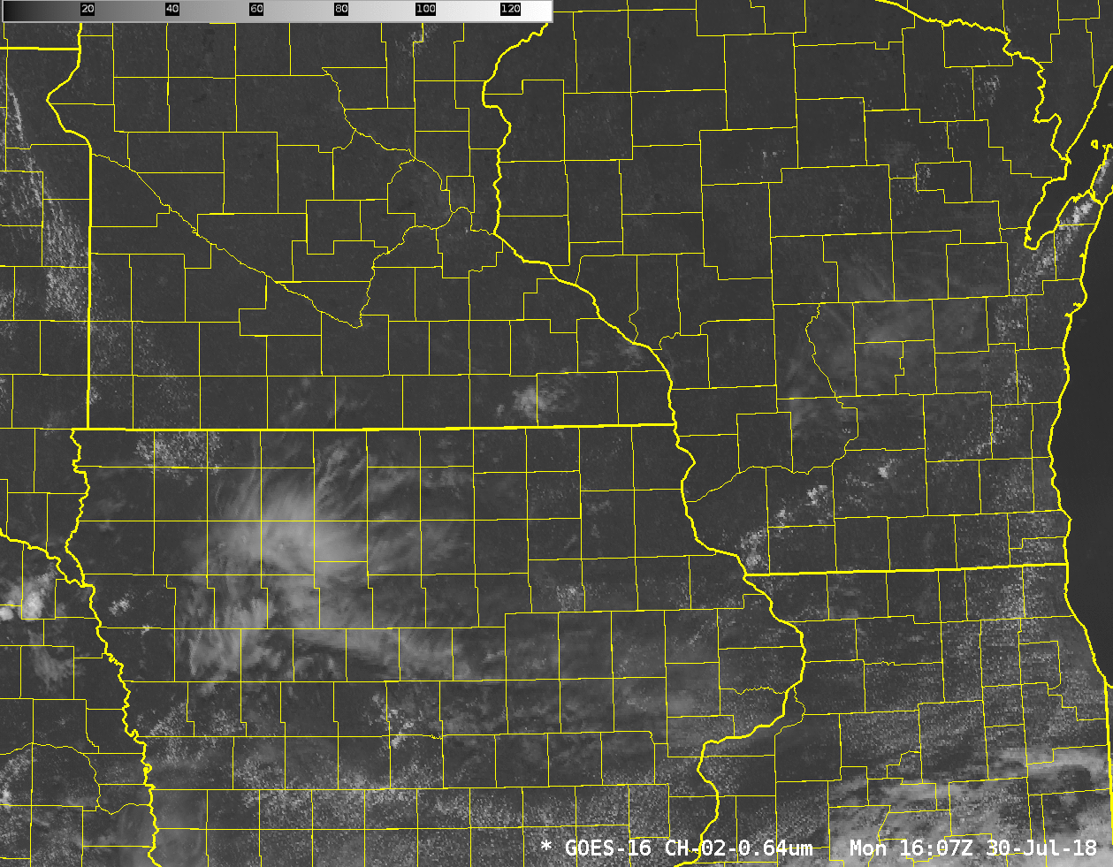
Legacy Atmospheric Profiles
Quick Brief
In addition to horizontal fields of CAPE, LI, TPW, there are vertical profiles that are available in AWIPS. Time tendencies of these can help you anticipate convective initiation
Notes:
There are horizontal fields under the Derived Products Menu in AWIPS, but there are also vertical profiles, and an animation of those can give you information about the evolution of the atmosphere. The moisture information is what is being affected the most by the ABI data. Observe the soundings, over SE Wisconsin, and the developing showers.

Slide 8
Legacy Atmospheric Profiles
Quick Brief
ABI Information is used to modify background fields from model
  ABI Moisture information is from 3 Water Vapor Channels (6.19 μm, 6.95 μm, 7.34 μm) that mostly describe moisture in the mid-troposphere
  Limited ABI Temperature information is mostly from near the surface (Window Channels) but some comes from the CO₂ and O₃ channels, and from the Water Vapor Channels.
Clear Sky only product; use them before convection starts to monitor destabilization
ATBD on Legacy Profiles at goes-r.gov
Notes:
LAP profiles adjust the thermodynamics in the GFS background by using ABI Channel information. The biggest adjustments come from the 3 water vapor channels. Temperature is highly constrained by the background field. These clear-sky products are useful in diagnosing thermodynamics before the onset of convection.
More information is available at the link shown.
This concludes the Quick Brief on Legacy Profiles. Thanks for listening!

