Slide 1

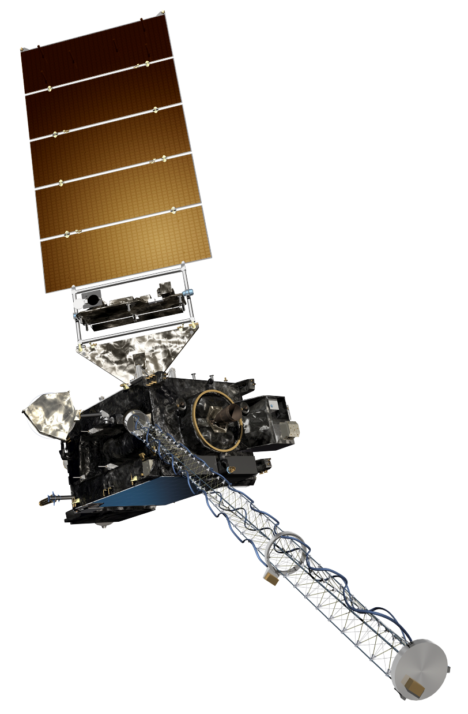
The GOES-R Series:
Welcome to GOES-R:
The 3.9 μm Shortwave IR Band
Scott Lindstrom
UW Madison CIMSS
with Kaba Bah, Margaret Mooney, Kathy Strabala, Scott Bachmeier, Tim Schmit and more!
SHyMet Introductory Course
Notes:
This is the SHyMet course on the Advanced Baseline Imager (the ABI), one of two sensors on GOES-R that measures the Earth's atmosphere (the Geostationary Lightning Mapper is the second). This course has been created with funding from the GOES-R Program and it should show you uses for the 16 channels on ABI. The module discusses ABI Band 7 – the shortwave Infrared band at 3.9 micrometers.

Slide 2
ABI: Bands 7-16 (Infrared)
ABI Band | Wavelength (µm) | Wavelength range (µm) | Sub-point pixel spacing (km) | Descriptive Name
7 | 3.90 | 3.80 - 3.99 | 2 | “Shortwave window”
8 | 6.19 | 5.79 - 6.59 | 2 | “Upper-level Water Vapor”
9 | 6.93 | 6.72 - 7.14 | 2 | “Mid-Level Water Vapor”
10 | 7.34 | 7.24 - 7.43 | 2 | “Lower/Mid-level Water Vapor”
11 | 8.44 | 8.23 - 8.66 | 2 | “Cloud-top Phase”
12 | 9.61 | 9.42 - 9.80 | 2 | “Ozone”
13 | 10.33 | 10.18 - 10.48 | 2 | “Clean longwave window”
14 | 11.21 | 10.82 - 11.60 | 2 | “Longwave window”
15 | 12.29 | 11.83 - 12.75 | 2 | “Dirty longwave window”
16 | 13.28 | 12.99 - 13.56 | 2 | “CO₂”
There are 10 infrared bands on the ABI.
There were only four on heritage imager.
Notes:
This chart shows the infrared bands on the Advanced Baseline Imager. Again, the chart shows the band, or channel, number. The central wavelength, the wavelength range sensed, the pixel resolution at the sub-satellite point (Nadir), in kilometers, and the nickname. You might ask: Why are the bands placed where they are? Similar to the placement of visible/near IR channels, placement here relates to the radiative properties of the atmosphere, which we’ll see next.

Slide 3
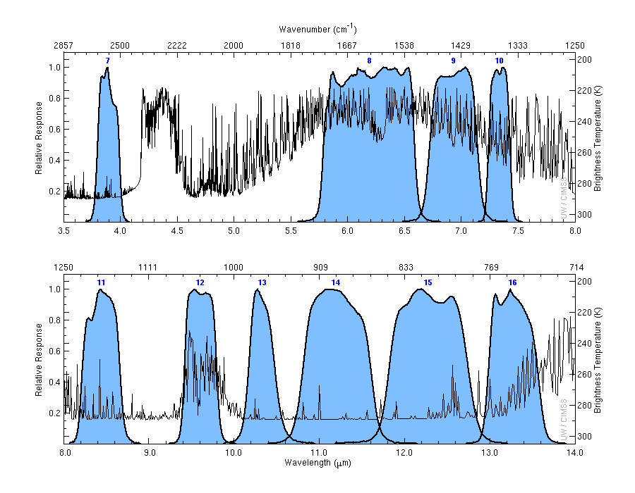
ABI IR Spectral Bands (7-16)
Black line: What would a satellite sense above a US Standard Atmosphere!
7
8
9
10
cold
3.9 μm
6.19 μm
6.95 μm
7.3 μm
warm
11
12
13
14
15
16
8.4 μm
9.6 μm
10.3 μm
11.2 μm
12.3 μm
13.3 μm
Notes:
This chart shows the - in blue - the spectral response functions for each of the 10 infrared channels. So, for example, Band 8 - the upper-level water vapor band at 6.19 micrometers - is spectrally broad whereas Band 10 - the low-level water vapor band at 7.3 micrometers - is spectrally more narrow. The black line is the temperature that a satellite would sense (as a function of wavelength) above a US Standard atmosphere. In some channels - such as the clean window at 10.3 micrometers, band 13 - the satellite detects the surface. This is a 'window channel' because the satellite sees right through the atmosphere and can detect the surface (in clear skies - that's an important caveat!) because gases in the atmosphere do not absorb 10.3 micrometer energy emitted from the surface. The Shortwave IR band is also a window channel, albeit with some absorption because of water vapor.

Slide 4
Why use the Shortwave IR Band
2-km Resolution
Especially sensitive to hot temperatures: Fire Detection
Both the Fire Detection and Characterization Algorithm and Fire RGB
Cloud droplets are not blackbody emitters of 3.9 μm radiation
Useful for fog/stratus detection at night
Significant reflected solar radiation at 3.9 μm can provide insight into cloud-top particle size and/or phase
Smaller particles are more highly reflective and will appear warmer
Used in Baseline Products such as Derived Motion Winds
14-bit data, detects temperatures from -75 C to 140 C
Notes:
The shortwave IR band is unique among ABI's 16 channels because it routinely senses both emitted terrestrial radiation and reflected solar radiation.
This band is a heritage channel, meaning it was present on previous GOES satellites, back into the 1970s.
Some uses for the 3.9 micrometer band are shown here. Read them over.
The 14-bit 3.9 micrometer band on ABI detects over the widest range of temperatures of all ABI Bands: -75 C to 140 C. It has relatively low precision at very cold temperatures, however: you might see speckling at night over very cold cloud tops.

Slide 5
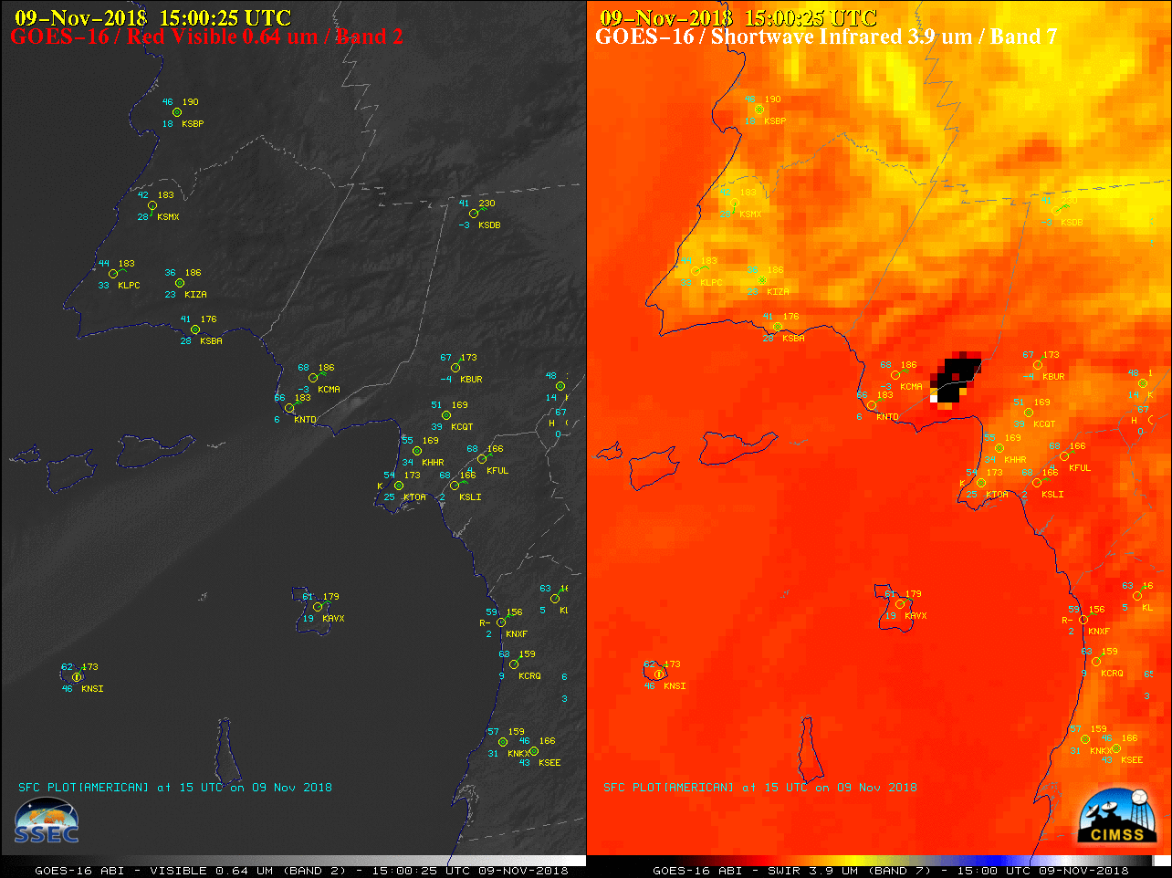
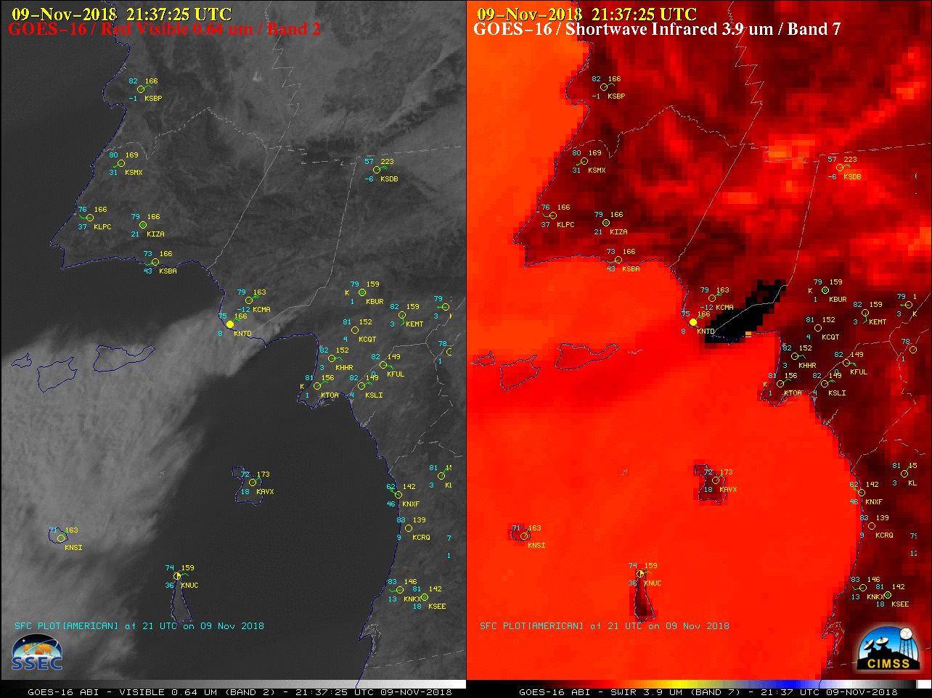
The ability to detect surface thermal features
Notes:
The Shortwave IR band detects fires. The 5-minute cadence on ABI for CONUS projection means precise monitoring of the early fire evolution is possible (and Mesoscale domains can give even better temporal coverage: every minute! This can be vital information for a fast-moving fire in its early stages!). This slide shows two times of the Woolsley Fire near Malibu CA in 2018, with the smoke plume displayed on the left ni visiuble imagery and the large and intense thermal signal from the 3.9 micrometer imagery on the right. In addition to the pixels affected by the fire, the general warming is obvious. The 3.9 micrometer can also be handy at night over Southern California to monitor the evolution of Santa Ana wind-driven warming.

Slide 6
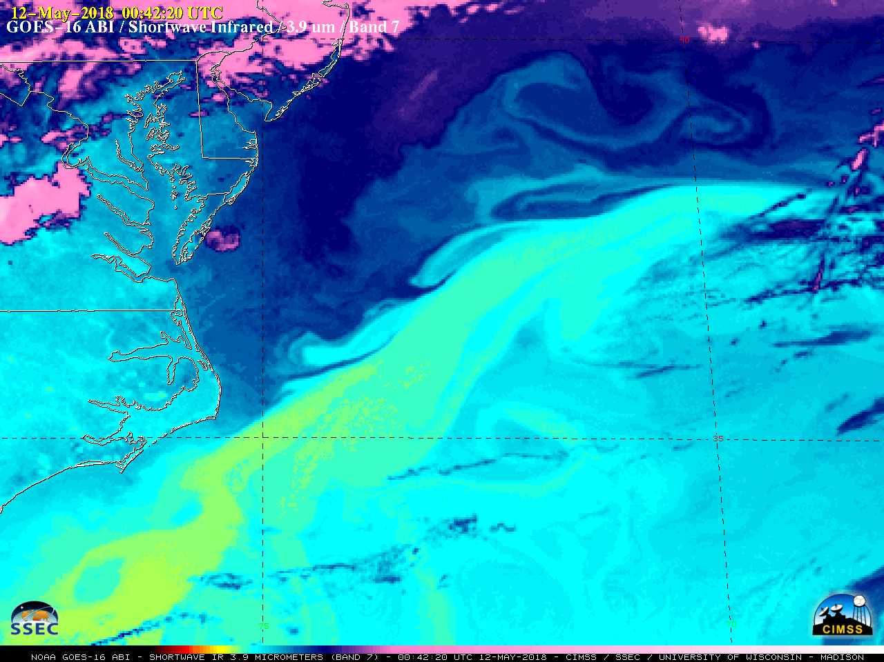
The ability to detect surface thermal features
Notes:
Thermal boundaries can also be highlighted over the ocean. It is important to know where the north wall of the Gulf Stream is, for example. Gradients in temperature can help fishermen as well. The band is especially sensitive to low-level temperatures and will see heat islands too, near cities (such as Norfolk in this image)

Slide 7
The ability to detect fog/stratus at Night!
The ‘Night Fog’ Brightness Temperature Difference field is available in AWIPS, and is easily computed elsewhere
Highlights liquid water droplets because they do not emit 3.9 μm radiation as a blackbody, but they do emit 10.3 μm radiation as a blackbody
The Advanced Nighttime Microphysics RGB uses the Night Fog Brightness Temperature Difference field
Neither technique can view fog/stratus if there are multiple cloud decks
Notes:
If you compare the Shortwave and Longwave infrared channels (3.9 and 10.3 micrometers, respectively), then differences that arise in the computed brightness temperature due to emissivity are apparent over liquid water droplets in clouds. This channel difference – called the Night Fog Brightness Temperature Difference in AWIPS – is an easy way to highlight stratus and/or fog at night, and it is also a component to the Nighttime Microphysics RGB.

Slide 8
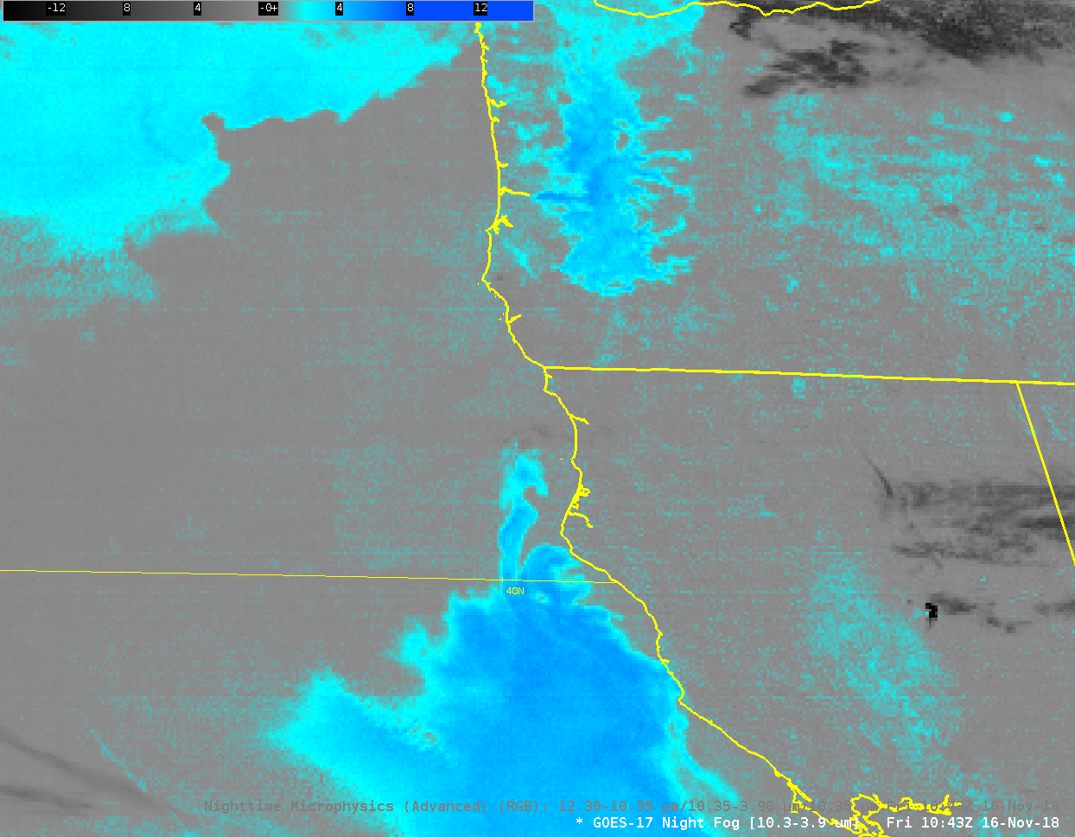
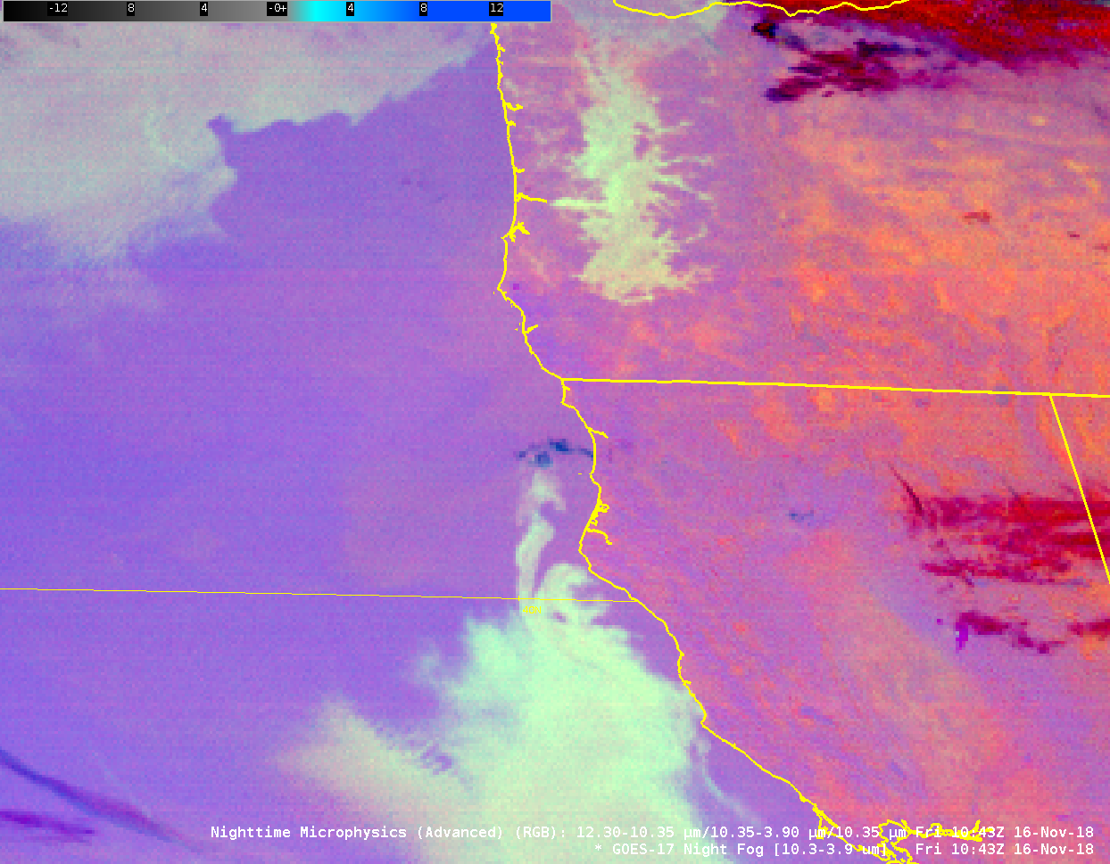
Example of fog/stratus detection
GOES-17 Night Fog Brightness Temperature Difference
GOES-17 Nighttime Microphysics RGB
This GOES-17 Data is preliminary and non-operational
Notes:
In AWIPS, the blue/cyan regions are those with stratus decks made up of liquid water droplets. This may or may not be fog – it’s difficult to tell from the cloud top, which is the point of view of the satellite. In the Willamette Valley in Oregon, fog is present. Observations show it. You can see how the Nighttime Microphysics RGB also highlights the regions of fog and stratus. The actual color of the low clouds will vary seasonally as the cloud temperature changes: the blue component of the RGB is the clean window 10.3 micrometer channgel

Slide 9
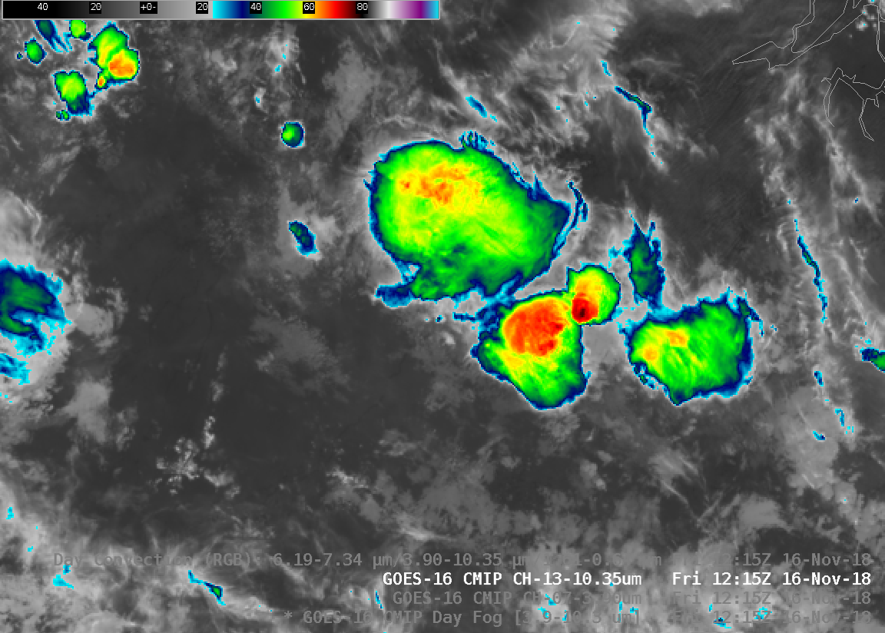
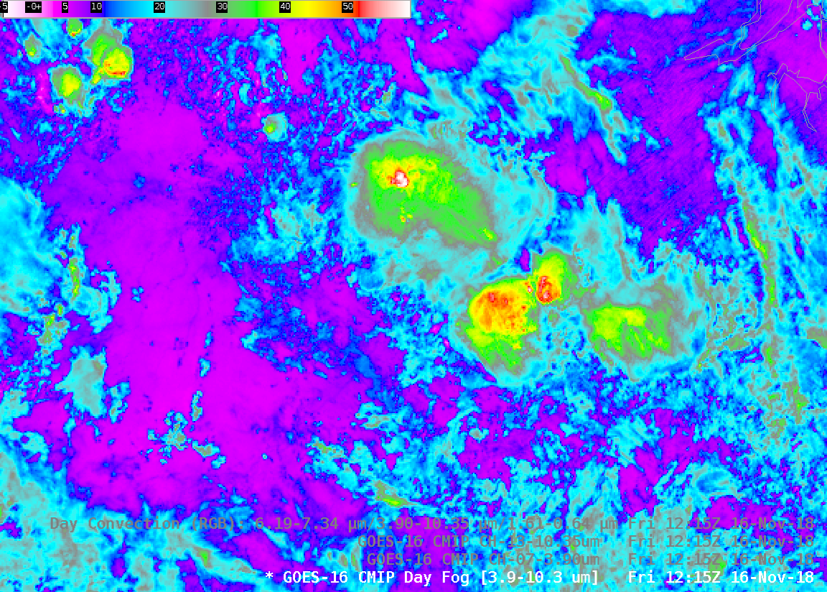
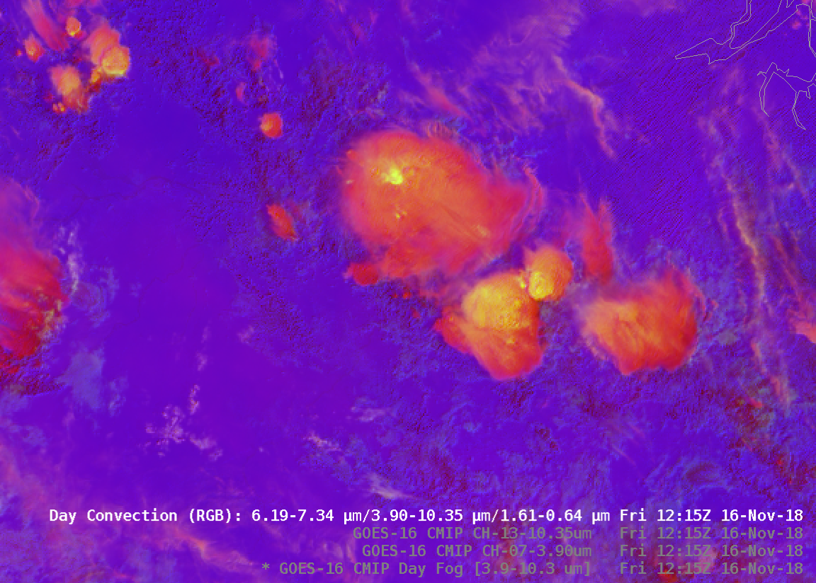
If you have strong convection, Day Cloud Convection RGB is useful
Strong updraft lofts small ice crystals to the top of the cloud
Small ice crystals strongly reflect 3.9 solar radiation
3.9 – 10.3 Brightness Temperature difference is largest where ice crystals are smallest
Notes:
A clean window image of convection (or the baseline product Cloud Top Temperature) can help you identify with coldest cloud tops – but which of the cloud tops here have the smallest ice crystals that have been lofted by very strong updrafts? A very strong updraft limits the residence time in the cloud, limiting the growth of the particle. Smaller ice particles are more highly reflective, and the 3.9 micrometer brightness temperature will therefore be warmer because it contains a larger signal from reflected solar radiation. The Day Convection RGB highlights these vigorous updrafts in yellow – they may or may not correspond the coldest cloud top temperatures.

Slide 10
GOES-R ABI Band 7
Fire Detection and Characterization Algorithm
Derived Motion Wind Vectors
Clear Sky Mask
Cloud Particle Size
Derived Motion Winds
Sea-Surface Temperature
Snow Cover (planned enhancement)
Day Convection RGB
Day Snow Fog RGB
Nighttime Microphysics RGB
Fire Detection
Fog/Stratus Detection (night)
SST observations
Cloud Particle size/phase determination (day)
Link to GOES-R.gov
Band 7 Fact Sheet
Notes:
Uses for this channel are listed on the left; Baseline products that use the shortwave Infrared channel are on the right

Slide 11

Thank you
For more information visit www.goes-r.gov --
or find your favorite social media link below
www.facebook.com/GOESRsatellite
www.youtube.com/user/NOAASatellites
twitter.com/NOAASatellites
www.flickr.com/photos/noaasatellites
Notes:
There are places online that you can find more information. Here as some Social Media contacts as of 2018.

