Slide 1
GOES-R Cloud and Microphysical Products, Fog and Low Stratus
Andy Heidinger
Michael Pavolonis
NOAA / STAR
Patrick Minnis
NASA Langley Research Center
Andi Walther
Scott Lindstrom
University of Wisconsin-Madison CIMSS
(Cooperative Institute for Meteorological Satellite Studies)
Notes:
This is the Satellite Foundation Course for GOES-R Training on Baseline Cloud Products. My name is Scott Lindstrom and I will be describing these products developed by Andy Heidinger and Mike Pavolonis from NOAA/Star, Patrick Minnis from NASA Langley, and Andi Walther at CIMSS

Slide 2
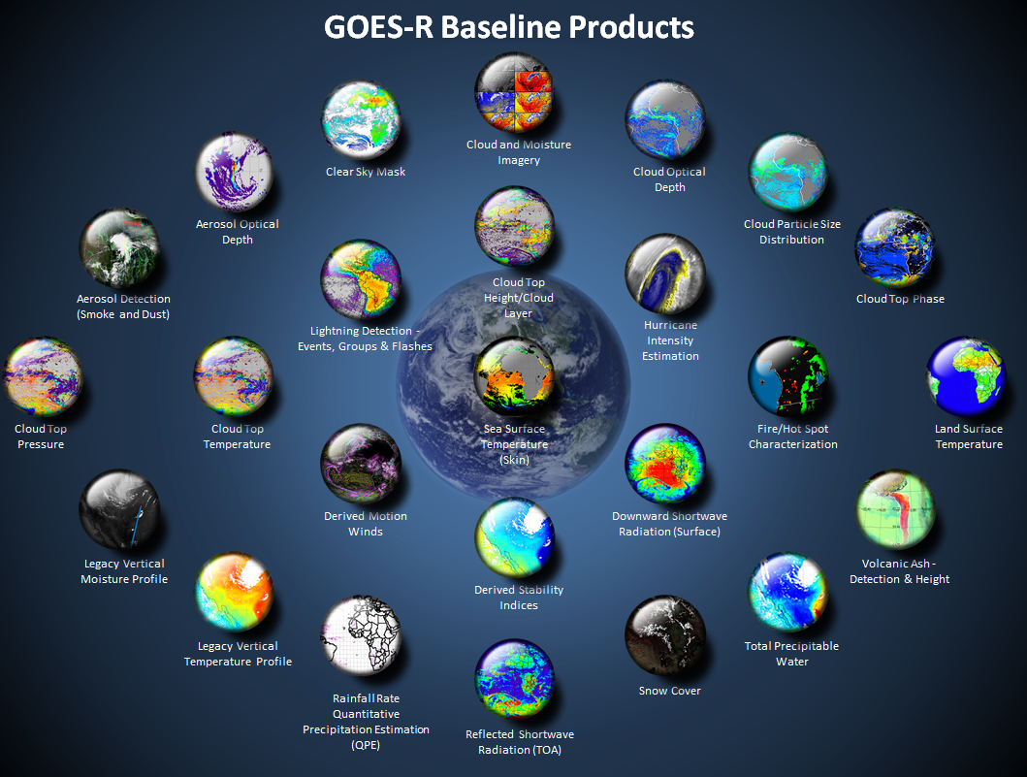
Cloud Optical Depth
Cloud Particle Size
Clear Sky Mask
Cloud Top Height
Cloud Top Phase
Cloud Top Pressure,
Temperature
http://www.goes-r.gov
Notes:
The subjects of this GOES-R Baseline products training are the different cloud products boxed in yellow. There are a lot of them and some -- chiefly the cloud mask -- have a big influence on other products.

Slide 3
Learning Objectives Baseline Products
Which ABI bands are used for the Cloud Products
Cloud Product Production order
Temporal cadence and spatial resolution of products
Limitations
Sample uses of products
Clear Sky Mask (i.e., Cloud Mask)
Cloud Optical Depth
Cloud Particle Size
Cloud Top Height
Cloud Top Phase
Cloud Top Pressure
Notes:
Learning objectives for this training are listed on the left -- you'll learn which ABI bands are used for products, how the products are produced (there is a specific order), the temporal and spatial resolution, and some sample uses and limitations.
GOES-R Baseline Cloud Products are listed on the right. These are the products that will be available in AWIPS.

Slide 4
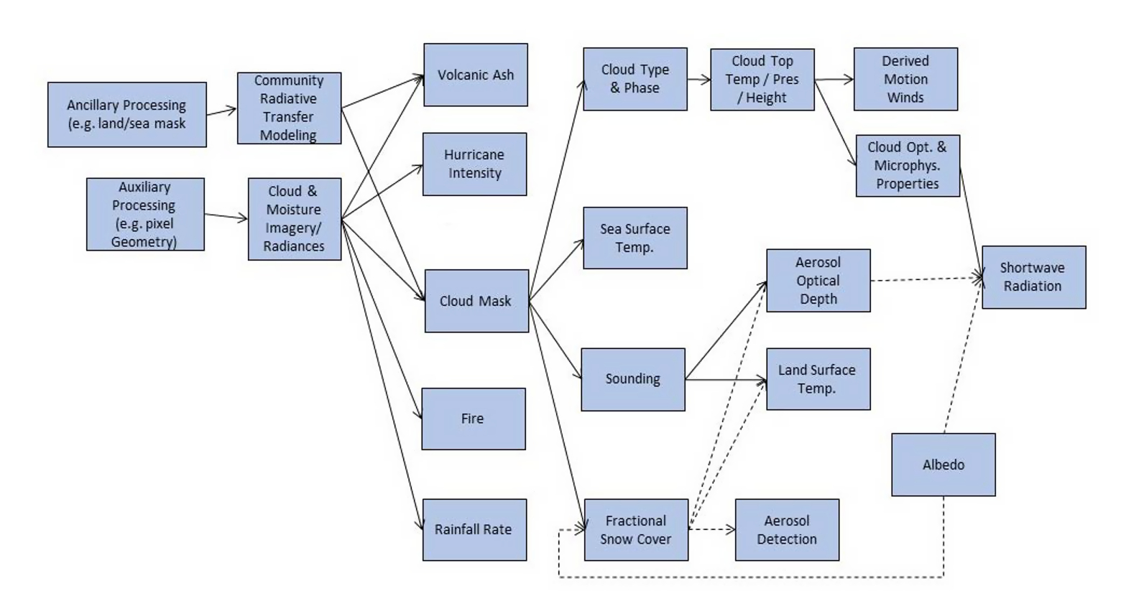
Cloud Mask influences – and must be computed before – many many products!
Part of this training
Figure from Schmit et al., 2017
If there is a problem in the products ‘downstream’ of Cloud Mask, look at the Cloud Mask to help diagnose the problem
Notes:
This 'flow chart' shows how the products are computed. Note that the Cloud Mask is computed first, then cloud type/phase, the cloud top parameters and then cloud optical properties. If you find something suspicious in a cloud product, or in a product that might rely on cloud-clearing, step 1 should be to examine the Cloud Mask - it's not perfect and it can causes errors in downstream predictions. In the case above, if Cloud Masking is wrong, it can introduce errors into every variable within the dashed red box! Similarly, if Cloud Typing/Phase is wrong, Cloud Top Pressure and microphysical properties will be affected.

Slide 5
Cloud Product Production Order
Clear Sky Mask (i.e., Cloud Mask)
Cloud Type/Cloud Phase
Cloud Top Temperature/Pressure/Height
Cloud Optical/Microphysical Properties
Notes:
As noted, there is an order to how the Cloud Products are created. Each builds on its predecessor or requires information from the predecessor.

Slide 6
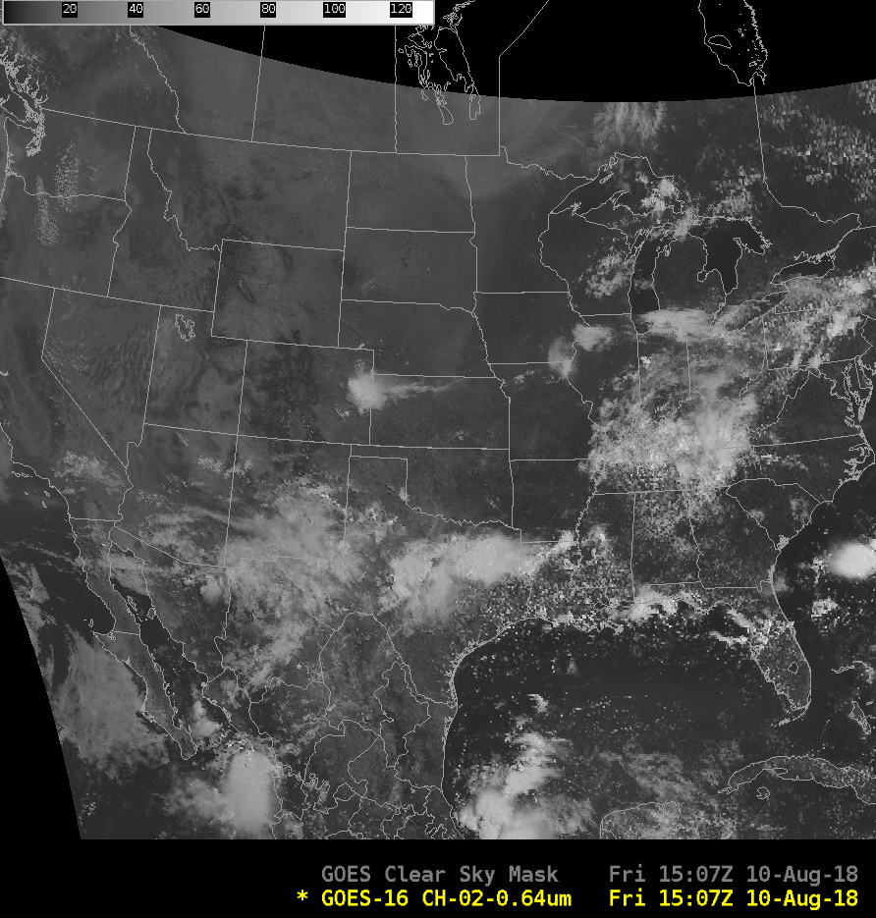
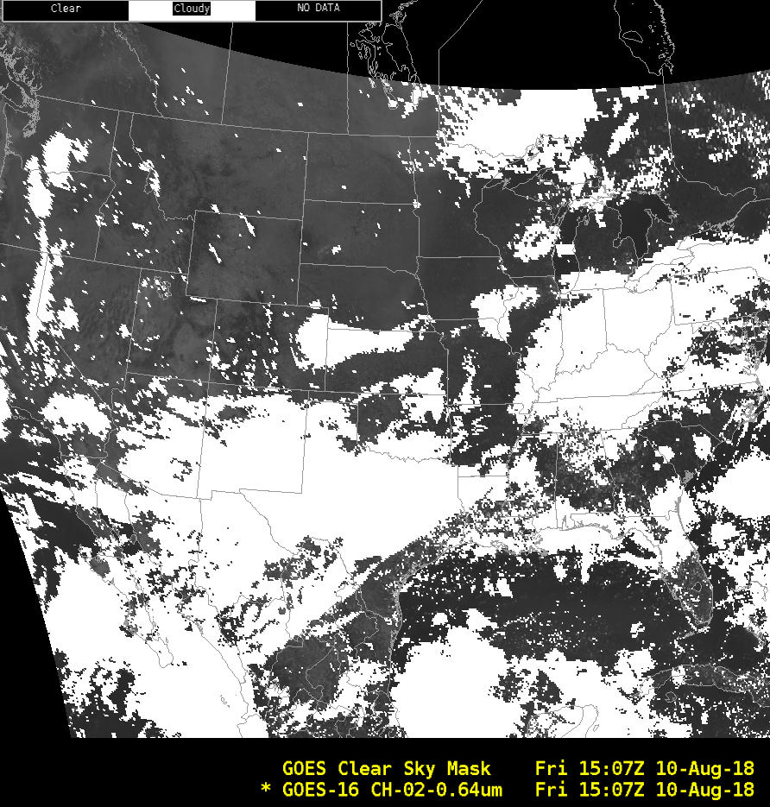
The first thing created in the product stream : Clear Sky Mask
0.64 μm
Clear Sky Mask
Notes:
Clear Sky Mask is produced with every CONUS image, and an example is shown here. Clouds are denoted as white, clear regions have missing values and are transparent. Note the region over Virginia. Clouds are not apparent in the visible (but they are in the 1.38 micrometer cirrus channel) but the Clear Sky mask correctly identifies the region as cloudy

Slide 7
Clear Sky Mask
Temporal Refresh
  Full Disk Domain: 15 minutes
  CONUS Domain: 5 minutes
  MESO Domain: 1 minute
2-km resolution
Assumes clear pixels, tries to find evidence of cloud
Produced out to a Satellite Zenith Angle of 70º
Four categories produced: Clear, probably Clear, Probably Cloudy, Cloudy. AWIPS displays Clear (Missing)/Cloudy (White).
Misclassification is more likely for large zenith angles
Warm low cloud is sometimes misclassified as probably clear or probably-cloudy
Artifacts are most likely in coastal regions and near the terminator.
ATBD for more information
Notes:
The Clear Sky Mask is computed for every image in Full Disk CONUS and MESO domains. It has 2-km resolution. The default is clear. The algorithm seeks evidence of clouds. It is produced out to a local satellite zenith angle of 70degrees. There are known limitations with the cloud mask, chiefly at high viewing angles, over warm clouds, and in coastal regions or near the terminator (the divide between day and night)

Slide 8
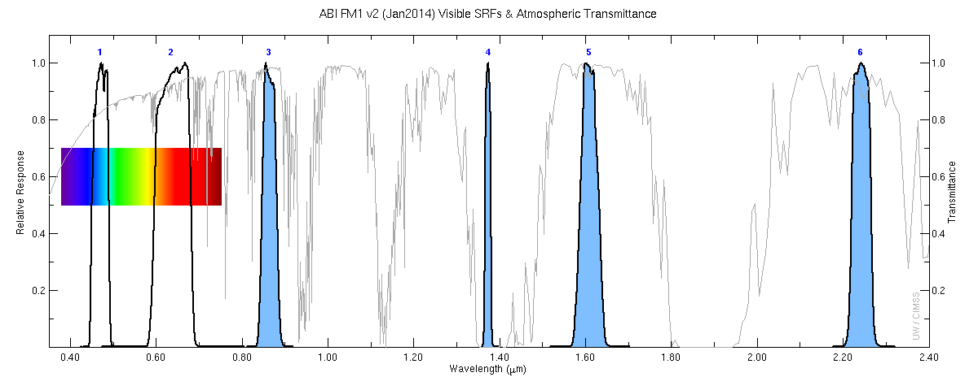
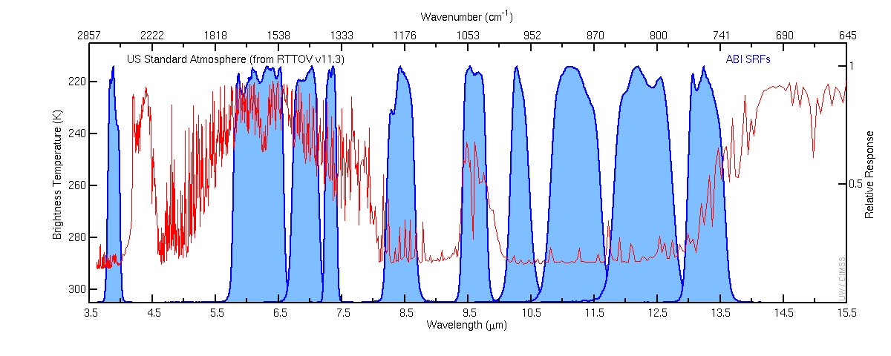
0.64 μm
1.4 μm
1.61 μm
What bands are used for ABI Cloud Mask (ACM)?
ABI
7
8
9
10
11
12
13
14
15
16
3.9 μm
7.3 μm
8.4 μm
11.2 μm
12.3 μm
Band 9 (6.9 μm) is used if Band 10 is not available
Notes:
Which bands are used to create the ABI cloud mask? Visible (0.64 micrometers), the Cirrus Channel (1.4 micrometers) and the Ice Channel (1.6 micrometers). The infrared channels used are the 3.9 micrometer channel, the low-level water vapor (7.3 micrometers), the 8.4 micrometer channel, and the 11.2 and 12.3 micrometer channels.

Slide 9
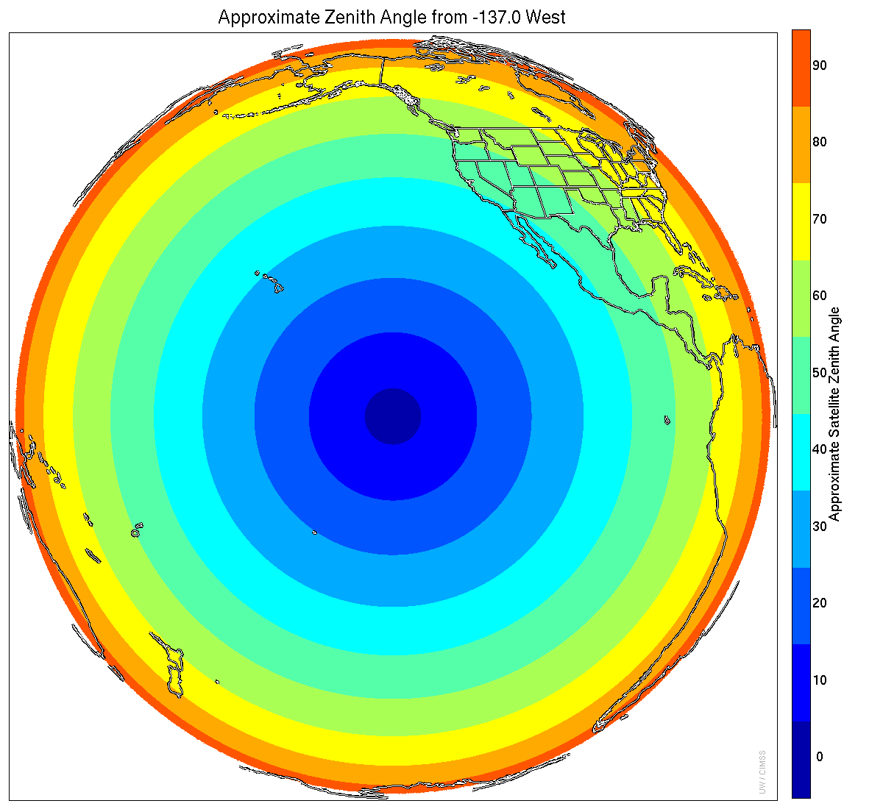
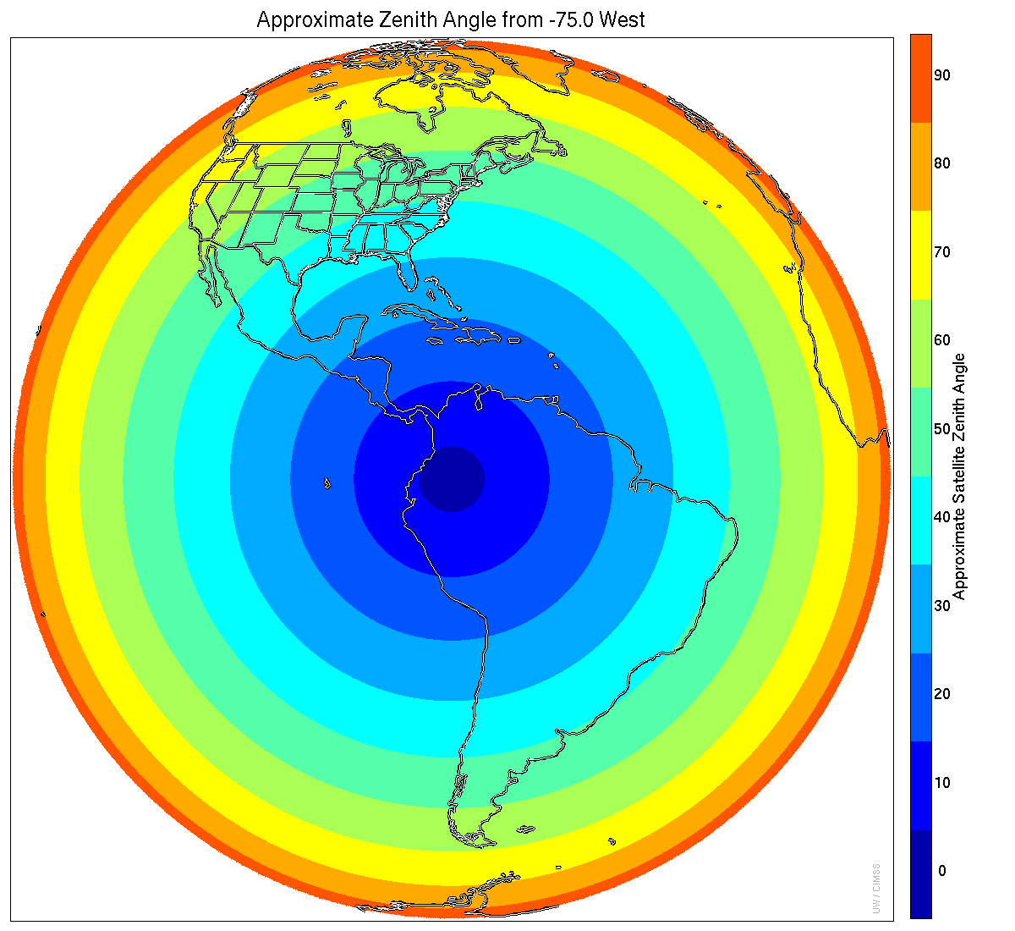
Cloud Mask Computed for Satellite Zenith Angle up to 70º
(halfway into the yellow is a satellite zenith angle of 70 degrees)
Satellite Zenith Angle is 0 at Nadir, and it approaches 90 as you move towards the limb
Notes:
Cloud Mask is computed up to a satellite zenith angle of 70 degrees, which is shown graphically here for the GOES-West and GOES-East locations. Note that Cloud Mask over most of Alaska and the eastern US cannot be quantitatively computed from GOES-West. Similarly, Cloud Mask for much of Western Canada cannot be computed from the GOES-East position.
Some cloud products computed subsequent to Cloud Mask are not computed all the way out to a satellite zenith angle of 70 -- they cut off at 62 or 65 degrees.

Slide 10
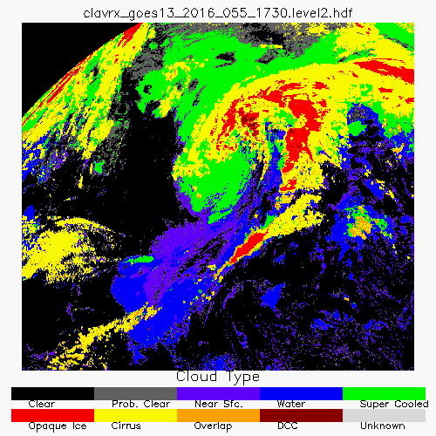
Cloud Type
Algorithm: CLAVR-x Cloud Type
(NOT Baseline)
Clouds are divided into 7 categories:
Near-sfc
Water
Super-cooled
Opaque ice
Cirrus
Overlap (cirrus over low cloud)
Deep convective cloud (DCC).
‘Clear’ and ‘Probably Clear’ are derived from the cloud mask.
DCC is convection that has reached the tropopause.
Super-cooled clouds are based on temperature.
Glaciation changes give insight into growing convection.
Use for seeder-feeder situations.
Qualitative way to distinguish cloud layers.
More details in ATBD
Notes:
Once Cloud Mask is computed, Cloud Type as shown here is then computed. Cloud Type is a Future Capability product - it is not baseline and it is not available in AWIPS - but it is used by other products. Cloud Type is a way to identify cloud layers and cloud types.

Slide 11
Cloud Phase is defined after Cloud Type
Cloud Mask is input
Temporal Refresh
  FD: 15 minutes
  CONUS: 5 minutes
  MESO: 1 minute
2-km resolution
Computed to a Local Zenith Angle of 65º
Uses Bands 10,11,14,15 (7.3 μm, 8.4 μm, 11.2 μm, 12.3 μm)
Cloud Phase, a baseline product, is derived from Cloud Type
Four Categories:
  Warm liquid water (liquid water cloud ; opaque cloud temperature > 273 K)
  Supercooled liquid water (liquid water topped cloud ; opaque cloud temperature < 273 K)
  Mixed phase clouds (high probability of both liquid water and ice near cloud top)
  Ice phase clouds (all ice topped clouds)
Notes:
The baseline product associated with Cloud Type is Cloud Phase. Cloud Phase is produced every 15 minutes (for the Full Disk domain) every 5 minutes for CONUS and every minute for Meso domains). It's computed out to a local zernith angle of 65 degrees, and Only uses IR bands to avoid day/night discontinuities that would arise if reflectance bands were used.
The Baseline Product Cloud Phase that is available in AWIPS includes four separate categories: warm liquid water clouds, super-cooled liquid water clouds, mixed phase cloud, and ice phase clouds.

Slide 12
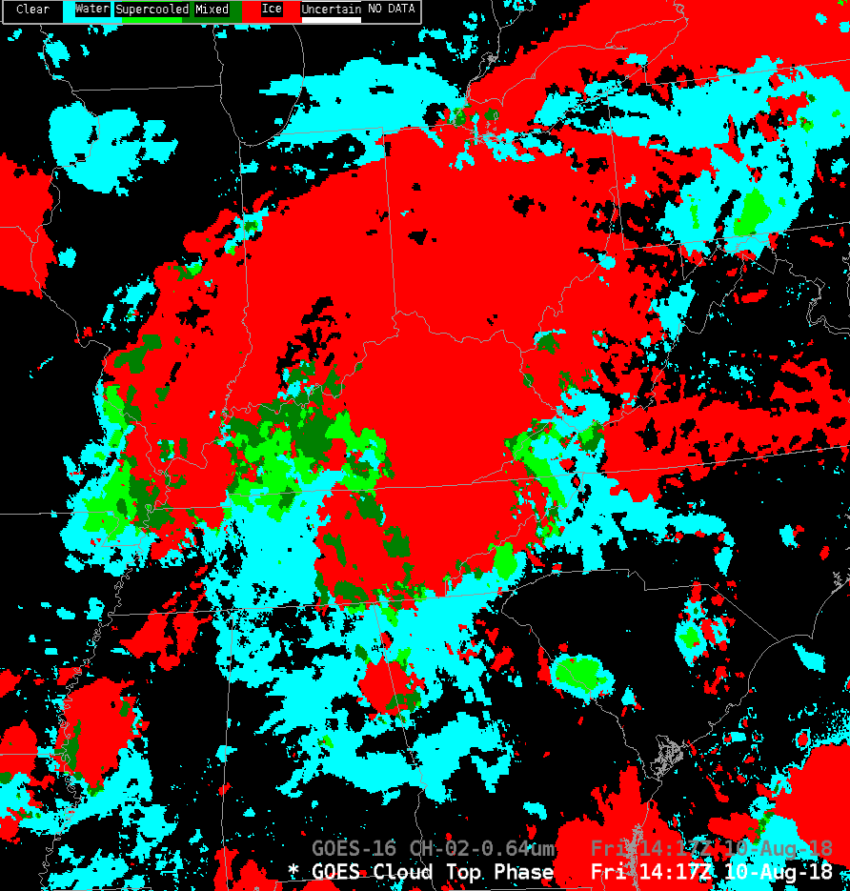
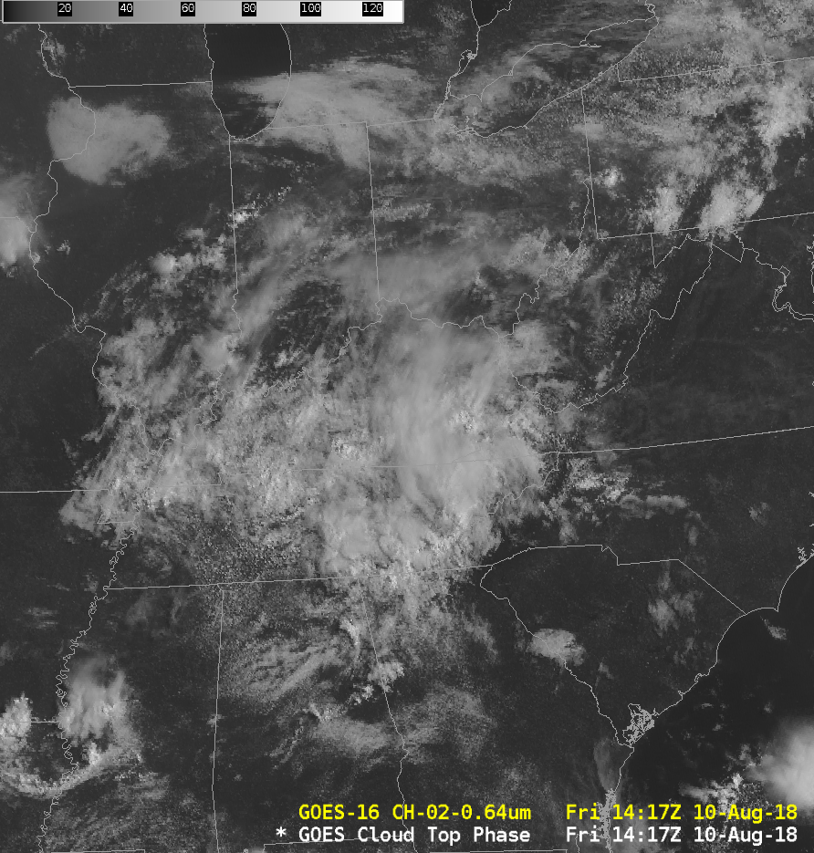
Cloud Phase: Baseline
Liquid Water Clouds
Mixed Phase Clouds
Created with every image: 15-minute FD, 5-minute CONUS, 1-minute MESO
Supercooled Water Clouds
Glaciated with lightning?
Seeder-Feeder?
Ice Clouds
Notes:
Here's an example showing Visible imagery on the right, and the Cloud Phase product on the left.

Slide 13
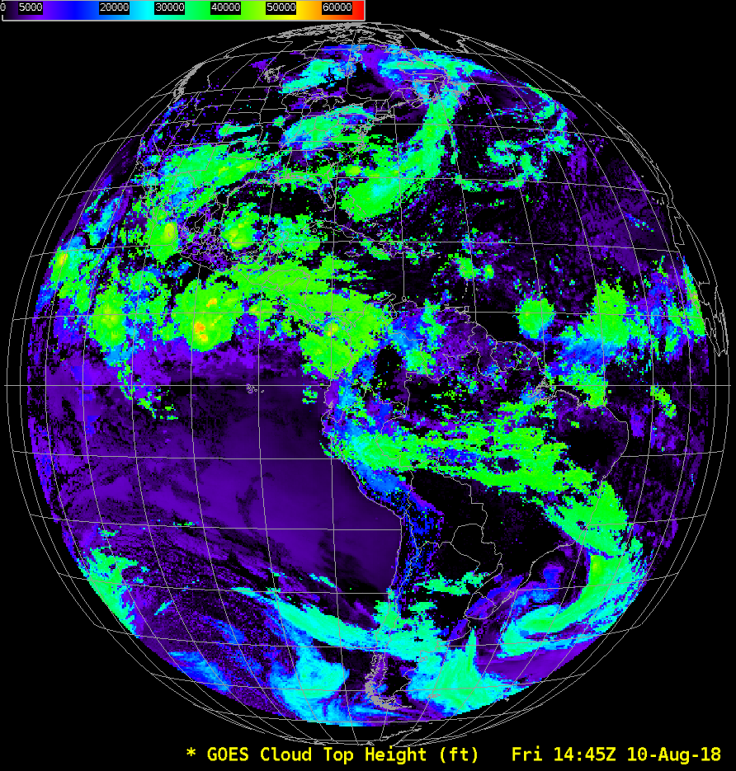
ABI Cloud Height
Requires Cloud Mask and Cloud Phase
Full Disk Domain: Every 15 minutes
CONUS Domain: Every 5 minutes
MESO Domain: Every 1 minute/30 seconds
Averages good quality pixels:
(FD/CONUS domains): 10-km resolution (MESO domains): 4-km resolution
Quantitative to 62º zenith angle
Qualitative for > 62º zenith angle
Uses ABI Bands 14,15,16 (11.2 μm, 12.3 μm, 13.3 μm)
An acronym you might see: ACHA: ABI Cloud Height Algorithm
Dubious results for thin cirrus
Low-level Inversions introduce uncertainty
NWP guidance helps and is used over the ocean with water clouds.
Notes:
Cloud Top Height (a baseline product very useful for Aviation) is computed for every Full Disk, CONUS and Meso image. For Full Disk and CONUS domains, the product has 10-km resolution (meaning 5x5 pixel footprint can be used -- the best 2-km pixels within the footprint give information); in the MESO domain there is 4-km resolution (a 2x2 pixel footprint is used). Height is computed using Bands 14, 15, 16 (11, 12, 13 micrometers) and it requires the cloud mask and cloud phase. It does not necessarily gives a good answer with thin cirrus -- thin cirrus is a problem for many cloud products.

Slide 14
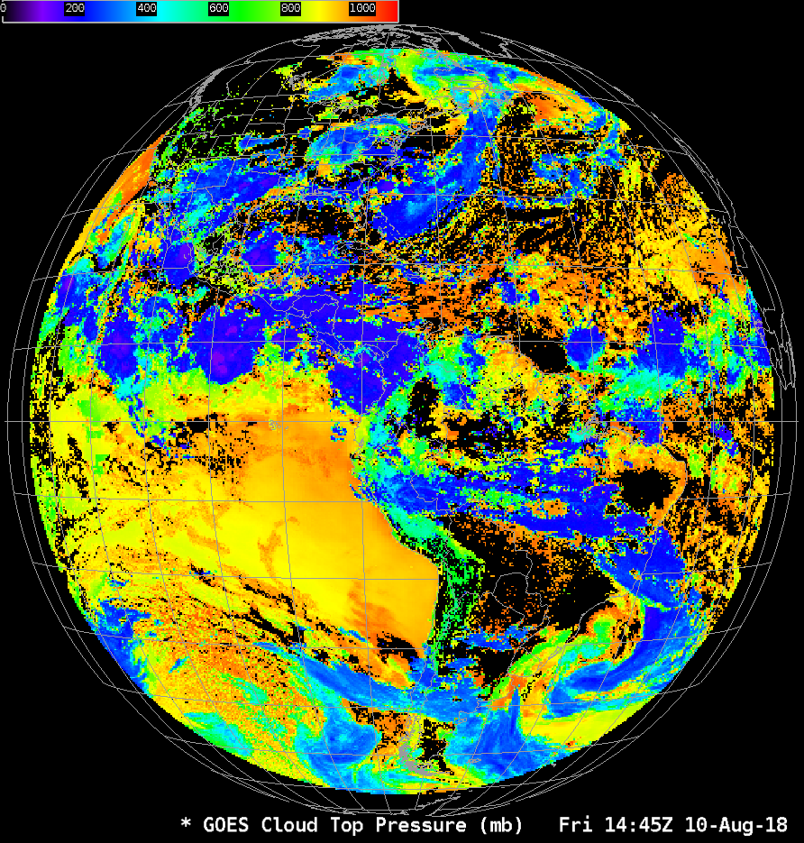
Cloud-top Pressure: derived with Cloud Height
Algorithm: AWG Cloud Height Algorithm (ACHA)
The atmospheric pressure of the highest cloud layer in the column
Part of ABI Cloud Height Algorithm (ACHA) output
Full Disk Domain: Every 15 minutes
CONUS Domain: Every 5 minutes
MESO Domain: Every 1 minute
Averages good quality pixels:
FD/CONUS: 10-km resolution
MESO: 4-km resolution
Quantitative to 62º zenith angle
Qualitative for > 62º zenith angle
Computed using ABI bands 14, 15, 16
Dubious results for thin cirrus
Aviation Applications
Notes:
Cloud Top Pressure -- a baseline Product that is also used in aviation -- is derived simultaneously with Cloud Top Height and Cloud Top Temperature. It is computed for all Full Disk, CONUS and Meso images, and has a 10-km resolution at Full Disk and CONUS domains and a 4-km resolution in Meso domains; this is the same temporal cadence and horizontal resolution as cloud top height. Forecast model temperature profiles convert cloud top temperature computed to cloud top pressure and cloud top height.
ACHA variables are computed using bands 14, 15, 16 on ABI - that is, 11.2, 12.3 and 13.3 micrometers on GOES-R's ABI

Slide 15
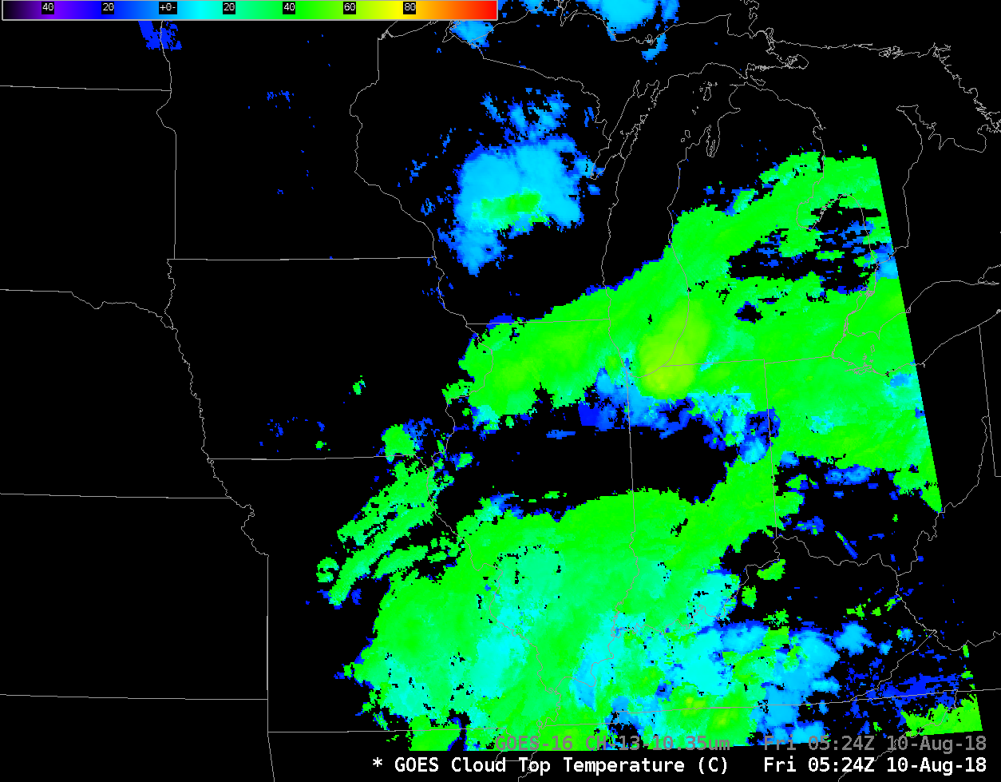
Cloud-top Temperature
Algorithm: AWG Cloud Height Algorithm (ACHA)
The effective radiative temperature of the highest cloud layer in the column.
Generally gives more accurate information than a single window channel
Part of ABI Cloud Height Algorithm (ACHA) output
Full Disk Domain: Every 15 minutes
MESO Domain: Every 1 minute
Not computed for CONUS domain!
2-km resolution
Quantitative to 62º zenith angle
Qualitative for > 62º zenith angle
Computed using ABI bands 14, 15, 16
Dubious results for thin cirrus
Default AWIPS color scale from -109 to 55
Notes:
Cloud Top temperature is also Baseline, and it's a product that is used in other products because it generally gives a more accurate value than individual channels. It is computed in concert with Cloud Top Height and Cloud Top Pressure as part of the ABI Cloud Height Algorithm (ACHA). The temporal cadence and horizontal resolution is shown.
It's computed using the three longest wavelength band on ABI: 14, 15, 16 -- that is, 11.2, 12.3 and 13.3
Cloud Top Temperature is computed for every Full Disk image, and for every MESO image. It is not computed for CONUS domains.

Slide 16
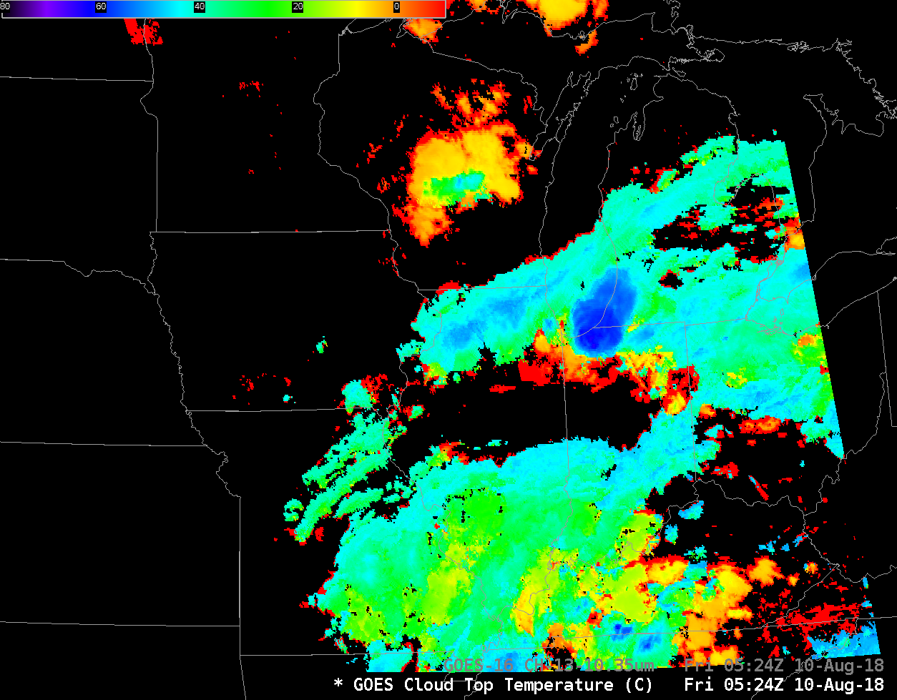
Cloud-top Temperature
Algorithm: AWG Cloud Height Algorithm (ACHA)
The effective radiative temperature of the highest cloud layer in the column.
Generally gives more accurate information than a single window channel
Part of ABI Cloud Height Algorithm (ACHA) output
Full Disk Domain: Every 15 minutes
MESO Domain: Every 1 minute
Not computed for CONUS domain!
2-km resolution
Quantitative to 62º zenith angle
Qualitative for > 62º zenith angle
Computed using ABI bands 14, 15, 16
Dubious results for thin cirrus
Modified AWIPS color scale from -80 to 10
and flipped so blue is cold, red is warm
Notes:
Here's the same slide -- but the default color has been changed so that coldest temperatures are blue. Don't be afraid to change color tables! Save them, and then load the products as part of a procedure.

Slide 17
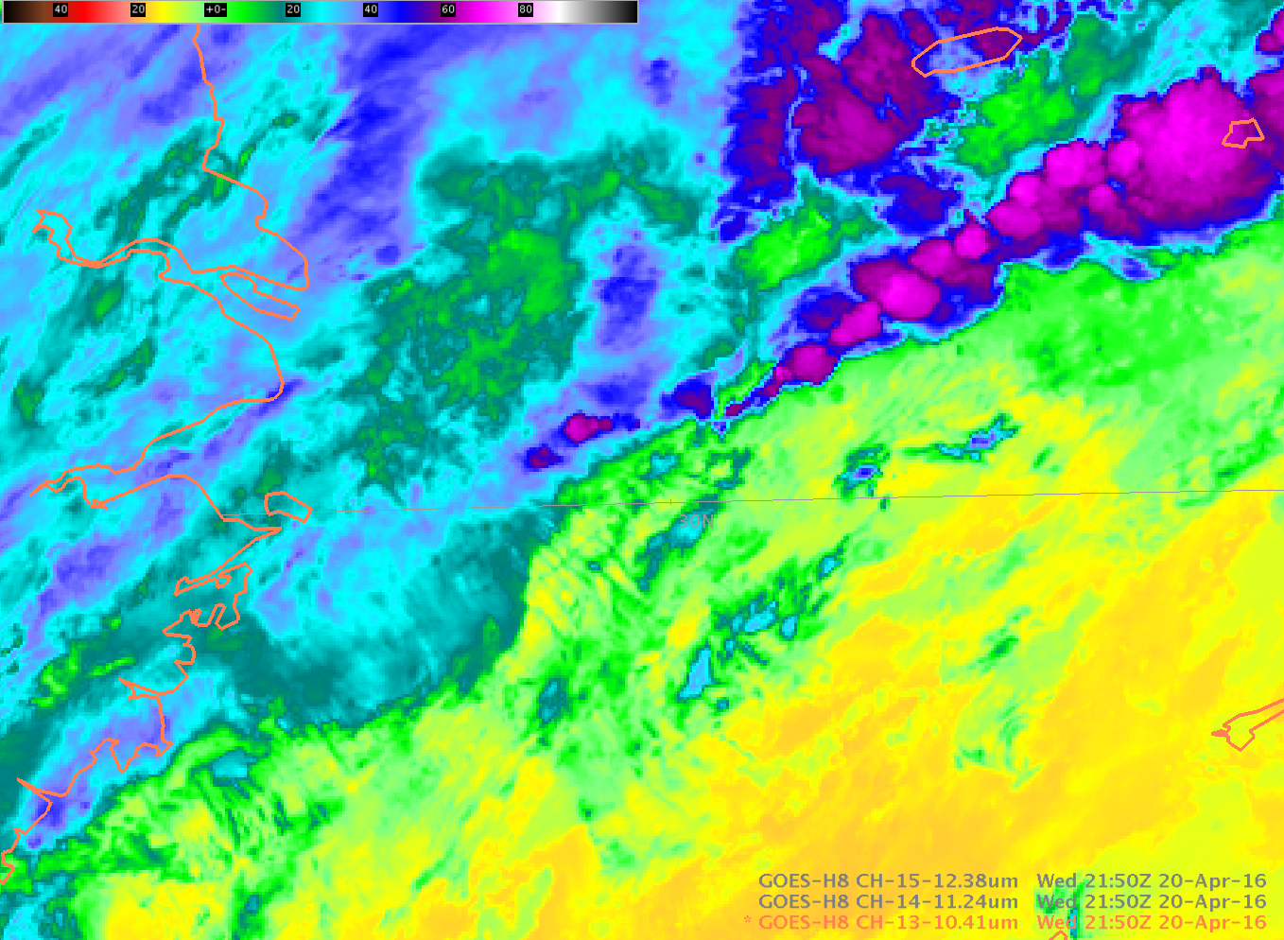
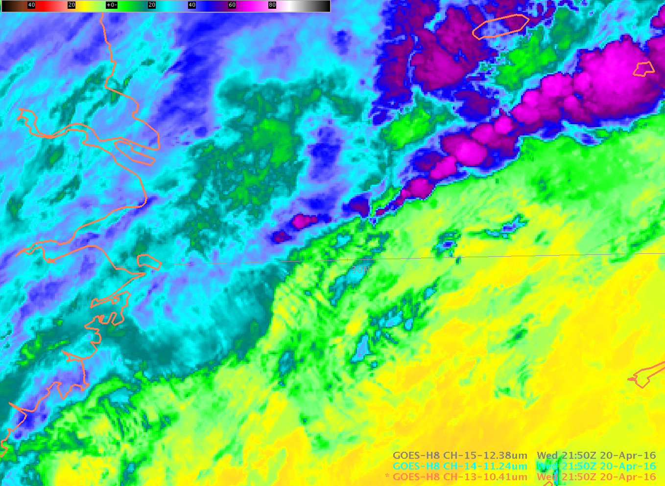
Why not just use Brightness Temperature for the Cloud Top Temperature?
Which brightness temperature do you use if there are multiple window channels? 8.5 μm? 10.3 μm? 11.2 μm? 12.3 μm?
GOES-R ABI offers more choices – maybe the brightness temperature product is not best – because which value is best?
Notes:
And here's a reason why you might want to use the Temperature Product. Which band would you use for a cloud-top temperature? There are 4 good window channels on ABI - which is best?
For The 10.3 and 11.2 micrometer channels shown -- look at the cold cloud top circled in yellow. It's a slightly different temperature. If you need a threshold temperature for an algorithm, this can make a difference

Slide 18
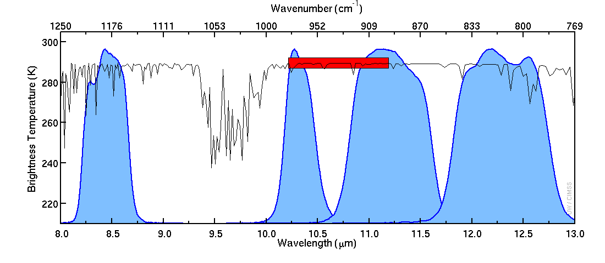
ABI Infrared Window Bands
Width of legacy 10.7 μm spectral response
Spectral response functions for AHI window IR bands
(that are all similar to ABI bands). The red bar is GOES-15.
Notes:
In addition, If you're looking at brightness temperatures, It's hard to compare the legacy GOES Window channel to current ABI channels because the width of the heritage channel is different than the width of the ABI channels. Central wavelengths are different as well.

Slide 19
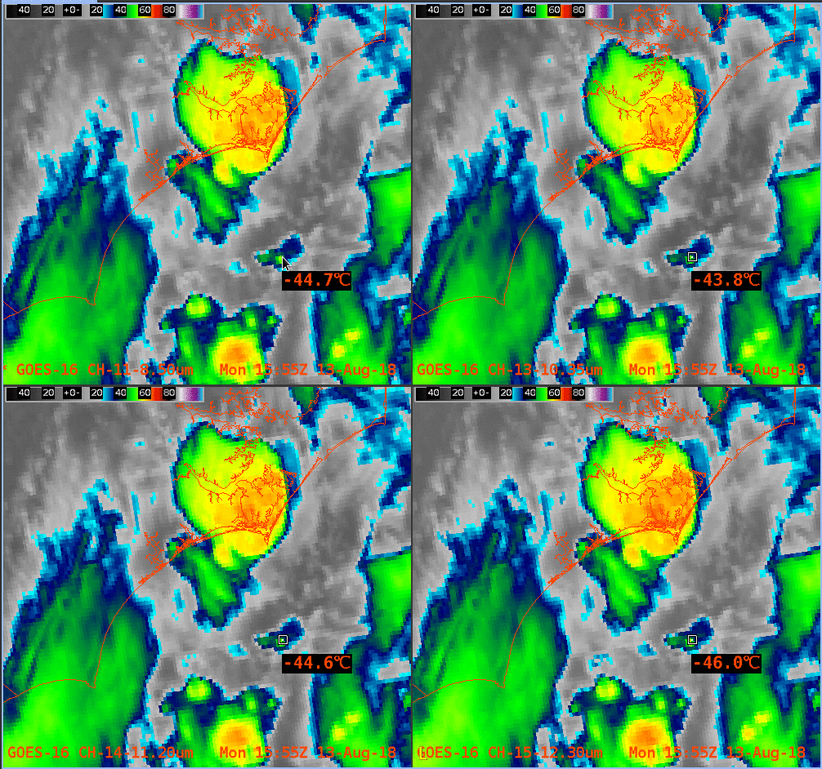
Here are Four IR ABI Window Channels (8.4μm, 10.3μm, 11.2μm, 12.3μm) at 1555 UTC
Band 11
Band 13
Band | Temperature
11 | -44.7 C
13 | -43.8 C
14 | -44,6 C
15 | -46.0 C
Band 14
Band 15
Notes:
Here's an example that shows brightness temperatures for 4 window channels on GOES-16 for a developing cumulonimbus cloud ( the region circled). Brightness Temperature values are close, but not exact. If you were using a threshold of-44 C, for example, there are values are on either side. Brightness Temperature Differs by 2-3 K between the bands. (Note that the cleanest window, the 10.3 micrometer, is the warmest, as expected)

Slide 20

Here are Four IR ABI Window Channels
(8.4μm, 10.3μm, 11.2μm, 12.3μm) at 1556 UTC
Band 11
Band 13
Band | Temperature | δT
11 | -48.6 C | -3.9 C
13 | -48.0 C | -4.2 C
14 | -48.4 C | -3.8 C
15 | -49.9 C | -3.9 C
Band 14
Band 15
Notes:
This is the same scene, but 1 minute later. Cloud top temperatures have cooled. Again, temperatures in the window channel at cloud top differ by about 2-3K. Note that delta-T values, showing cooling, are fairly similar, within 0.4K.

Slide 21
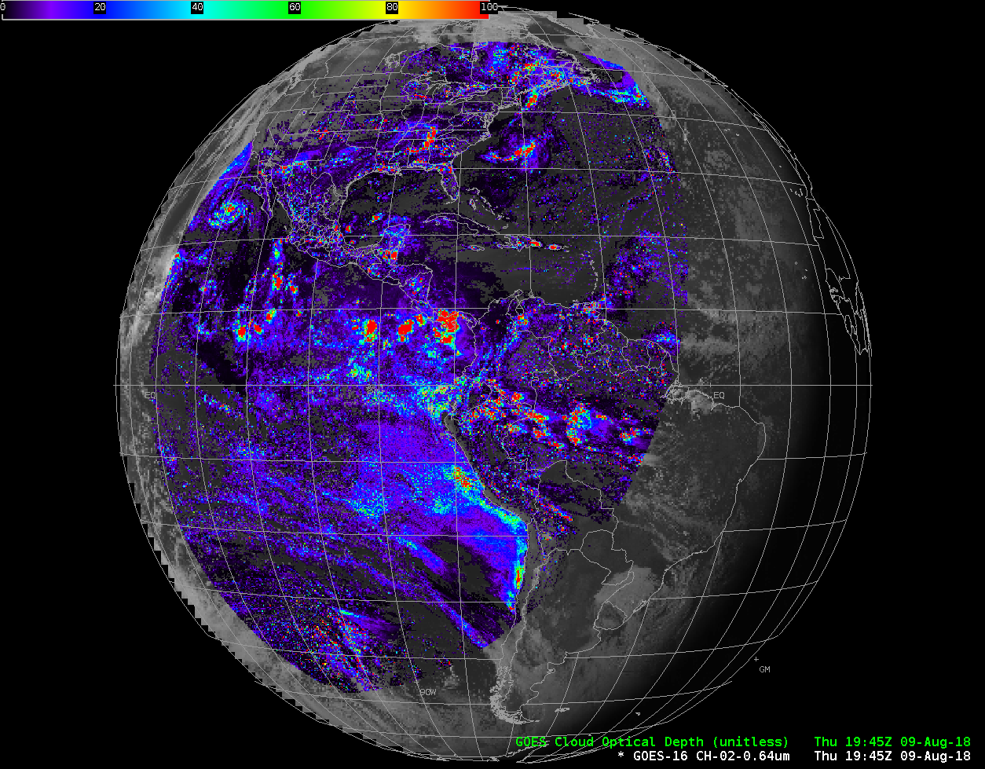
Cloud Optical Depth (Daytime only!)
Algorithm: Daytime Cloud Optical and Microphysical Properties (DCOMP)
Cloud optical depth (COD) is the integrated extinction (attenuation of 0.64 μm light) due to solid water particles through the column.
Computed every 15 minutes for Full Disk, every 5 minutes for CONUS; not produced for AWIPS in Meso domains.
Horizontal Resolution: 4 km (Full Disk) and 2 km (CONUS)
Computed up to a Satellite Zenith Angle of 65º
Computed using Bands 2 and 6 on ABI
Compare COD to AOD – which is computed in the absence of clouds
This daytime-only product is in AWIPS. A nighttime IR product (using Bands 7, 14 and 15) can be found online
Notes:
Cloud optical depth, COD, is a Baseline Product computed using different algorithms in the day and at night. The daytime algorithm is the only one available in AWIPS.
The temporal cadence and horizontal resolution for COD are shown. Note that COD is not produced for AWIPS in MESO domains.
It is computed up to a Satellite Zenith Angle of 65 degrees using the
the visible band 2 (0.64 micrometers) and the cloud particle size band 6 (2.25 micrometers).
The algorithm also requires Cloud Mask, Cloud Phase, and Cloud Height as inputs.
The product is similar to the aerosol optical depth that is computed in the absence of clouds, and it's used to estimate cloud thickness, icing threats, and precipitation.
Cloud Optical Depth at night is infrared-only. Like the day-time reflectance-driven product, it is computed every 15 minutes in the Full Disk and CONUS domains and every 5 minutes in the MESO domain. Horizontal resolution is 4-km for Full Disk and 2-km for CONUS and Meso, and it's not computed for a SZA exceeding 65 degrees.
This product is computed using the shortwave IR channel Band 7 (3.9), the window channel Band 14 (11.2) and the dirty window channel Band 15 (12.3)
The IR product can be used to estimate cloud thickness and cloud bases. It has little skill for low clouds.

Slide 22
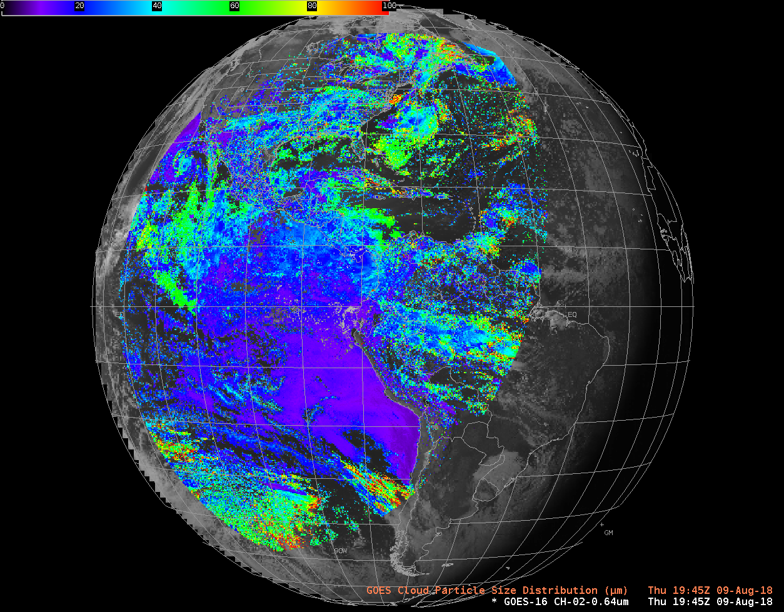
Cloud Particle Size (Day)
Algorithm: Daytime Cloud Optical and Microphysical Properties (DCOMP)
A single metric representing the most common cloud particle size.
Computed every 15 minutes for Full Disk Domains; every 5 minutes for CONUS and every minute MESO domains.
Horizontal Resolution: 4 km (Full Disk) and 2 km (CONUS/MESO)
Computed up to a Satellite Zenith Angle of 65º
Computed using Bands 2 and 6 on ABI
Small ice particles in convection indicate strong updrafts. Large water droplets in boundary layer clouds denote precipitating clouds.
Cannot separate out influence of multiple cloud layers. Values for cirrus over low cloud are under-estimated.
Large uncertainty over bright surfaces.
This daytime-only product is in AWIPS. A nighttime IR product (using Bands 7, 14 and 15) can be found online
Notes:
Cloud Particle Size considers all pixels identified as cloud by the cloud mask. Cloud Particle Size represents the cloud droplet distribution. This is a Baseline Product.
This daytime-only product is computed for every FD CONUS and Meso image. the FUll-disk product has 4-km resolution and the CONUS and MESO domains have 2-km resolution). It is computed using the visible channel band 2 (0.64 micrometers) and the cloud particle size channel band 6 (around 2.2 micrometers)
If you combine cloud particle size with cloud optical depth, you can estimate the cloud mass. also, large water droplets in BL clouds will likely be precipitating.
The IR product has difficulty detecting large particles and low clouds.

Slide 23
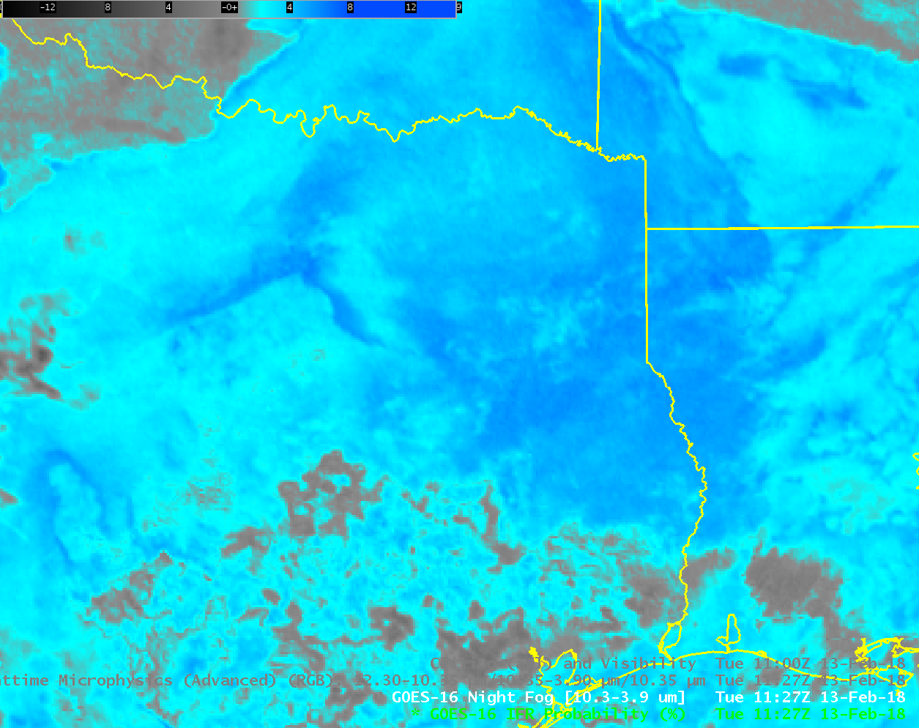
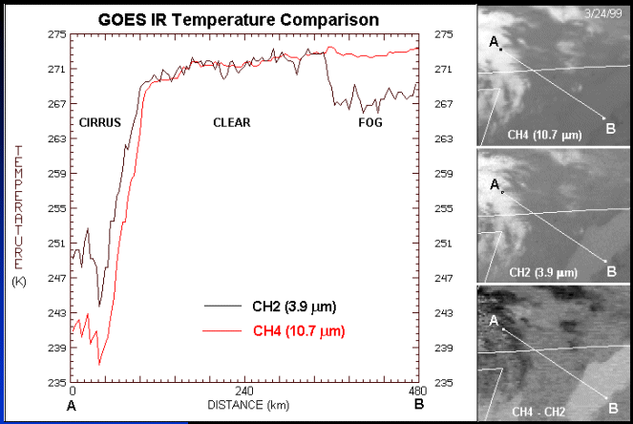
Fog and Low Stratus
Brightness Temperature Difference between 10.3μm and 3.9 μm leverages the emissivity differences in water clouds at those two wavelengths
Problem: Plain Stratus clouds look a lot like fog from the top – that is, from the satellite!
Notes:
Let's switch topics to discuss Fog and Low Stratus. A legacy night-time method for identifying low clouds involves the brightness temperature differences between the window channel (10.7 micrometers on legacy GOES, or 10.3 micrometers, band 13, on GOES-R ABI) and the shortwave IR Channel (3.9 micrometers) on both. Clouds made of water droplets are not blackbody emitters of 3.9 micrometer radiation. Thus, the brightness temperature computed from the radiance sensed by the satellite (a computation that assumes blackbody emissions), will be colder than reality. In contrast, CLouds made of water droplets are more nearly blackbody emitters at wavelengths around 10 or 11 micrometers, so the computed brightness temperatures at those wavelengths are closer to reality. Taking the difference between the two values highlights clouds made of water droplets, that is, stratus. That's shown in the color enhancement, and also in the inset (using Legacy data) that shows a cross-section from fog to cirrus. Computed brightness temperatures shortwave and longwave wavelengths are different because of emissivity differences. (Note that cirrus temperatures are different as well, because of sub-pixel effects that have been described in other Satellite Foundation Courses for GOES-R)
The problem: Stratus and fog can look very similar from the top of the cloud deck. It's very hard for the satellite to view the cloud base!!

Slide 24
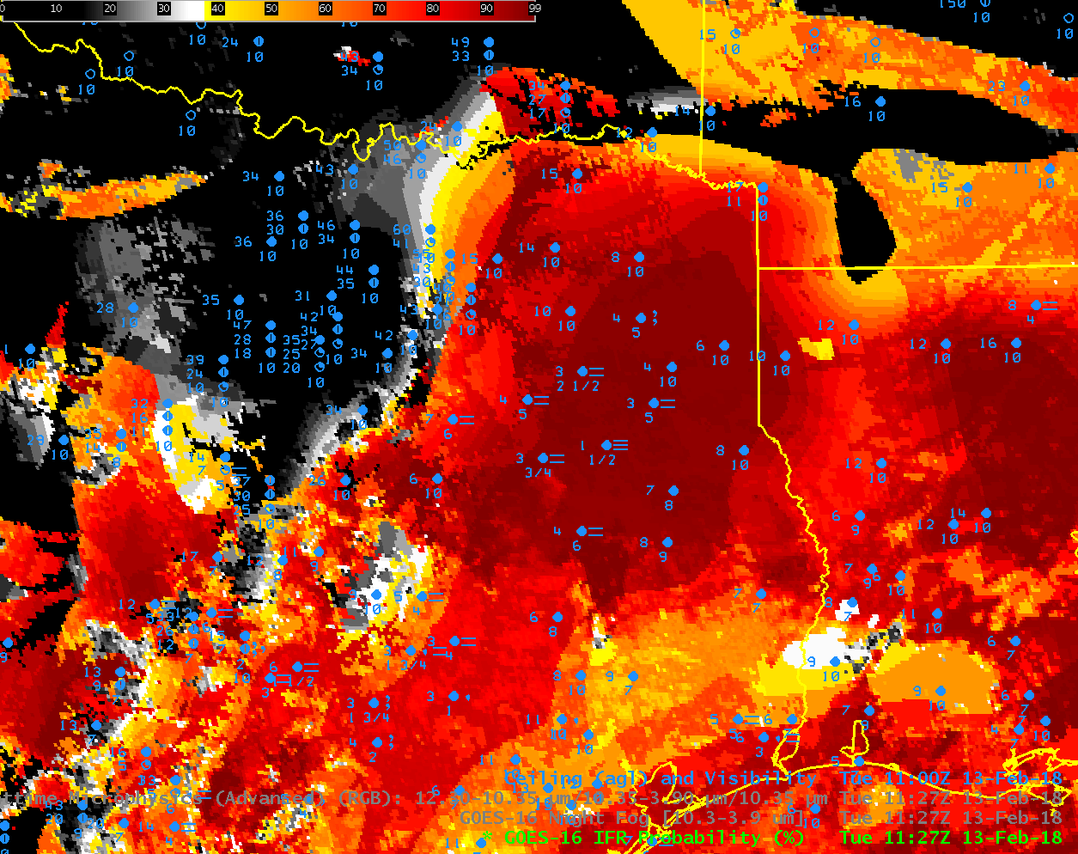
Solution: Fuse Model information about low-level saturation with satellite data
A large Region of mid-level stratus is screened out by the use of Rapid Refresh Model Data: in this region there is no evidence of low-level saturation in the model, so probabilities of IFR conditions are low
Here’s a region where Rapid Refresh data shows saturation where high clouds block the view of low clouds
Notes:
Because mid-level stratus aren't an important aviation hazard -- not usually -- the aviation-focused IFR Probability field was developed to screen out regions of mid-level stratus and highlight only regions of fog on the ground. That product is shown here over Texas. In regions around Dallas, where the brightness temperature difference product on the previous page had a strong signal, IFR Probablilty is low; IFR Probability uses Model Output: if the model output does not show low-level saturation, then it's unlikely that there is fog present. IFR Probability screens out regions of not-interesting mid-level stratus and allow a forecaster to direct more focus to a potential transportation hazard.
Brightness Temperature Difference fields cannot detect low clouds in the present of cirrus, because the emissivity differences of the low clouds aren't apparent to the satellite when cirrus blocks the view. In those cases, an example of which is shown in Louisiana, model data can provide information about low-level saturation even when Satellite data are incomplete, and alert a forecaster to the potential presence of reduced visibility

Slide 25
Internet Resources
ATBD for Cloud Mask
ATBD for Fog/Low Stratus
ATBD on Cloud Type and Cloud Phase
ATBD on Cloud Height/Pressure/Temperature
ATBD on Daytime Cloud Optical/Microphysical Properties
ATBD on Nighttime Cloud Optical/Microphysical Properties
Link to Cloud Products on line (Google Earth kml files)
Blog on IFR Probability Fields
Baseline Products ; Future Capability Products
Notes:
IFR Probability on the previous slide is not a Baseline Product, it is a future capability product. A list of all baseline and future capability products is available at the link on this page.
There are other supplemental links on this page for more in-depth information on these products.
This concludes the GOES-R Training on Cloud Products and Fog Detection. Thank you for listening

