Slide 1
Cyclogenesis: PV Concepts
Scott Bachmeier, Scott Lindstrom
Cooperative Institute for Meteorological Satellite Studies (CIMSS)
University of Wisconsin - Madison
Contributors: Michael Folmer (NOAA/NWS/NCEP/WPC/OPC/SAB)
Andrew Orrison (NOAA/NWS/NCEP/WPC)
October 2018
Notes:
This is the Satellite Foundation Course for GOES-R Training on “Cyclogenesis: PV Concepts”. Subject Matter Experts for this topic were Michael Folmer and Andrew Orrison at NOAA/NWS/NCEP/WPCC. My name is Scott and I will be guiding you through this training.

Slide 2
Lesson Objectives
Review the concept of “potential vorticity (PV) thinking”, and how it relates to cyclogenesis
Discuss satellite identification of “PV anomalies”
Examine a recent case study
Notes:
The learning objectives are listed on this slide. take some time to read them. The Satellite information you will see includes water vapor channels, the AirMass RGB, and the Split WV Brightness Temperature Difference field.

Slide 3
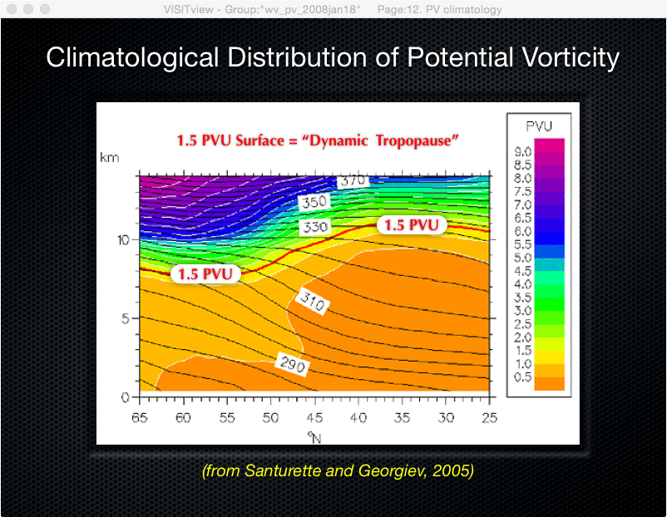
Uses GOES-R ABI Cloud Height Algorithm (ACHA) products: Cloud Mask, Cloud Type, Cloud Top Pressure, Cloud Top Temperature
Notes:
This figure shows the climatological distribution of Potential Vorticity -- latitude is on the x-axis, and height in km is on the y-axis. Potential Vorticity has a reservoir in the straosphere and a variability with latitude. the “Dynamic Tropopause” in Red is the height of the 1.5 Potential Vorticity Unit (PVU) surface. The Dynamic Tropopause generally exists lower in the atmosphere at higher latitudes (toward the poles), and at a higher altitudes in the tropics.

Slide 4
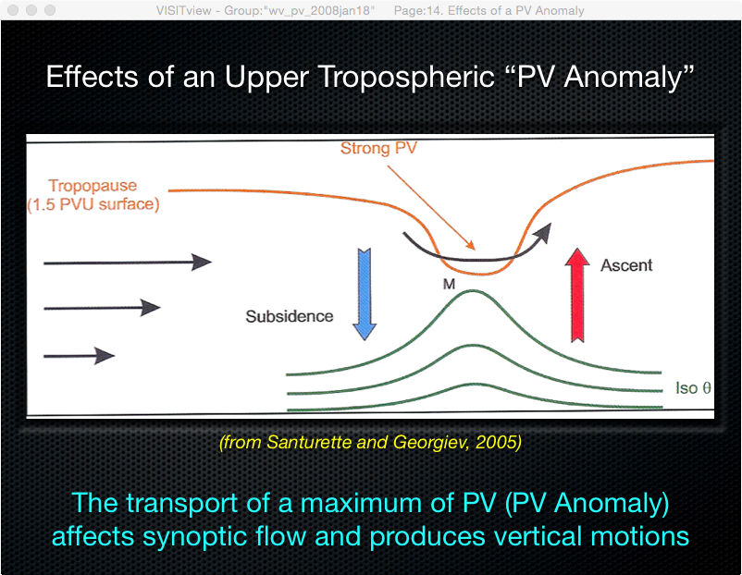
Uses GOES-R ABI Cloud Height Algorithm (ACHA) products: Cloud Mask, Cloud Type, Cloud Top Pressure, Cloud Top Temperature
Notes:
The transport of an upper-tropospheric PV Anomaly can affect lower-level synoptic flow and produce vertical motions (via deformation of the isentropic surfaces) . The Dynamic Tropopause (the 1.5 PVU surface) extends to much lower altitudes in the vicinity of the upper-level PV Anomaly.

Slide 5
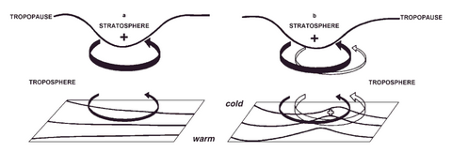
Effect of a PV Anomaly
The classic figure from Hoskins et al. (1985) – the tropopause-level circulation (solid arrows) induces a low level circulation that creates a PV anomaly (open arrows) ; the two PV anomalies work in concert during a cyclogenetic event
This requires a low-level baroclinic zone.
Conclusion: A strong PV signature in WV that is approaching a low-level baroclinic zone: Something to watch and anticipate.
Notes:
This classic figure from the 1985 Hoskins et al. paper shows that the upper level potential vorticity anomaly induces a low-level Potential vorticity anomaly -- and then the two anomalies grow in concert during cyclogenesis when strong upper level forcing (as shown by the PV Anomaly) is driving cyclogenesis.

Slide 6
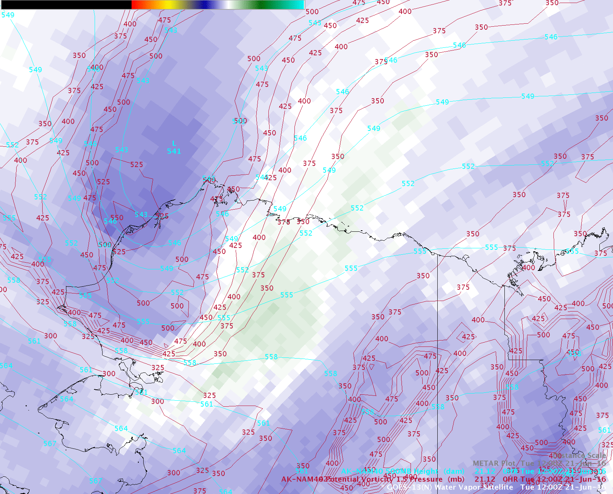
Often a good correspondence between a PV Anomaly
and dry features seen on Water Vapor imagery
Pressure of PV1.5 surface 500 hPa geopotential height
Notes:
There is often a good correspondence between an upper-tropospheric PV Anomaly and dry features seen on GOES Water Vapor imagery. In the example shown here, NAM40 model fields depicted a PV Anomaly at the base of an upper-level low which was moving southeastward across northern Alaska. The Dynamic Tropopause was brought downward to the 600 hPa pressure level in the vicinity of the PV Anomaly near the northwest coast of Alaska (where dry air was also seen on the Water Vapor image). This system produced several inches of snow over parts of the Brooks Range in northern Alaska on the first full day of summer (21-22 June 2016).

Slide 7
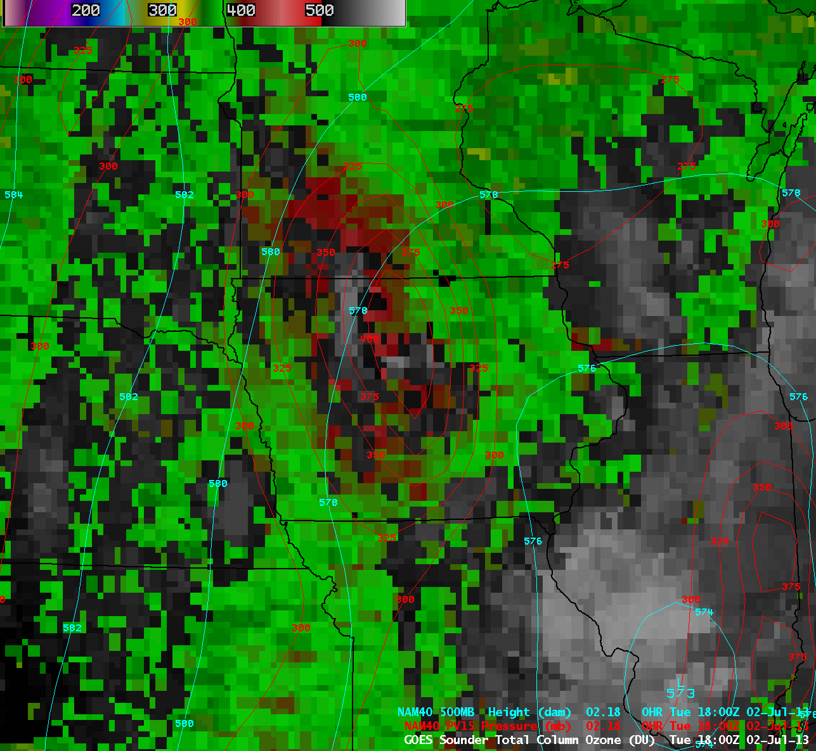
Usually a good correspondence between a PV Anomaly
and high values of Total Column Ozone
Pressure of PV1.5 surface 500 hPa geopotential height
Notes:
If you have access to ozone measurements (from OMPS instruments on polar orbiters, for example), you will often see high concentrations of ozone when the height of the 1.5 PVU surface descends -- because stratospheric air typically has high ozone concentrations. This example shows a Total Column Ozone product from the Legacy GOES SounderWith the 9.7 µm “Ozone band”. And it shows a very good correlation between a PV Anomaly and high values of Total Column Ozone.

Slide 8
High ozone features associated with a PV Anomaly
can be identified using an “Airmass RGB” product
Animation: https://youtu.be/zJh5jG_Va6k
Notes:
In the absence of a Total Column Ozone product, high ozone features can often be identified qualitatively using an Airmass RGB product. In this example of a rapidly-intensifying hurricane force low over the North Pacific, the darker red to pink shades help to highlight an area of high ozone associated with the lowering tropopause beneath a PV Anomaly.

Slide 9
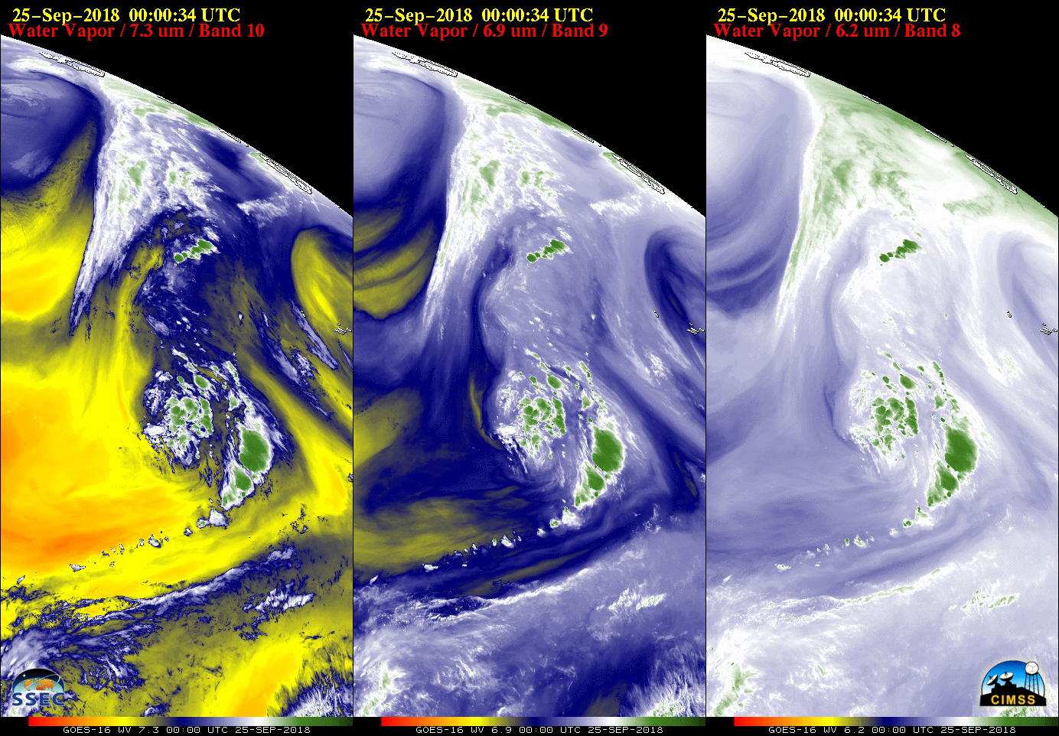
The GOES-R Series ABI instrument has 3 Water Vapor bands:
Low-level (7.3 µm), Mid-level (6.9 µm) and Upper-level (6.2 µm)
Complete animation available here
Notes:
The GOES-R series Advanced Baseline Imager instrument has 3 Water Vapor bands as noted in the labels and these 3 water vapor bands help identify and track 3-dimensional aspects of PV Anomaly features. In this example, note the pronounced drying (that is, descent) that is occurring – especially noteable in the 7.3 micrometer channel – as Tropical Cyclone Leslie starts to undergo extratropical transition in response to the approaching PV anomaly from the northwest.

Slide 10
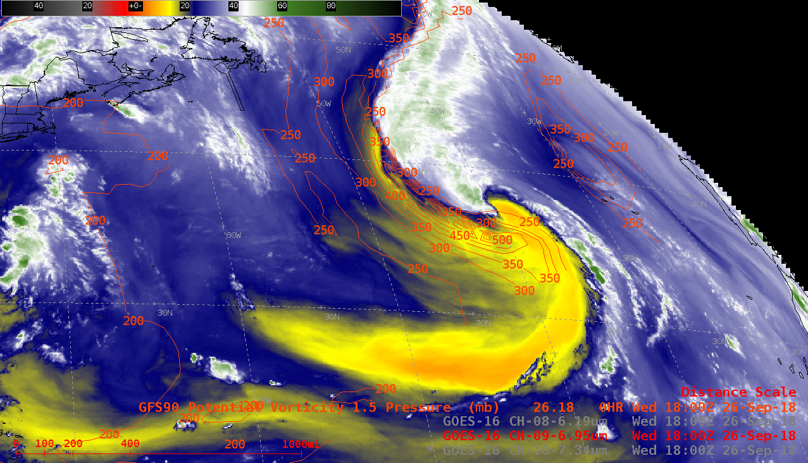
The approach of an upper-level PV Anomaly
aided in the intensification of a surface cyclone
Complete animation available here
Notes:
This animation of GOES-16 Mid-level (6.9 µm) Water Vapor imagery shows the period of warm seclusion intensification of the remnants of Subtropical Storm Leslie over the North Atlantic, beginning after 15 UTC on 26 September 2018.as an upper-level PV approached from the west-northwest. The “dynamic tropopause” - taken to be the pressure of the 1.5 Potential Vorticity Unit (PVU) surface - descended to the 660 hPa pressure level (around 10,000 feet or 3 km) at 18 UTC on 26 September, according to GFS90 model fields.

Slide 11
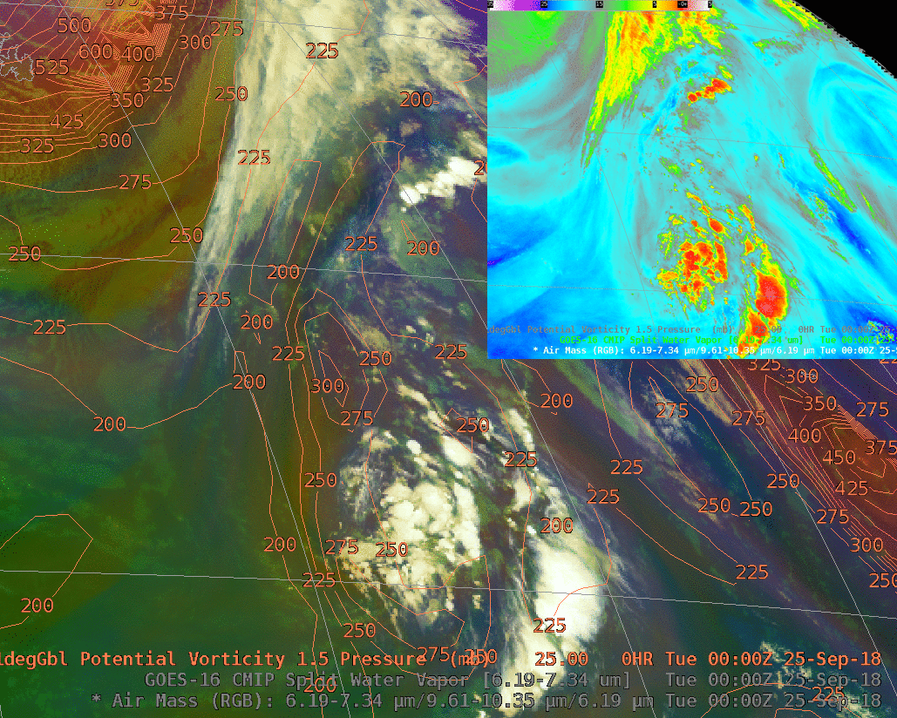
The approach of an upper-level PV Anomaly
aided in the intensification of a surface cyclone
More information
on this storm
Notes:
This shows the GOES-16 Air Mass RGB at 6-hour intervals from 00 UTC on 25 September to 12 UTC on 27 September is shown here, along with GFS contours of pressure on the 1.5 PVU surface. The dynamic tropopause descended to 850 hPa at 06 UTC on 27 September (when the storm was producing hurricane force winds) and eventually to 925 hPa at 12 UTC on 27 September (when it was producing storm force winds . The Air Mass RGB images highlighted the signature of the PV anomaly (shades of red) as it approached from the northwest then wrapped around the western and southern portion of the storm circulation. Note a strong signal, in green, also exists in the Split Water Vapor Difference (6.19 - 7.3 micrometers), inset, for the same times. The Split WV Difference is the red component of the Air Mass RGB.

Slide 12
Summary
The transport of an upper-tropospheric PV Anomaly can affect lower-tropospheric synoptic flow patterns and induce vertical motions
Overlays of model fields such as the pressure (or height) of the PV1.5 surface on water vapor images can help to identify PV Anomalies and track changes in the altitude of the Dynamic Tropopause
The GOES-R series ABI has 3 Water Vapor bands:
  Band 9 (Upper-level Water Vapor, 6.2 µm)
  Band 10 (Mid-level Water Vapor, 6.9 µm)
  Band 11 (Low-level Water Vapor, 7.3 µm)
The “Airmass RGB” and “Split Water Vapor Difference” products can also be used to help locate and follow dry, ozone-rich PV Anomaly features, tropopause folds, etc
Notes:
Here is a summary of the key points discussed in this training. GOES-R Satellite imagery can help diagnose where Potential Vorticity intrusions into the troposphere are occurring. Those are regions where strong cyclogenesis might occur

Slide 13
Internet Resources
GOES-R Water Vapor band Quick Guides:
  Band 8 (6.2 µm) Upper-level Water Vapor
  Band 9 (6.9 µm) Mid-level Water Vapor
  Band 10 (7.3 µm) Low-level Water Vapor
“Split Water Vapor Difference” Quick Guide
“Total Column Ozone” Algorithm Theoretical Basis Document (ATBD)
CIMSS Satellite Blog - PV Anomaly posts
North Pacific Extratropical Hurricane Force Low Centers – Page 8 (Airmass RGB)
GOES-R Website
Notes:
You can find additional information pertaining to water vapor imagery, the Airmass RGB and Split Water Vapor Difference products, and PV Anomaly cases at the links listed here.
This concludes the Satellite Foundational Course for GOES-R on “Cyclogenesis: PV Concepts”. Thanks for listening!

