Slide 1
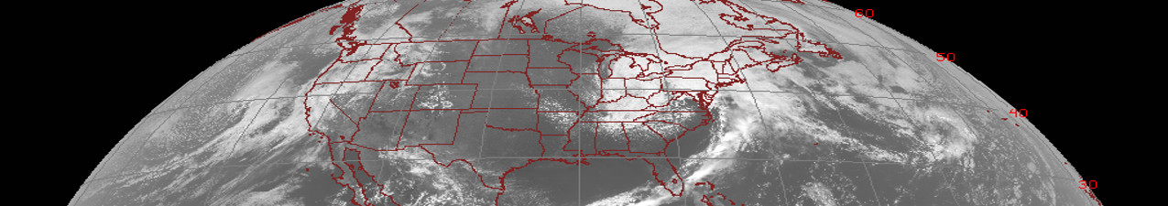




Volcanic Ash Detection and Retrieval
Quick Brief
Scott Lindstrom and Lee Cronce
UW-Madison Cooperative Institute for Meteorological Satellite Studies
Notes:
This Quick Brief discuss the GOES-R Baseline level 2 product that detects Volcanic Ash.

Slide 2
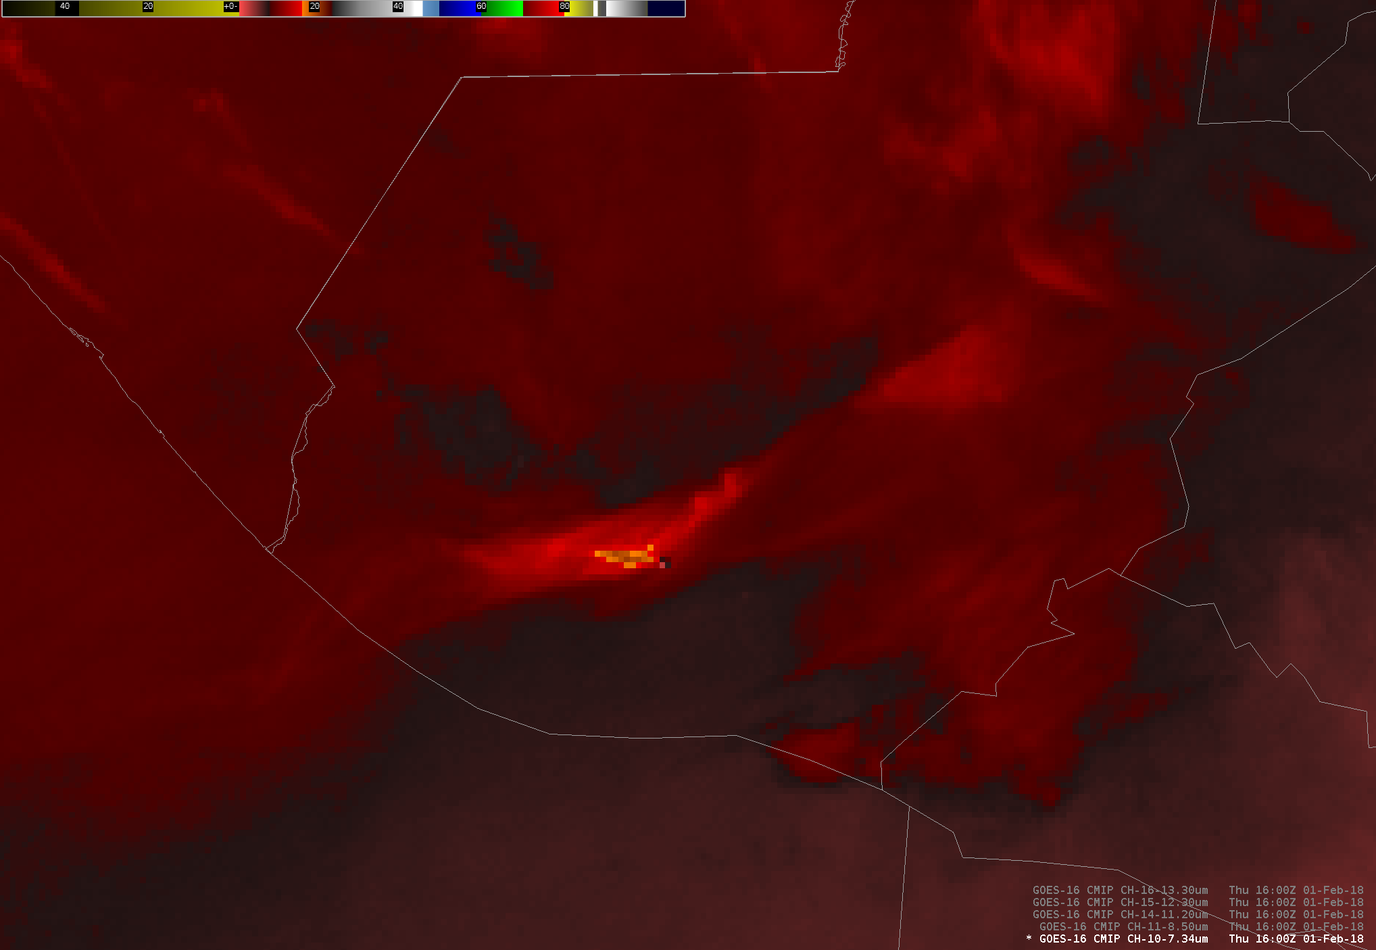
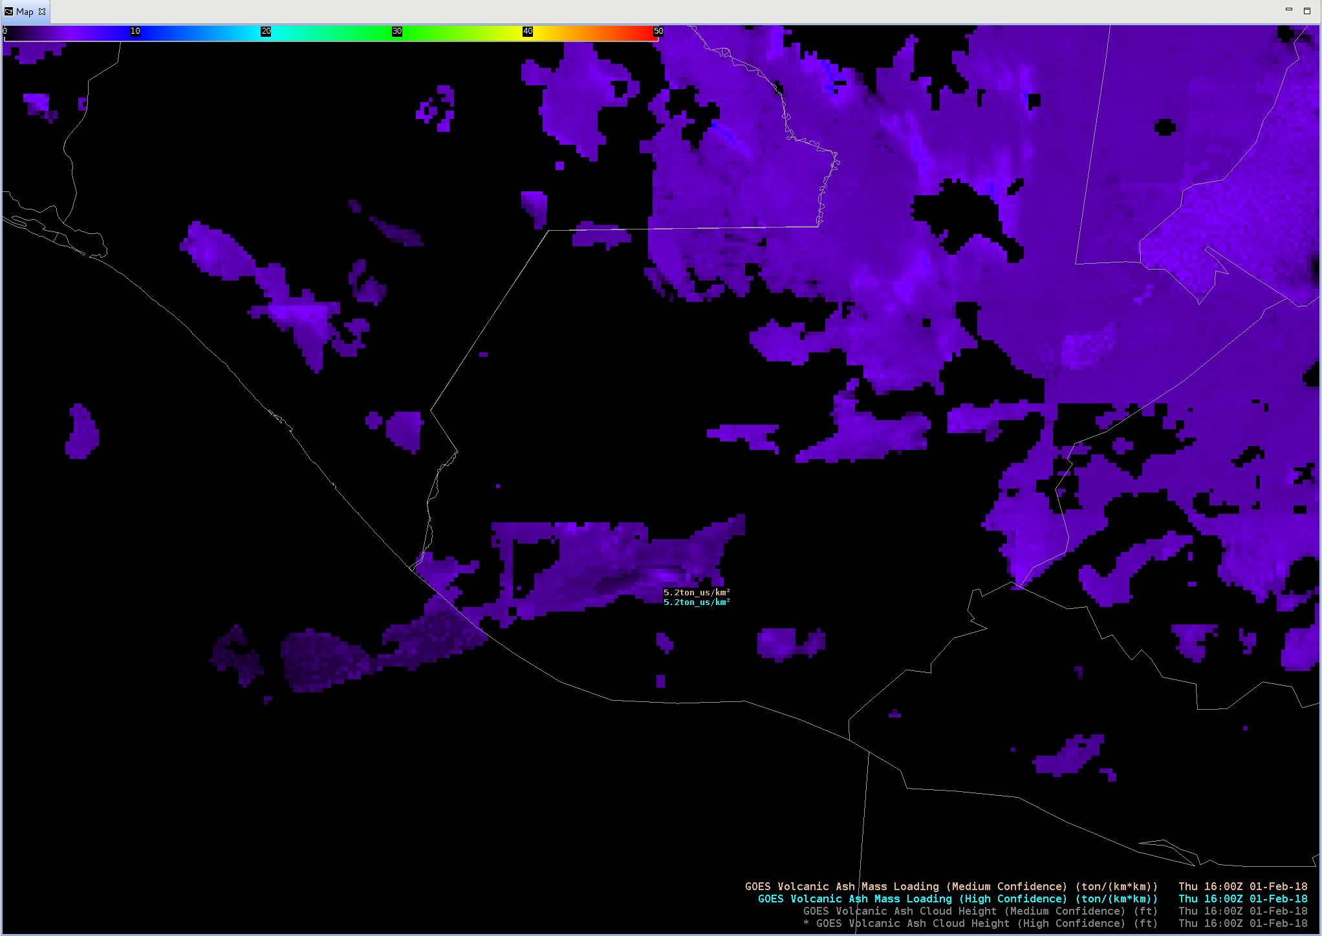
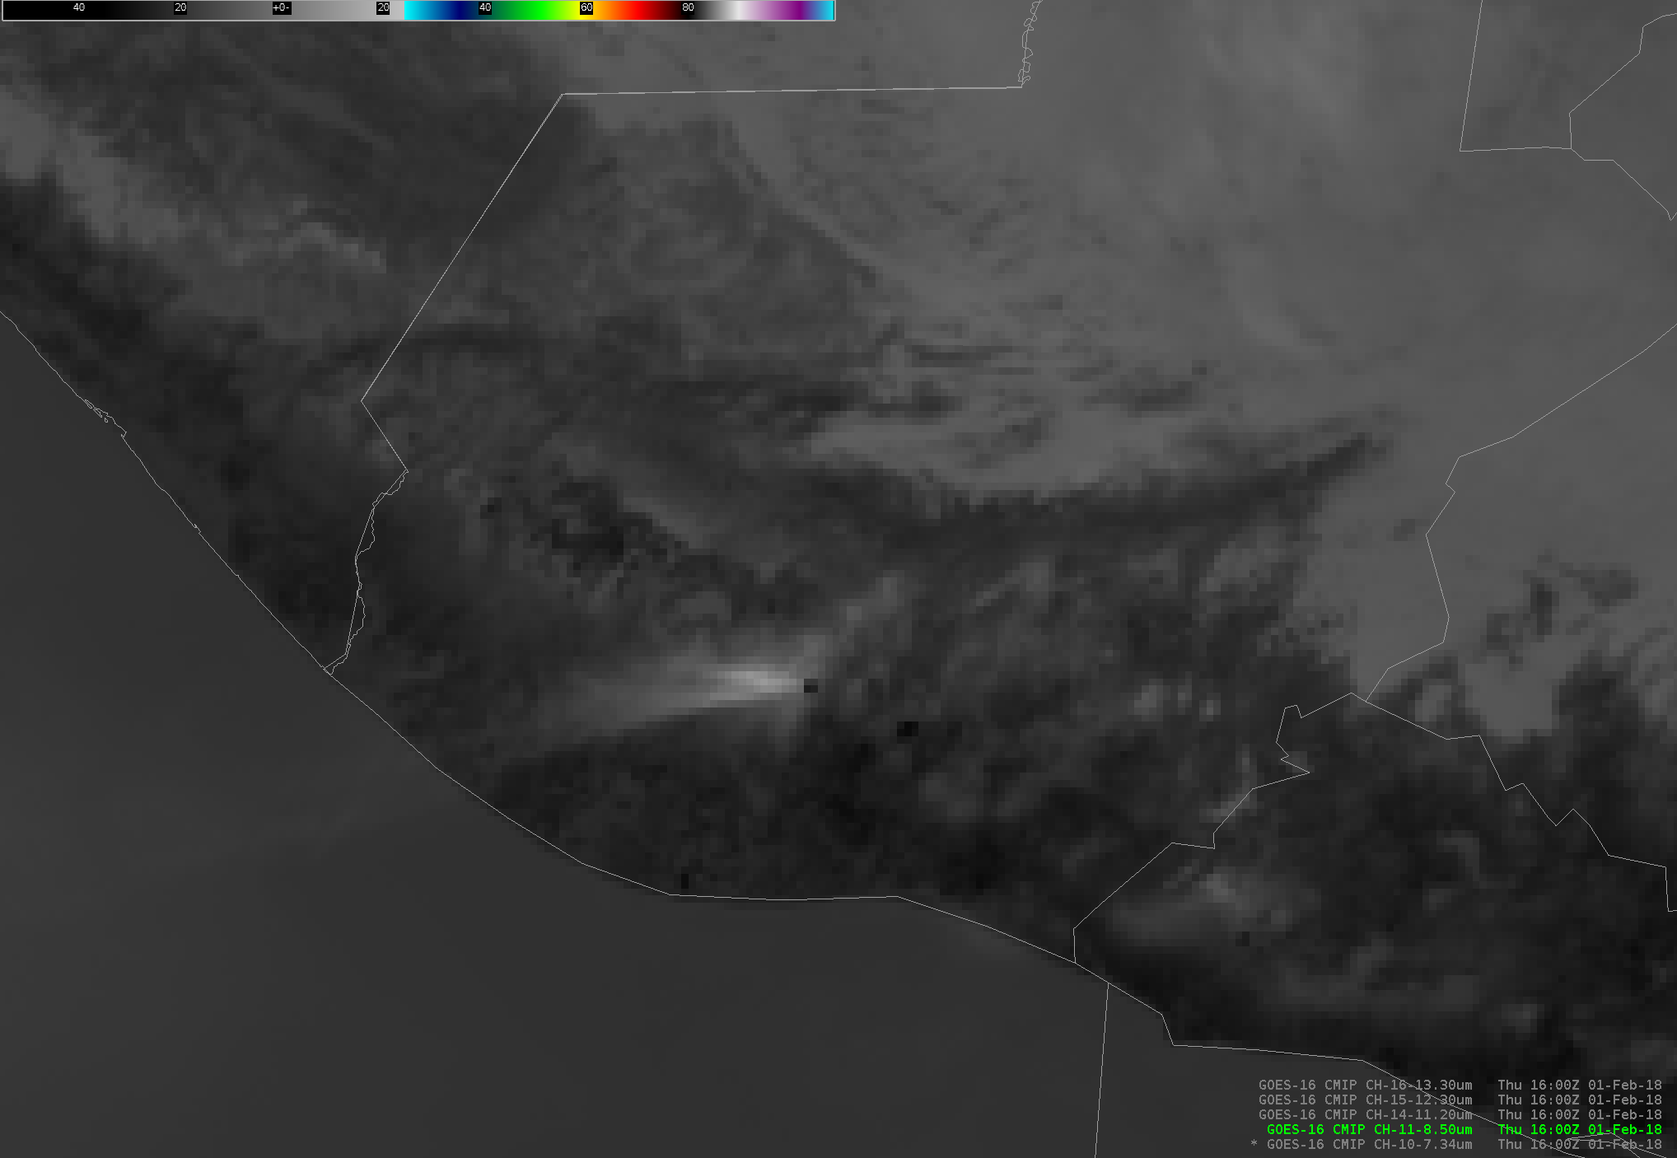
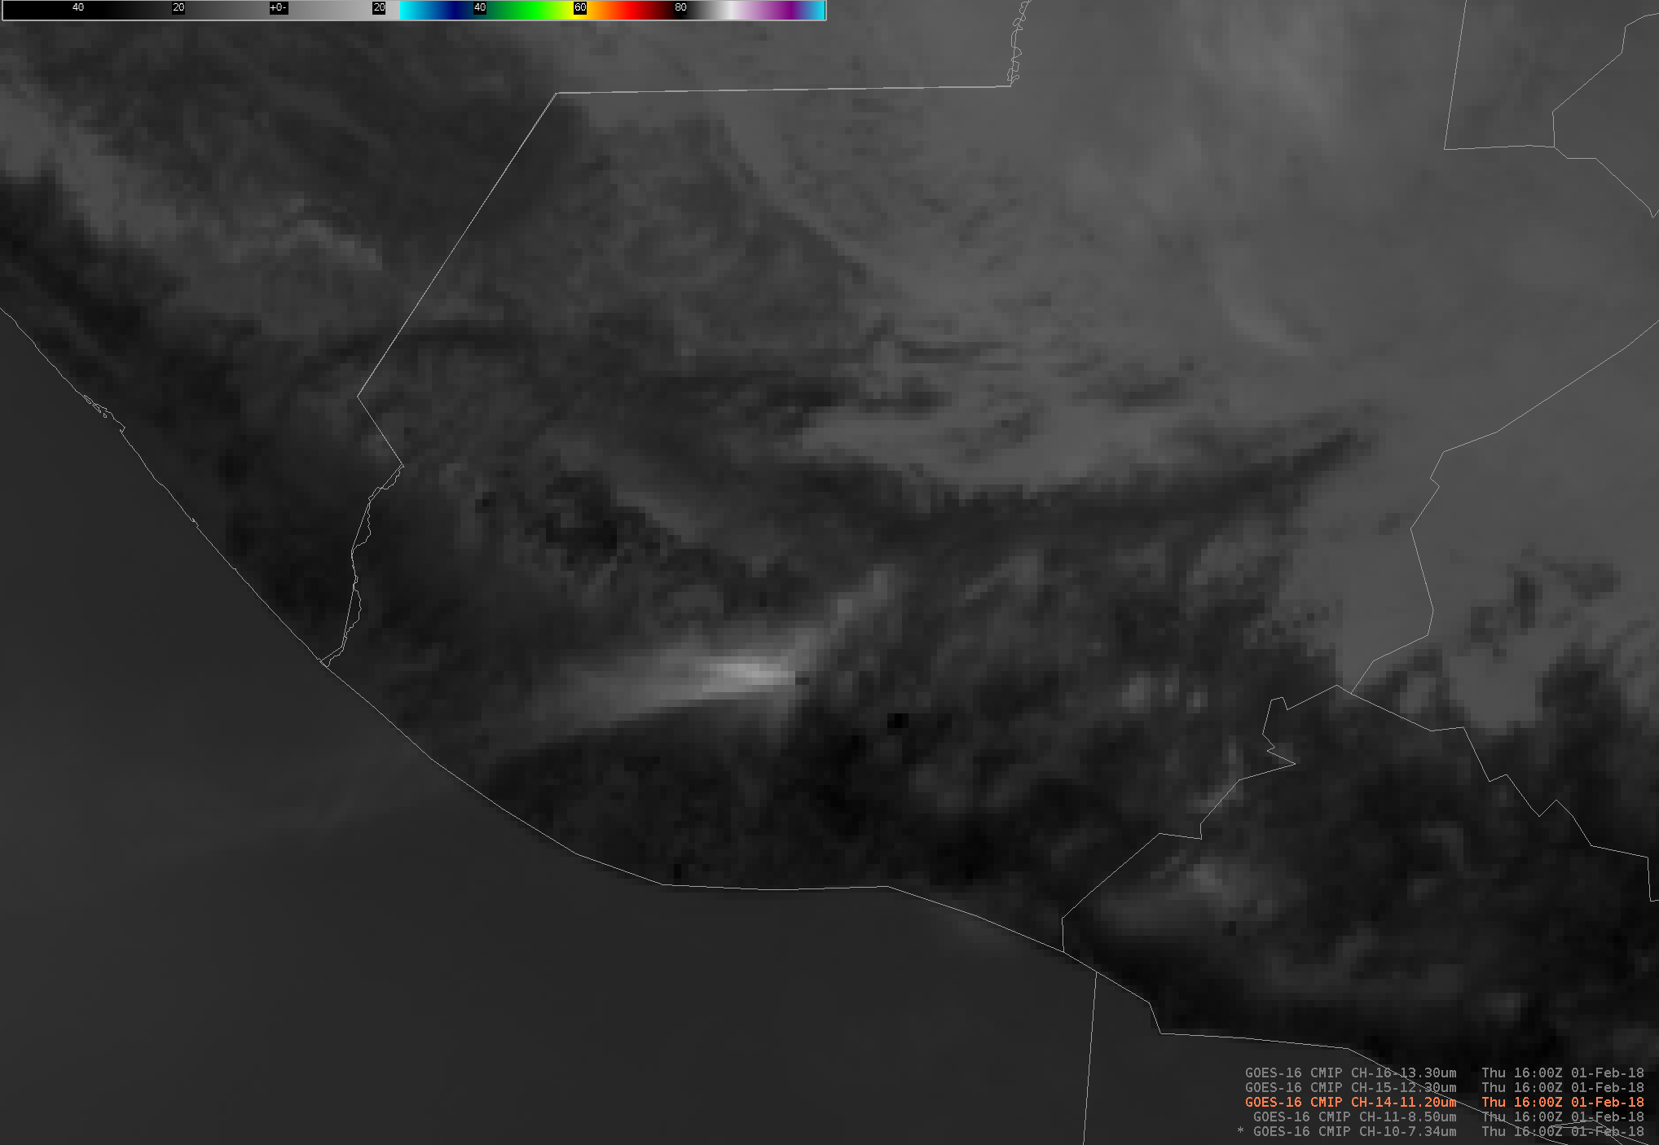
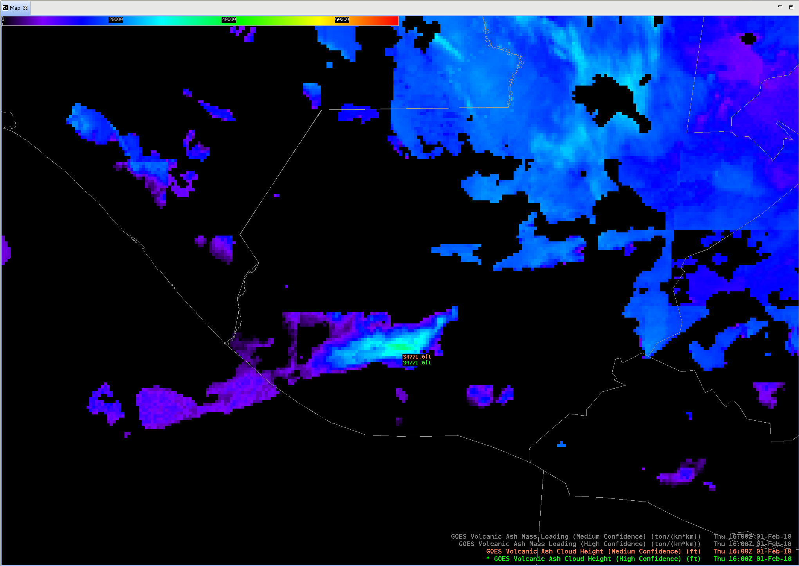
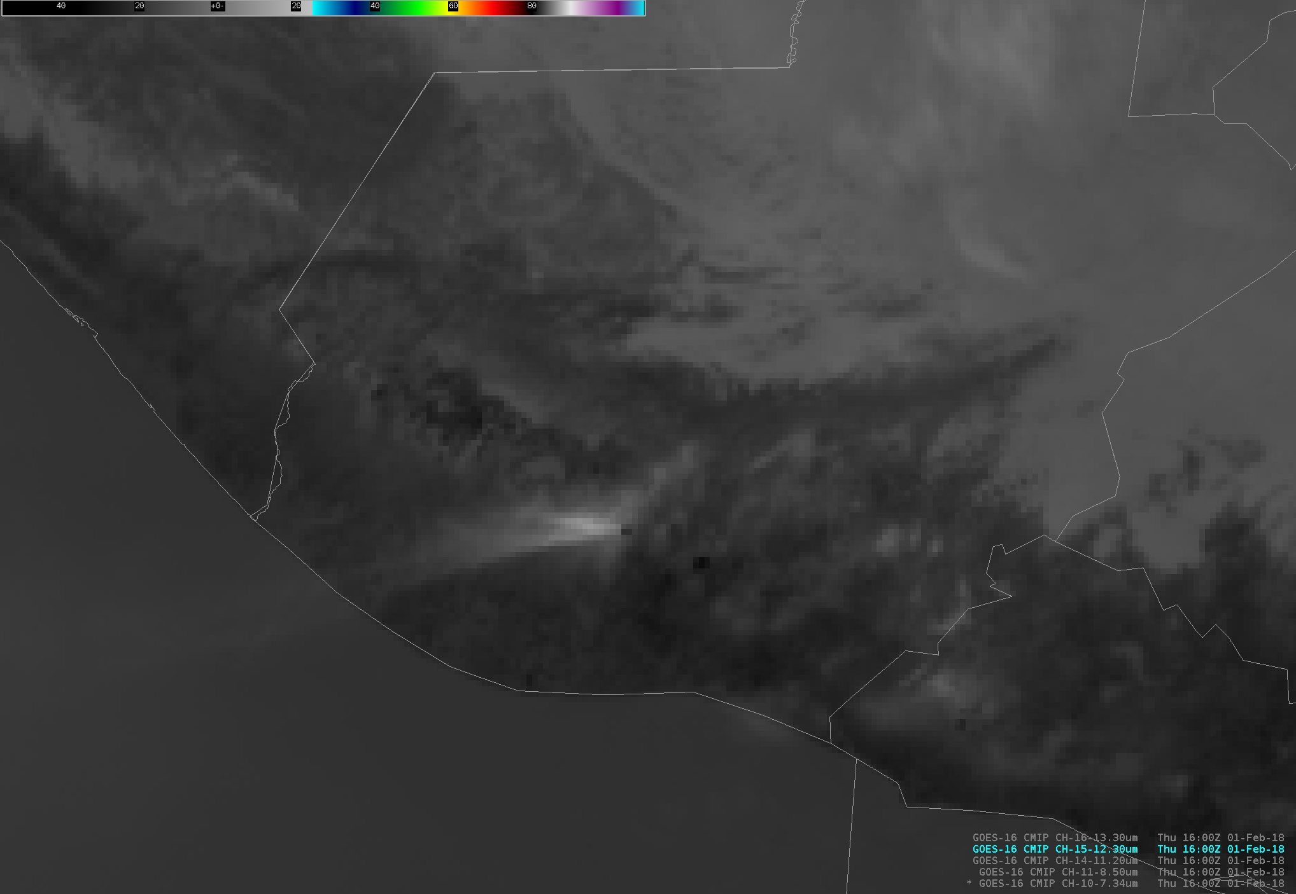
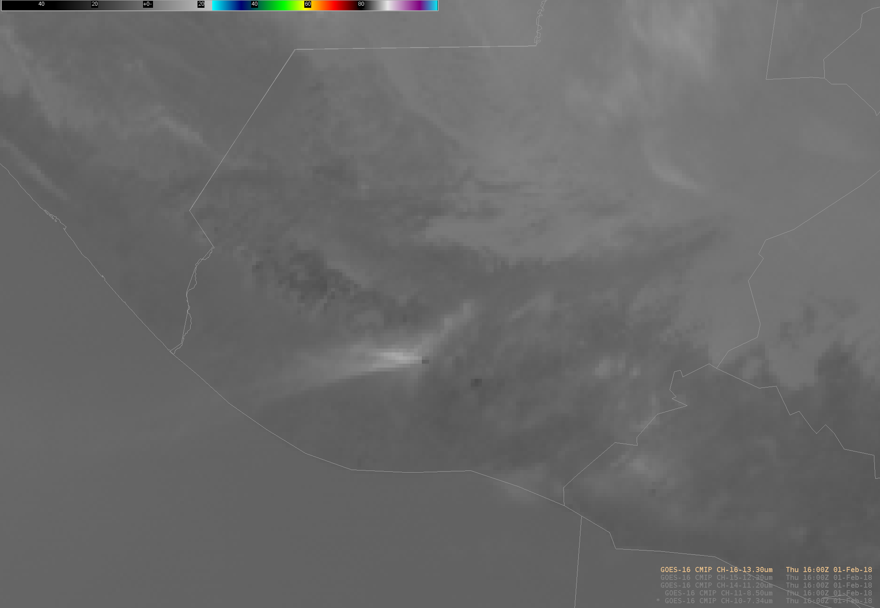
Volcanic Ash Detection and Retrieval
Quick Brief
7.3 μm
Multi-spectral derived products (Level 2 baseline product)
8.4 μm
10.3 μm
12.3 μm
13.3 μm
Individual GOES-R ABI spectral bands
Notes:
The Volcanic Ash Detection and Retrieval algorithm is a multi-spectral tool: Five GOES-R ABI infrared bands are used as shown. These bands were chosen because of their special radiative characteristics that allow discernment between meteorological and volcanic constituents in the atmosphere. Because the spectral bands are all infrared, volcanic ash detection can occur day or night.

Slide 3
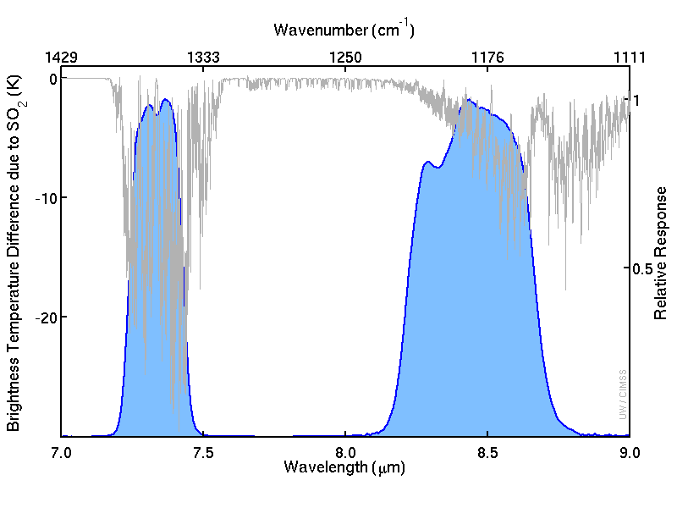
Volcanic Ash Detection and Retrieval
Quick Brief
ABI
Band 10
ABI
Band 11
7.3 μm
8.4 μm
Notes:
This chart shows the spectral response functions for both bands 10 and 11 on the ABI, two of the bands used in the algorithm. The plot includes a line in grey that shows the temperature difference sensed by a satellite between a US Standard Atmosphere with and without an infusion of sulfur dioxide. The 7.3 and 8.4 µm bands are in regions of the electromagnetic spectrum where sensitivity to Sulfur Dioxide (SO2) - a common discharge from Volcanoes -- exists, and significant cooling due to SO2 is plotted. The 8.4 micrometer band is regularly used in conjunction with the 11.2 µmeter band (a band that is not sensitive to SO2 emissions) in volcanic ash RGBs for sulfur dioxide detection.

Slide 4
Volcanic Ash Detection and Retrieval
Quick Brief
ABI
Band 16
ABI
Band 15
ABI
Band 13
ABI
Band 11
13.3 μm
12.3 μm
10.3 μm
8.4 μm
These two channels are used in the Split Window Difference
Notes:
This chart shows the spectral response functions for bands 16 (on the left) to 11 (on the right), along with, in red, the temperature sensed by a satellite above a clear US Standard Atmosphere. (The red box means the channel is used in the Baseline Volcanic Ash product - note that Band 10 is missing from the chart) There are multiple water vapor absorption spikes, signifying cooling, in Bands 15 and 13, with more absorption due to water vapor in Band 15 than in Band 13. This is a 'split window difference'. This split window difference is also handy for ash detection because the two bands have different sensitivity to ash. Band 16 is The longest wavelength infrared GOES-R ABI channel used within the Volcanic Ash Products. This band will generally show colder brightness temperatures than ABI window channels - like 15 and 13 - because of strong carbon dioxide absorption. Band 16 is regularly used to estimate mean tropospheric air temperature, cloud opacity and cloud top heights. Bands 13 15 and 16 are integral to the volcanic ash height and mass loading calculations.
Note: in addition to the water vapor and CO2 absorption spikes, there is also on this chart absorption due to ozone, and due to SO2.

Slide 5
Volcanic Ash Detection and Retrieval
Quick Brief
Sensed Brightness Temperature
10.3 µm
12.3 µm
Vapor
Ash
adapted from all-geo.org
More 12.3 μm absorbed
More 10.3 μm absorbed
Split Window Difference
Notes:
The 10.3 µm and 12.3 µm bands behave similarly when observing radiation from a uniform surface or water cloud source. However, volcanic ash is a stronger absorber of radiation at 10.3 µm than at 12.3 µm. Conversely, water vapor is a stronger absorber at 12.3 µm than at 10.3 µm. That has an effect on the sensed brightness temperature. These relationships are used to distinguish between ash/dust and water vapor. The “Split Window Difference” is integral to the detection of ash by the GOES-R Volcanic Ash Product.

Slide 6
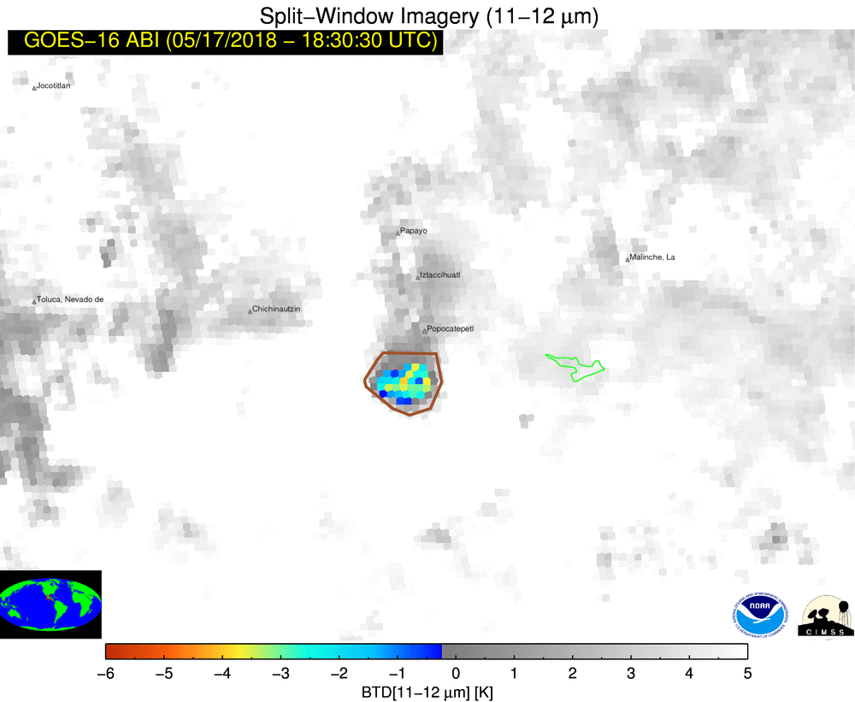
Volcanic Ash Detection and Retrieval
Quick Brief
7.3 and 8.4 µm data
10.3 – 12.3 give very similar results
RTM data
Ash Detection
Notes:
How does the GOES-R Volcanic Ash detection algorithm use the spectral information from ABI? Generally speaking, the Split Window Difference technique is first used to determine if a cloud of interest potentially contains ash. If ash existence is possible, the 7.3 and 8.4 µm bands are then used to further increase confidence in ash detection because of their sensitivity to sulfur dioxide. In practice, detection is very difficult with this simplistic approach: many factors can lead false positives. To mitigate these effects, the background state of the atmosphere and surface must be considered. This requires the inclusion of ancillary data such as land cover, surface type, and radiative properties of the atmosphere the latter of which are based on radiative transfer model guidance.

Slide 7
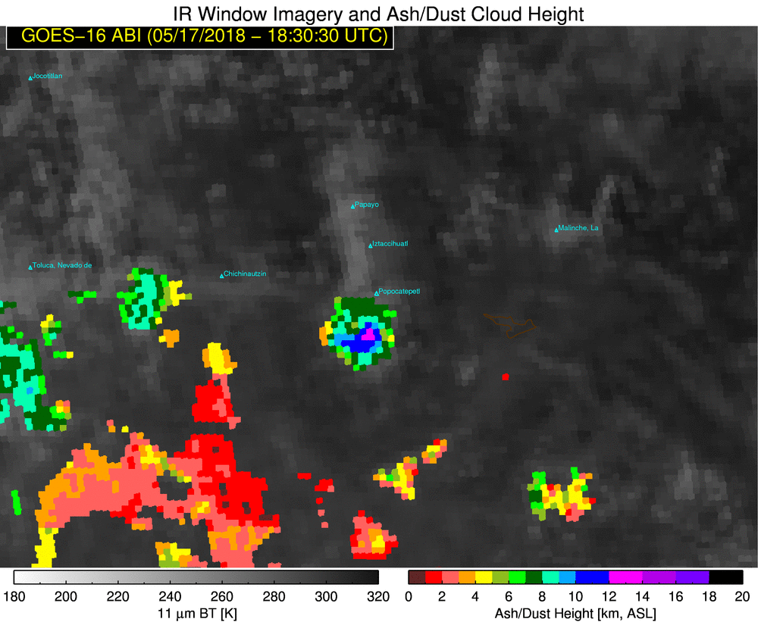
Volcanic Ash Detection and Retrieval
Quick Brief
Derived volcanic ash cloud effective temperature
Ash Height
vs.
NWP Thermal Profile
Notes:
If a cloud possibly contains volcanic ash, how does the GOES-R Volcanic Ash Retrieval algorithm determine the ash height of that cloud? Information from Bands 13 15 and 16 at 10.3, 12.3, and 13.3 µm are used to derive these values. The algorithm does not calculate the cloud height directly. ABI band data are used to derive effective temperature, emissivity, and microphysical parameters, and then those data are formulated to produce estimates of the ash cloud height. Ash cloud height is determined through comparison of the ash cloud effective temperature with an NWP temperature profile, through which the height is linearly derived. Complete details of this algorithm are available in the ATBD of this Quick Brief.

Slide 8
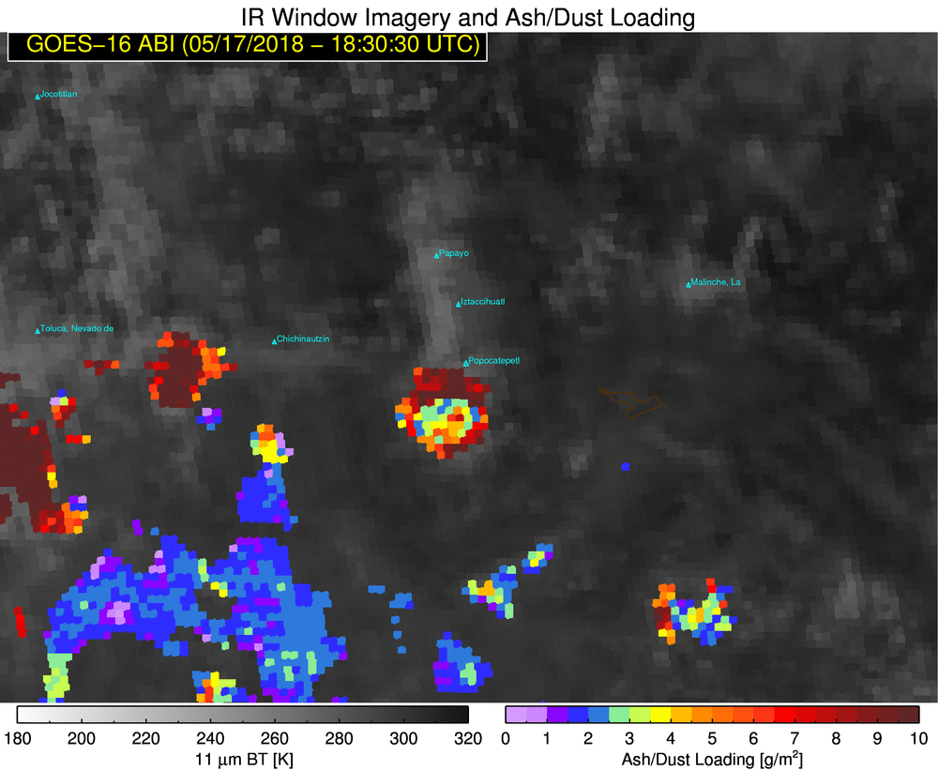
Volcanic Ash Detection and Retrieval
Quick Brief
10.3 µm retrieved emissivity
Split Window Data
Ash Mass Loading
Notes:
Ash mass loading is defined as the total columnar ash mass within the given satellite pixel. It is computed using the retrieved 10.3 µm emissivity and 10.3/12.3 µm comparisons, applying the ash absorption characteristics of those bands.

Slide 9
Volcanic Ash Detection and Retrieval
Quick Brief
Northeast of the Volcanic Cloud there is a region that is not confidently non-ash – so there is a signal there, but not necessarily actual Volcanic Ash
Notes:
Here is the GOES-R Volcanic Ash Height operationally within AWIPS II. In the center of the picture is an ash cloud from the eruption of Volcán de Fuego in south central Guatemala on February 1st, 2018 at 1600 UTC. The detected ash plume has an estimated cloud height of 34771 ft at the referenced pixel, as indicated by the product sampling. Note the caveat printed at the right.

Slide 10
Volcanic Ash Detection and Retrieval
Quick Brief
Northeast of the Volcanic Cloud there is a region that is not confidently non-ash – so there is a signal there, but not necessarily actual Volcanic Ash
Notes:
For this same case, but with a slightly different map, the GOES-R Volcanic Ash Mass loading estimated a mass loading of 5.2 ton/km² for the referenced pixel of the Volcán de Fuego ash cloud. This is not a lot of Mass Loading. Again, note the caveat.

Slide 11
Volcanic Ash Detection and Retrieval
Quick Brief
The GOES-R Volcanic Ash Detection and Retrieval Algorithm identifies the location, height and ash loading properties for satellite pixels potentially containing volcanic ash
It is a multi-spectral product, meaning it uses data from multiple infrared ABI channels to create its products both day and night
  Band 10: 7.3 µm
  Band 11: 8.4 µm
  Band 13: 10.3 µm (this was changed in 2018 – previous to that the algorithm used 11.2 µm / Band 14)
  Band 15: 12.3 µm
  Band 16: 13.3 µm
The VOLCAT website includes updated multi-spectral ash detection algorithm, and also a notification service. Link: http://volcano.ssec.wisc.edu
Useful References
  GOES-R Volcanic Ash Detection and Retrieval Algorithm Theoretical Basis Document
  GOES-R Volcanic Ash Detection and Retrieval Algorithm Product Information
  GOES-R Volcanic Ash Detection and Retrieval Algorithm Retrieval Technique
Notes:
Here are some concluding thoughts and useful links. A more sophisticated Volcanic detection algorithm is used by many VAACs and it available at the link shown. Accurate interpretation of volcanic eruptions as viewed by satellites is a skill that is acquired with years of practice. If you suspect Volcanic Activity, a prudent course of action is to view the VAAC website for the area of interest. You have concluded the GOES-R Volcanic Ash Detection and Retrieval Quick Brief.

