Slide 1
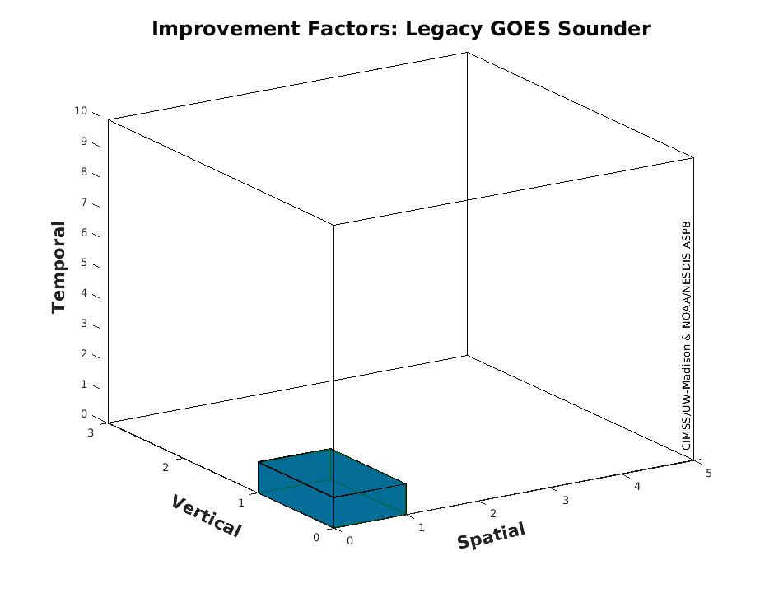

US Plans for Geostationary Hyper-spectral Infrared Sounders
GeoXO Sounder (GXS)
Tim Schmit, NOAA NESDIS STAR CoRP ASPB
GXS Team, Zhenglong Li, Joel McCorkel, etc., ……
March, 2022

Slide 2
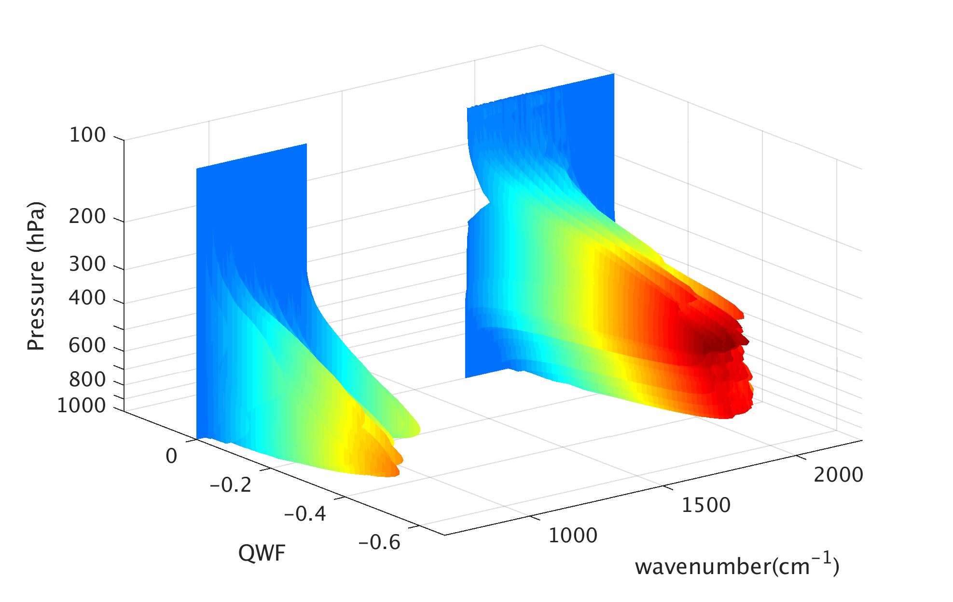
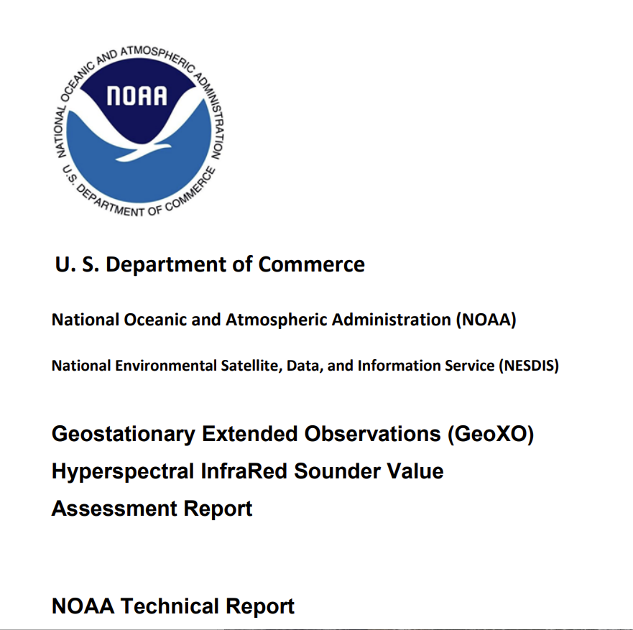
Introduction
Tim Schmit, Research Satellite Meteorologist
  Specializing with GOES (GOES-7 -> GOES-18)
  Madison, Wisconsin
Product Lead for GXS science
  David Johnson, instrument lead
  Jim Yoe, user lead
The GXS will supply unique information to better monitor the current state of the atmosphere
  Vertical moisture profiles, Atmospheric winds at many levels, Vertical temperature profiles, some information on Trace Gases
So, the future state can be better forecast
  Clouds, thunderstorms, winds, temperatures, moisture,
  Air quality, etc.
  Nowcasting, short-term forecasts
  NWP (regional and global)
References
  https://www.ssec.wisc.edu/geo-ir-sounder
  https://www.nesdis.noaa.gov/next-generation/geostationary-extended-observations-geoxo

Slide 3
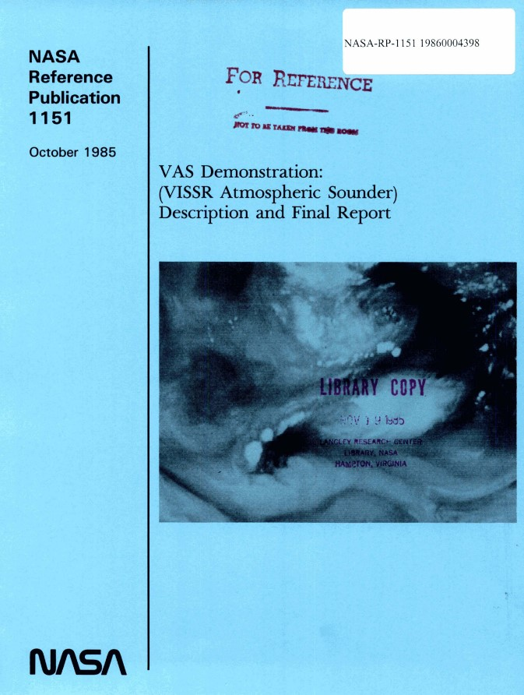
History
FOREWORD
What about the future?
These results are the foundation for future satellites. The VAS experience suggests that extension into the microwave region, and increased spectral resolution in the infrared region, are essential so that we can obtain soundings through persistent clouds and with improved vertical resolution. Geostationary microwave instruments and high spectral resolution infrared interferometers are feasible and would be highly useful.
The administrative mechanisms of interagency cooperation must be put into motion as soon as possible to accomplish this. We must not lose the momentum ....
Professor Verner E. Suomi
Director
Space Science and Engineering Center
University of Wisconsin-Madison
1985
[Bold highlights added]
Notes:
https://www.ssec.wisc.edu/geo-ir-sounder/need/

Slide 4
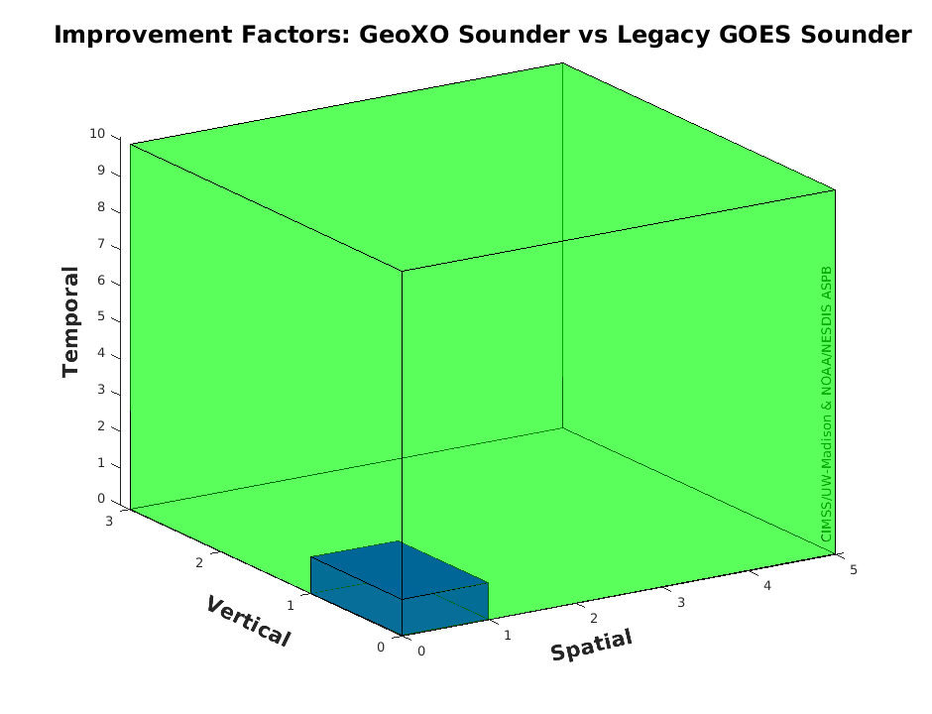
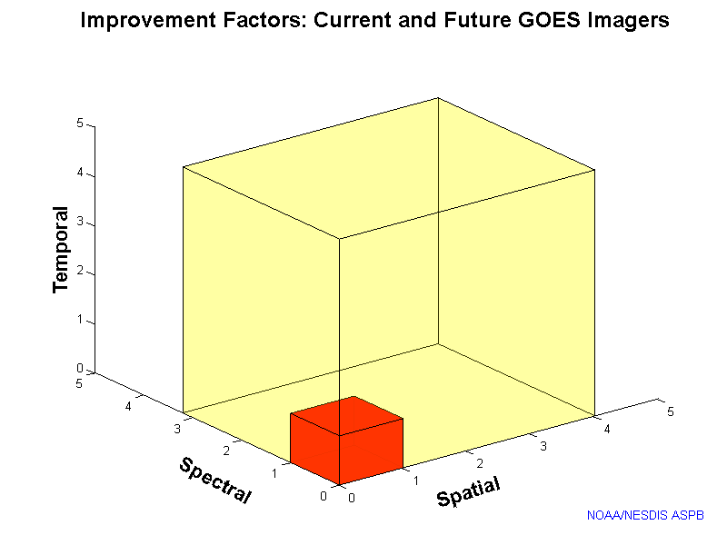
GXS/Legacy GOES Sounder ~ ABI/Legacy Imager
GeoXO Sounder could be something like 3, 5 and 10 times improved (vertical, spatial and temporal) over the legacy geo sounder! (The legacy sounder had many operational uses: moisture, winds, atmospheric stability, clouds, etc.)
“Everyone” knows about the ABI being 3, 4 and 5 times (spectral, spatial and temporal) improved over the legacy geo imager.
Improvement Factors:
GeoXO Sounder and Legacy geo Sounders
Improvement Factors:
ABI and Legacy geo Imagers
Notes:
Li, J., Menzel, W. P., Sun, F., Schmit, T. J., & Gurka, J. (2004). AIRS Subpixel Cloud Characterization Using MODIS Cloud Products, Journal of Applied Meteorology, 43(8), 1083-1094. Retrieved Oct 21, 2021, from https://journals.ametsoc.org/view/journals/apme/43/8/1520-0450_2004_043_1083_asccum_2.0.co_2.xml
Schmit, T. J., Li, J., Li, J., Feltz, W. F., Gurka, J. J., Goldberg, M. D., & Schrab, K. J. (2008). The GOES-R Advanced Baseline Imager and the Continuation of Current Sounder Products, Journal of Applied Meteorology and Climatology, 47(10), 2696-2711.
https://journals.ametsoc.org/view/journals/apme/47/10/2008jamc1858.1.xml
Sieglaff, J. M., Schmit, T. J., Menzel, W. P., & Ackerman, S. A. (2009). Inferring Convective Weather Characteristics with Geostationary High Spectral Resolution IR Window Measurements: A Look into the Future, Journal of Atmospheric and Oceanic Technology, 26(8), 1527-1541. https://journals.ametsoc.org/view/journals/atot/26/8/2009jtecha1210_1.xml
Schmit, T. J., Li, J., Ackerman, S. A., & Gurka, J. J. (2009). High-Spectral- and High-Temporal-Resolution Infrared Measurements from Geostationary Orbit, Journal of Atmospheric and Oceanic Technology, 26(11), 2273-2292. https://journals.ametsoc.org/view/journals/atot/26/11/2009jtecha1248_1.xml
Smith Sr., W. L., Revercomb, H., Bingham, G., Larar, A., Huang, H., Zhou, D., Li, J., Liu, X., and Kireev, S.: Technical Note: Evolution, current capabilities, and future advance in satellite nadir viewing ultra-spectral IR sounding of the lower atmosphere, Atmos. Chem. Phys., 9, 5563-5574, https://doi.org/10.5194/acp-9-5563-2009, 2009.
Li, J., Li, J., Otkin, J., Schmit, T. J., & Liu, C. (2011). Warning Information in a Preconvection Environment from the Geostationary Advanced Infrared Sounding System—A Simulation Study Using the IHOP Case, Journal of Applied Meteorology and Climatology, 50(3), 776-783. https://journals.ametsoc.org/view/journals/apme/50/3/2010jamc2441.1.xml
Menzel, W. P., Schmit, T. J., Zhang, P., & Li, J. (2018). Satellite-Based Atmospheric Infrared Sounder Development and Applications, Bulletin of the American Meteorological Society, 99(3), 583-603. Retrieved Oct 21, 2021, from https://journals.ametsoc.org/view/journals/bams/99/3/bams-d-16-0293.1.xml
Yin, R., Han, W., Gao, Z., & Li, J. (2021). Impact of high temporal resolution FY-4A Geostationary Interferometric Infrared Sounder (GIIRS) radiance measurements on Typhoon forecasts: Maria (2018) case with GRAPES global 4D-Var assimilation system. Geophysical Research Letters, 48, e2021GL093672. https://doi.org/10.1029/2021GL093672
Ma, Z., Li, J., Han, W., Li, Z., Zeng, Q., Menzel, W. P., et al. (2021). Four-dimensional wind fields from geostationary hyperspectral infrared sounder radiance measurements with high temporal resolution. Geophysical Research Letters, 48, e2021GL093794. https://doi.org/10.1029/2021GL093794
Yin, Ruoying, Wei Han, Zhiqiu Gao, and Di Di. “The evaluation of FY4A’s Geostationary Interferometric Infrared Sounder (GIIRS) long‐wave temperature sounding channels using the GRAPES global 4D‐Var.” Quarterly Journal of the Royal Meteorological Society 146, no. 728 (2020): 1459-1476. https://doi.org/10.1002/qj.3746
Holmlund, et al., P. (2021). Meteosat Third Generation (MTG): Continuation and Innovation of Observations from Geostationary Orbit, Bulletin of the American Meteorological Society, 102(5), E990-E1015. https://journals.ametsoc.org/view/journals/bams/102/5/BAMS-D-19-0304.1.xml
W. L. Smith et al., "Hyperspectral Satellite Radiance Atmospheric Profile Information Content and Its Dependence on Spectrometer Technology," in IEEE Journal of Selected Topics in Applied Earth Observations and Remote Sensing, vol. 14, pp. 4720-4736, 2021, doi: 10.1109/JSTARS.2021.3073482. https://ieeexplore.ieee.org/abstract/document/9406029
More: https://www.ssec.wisc.edu/geo-ir-sounder/

Slide 5
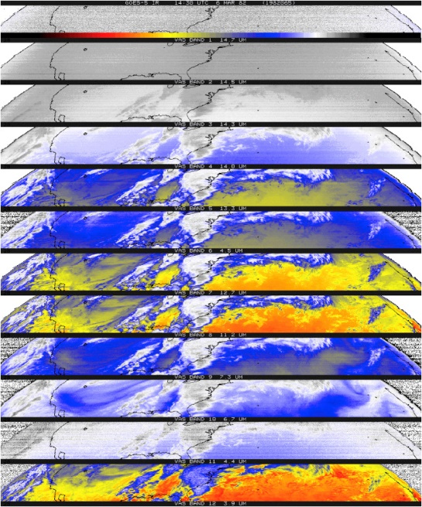
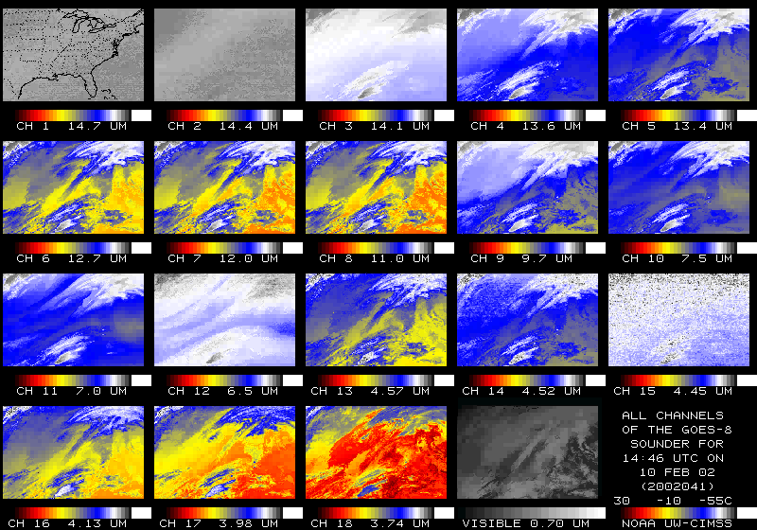
U.S. Geostationary Game-changers
Item | Imagery | Sounding
First of it’s kind (experimental) | ATS-1 (1966) | VAS (1980)
First Operational | GOES-1 (1975) | GOES-8 (1994)
Orders of magnitude improvements | GOES-R series (2016) | High-spectral IR (203?)
?
GOES-R series included the first geostationary lightning mapper
Geo advanced IR sounders are the next big step
Notes:
T. Schmit AMS presentation in Boston.

Slide 6
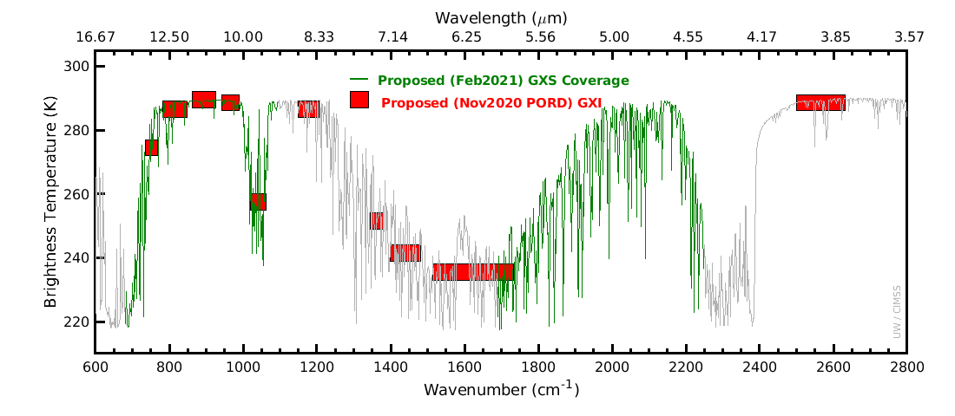
Spectral
Imagers average out important vertical information

Slide 7
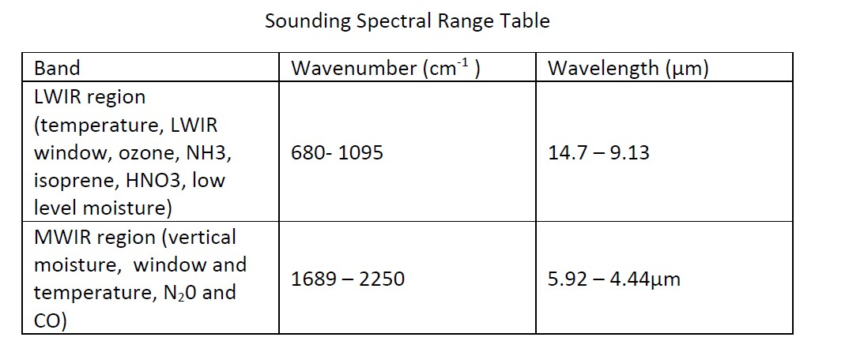
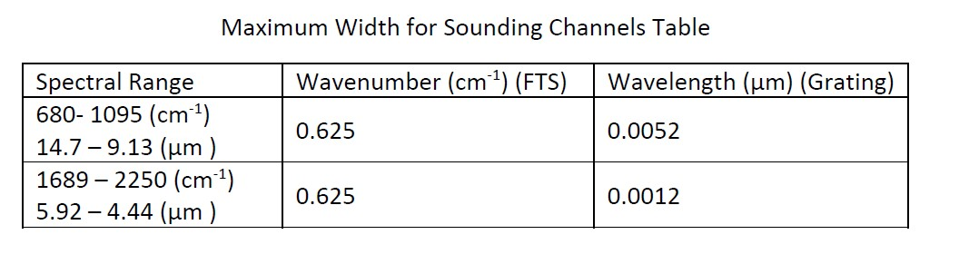
Spectral
From the posted PORD
Spectral coverage and resolution is similar to Europe's planned geo Sounder

Slide 8
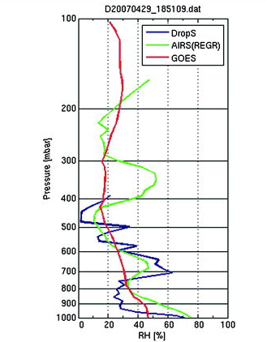
Improved Vertical Resolutions
Three RH soundings:
Although legacy GOES Sounder [similar to ABI or GXI] (red) has reasonable men accuracy in general, it lacks vertical structures when compared with dropsonde (blue).
The high-spectral-resolution observations of AIRS SFOV sounding (green) better depicts the fine structures in this case, which are close to those from the dropsonde.
Retrieval performance has improved over the last more than a decade.
High-spectral IR observations are critical to obtaining improved vertical moisture (and temperature and winds, not shown).
2.1-8

Slide 9
ABI is not an advanced sounder!
“GXS”
The relative vertical number of independent pieces of information is shown. The moisture content is similar between the ABI and the current GOES Sounder. The Sounder does show more temperature information than the ABI. The ABI is not close to the information content of a high-spectral sensor.
Notes:
https://journals.ametsoc.org/view/journals/atot/26/11/2009jtecha1248_1.xml

Slide 10
Temporal Coverage (posted PORD)
In Disk Sounding task, the GXS shall acquire each Sounding Disk (SD) and perform all necessary housekeeping and calibration functions in less than 30 minutes.
SD is a collection of spatial resolution elements viewing the earth where the local zenith angle (LZA) to a GOES is less than 62 degrees and the local zenith angle is less than or equal to the local zenith angle to the neighboring GOES.
Even if the GXS scanned twice as slow as the posted PORD values, it would still be faster than the legacy GOES Sounder. This faster scanning allows for obtaining wind information, something not possible from LEO satellites over most areas.

Slide 11
Spatial Resolutions: Ground Sample Distance and Angle
The centroid-to-centroid distance between adjacent spatial samples on the Earth’s surface, as measured at the Sub-Satellite Point, defines the ground sample distance (GSD). The ground sample angle (GSA) is the associated angle. A two-dimensional pixel is defined by the GSD in the East/West and North/South dimensions. The GXS shall have a GSA no larger than 112 microradians (4 km at nadir) for emissive channels.
This is much improved over the legacy GOES Sounders and the current polar hyperspectral IR sounders.

Slide 12
Applications in forecasting
The improved vertical resolution allows for the critical vertical distribution of moisture to be monitoring (in clear skies)
NWS and other forecasters have been using hyperspectral sounder data from LEO satellites for years via the Hazardous Weather Testbed and NOAA Unique Combined Atmospheric Processing System (NUCAPS)
However, a LEO sounder has a revisit time of 12 hours for a spot over the equator compared to the GEO sounder that can revisit the same location in about 30 minutes
  The intrinsic nature of the geostationary orbit permits longer integration time of the detector over the same Earth scene and continuous data downlink. As a result, GXS is expected to achieve a footprint on the Earth surface of 4 km (subpoint)
    Doubling the clear-sky yields, comparted to LEO

Slide 13
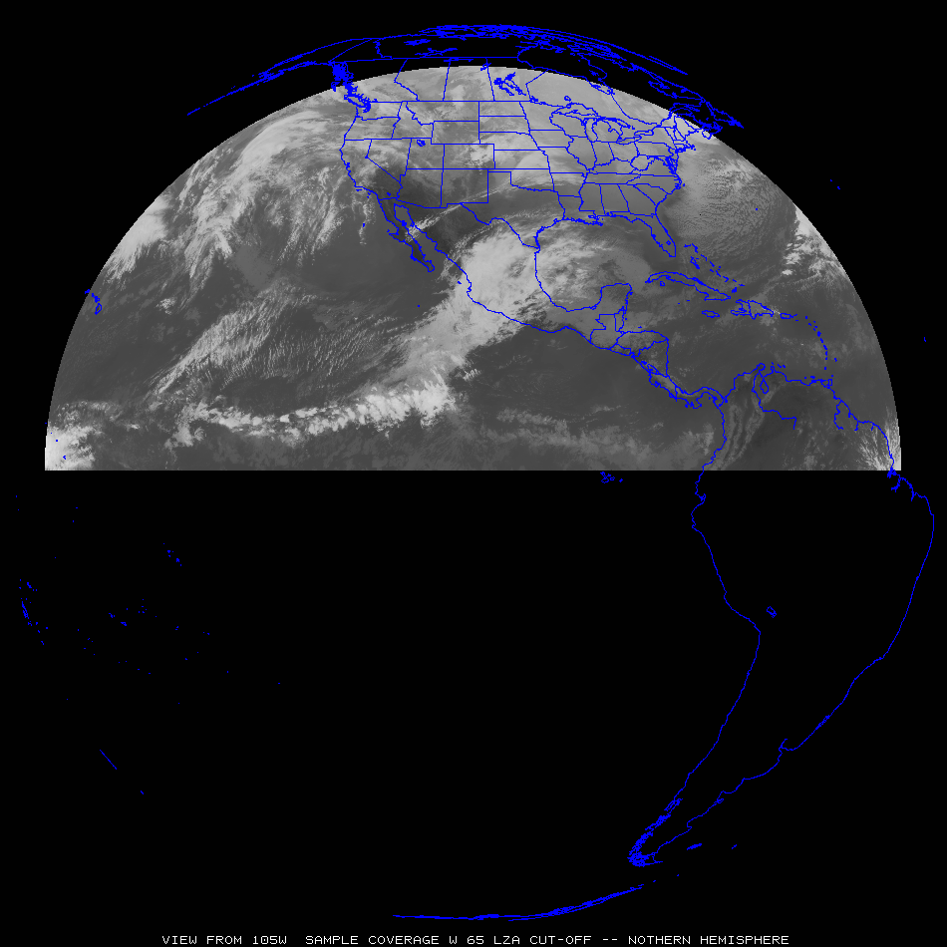
Sample GeoXO Sounder Uses
“clippers”
Most everywhere:
Pre-convection, stability, winds, moisture, high clouds, help AQ, etc.
“atmospheric
rivers”
“Nor-easters”
“dryline”
Sub-tropical jet
“return flow”
“Atlantic
Tropical
Cyclones”
“EastPac Tropical Cyclones”
Tropical winds for NWP
Tropical winds for NWP
Tropical winds for NWP

Slide 14
Benefits and Outcomes
There are many additional applications from high temporal and spectral observations providing better cloud/thunderstorm/hurricane/etc. forecasts (in both nowcasts and NWP forecasts).
High-spectral-resolution sounder observations would also improve derived products with only advanced imager data (and or with polar-orbiter and other data), volcanic ash, cloud detection, cloud-top properties, atmospheric motion vectors, dust detection, land and sea surface temperatures.
New areas are possible, such as moisture flux, capping inversion, surface emissivity, and climate (especially the diurnal aspects).
Information on several trace gases will also be possible, including ozone, HNO3, NH3, and isoprene (combined with ACX observations)
GXS observations will allow for significant improvements in forecasting key parameters to better help save lives, protect property and provide economic benefits.

Slide 15
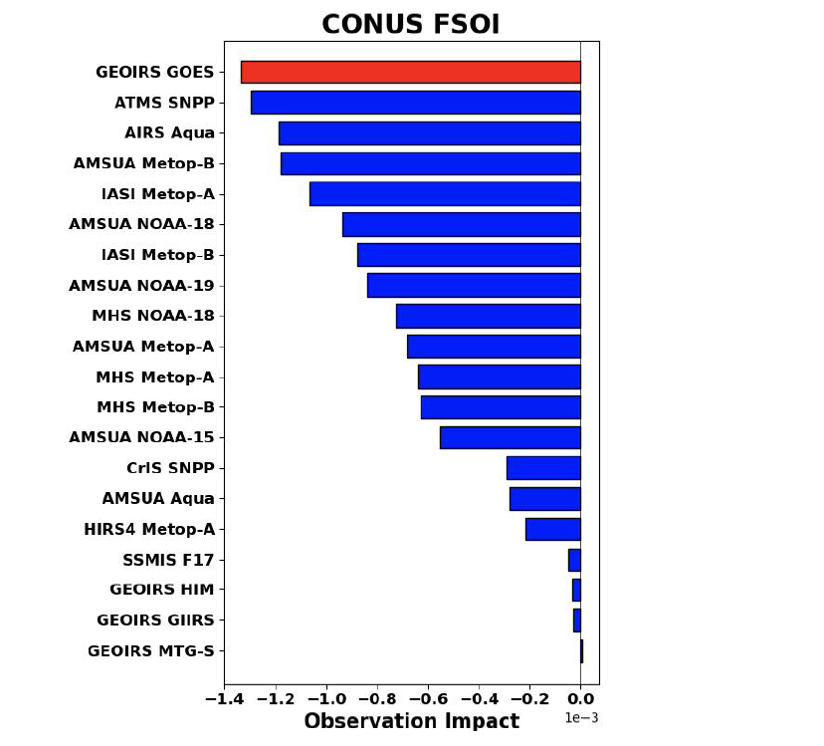
Benefits
Hyperspectral infrared (IR) sounders
  https://www.ssec.wisc.edu/geo-ir-sounder
NOAA NESDIS Tech Report: Geostationary Extended Observations (GeoXO) Hyperspectral InfraRed Sounder Value Assessment Report
  https://repository.library.noaa.gov/view/noaa/32921
GeoXO
  https://www.nesdis.noaa.gov/next-generation-satellites/geostationary-extended-observations-geoxo
Computer simulation of 24-hr Forecast Sensitivity Observation Impact ... for CONUS, for the four cycles (NASA GMAO):
Based on early CrIS implementation strategy

Slide 16
GeoXO : GXS Summary (What and Why)
Attribute |  | What |  | Why
Coverage |  | Ideally: Sounding Disk as seen from both GOES-East and –West positions; Central satellite position currently planned |  | The Atlantic for hurricane development and model initializations, CONUS for the pre-convective environment monitoring and the Pacific for both upstream weather and monitoring moisture (and winds) over the huge area with little conventional data.
Spatial Resolution |  | 4 km (at the satellite subpoint) |  | Doubling the clear-sky yields, comparted to LEO, for a given time. Also for finer moisture gradients to be monitored.
Temporal Resolution |  | Sounding Disks (60 min), CONUS (~30 min) and mesoscale (5 min) |  | Sounding Disk upstream information and hurricane monitoring (improved track and intensity), CONUS for pre-convective monitoring and the targeted for regions of extremely active weather. Allows for clouds to move out and obtain more clear sky information.
Spectral Coverage / Resolution |  | 680‐ 1095 cm‐1 14.7 – 9.13 μm 1689 – 2250 cm‐1 5.92 – 4.44 μm ) @ ~0.6 cm-1 |  | Spectral with information related to temperature, moisture and support select atmospheric compositions (ozone, NH3, isoprene, HNO3, N20 and CO). Need to resolve, not average out, the critical on/off spectral lines.
Other |  | Evolution of the radiances |  | Provides critical vertical information on atmospheric winds for both nowcasting and NWP applications.

Slide 17
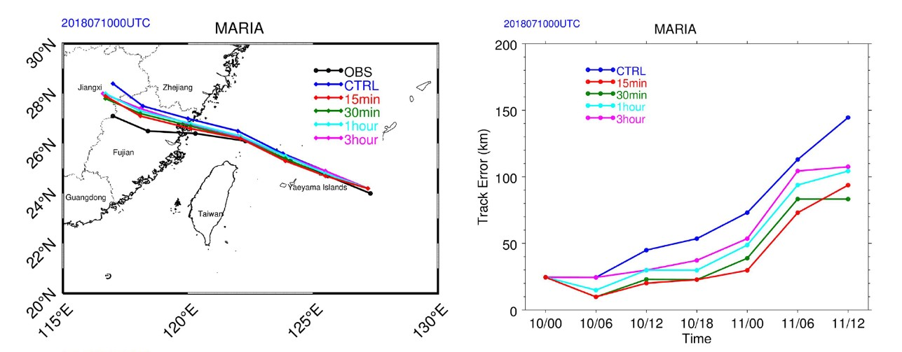
Improved track and intensity forecasts
Improving tropical cyclone forecasts with high temporal/spectral IR observations.
Track & intensity forecasts for Typhoon Maria are most improved with 15 min data, the track (> 40%) and the intensity (18%).
Precipitation forecasts also improved.
The 36 h track forecast for Typhoon Maria from 0000 UTC on July 10, 2018. The black, blue, red, green, cyan, and magenta lines indicate the Best Track, control experiment, 15 min, 30 min, 1 and 3 h, respectively. https://agupubs.onlinelibrary.wiley.com/doi/10.1029/2021GL093672

Slide 18
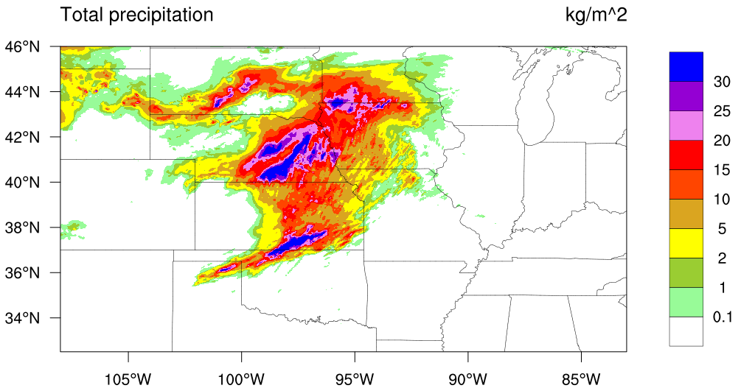
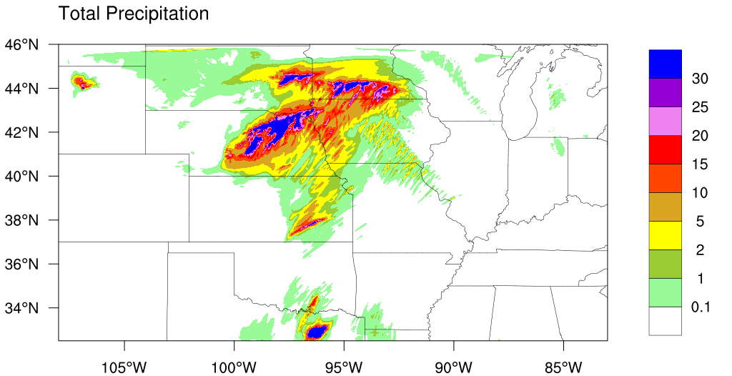
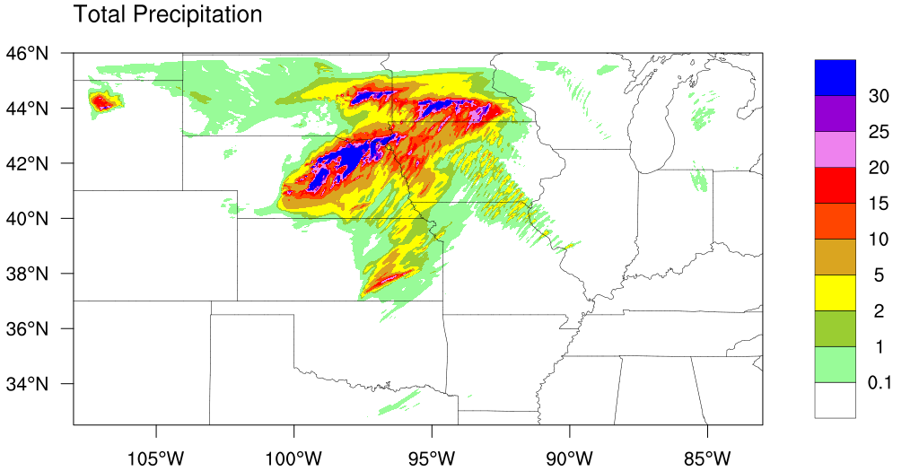
Hybrid OSSE: Precipitation Impact Verification
Observation
2019-5-27 06UTC – 12UTC
The high spectral IR was able to remove a spurious storm over Eastern Texas
A false heavy precipitation that might lead to a false warning
CNTRL
No “GXS”
EXP
With “GXS”

Slide 19
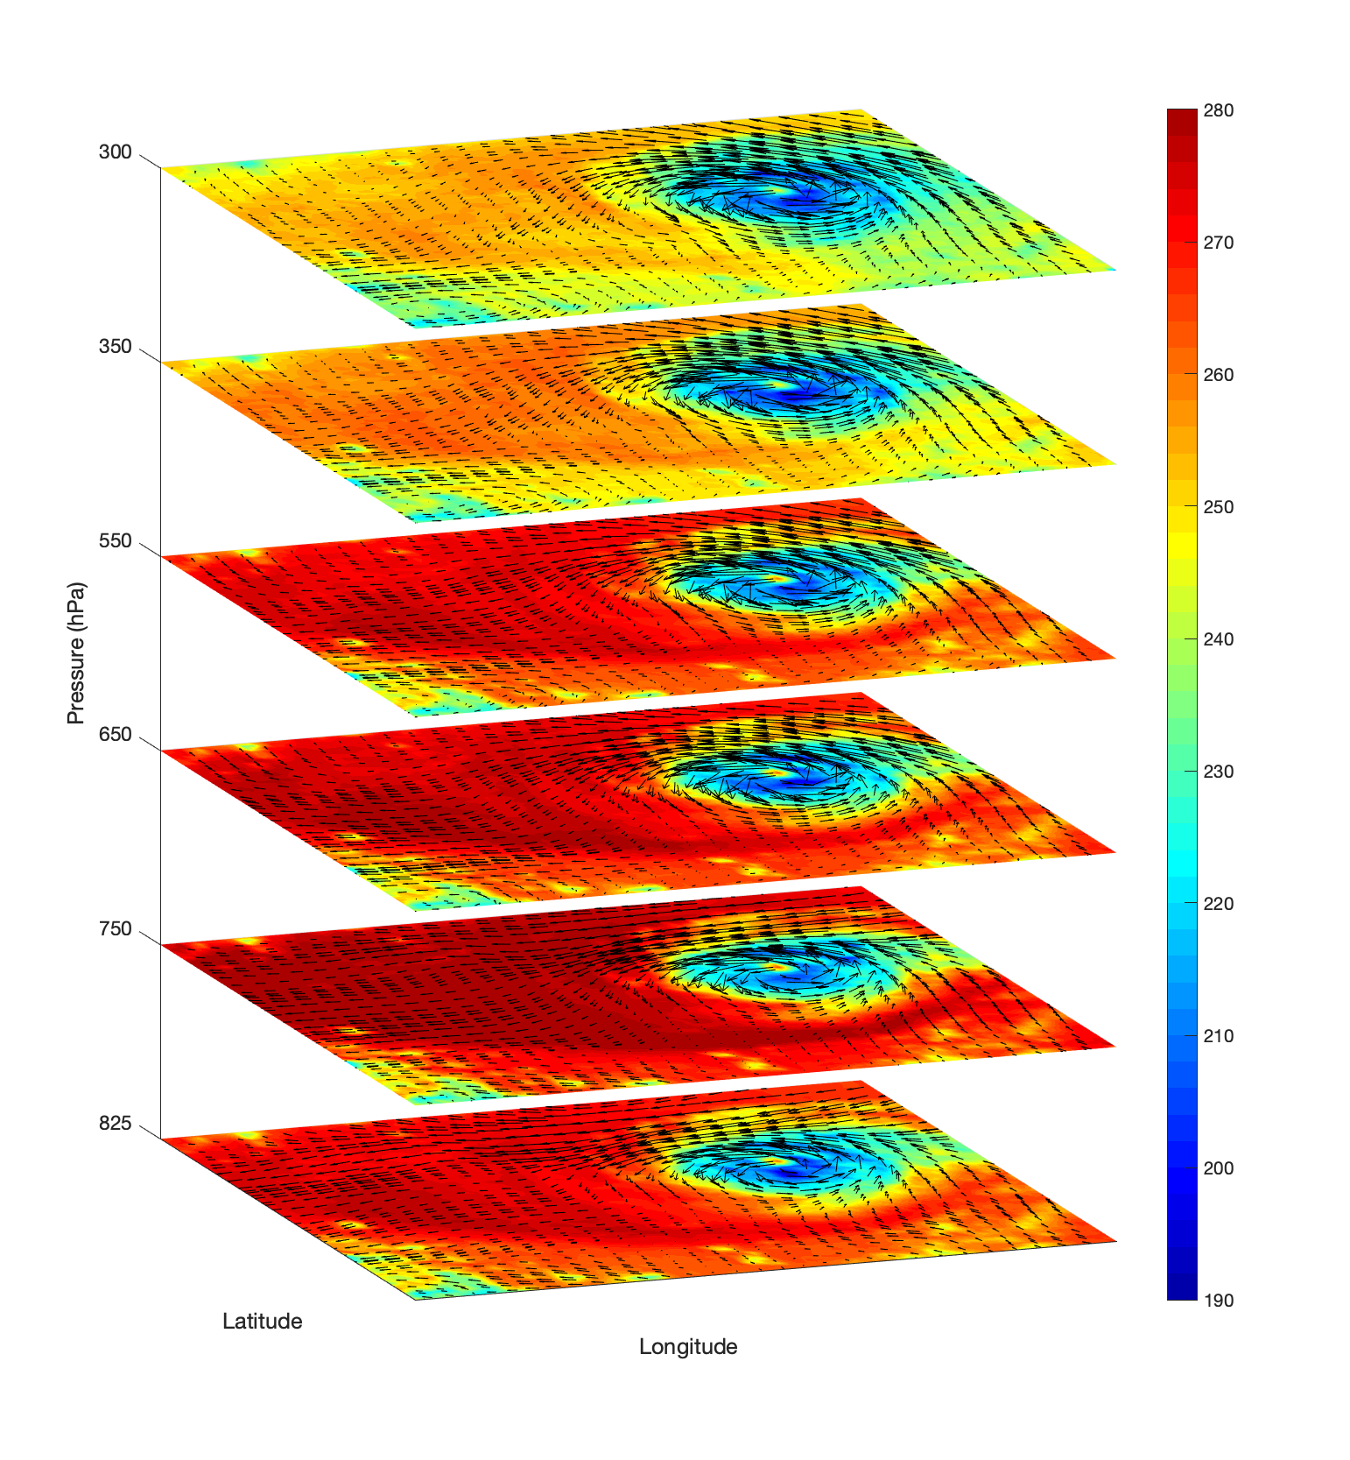
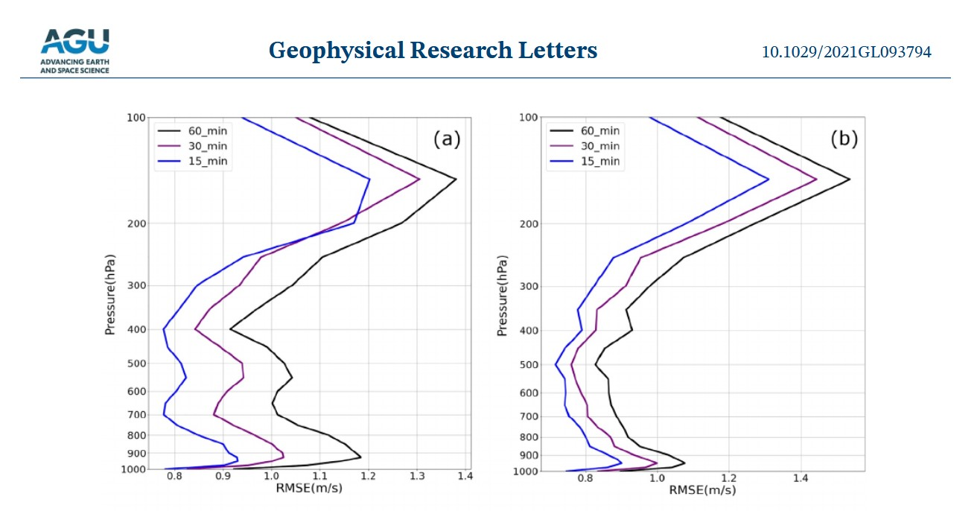
Why 15-min? (GIIRS and ABI)
https://agupubs.onlinelibrary.wiley.com/doi/10.1029/2021GL093794
Using 15-min Geosynchronous Interferometric Infrared Sounder (GIIRS) observations, … and higher temporal resolution provides better 4D wind fields than the lower temporal resolution.

Slide 20
Need for high spectral/temporal observations
High-spectral-resolution observations provide much more information
  Imagers average out important vertical information; GEO offers time evolution
Forecasting Applications – fill in critical gaps wrt vertical moisture, wind and temperature
  Nowcasting and Numerical weather prediction, especially on the regional/mesoscales
Additional applications
  High-spectral-resolution sounder observations would also improve derived products with only advanced imager data (and or with polar-orbiter and other data)
    volcanic ash, cloud detection, cloud-top properties, atmospheric motion vectors, dust detection, land and sea surface temperatures.
  New areas
    trace gases, moisture flux, capping inversion, surface emissivity and climate
Economic impacts (“in the billions”…) More with the benefits of 4dvar analysis … and cloudy radiances
Critical Component of the Global Constellation

Slide 21
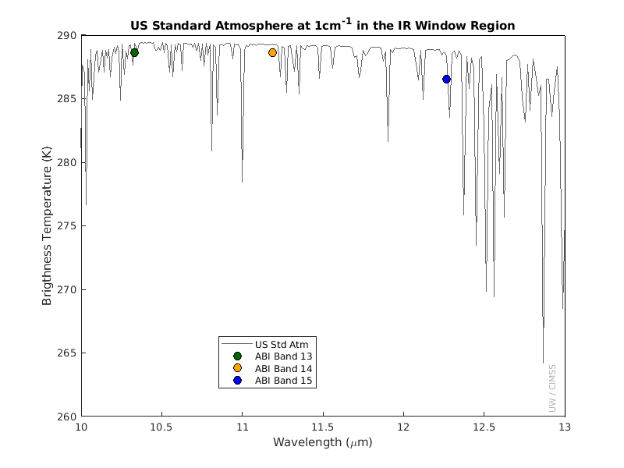
Questions ?
"Geostationary satellites are essential for monitoring weather and storms across the Pacific Basin. If we could add one instrument to our toolkit for weather surveillance, it would be a geostationary hyperspectral infrared sounder. Such observations would dramatically increase confidence in forecasts of hurricanes and other storms that originate over the ocean and head towards U.S. interests."
Eric Lau
Environmental and Scientific Services Division Chief
NWS Pacific Region Headquarters, Honolulu, Hawaii
Advanced sounders have much more temperature and moisture vertical information (Images: Mat Gunshor, CIMSS)
Thanks to many who have contributed, especially Ed Grigsby and the geoXO Hyperspectral InfraRed Sounder value assessment team and the geoXO sounder working group
More: https://www.ssec.wisc.edu/geo-ir-sounder

Slide 22
Select References (1 of 2)
Li, J., Menzel, W. P., Sun, F., Schmit, T. J., & Gurka, J. (2004). AIRS Subpixel Cloud Characterization Using MODIS Cloud Products, Journal of Applied Meteorology, 43(8), 1083-1094. Retrieved Oct 21, 2021, from https://journals.ametsoc.org/view/journals/apme/43/8/1520-0450_2004_043_1083_asccum_2.0.co_2.xml
Schmit, T. J., Li, J., Li, J., Feltz, W. F., Gurka, J. J., Goldberg, M. D., & Schrab, K. J. (2008). The GOES-R Advanced Baseline Imager and the Continuation of Current Sounder Products, Journal of Applied Meteorology and Climatology, 47(10), 2696-2711. https://journals.ametsoc.org/view/journals/apme/47/10/2008jamc1858.1.xml
Sieglaff, J. M., Schmit, T. J., Menzel, W. P., & Ackerman, S. A. (2009). Inferring Convective Weather Characteristics with Geostationary High Spectral Resolution IR Window Measurements: A Look into the Future, Journal of Atmospheric and Oceanic Technology, 26(8), 1527-1541. https://journals.ametsoc.org/view/journals/atot/26/8/2009jtecha1210_1.xml
Schmit, T. J., Li, J., Ackerman, S. A., & Gurka, J. J. (2009). High-Spectral- and High-Temporal-Resolution Infrared Measurements from Geostationary Orbit, Journal of Atmospheric and Oceanic Technology, 26(11), 2273-2292. https://journals.ametsoc.org/view/journals/atot/26/11/2009jtecha1248_1.xml
Smith Sr., W. L., Revercomb, H., Bingham, G., Larar, A., Huang, H., Zhou, D., Li, J., Liu, X., and Kireev, S.: Technical Note: Evolution, current capabilities, and future advance in satellite nadir viewing ultra-spectral IR sounding of the lower atmosphere, Atmos. Chem. Phys., 9, 5563-5574, https://doi.org/10.5194/acp-9-5563-2009, 2009.
Li, J., Li, J., Otkin, J., Schmit, T. J., & Liu, C. (2011). Warning Information in a Preconvection Environment from the Geostationary Advanced Infrared Sounding System—A Simulation Study Using the IHOP Case, Journal of Applied Meteorology and Climatology, 50(3), 776-783. https://journals.ametsoc.org/view/journals/apme/50/3/2010jamc2441.1.xml

Slide 23
Select References (2 of 2)
Menzel, W. P., Schmit, T. J., Zhang, P., & Li, J. (2018). Satellite-Based Atmospheric Infrared Sounder Development and Applications, Bulletin of the American Meteorological Society, 99(3), 583-603. Retrieved Oct 21, 2021, from https://journals.ametsoc.org/view/journals/bams/99/3/bams-d-16-0293.1.xml
Yin, R., Han, W., Gao, Z., & Li, J. (2021). Impact of high temporal resolution FY-4A Geostationary Interferometric Infrared Sounder (GIIRS) radiance measurements on Typhoon forecasts: Maria (2018) case with GRAPES global 4D-Var assimilation system. Geophysical Research Letters, 48, e2021GL093672. https://doi.org/10.1029/2021GL093672
Ma, Z., Li, J., Han, W., Li, Z., Zeng, Q., Menzel, W. P., et al. (2021). Four-dimensional wind fields from geostationary hyperspectral infrared sounder radiance measurements with high temporal resolution. Geophysical Research Letters, 48, e2021GL093794. https://doi.org/10.1029/2021GL093794
Yin, Ruoying, Wei Han, Zhiqiu Gao, and Di Di. “The evaluation of FY4A’s Geostationary Interferometric Infrared Sounder (GIIRS) long‐wave temperature sounding channels using the GRAPES global 4D‐Var.” Quarterly Journal of the Royal Meteorological Society 146, no. 728 (2020): 1459-1476. https://doi.org/10.1002/qj.3746
Holmlund, et al., P. (2021). Meteosat Third Generation (MTG): Continuation and Innovation of Observations from Geostationary Orbit, Bulletin of the American Meteorological Society, 102(5), E990-E1015. https://journals.ametsoc.org/view/journals/bams/102/5/BAMS-D-19-0304.1.xml
W. L. Smith et al., "Hyperspectral Satellite Radiance Atmospheric Profile Information Content and Its Dependence on Spectrometer Technology," in IEEE Journal of Selected Topics in Applied Earth Observations and Remote Sensing, vol. 14, pp. 4720-4736, 2021, doi: 10.1109/JSTARS.2021.3073482. https://ieeexplore.ieee.org/abstract/document/9406029

