Slide 1
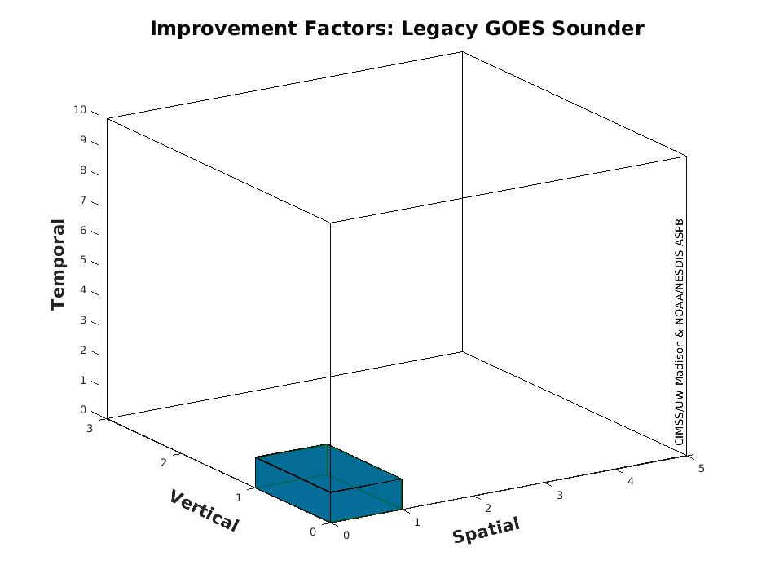

Information Content from the GeoXO Sounder (GXS)
AMS 2023
Timothy J. Schmit ª, Zhenglong Li ^{b}, Jinlong Li ª, Mat Gunshor ^{b},
Dave Tobin ^{c}, Andrew Heidinger ^{e}
ª NOAA/NESDIS/STAR ^{b} University of Wisconsin-Madison/CIMSS
^{c} University of Wisconsin-Madison/SSEC ^{e} NOAA/GeoXO
Jan, 2023

Slide 2
https://www.nesdis.noaa.gov/next-generation/geostationary-extended-observations-geoxo
The first Geostationary Extended Observations (GeoXO) launch is planned for the early 2030s and will maintain and advance NOAA’s critical geostationary observations through 2055.
"For weather surveillance a geostationary hyperspectral infrared sounder would dramatically increase confidence in forecasts of hurricanes and other storms that originate over the ocean and head towards U.S. interests."
- Ken Graham, NWS Director (former NHC Director)

Slide 3
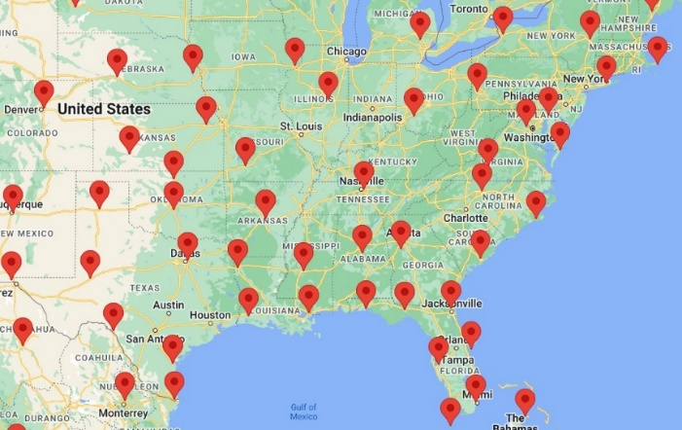
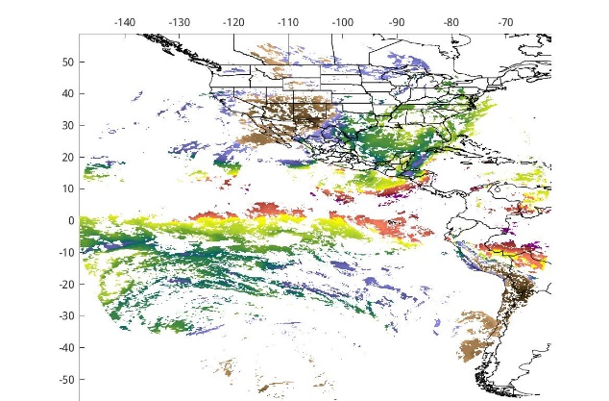
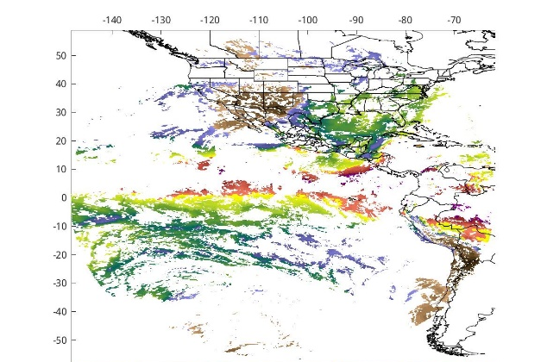
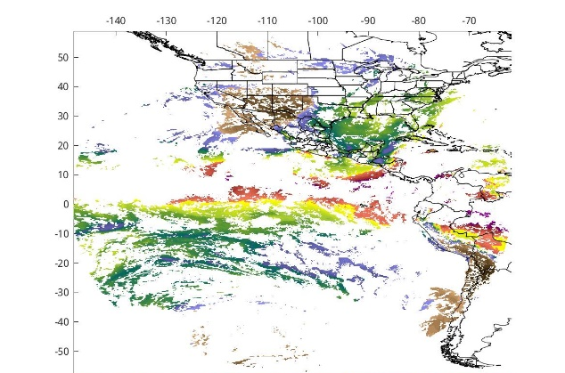
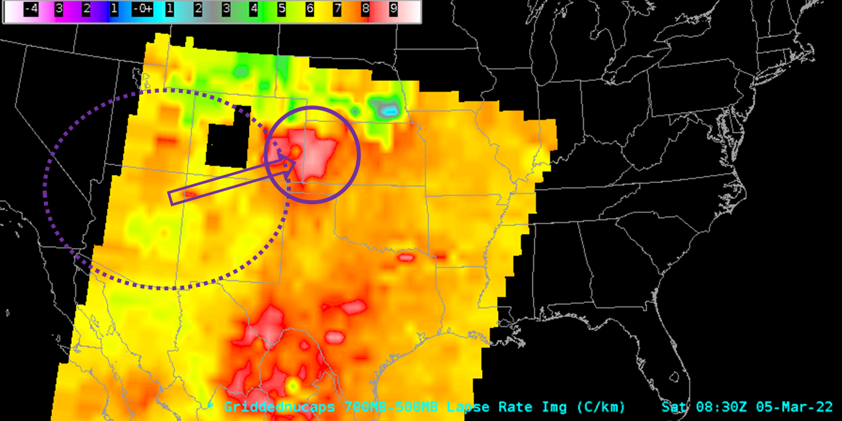
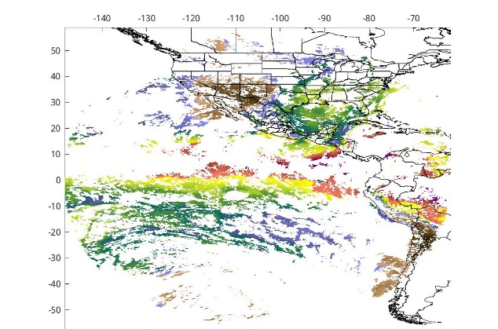

Radiosondes
(2x/day), scattered (mostly) land locations
Vertical Moisture Information
GeoXO Sounder
(at least hourly), land and ocean, ~4km, hemispheric coverage
LEO passes
(several/day over CONUS), land and ocean, ~14-40km, global coverage
Notes:
FD TPW coverage should be from 105W.
Raobs are critical for validations.
LEO is critical for global coverage.

Slide 4
Spatial Resolutions: Ground Sample Distance and Angle
The centroid-to-centroid distance between adjacent spatial samples on the Earth’s surface, as measured at the Sub-Satellite Point, defines the ground sample distance (GSD). The ground sample angle (GSA) is the associated angle. A two-dimensional pixel is defined by the GSD in the East/West and North/South dimensions. The GXS shall have a GSA no larger than 112 microradians (4 km at nadir) for emissive channels.
This is much improved over the legacy GOES Sounders and the current polar hyperspectral IR sounders.
  ~10 km for legacy GOES Sounder
  ~13 - 15 km for polar hyperspectral IR sounders.

Slide 5
Temporal Coverage
In Sounding Disk mode, the GXS shall acquire each SD and perform all necessary housekeeping and calibration functions in less than 60 minutes.
Scan modes of operations still being defined, in an interleaving mode, finer time resolution of the Super-regional (3000 km x 5000 km) and/or Mesoscale (1000 km x 1000 km) maybe possible
Sounding Disk (SD) is a collection of spatial resolution elements viewing the earth where the local zenith angle (LZA) to a GOES is less than 62 degrees.

Slide 6
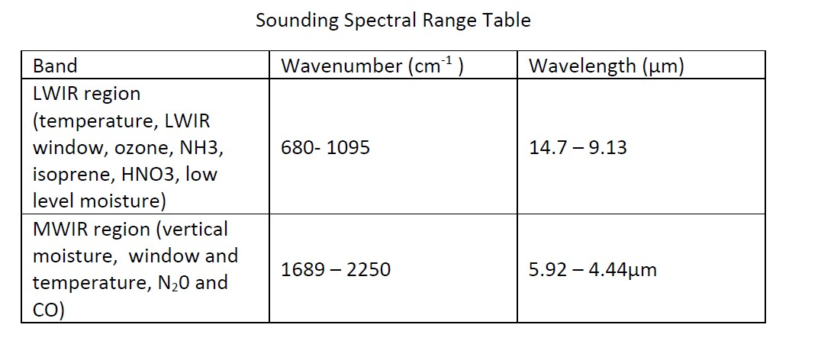
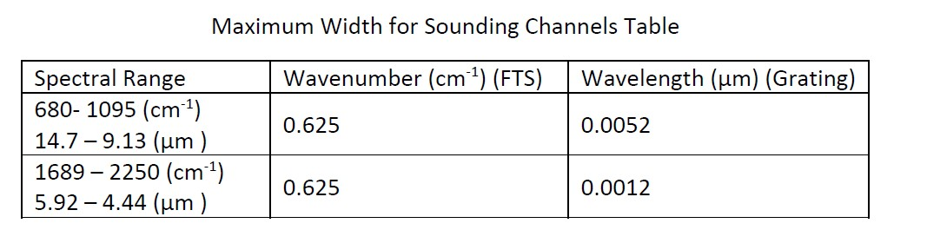
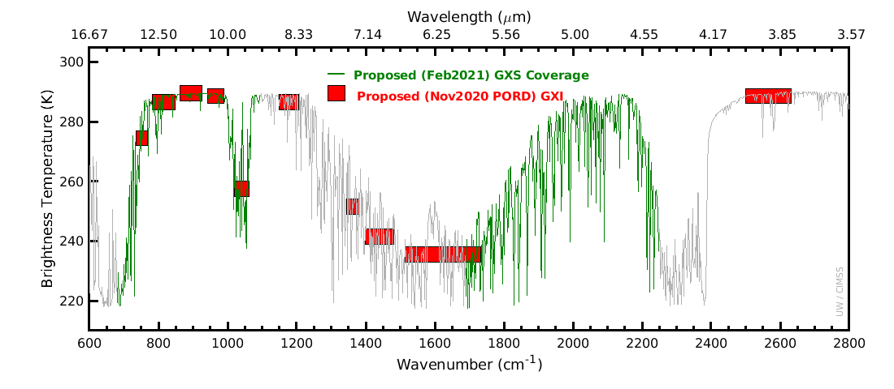
Spectral
(baseline)

Slide 7
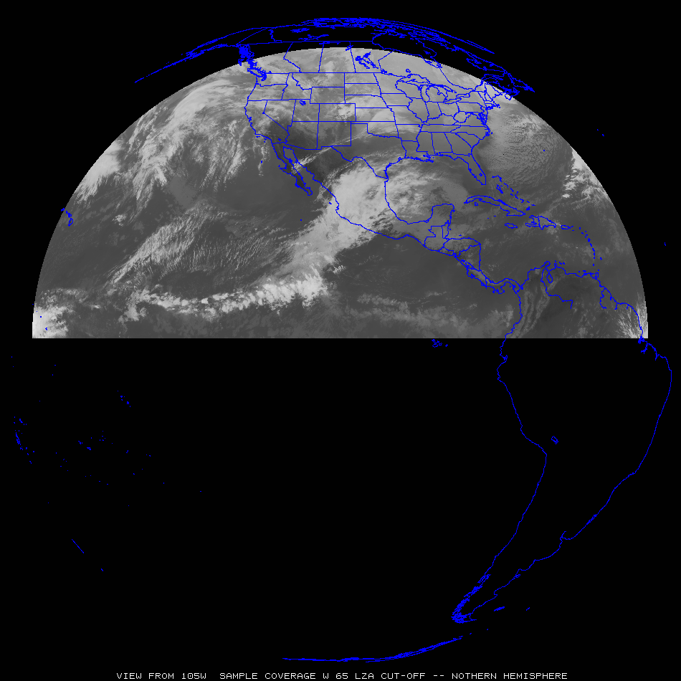
Sample GeoXO Sounder Uses
“clippers”
Select GXS uses for both nowcasting and NWP applications
Most everywhere:
Pre-convection, stability, winds, moisture, high clouds, help AQ, etc.
“atmospheric
rivers”
“Nor-easters”
“dryline”
Sub-tropical jet
“return flow”
“Atlantic
Tropical
Cyclones”
“EastPac Tropical Cyclones”
Tropical winds for NWP
Tropical winds for NWP
Tropical winds for NWP

Slide 8
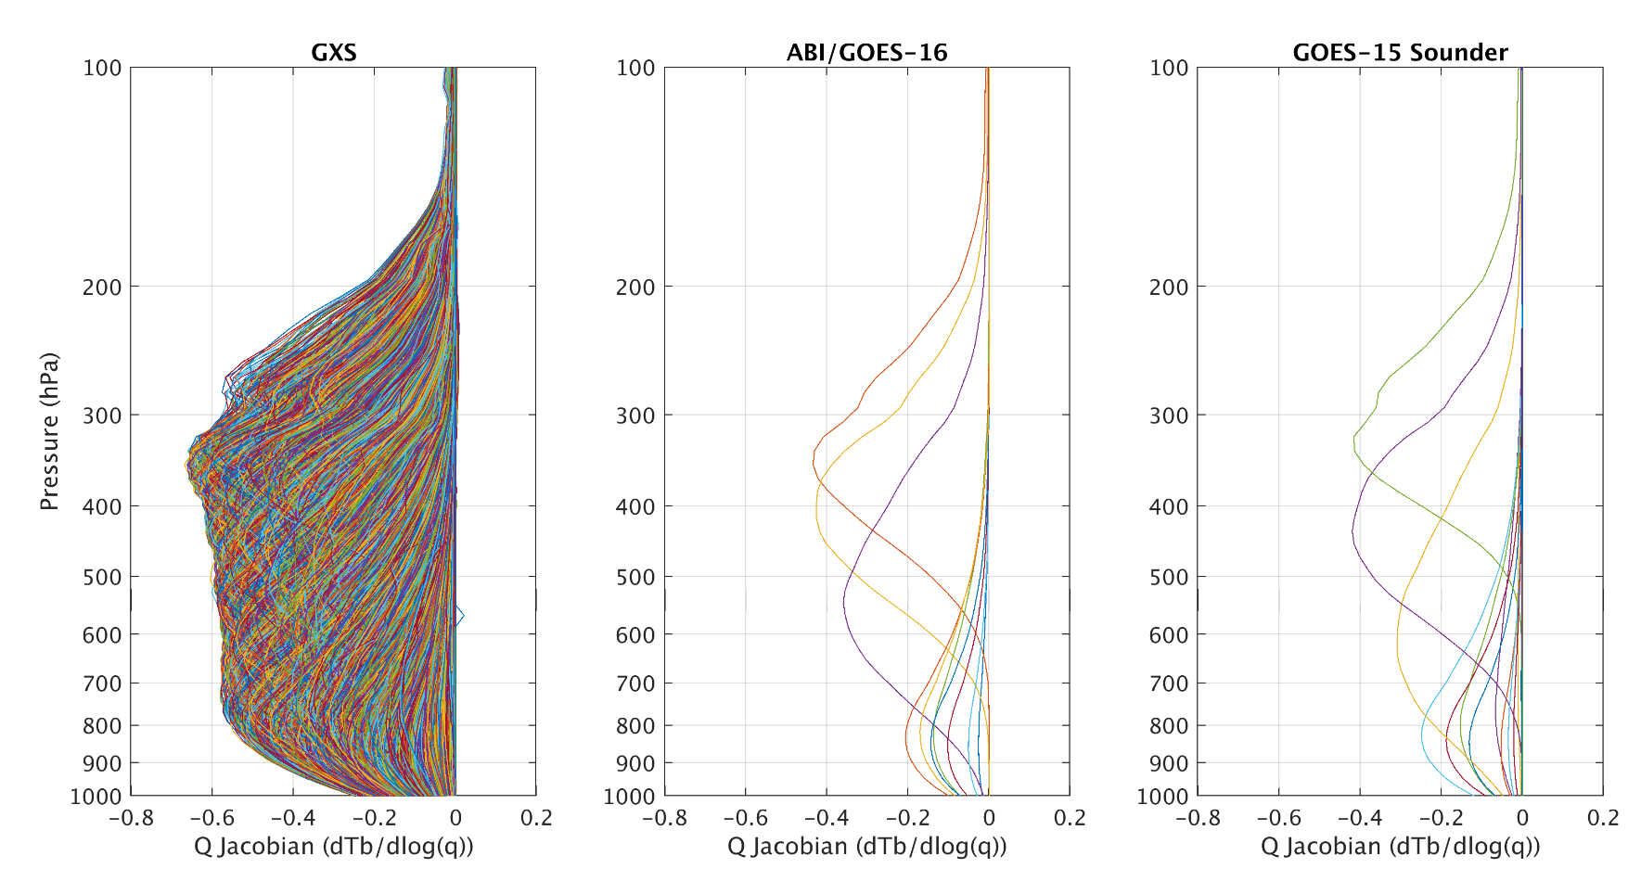
GeoXO GXS Moisture Weighting Functions
GeoXO IR-Sounder (GXS) Science Working Group has computed the Weighting functions for the nominal specifications of GXS.
Weighting functions (aka Jacobians) show where in the atmosphere information comes from.
These plots show the weighting functions for moisture.
These are also important for picking channels for data assimilation, although as many as possible should be used.
They show how much more vertical information GXS will provide compared to ABI or the previous GOES Sounders, this is in part to the many more overlapping spectral bands.
UW/CIMSS
Notes:
Farther from the zero line is more vertical resolution. More bands reduces the noise. 1976 US standard atmosphere

Slide 9
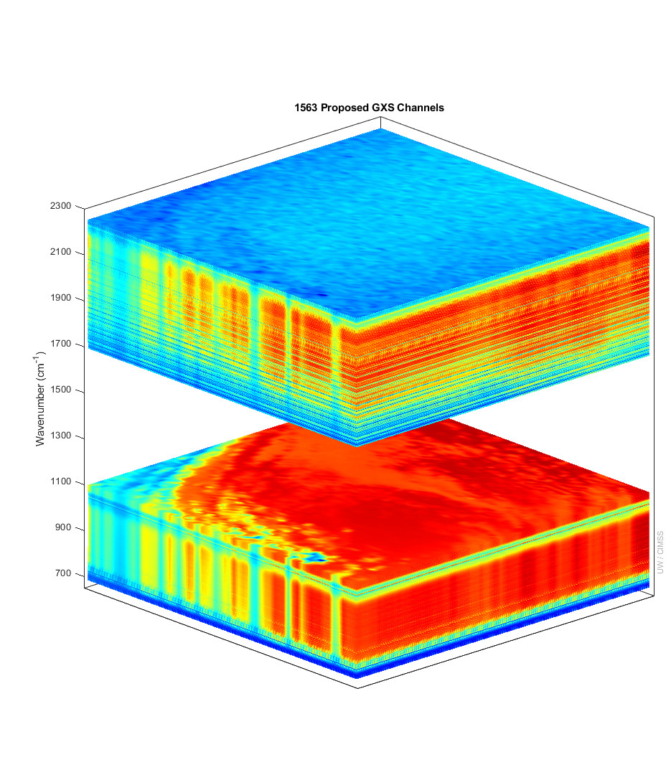
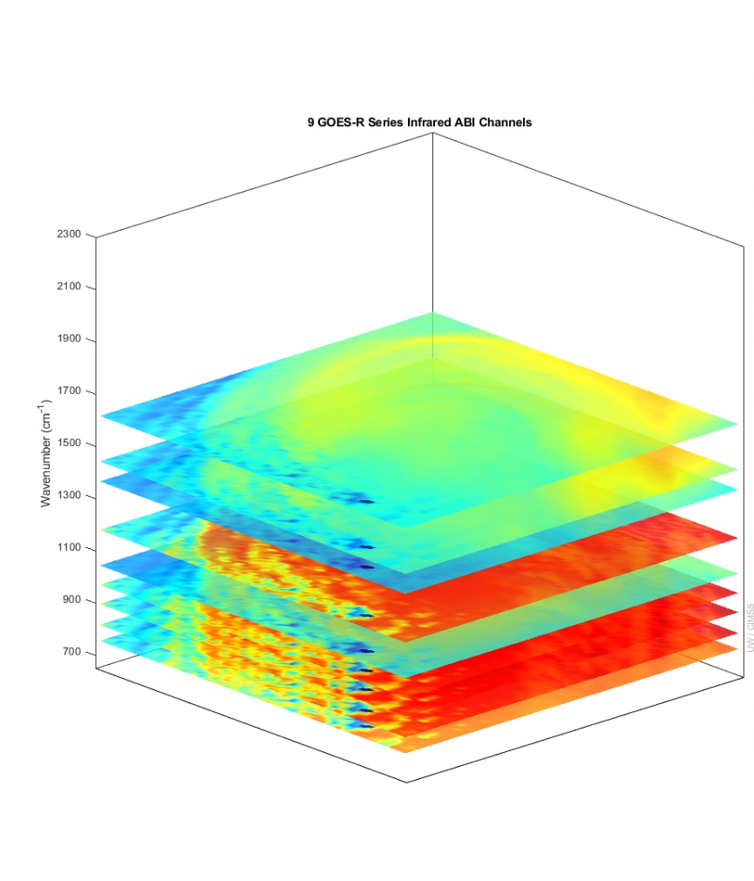
More spectral bands means more vertical information for temperature and moisture
GXS ABI
IASI granule used to show the great improvement of the GXS over previous geostationary capabilities. Not shown are the improved temporal or spatial attributes of the GXS.
There is more than six times (temperature) and four times (moisture) of number of independent pieces of vertical information compared to the ABI.
Number of Independent Pieces of Vertical Information
Temperature | 13 | 2
Moisture | 11 | 2.5
Notes:
Y axis is wavenumber. ABI and GOES Sounder bands within the GXS range are shown. Credit: UW/CIMSS
Vertical pieces recently calculated by Z. Li, UW/CIMSS.

Slide 10
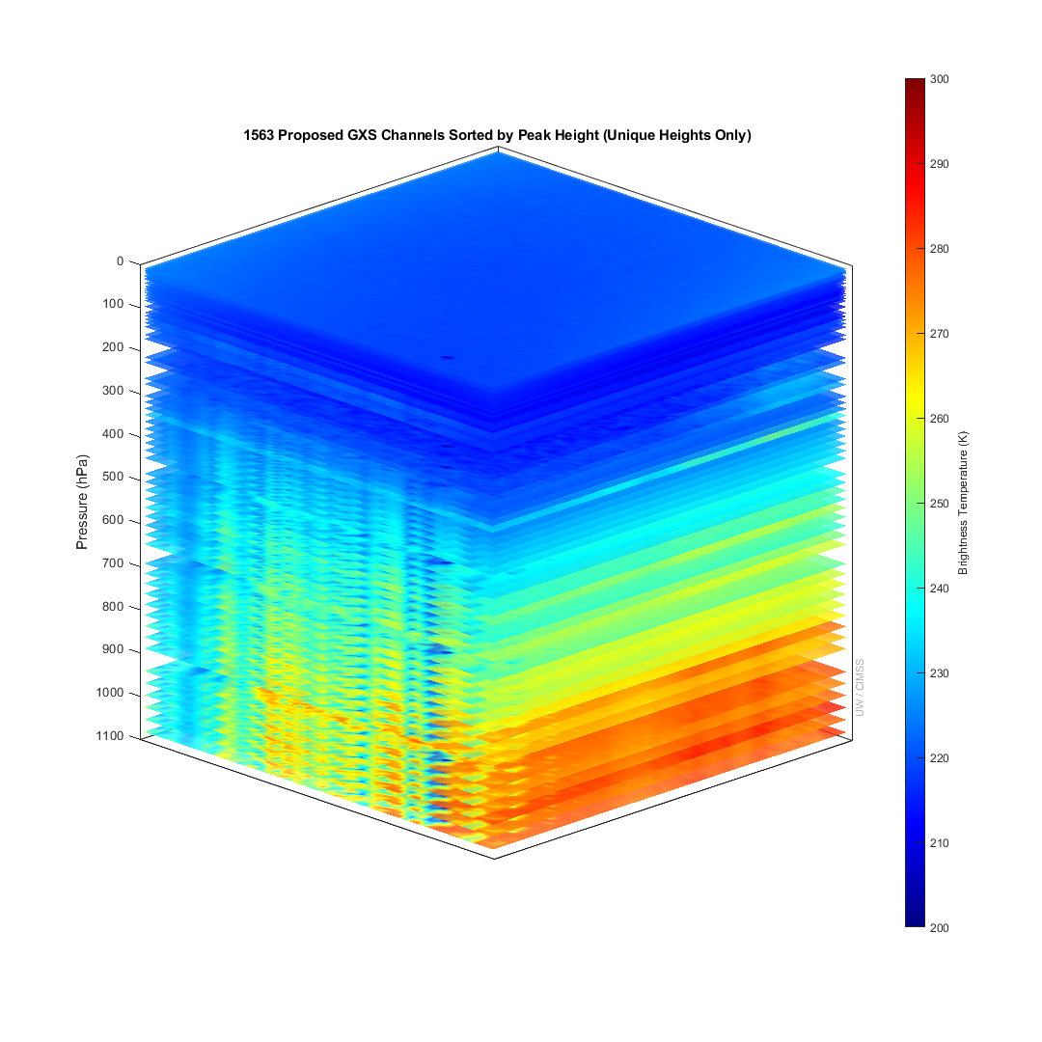
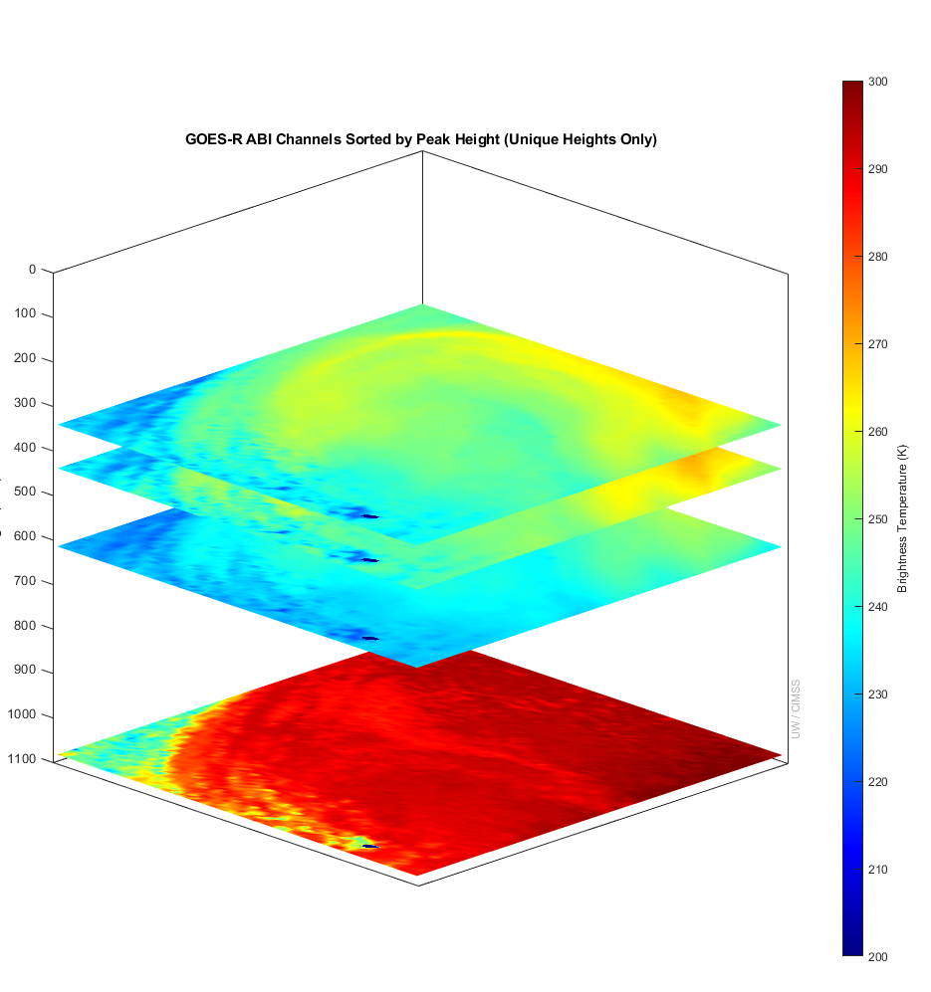
GeoXO Sounder ABI
The GeoXO Sounder (GXS) will provide much greater vertical atmospheric information than the ABI or the broad spectral band GOES Legacy Sounder, from the surface up to the stratosphere.
GXS will provide above today’s capabilities:
The boundary layer near/just above the surface. - Other trace gas information (N2O, CO, NH3, O3, etc.).
Information throughout the atmosphere. - Many more levels of water vapor information.
Notes:
Band heights determined from weighting functions on a standard atmosphere, which is only valid for a clear-sky pixel.
Using a 101-level forward model to calculate weighting functions gives us only a maximum of 101 levels for peak pressures in these figures. Over 700 bands of GXS will peak at the surface, but the other 700+ really peak at unique heights in the atmosphere but that isn’t reflected using the 101-level model. In other words, the GXS vertical coverage is really much more complete even than these figures indicate.

Slide 11
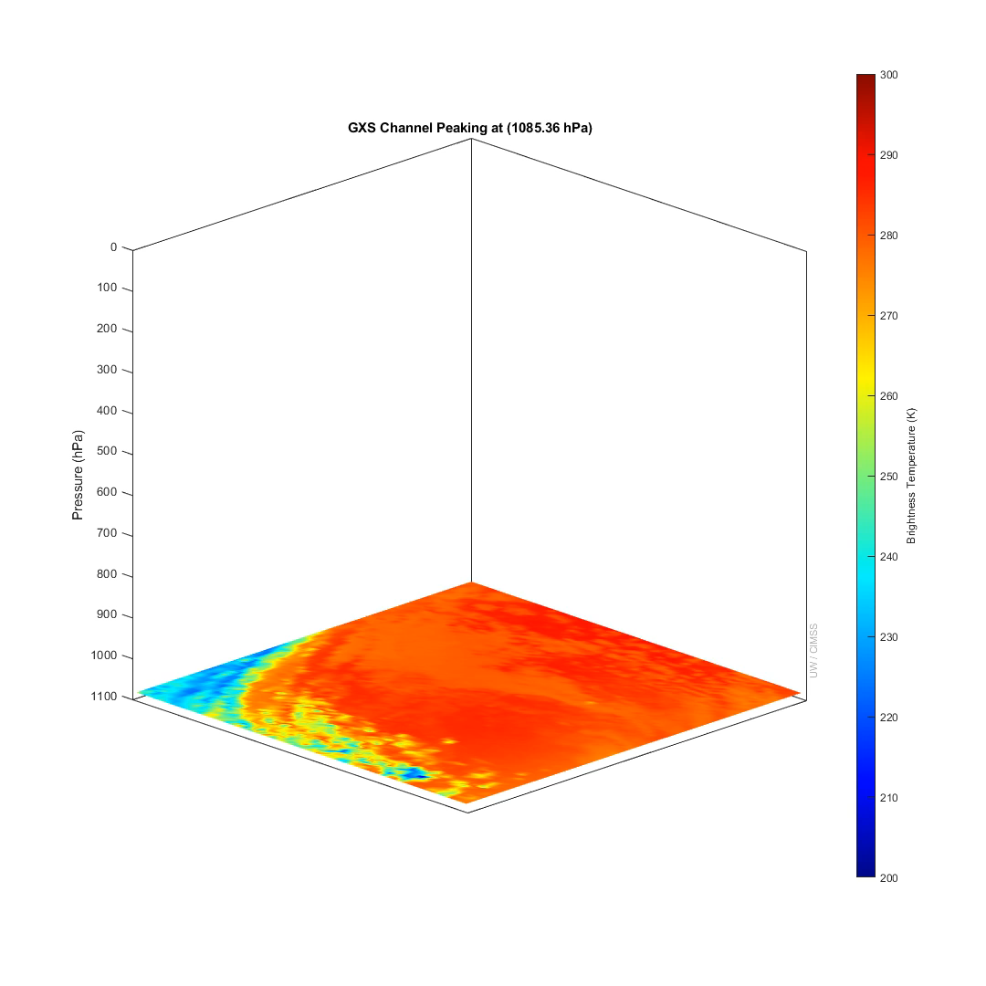
Proposed GeoXO Sounder
1563 IR Bands Total
Sorted by Peak Pressure
(related to height) in the atmosphere and only one shown for each unique layer in the forward model.
Animation

Slide 12
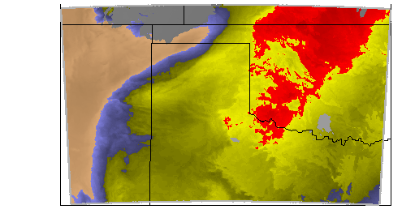
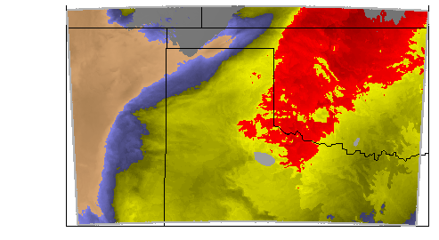
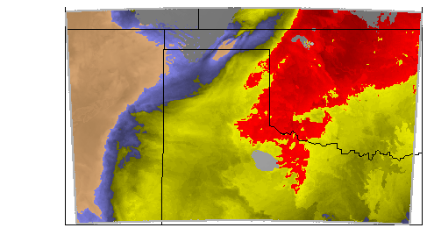
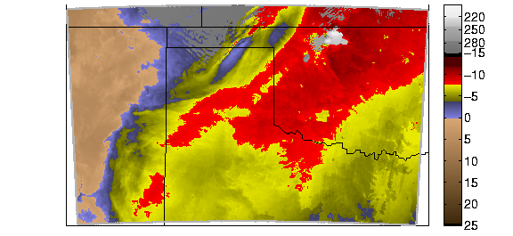
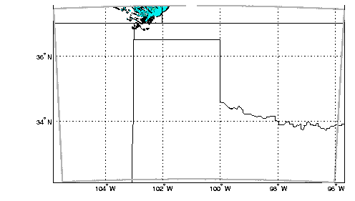
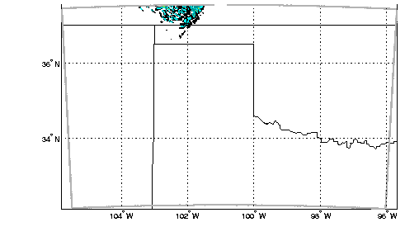
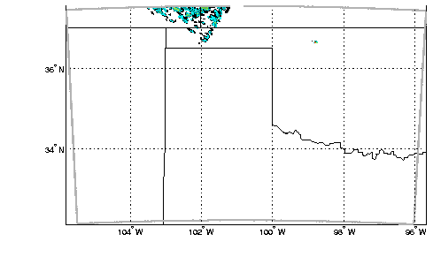
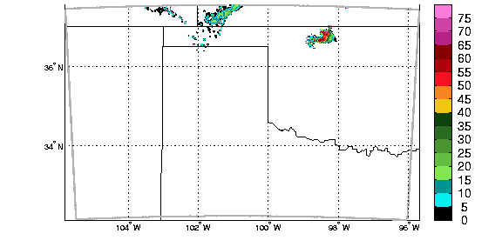
GeoXO GXS Can Monitor Conditions ripe for Thunderstorms; increasing lead times
The GXS - sounder can provide hours more lead time of atmospheric instability compared to waiting for the radar echoes. The GXS does this via uniquely monitoring upper-level drying; low-level moisture pooling; and atmospheric flow before the clouds form. These are important vertical moisture changes; as they are key to the prediction of convection. The GXI will not provide the detailed vertical moisture or temperature information (not shown).
- 3 hours before convection - 2 hours - 1 hour Convection
time
GXS Atmospheric Instability
Radar
Notes:
- 3 hours is 13Z in the published IHOP case … This is an OSSE, so radar is simulated. Ovals added for reference. Images are grouped.
1 hour is when the imager can be used, since the clouds have to have formed
The 0 hr is when there’s lightning and hence the LMX can see it.
PS: ACX also useful for modeling convection: Ntelekos, A.A., Smith, J.A., Donner, L., Fast, J.D., Gustafson, W.I., Jr, Chapman, E.G. and Krajewski, W.F. (2009), The effects of aerosols on intense convective precipitation in the northeastern United States. Q.J.R. Meteorol. Soc., 135: 1367-1391. https://doi.org/10.1002/qj.476

Slide 13
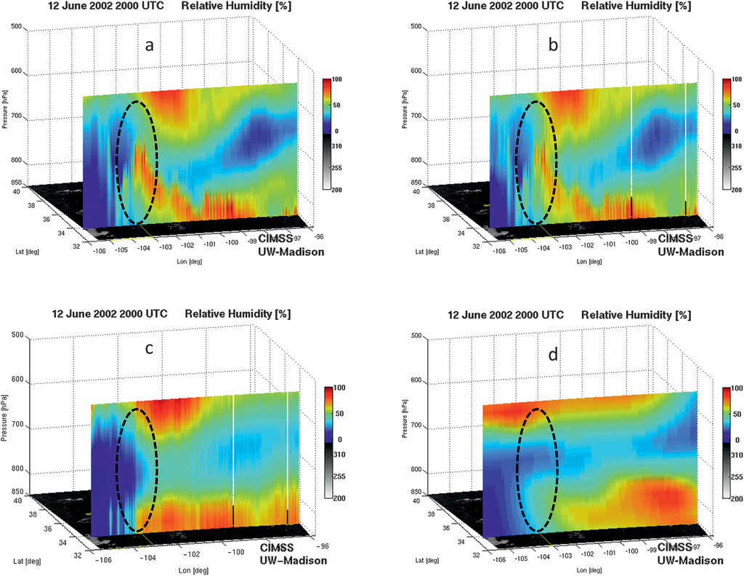
Truth
GXS-like
GXS can monitor important vertical moisture changes; these are the key to the prediction of convection
12-June-2002 20 UTC
Relative Humidity [%]
ABI-like
Regional NWP
Imagers nor NWP capture the vertical moisture changes
Notes:
Relative humidity cross section at 2000 UTC 12 Jun 2002 from (a) true, (b) the geostationary advanced IR sounder, (c) ABI, and (d) RUC.
Citation: Journal of Applied Meteorology and Climatology 50, 3; 10.1175/2010JAMC2441.1
Image and labels are grouped.

Slide 14
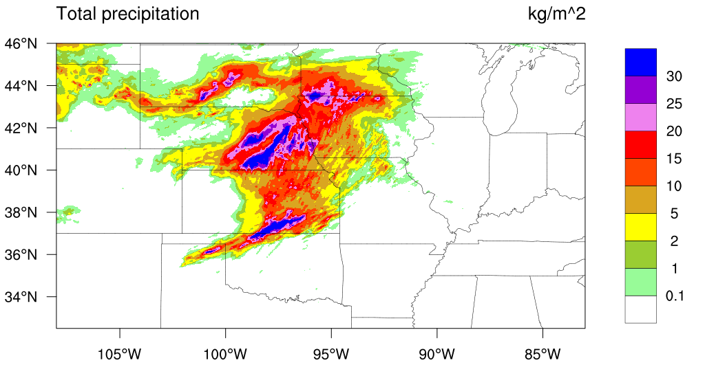
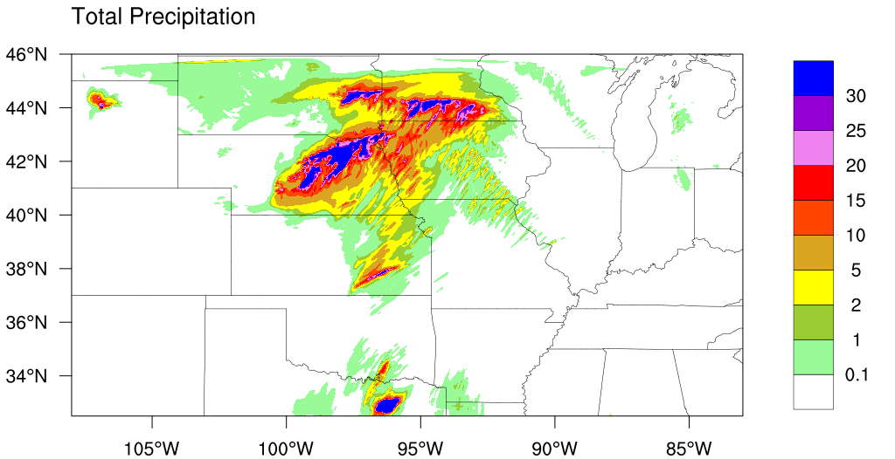
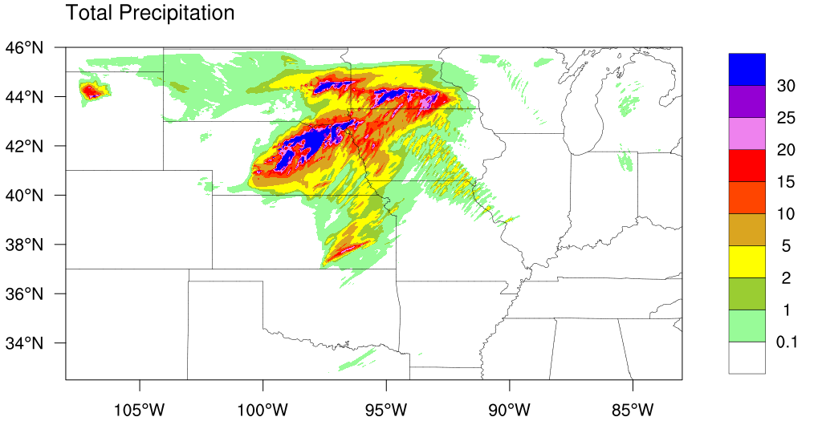
Hybrid OSSE: Precipitation Impact Verification
Observation
2019-5-27 06UTC – 12UTC
The high spectral IR was able to remove a spurious storm over Eastern Texas!
A false heavy precipitation that might lead to a false warning!
CNTRL
No “GXS”
EXP
With “GXS”

Slide 15
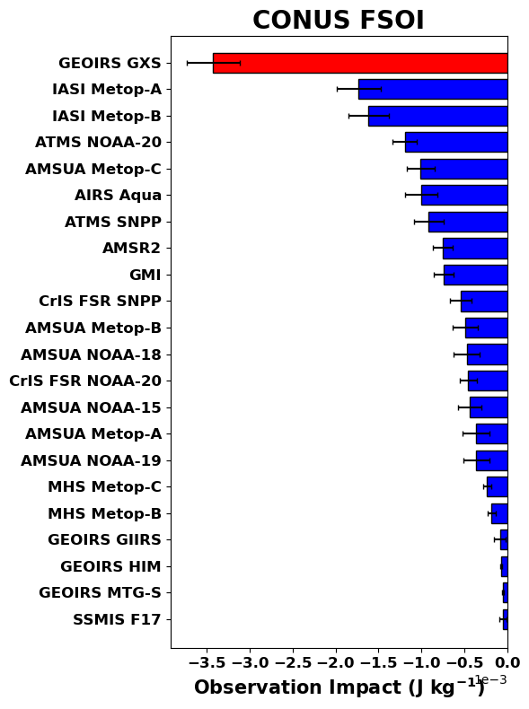
FSOI
(24-hr)
Preliminary NASA’s GMAO OSSE: GXS has more than twice the positive impact as the second closest contributor over the contiguous US region (included the 4 analysis times). These scores are for 24-hr forecasts. A negative value is a positive impact. Credit: Erica McGrath-Spangler, Morgan State University and the whole GMAO team.
More negative values mean more positive impacts

Slide 16
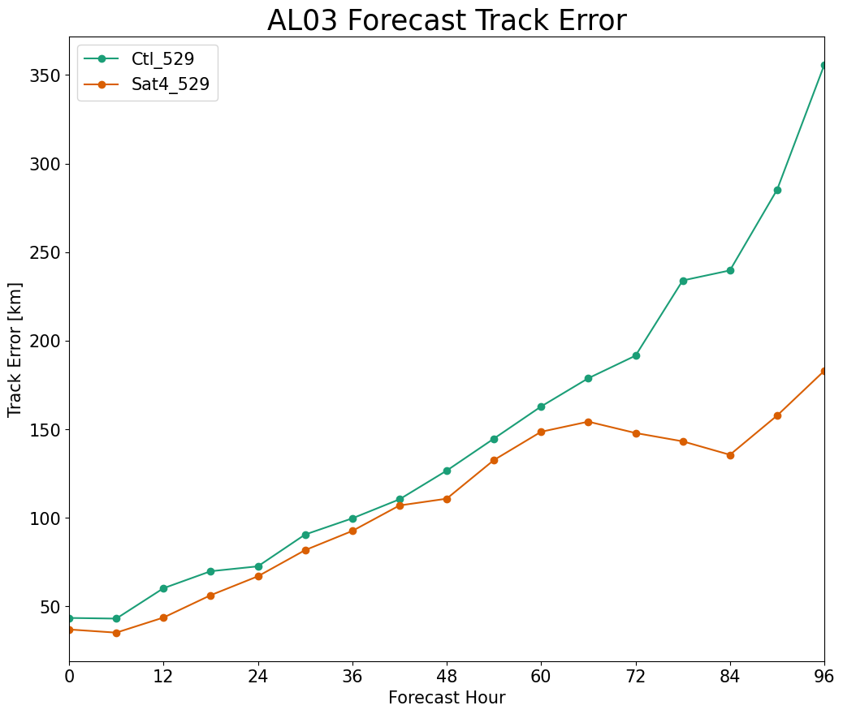
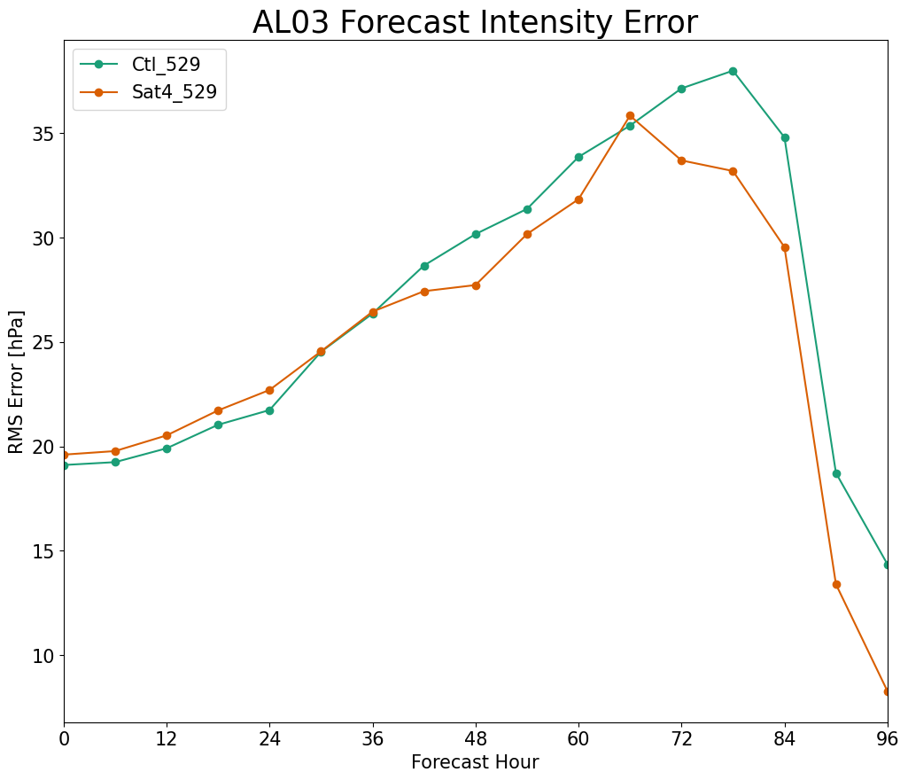
Forecasts
Control
Sat4
Preliminary GMAO OSSE: Hurricane Track and Intensity (after 36 hours) improvements with geostationary advanced hyperspectral IR Sounders. Credit: Erica McGrath-Spangler, Morgan State University and the whole GMAO team.
Fcst hour | 0 | 24 | 48 | 72 | 96
# Fcsts | 16 | 13 | 9 | 5 | 1

Slide 17
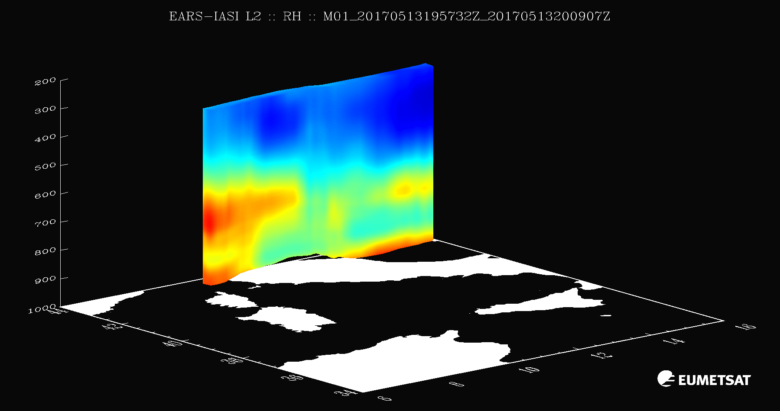

GeoXO GXS is the only sensor to monitor vertical moisture on high time and space scales
Relative Humidity (movie) note the elevated moisture plumes.
GXS will add the important time component.
Notes:
https://www.eumetsat.int/IASI-PWLR
Example of relative humidity fields generated from EARS-IASI L2 over Italy on 13 May 2017

Slide 18
Need for high spectral & temporal observations
High-spectral-resolution observations provide much more information
  Imagers average out important vertical information
  LEO has shown the many benefits, especially on the global scale, lacks time resolution
Forecasting Applications – fill in critical gaps wrt vertical moisture, wind and temperature
  Nowcasting and Numerical weather prediction, especially on the regional/mesoscales
Additional applications
  improve derived products with only advanced imager data
    cloud-top properties, atmospheric motion vectors, dust detection, land and sea surface temperatures
  New areas
    Moisture flux, capping inversion, surface emissivity, trace gases (Ozone and Carbon Monoxide, etc.) and climate
Economic impacts (“billions”…) More with the benefits of 4dvar analysis …
Critical Component of the Global Constellation

Slide 19
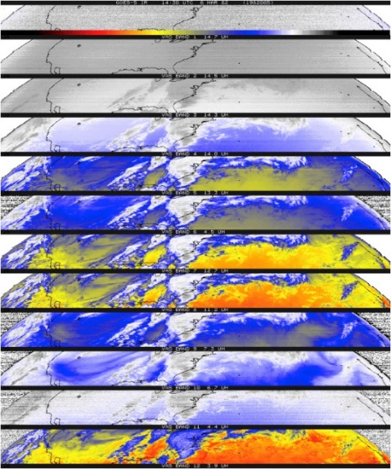
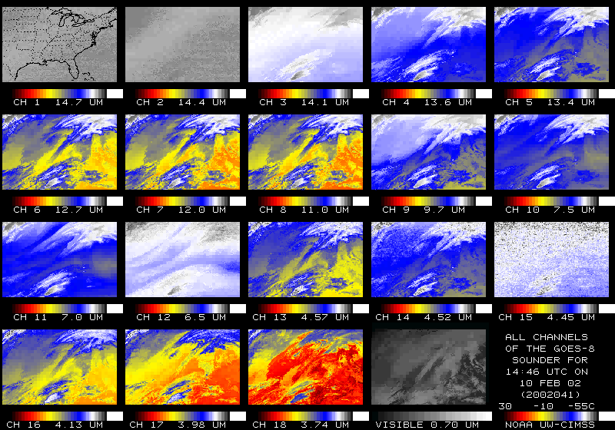

U.S. Geostationary Sounders
Item | # IR bands | Sounding
First Experimental | 12 | GOES-4 VAS (1980)
First Operational | 18 | GOES-8 (1994)
100x improved | ~1500 | High-spectral IR (203?)
The GOES-R series included advanced imagers, the first geostationary lightning mapper and space weather instruments.
Notes:
T. Schmit AMS presentation in Boston.

Slide 20
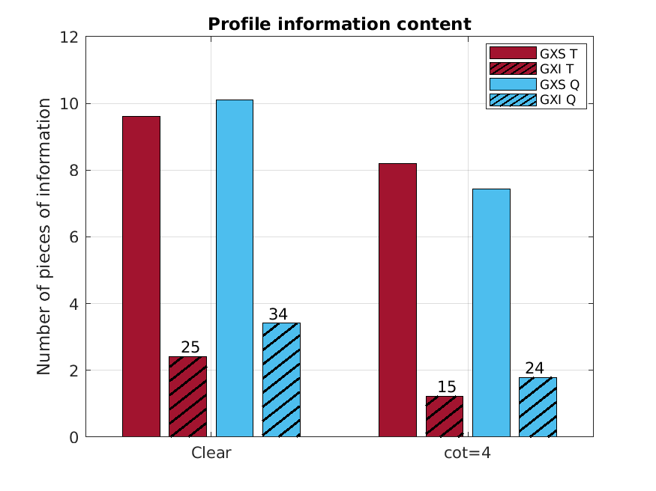
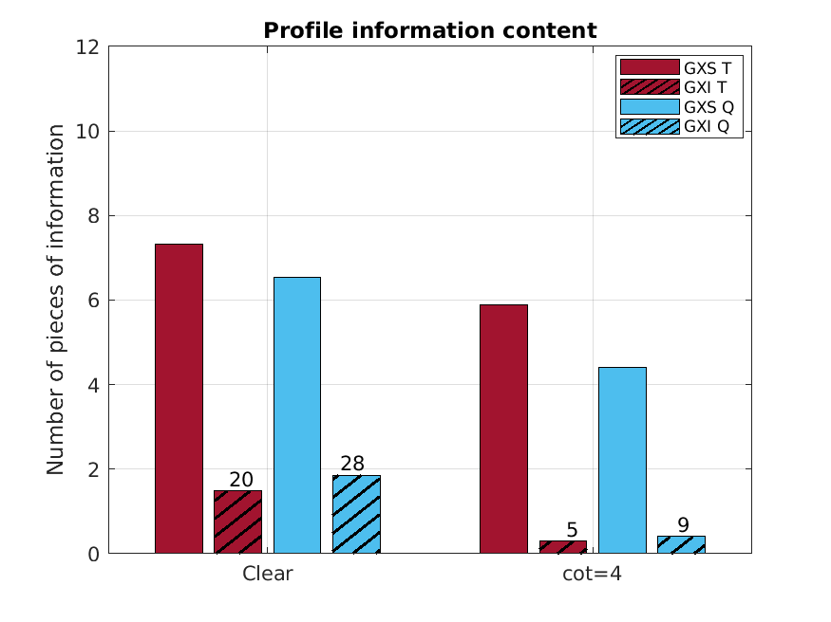
GXS information content is much more than GXI
Cloud top pressure = 300 hPa
GXS has 3-5 times more vertical information than the GXI in clear skies, and 4-20 times more vertical information than the GXI in thin clouds
  9 means GXI has 9% of moisture information content compared with GXS when COT is 4.
Tropical atmosphere profile
Midlatitude winter atmosphere profile
Numbers on top of bars show the percentage (%) of information content from GXI compared to GXS
High clouds reduce information content of T/Q, but significantly less impact from GXS

Slide 21
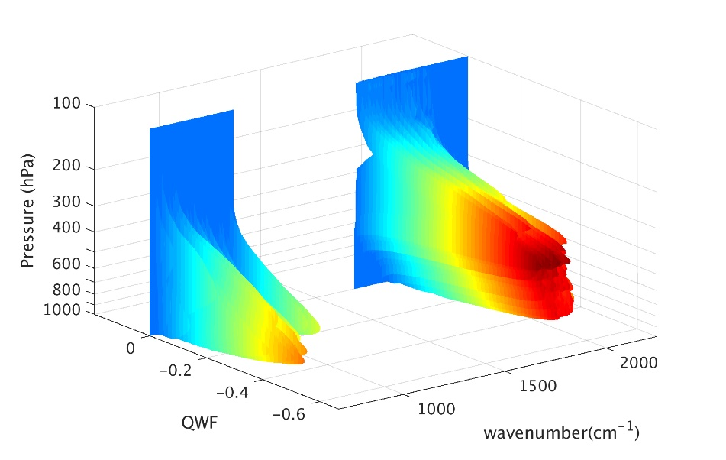

More Information
https://www.ssec.wisc.edu/geo-ir-sounder/
Home
OSSE
Proxy
Other Benefits
Needs
On-orbit examples
NOAA NESDIS Tech Report: Geostationary Extended Observations (GeoXO) Hyperspectral InfraRed Sounder Value Assessment Report
  https://repository.library.noaa.gov/view/noaa/32921
https://www.nesdis.noaa.gov/next-generation-satellites/geostationary-extended-observations-geoxo
PORD:
https://www.nesdis.noaa.gov/next-generation/geoxo/geoxo-sounder-gxs
Notes:
https://www.ssec.wisc.edu/geo-ir-sounder/need/

Slide 22
Backup

Slide 23
"Even though this historic journey has been 60+ years in the making, we are just scratching the surface. [The] biggest next step is the GEO hyperspectral sounder! Address the high resolution ΔT opportunity observed across the entire Earth System. Europe and Asia are leading the effort to launch and operate Geostationary Sounders. We are now the followers… we should be reasserting our past leadership position.”
Dr. Louis W. Uccellini, Former NWS Director, February 24, 2020

Slide 24
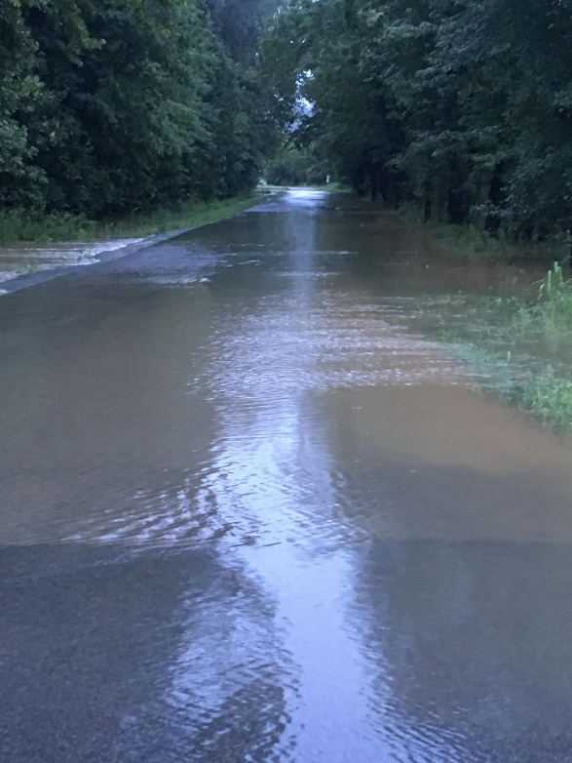
Forecasts with high spectral and time resolution satellite data greatly improve precipitation forecasts
NWS
KY flooding: 9-hour forecasts of hourly accumulated precipitation for the period 01:00 to 02:00 CDT, on August 5, 2022. The control forecast is obtained from the same model and conventional observations used for the ‘Satellite’ forecast but without the assimilation of the satellite moisture profile data. Without the satellite profiles, the heavy rain was not forecast by the model.
Notes:
https://www.weather.gov/pah/2022Aug4-5_Flooding

Slide 25
Information Content
(GXS-like)
(legacy)
The relative vertical number of independent pieces of information is shown. The moisture content is similar between the ABI and the legacy GOES Sounder. The legacy GOES Sounder does show more temperature information than the ABI. The ABI is not close to the information content of a high-spectral IR sensor.
Notes:
https://journals.ametsoc.org/view/journals/atot/26/11/2009jtecha1248_1.xml

Slide 26
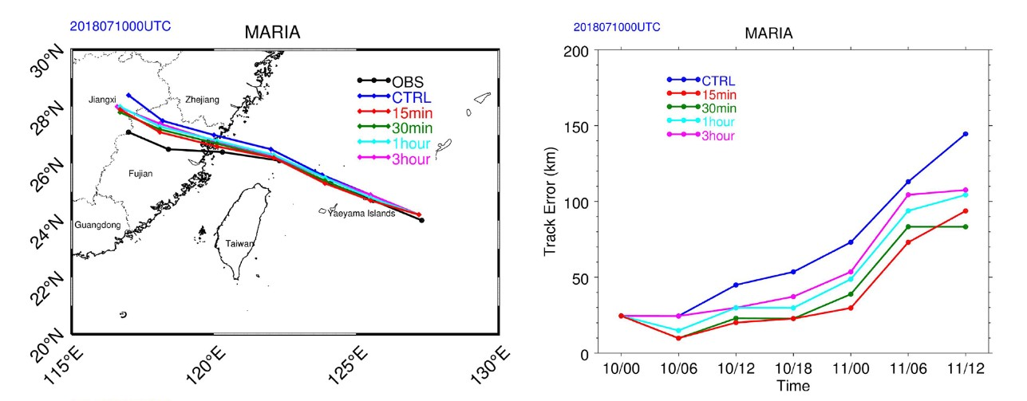
Improved track and intensity forecasts
Improving tropical cyclone forecasts with high temporal/spectral IR observations.
Track & intensity forecasts for Typhoon Maria are most improved with 15 min data, the track (> 40%) and the intensity (18%).
Precipitation forecasts also improved.
The 36 h track forecast for Typhoon Maria from 0000 UTC on July 10, 2018. The black, blue, red, green, cyan, and magenta lines indicate the Best Track, control experiment, 15 min, 30 min, 1 and 3 h, respectively. https://agupubs.onlinelibrary.wiley.com/doi/10.1029/2021GL093672

