Slide 1
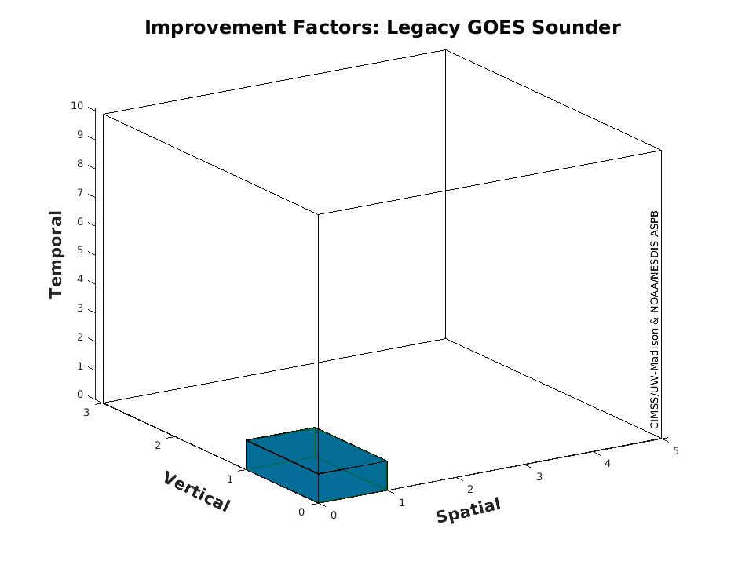

NOAA’s Geostationary Extended Observations Sounder (GXS)
AMS 2024
Timothy J. Schmit ª, Zhenglong Li ^{b}, Dave Tobin ^{c}, Mat Gunshor ^{b},
James G. Yoe ^{d}, Andrew Heidinger ^{e} etc.
ª NOAA/NESDIS/STAR ^{b} University of Wisconsin-Madison/CIMSS
^{c} University of Wisconsin-Madison/SSEC ^{d} NOAA/NWS ^{e} NOAA/GeoXO
Feb 1, 2024

Slide 2
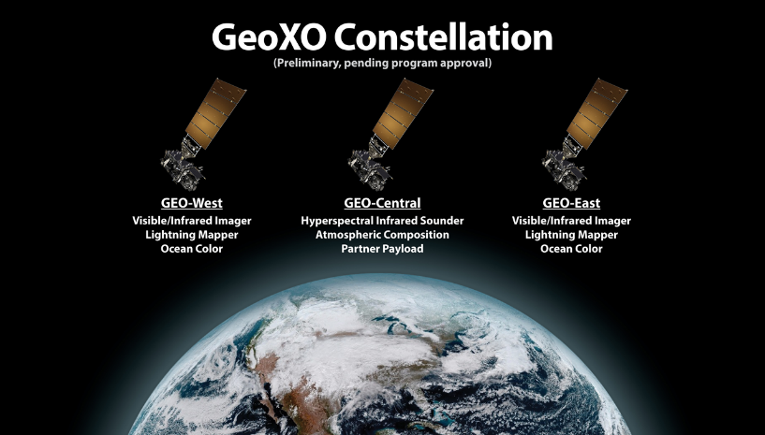
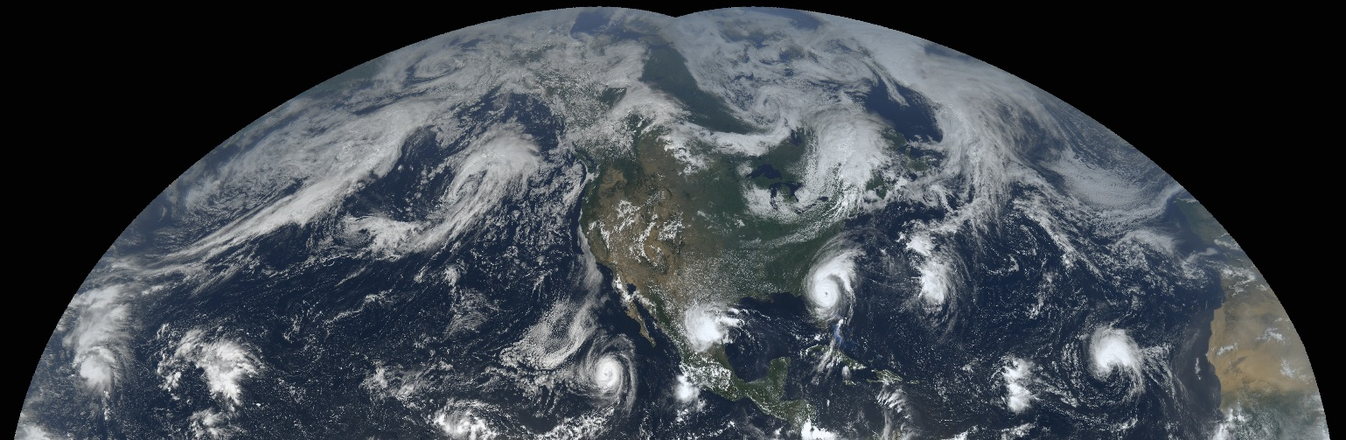
https://www.nesdis.noaa.gov/our-satellites/future-programs/geostationary-extended-observations-geoxo
"For weather surveillance a geostationary hyperspectral infrared sounder would dramatically increase confidence in forecasts of hurricanes and other storms that originate over the ocean and head towards U.S. interests."
- Ken Graham, NWS Director (former NHC Director)

Slide 3
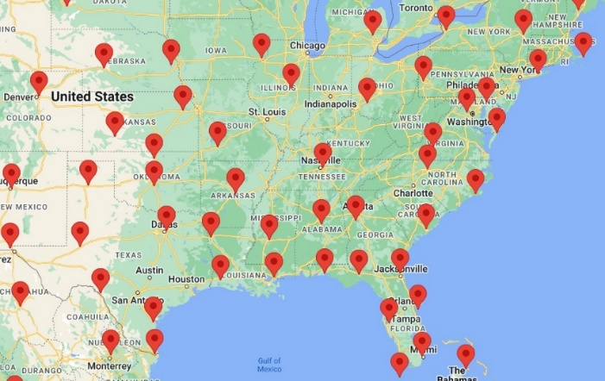
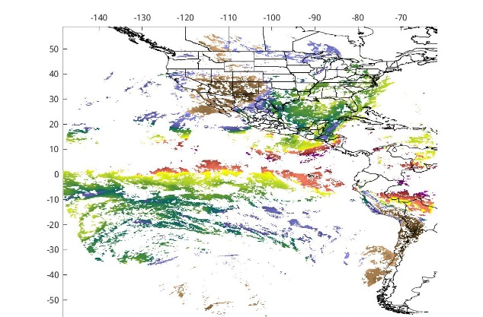
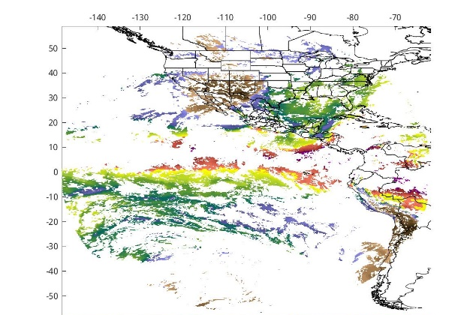
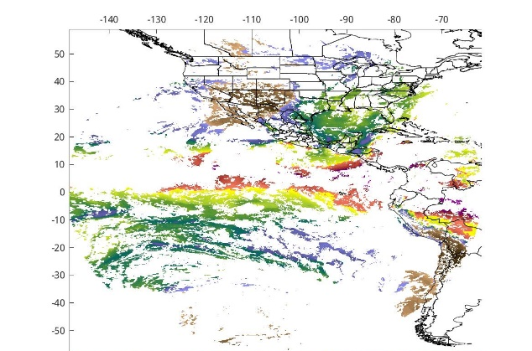
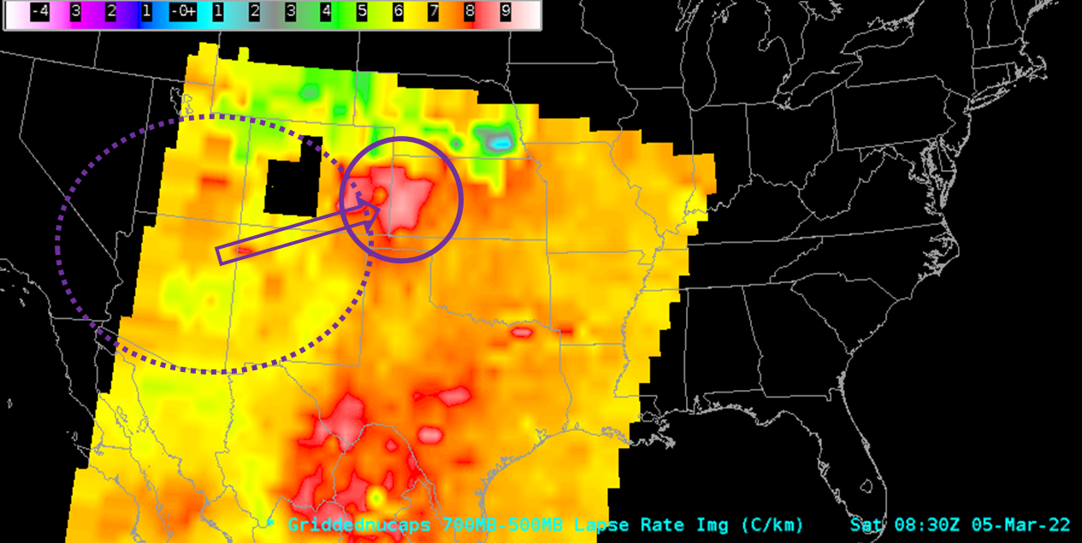
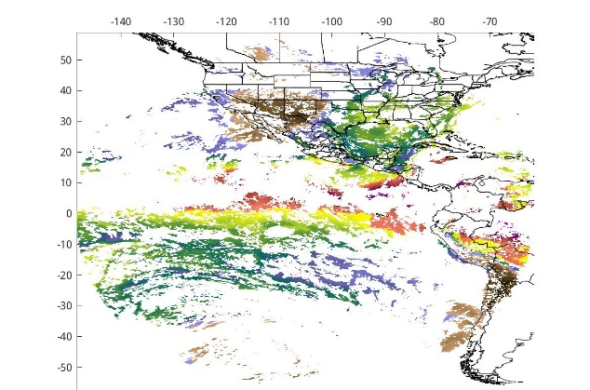

Radiosondes
(2x/day), scattered (mostly) land locations - used for validations and NWP
Vertical Moisture Information
GeoXO Sounder
(at least hourly), land and ocean, ~4km, hemispheric coverage
Regional/meso weather
LEO passes
(several/day over CONUS), land and ocean, ~14-40km, global NWP
Notes:
FD TPW coverage should be from 105W.
Raobs are critical for validations.
LEO is critical for global coverage.

Slide 4
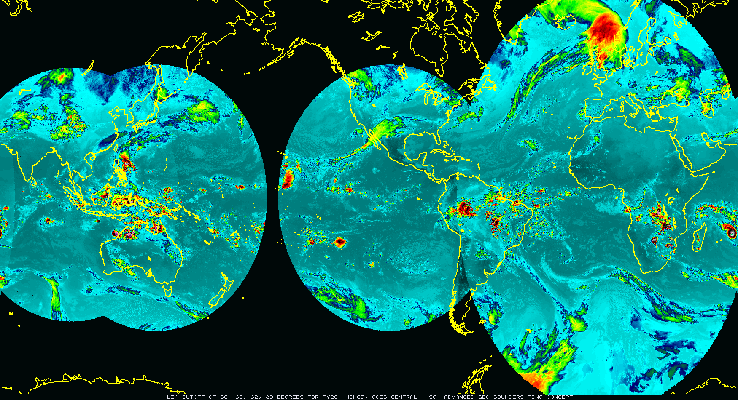
Critical Component of the Advanced Geo Sounder Ring
Consistent with WMO Vision
China (GIIRS)
EUMETSAT (IRS)
JMA (GHMS)
NOAA (GXS)
KMA
Both nowcasting and NWP applications
Needed to better fulfill NWS requirements (especially for vertical moisture, winds and temperature) on the regional and meso-scales

Slide 5
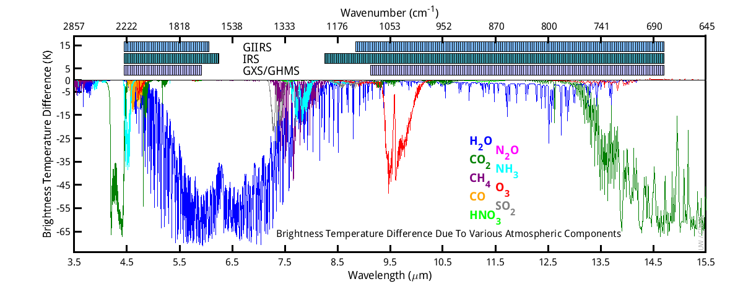
Geo Advanced Sounder-Ring: Spectral
Line-by-Line with various gases completely removed
Notes:
Up arrows denote increased (over background) gas amounts.
GHMS is the JMA advanced geo sounder

Slide 6
Geo Advanced Sounder-Ring: Coverage
Assuming various Local Zenith Angle cut-offs

Slide 7
Spatial Resolutions: Ground Sample Distance and Angle
The centroid-to-centroid distance between adjacent spatial samples on the Earth’s surface, as measured at the Sub-Satellite Point, defines the ground sample distance (GSD). The ground sample angle (GSA) is the associated angle. A two-dimensional pixel is defined by the GSD in the East/West and North/South dimensions. The GXS shall have a GSA no larger than 112 microradians (4 km at nadir) for emissive channels.
This is much improved over the legacy GOES Sounders and the current polar hyperspectral IR sounders.
  ~10 km for legacy GOES Sounder
  ~13 - 15 km for polar hyperspectral IR sounders.

Slide 8
Temporal Coverage
In Sounding Disk mode, the GXS shall acquire each SD and perform all necessary housekeeping and calibration functions in less than 60 minutes.
Scan modes of operations still being defined, in an interleaving mode, finer time resolution of the Super-regional (3000 km x 5000 km) and/or Mesoscale (1000 km x 1000 km) maybe possible to better meet the needs of forecasting mission
Sounding Disk (SD) is a collection of spatial resolution elements viewing the earth where the local zenith angle (LZA) to a GOES is less than 62 degrees.

Slide 9
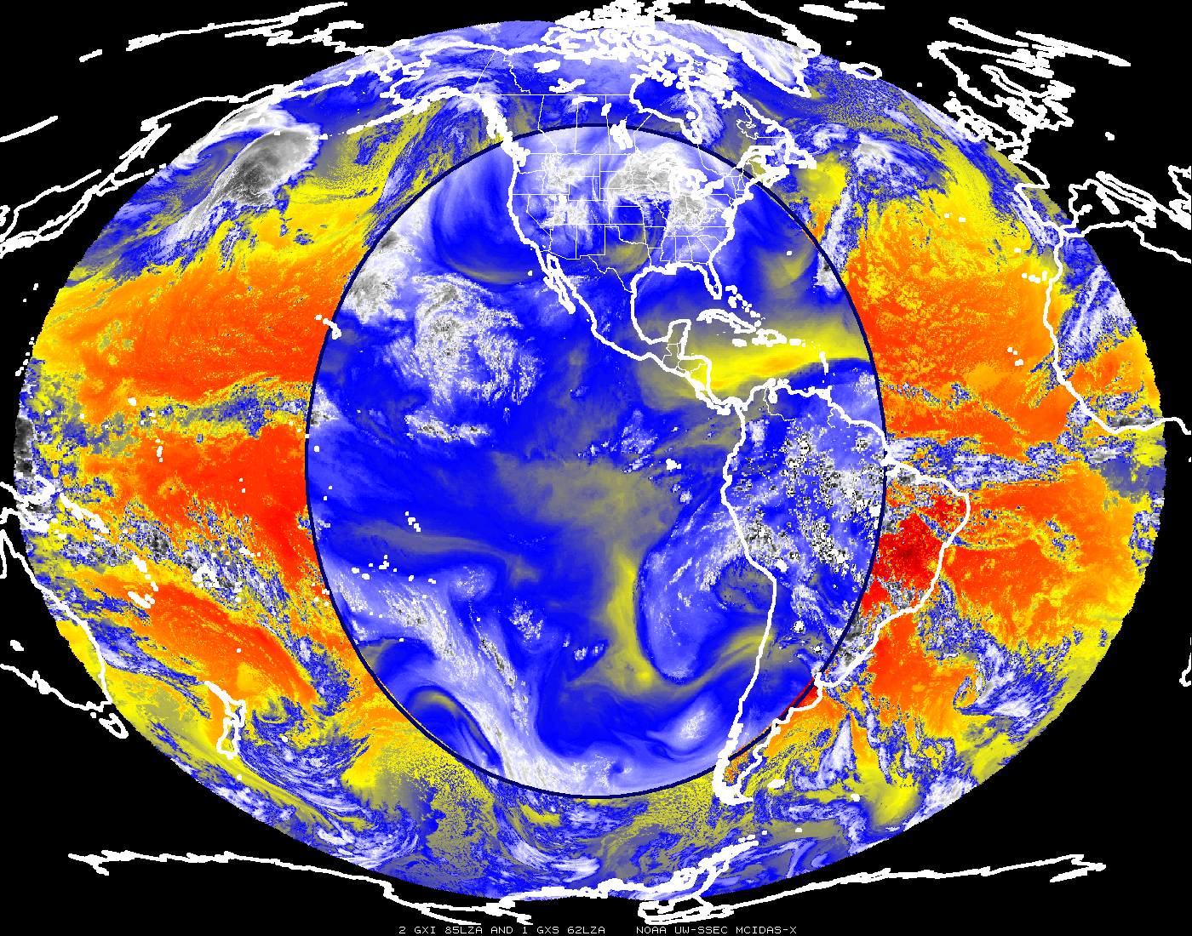

Slide 10
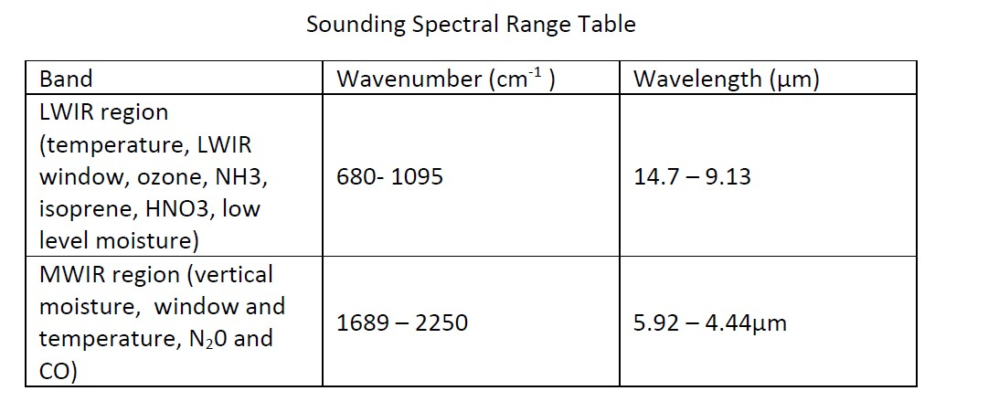
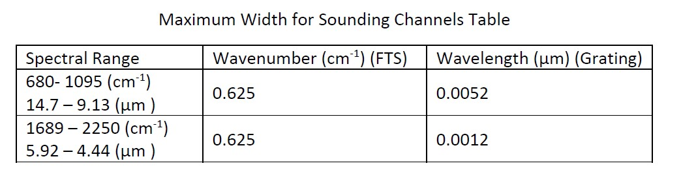
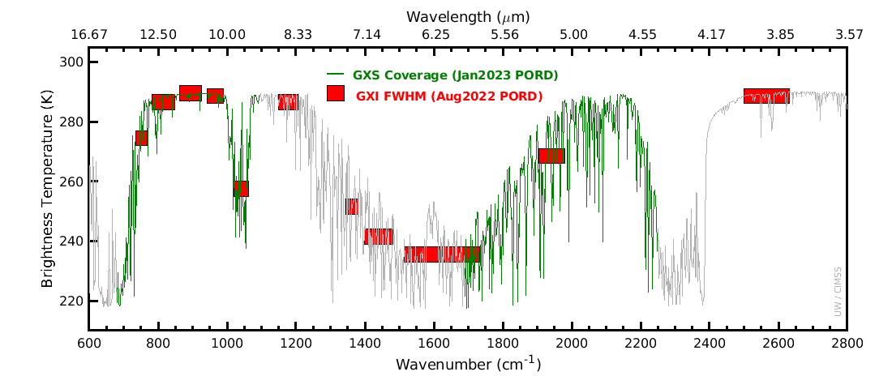
Spectral

Slide 11
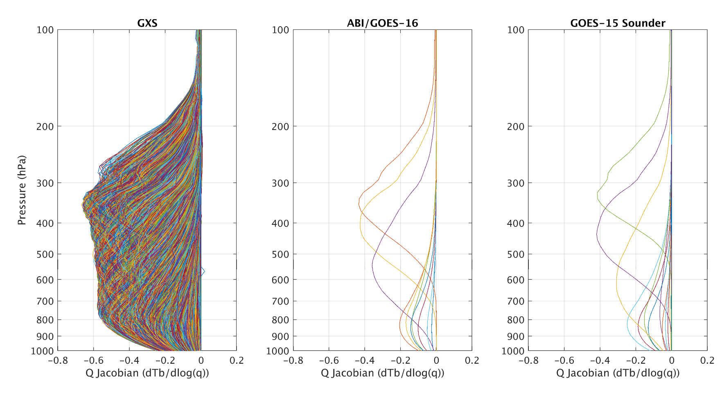
GeoXO GXS Moisture Weighting Functions
GeoXO IR-Sounder (GXS) Science Working Group has computed the Weighting functions for the nominal specifications of GXS.
Weighting functions (aka Jacobians) show where in the atmosphere information comes from.
These plots show the weighting functions for moisture.
These are also important for picking channels for data assimilation, although as many as possible should be used.
They show how much more vertical information GXS will provide compared to ABI or the previous GOES Sounders, this is in part to the many more overlapping spectral bands.
UW/CIMSS
Notes:
Farther from the zero line is more vertical resolution. More bands reduces the noise. 1976 US standard atmosphere

Slide 12
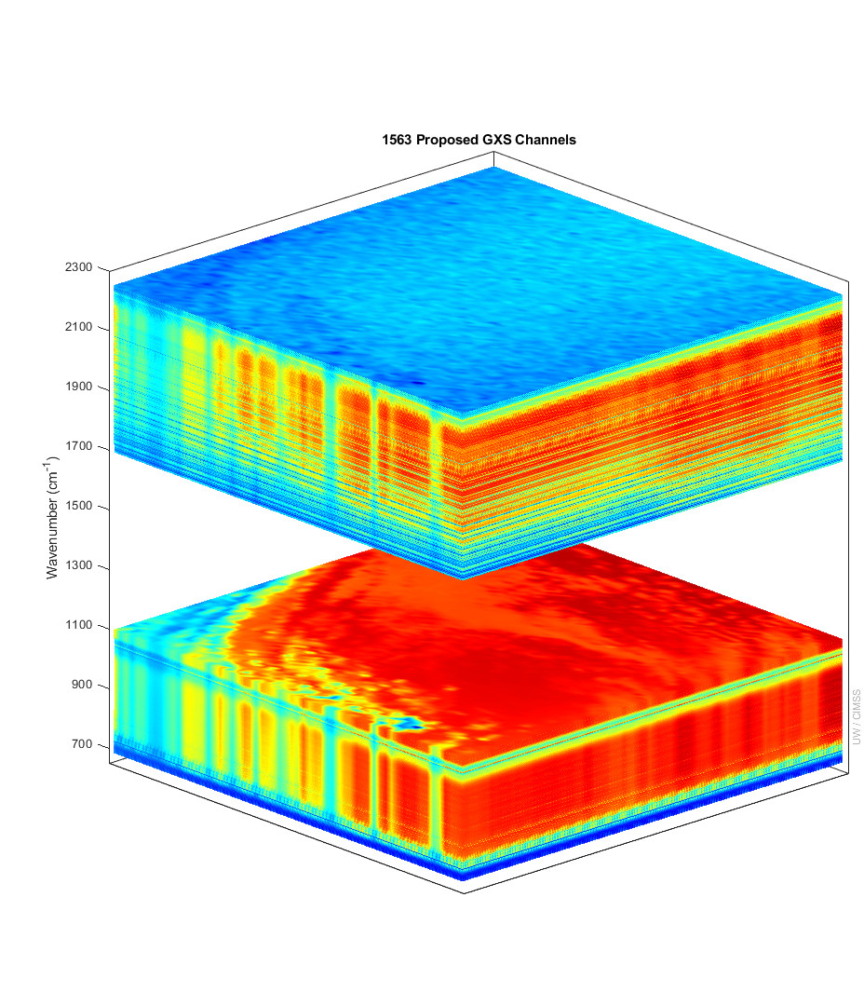
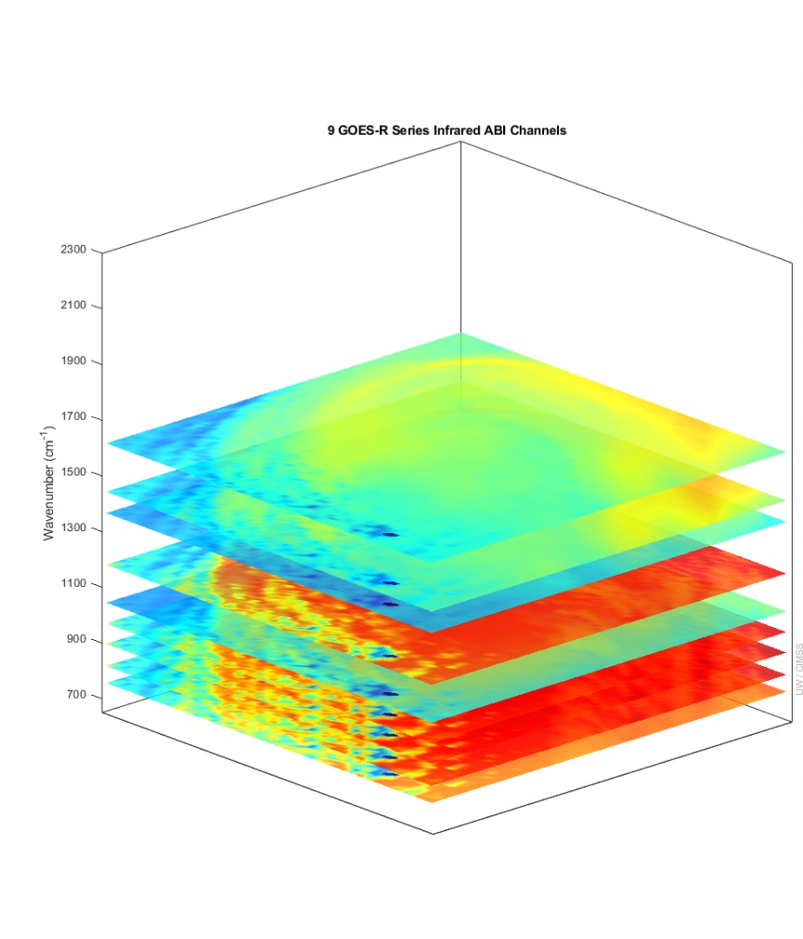
More spectral bands means more vertical information for temperature and moisture
GXS ABI
IASI granule used to show the great improvement of the GXS over previous geostationary capabilities. Not shown are the improved temporal or spatial attributes of the GXS.
There is more than six times (temperature) and four times (moisture) of number of independent pieces of vertical information compared to the ABI.
Number of Independent Pieces of Vertical Information
Temperature | 13 | 2
Moisture | 11 | 2.5
See later talk, this session: The Sounding Capability from the Future Geostationary Extended Observations (GeoXO) Satellites
Notes:
Y axis is wavenumber. ABI and GOES Sounder bands within the GXS range are shown. Credit: UW/CIMSS
Vertical pieces recently calculated by Z. Li, UW/CIMSS.

Slide 13
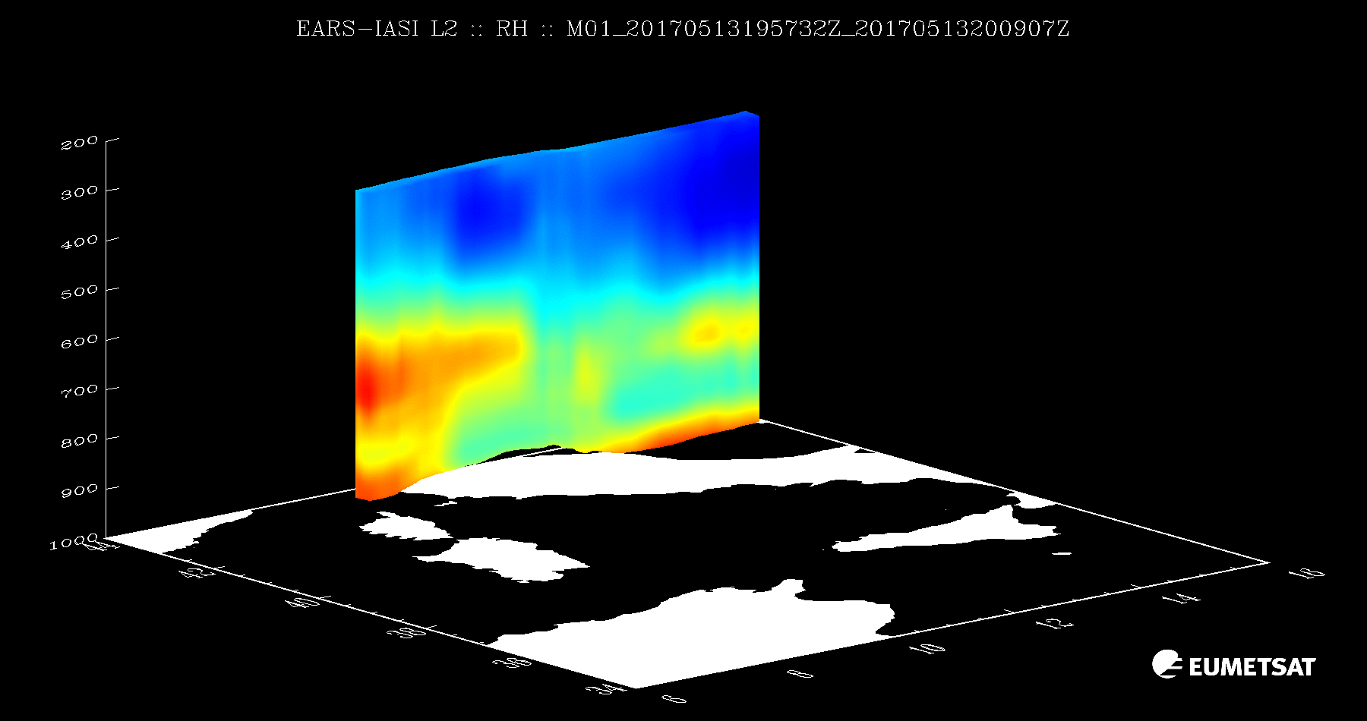
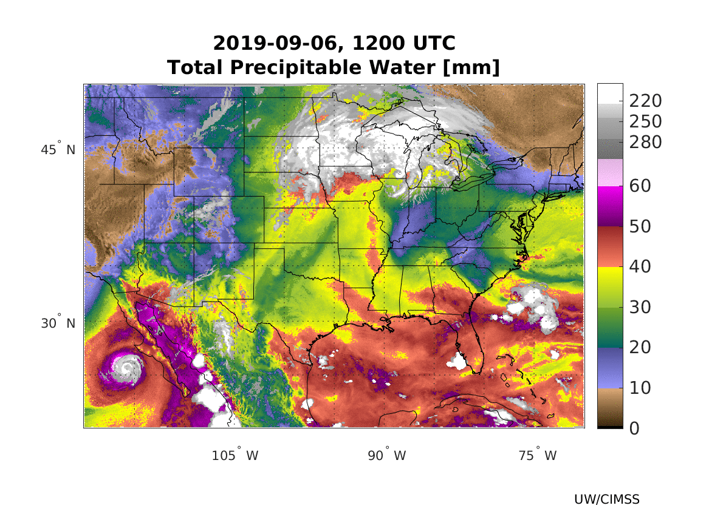
GeoXO Hyperspectral Sounder
APPLICATIONS
Improve Numerical Weather Prediction
  Global, Regional and Meso Scales
  Improve tropical storm track and intensity
  Improve forecasts of convection
Now-casting (short-term forecasts)
  Near-storm mesoscale analysis
  Winter weather
  Convective (location and intensity)
  Critical layer temperature/moisture fields
  Enable Warn on Forecast
  Determine precipitation type
  Real time comparisons to model guidance
Fire weather: forecasting winds, humidity, smoke
Aviation: forecasting icing
Air quality monitoring
  Trace Gases
Courtesy
EUMETSAT
Total Precipitable Water
“All Sky”
(K)
220
250
280
60
50
40
30
20
10
0
(mm)

Slide 14
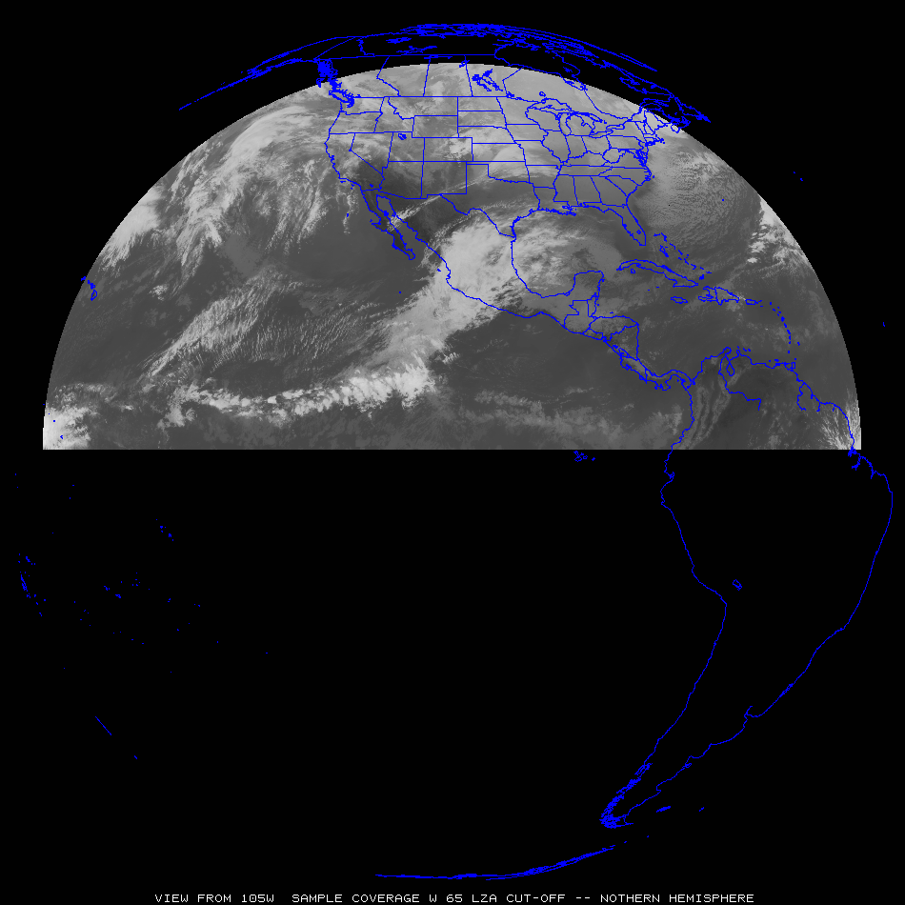
Sample GeoXO Sounder Uses
“clippers”
Select GXS uses for both nowcasting and NWP applications
Most everywhere:
Pre-convection, stability, winds, moisture, high clouds, help AQ, etc.
“atmospheric
rivers”
“Nor-easters”
“dryline”
Sub-tropical jet
“return flow”
“Atlantic
Tropical
Cyclones”
“EastPac Tropical Cyclones”
Tropical winds for NWP
Tropical winds for NWP
Tropical winds for NWP

Slide 15
Where does GXS fit in to the local WX Forecast?
GXS data will fill in observational gaps to help with these and other operational issues:
Near-Storm Mesoscale Analysis (before and during an event; compare to model forecasts)
  Convective
  Winter
Warn on Forecast (provides nearly constant updates to users, not just one warning)
Precipitation Type (the improved temperature, moisture and wind profiles)
Fire Weather/Spot Forecasts (wind surges, low-mid level RH, etc. )
Aviation Forecasts (Icing levels, convective turbulence)
Air Quality (daily cycle and nighttime constraints)
Physical Modeling (input to models, especially on the regional scale)
Machine Learning (great opportunity to train with GXS for many critical parameters
Flash Floods (Moisture transport; Low-mid level boundaries)
From NWS Briefing on “Day in the Life at NWS Columbia” by Frank Alsheimer

Slide 16
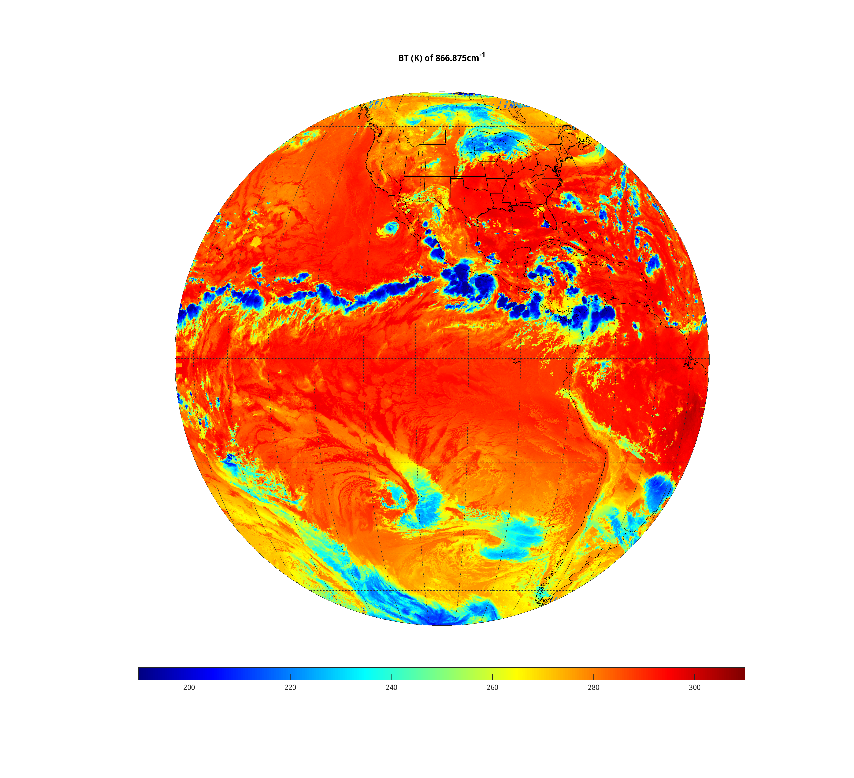
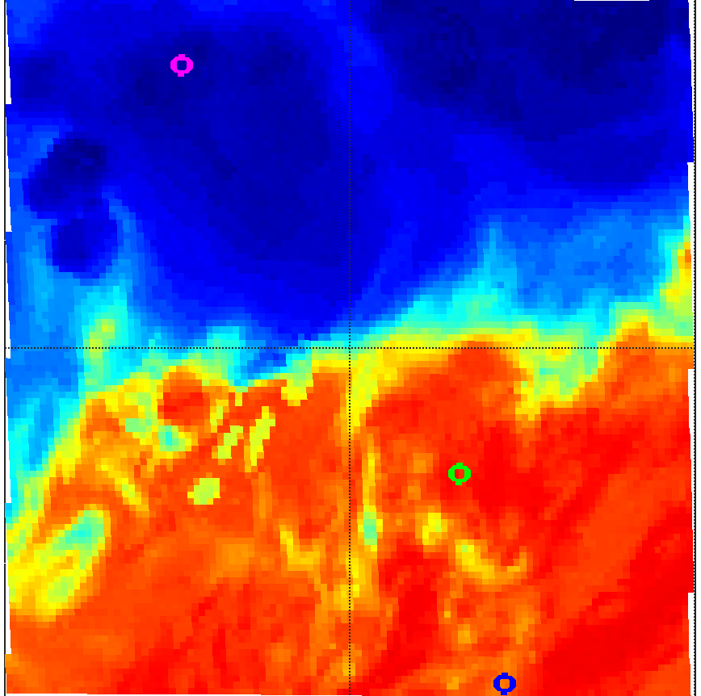
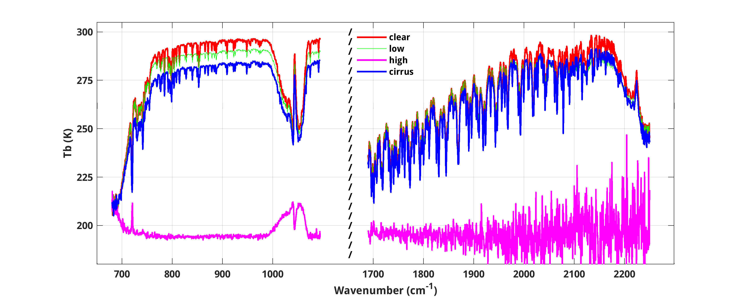

Simulated GXS Full Disk
Ocean
BT of 866.875 cm-1
Max zenith = 70$°$
COLD WARM
Clear Low Clouds High thick clouds Cirrus

Slide 17
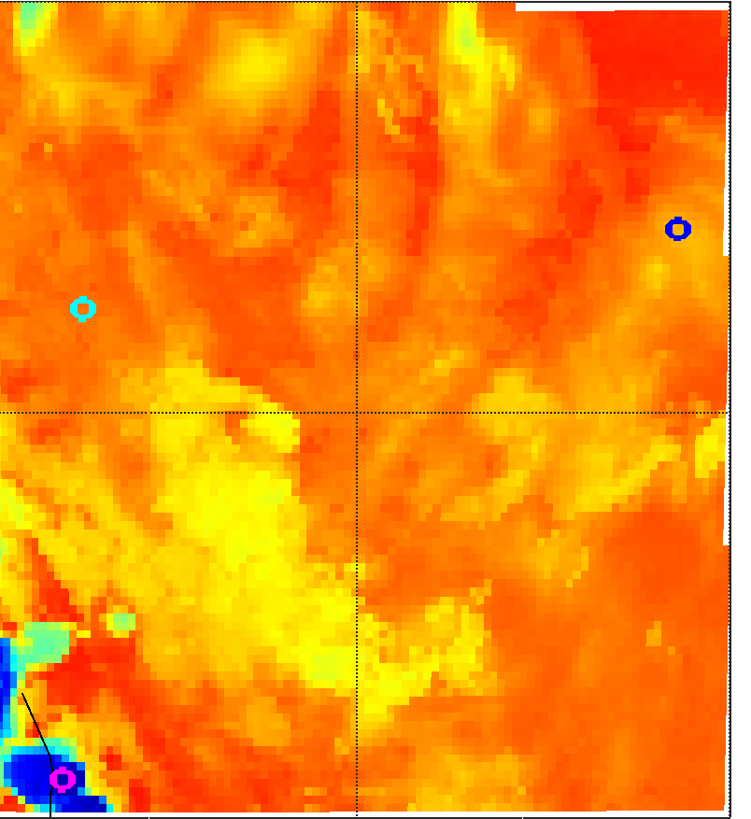
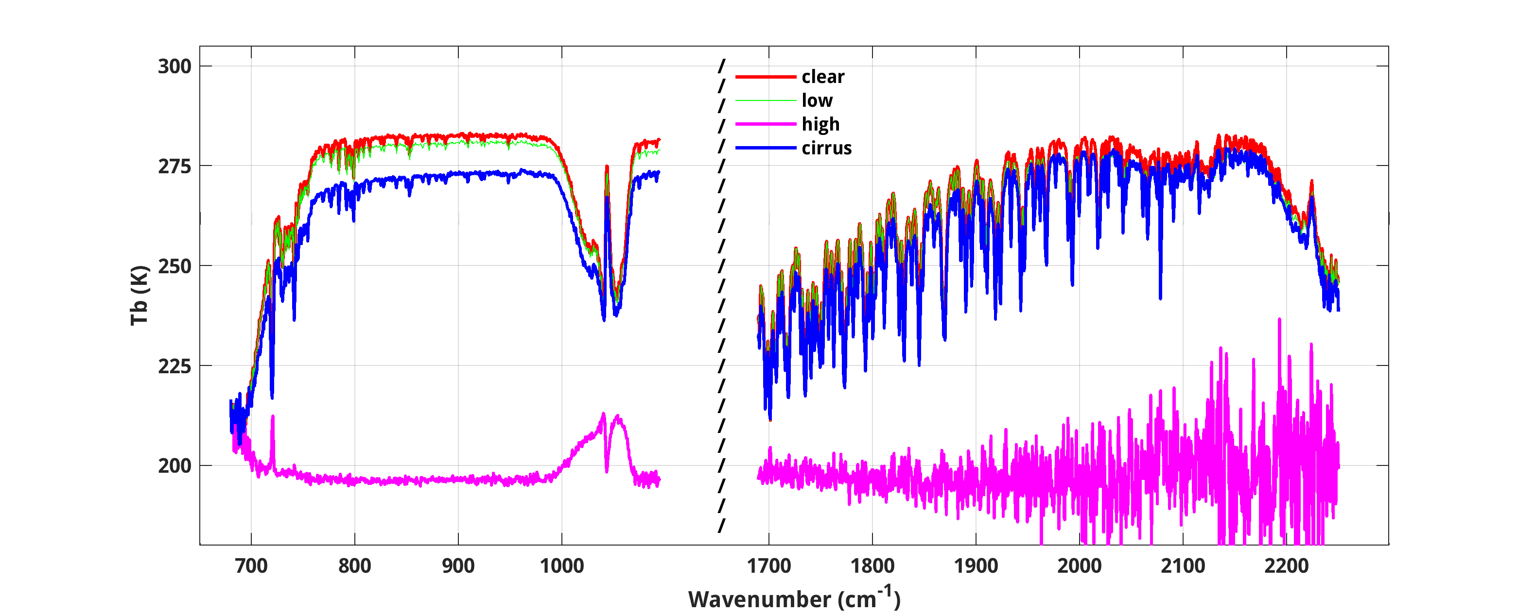
Simulated GXS Full Disk
High Altitude
BT of 866.875 cm-1
Max zenith = 70$°$
COLD WARM
Clear Low Clouds High thick clouds Cirrus

Slide 18
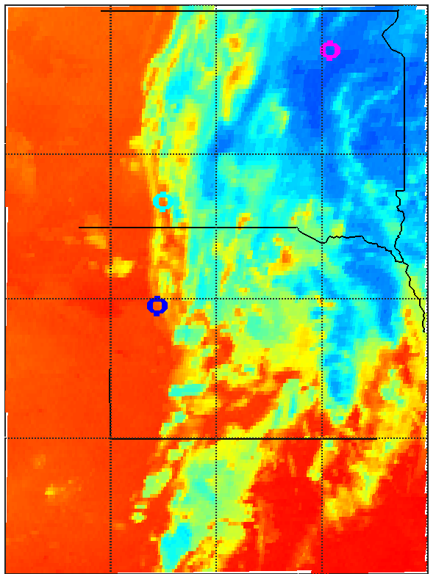
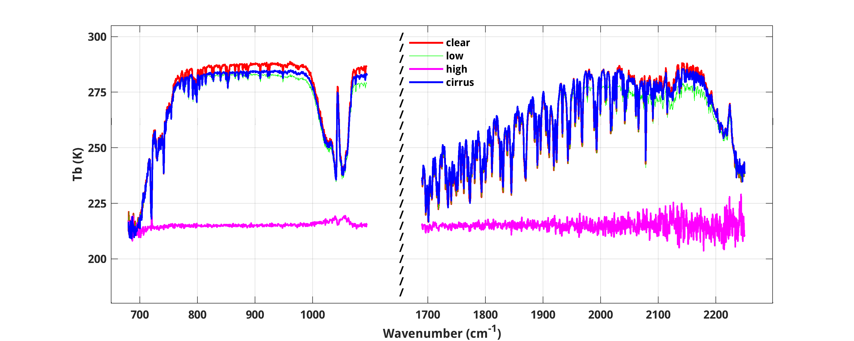
Simulated GXS Full Disk
Land
BT of 866.875 cm-1
Max zenith = 70$°$
COLD WARM
Clear Low Clouds High thick clouds Cirrus

Slide 19
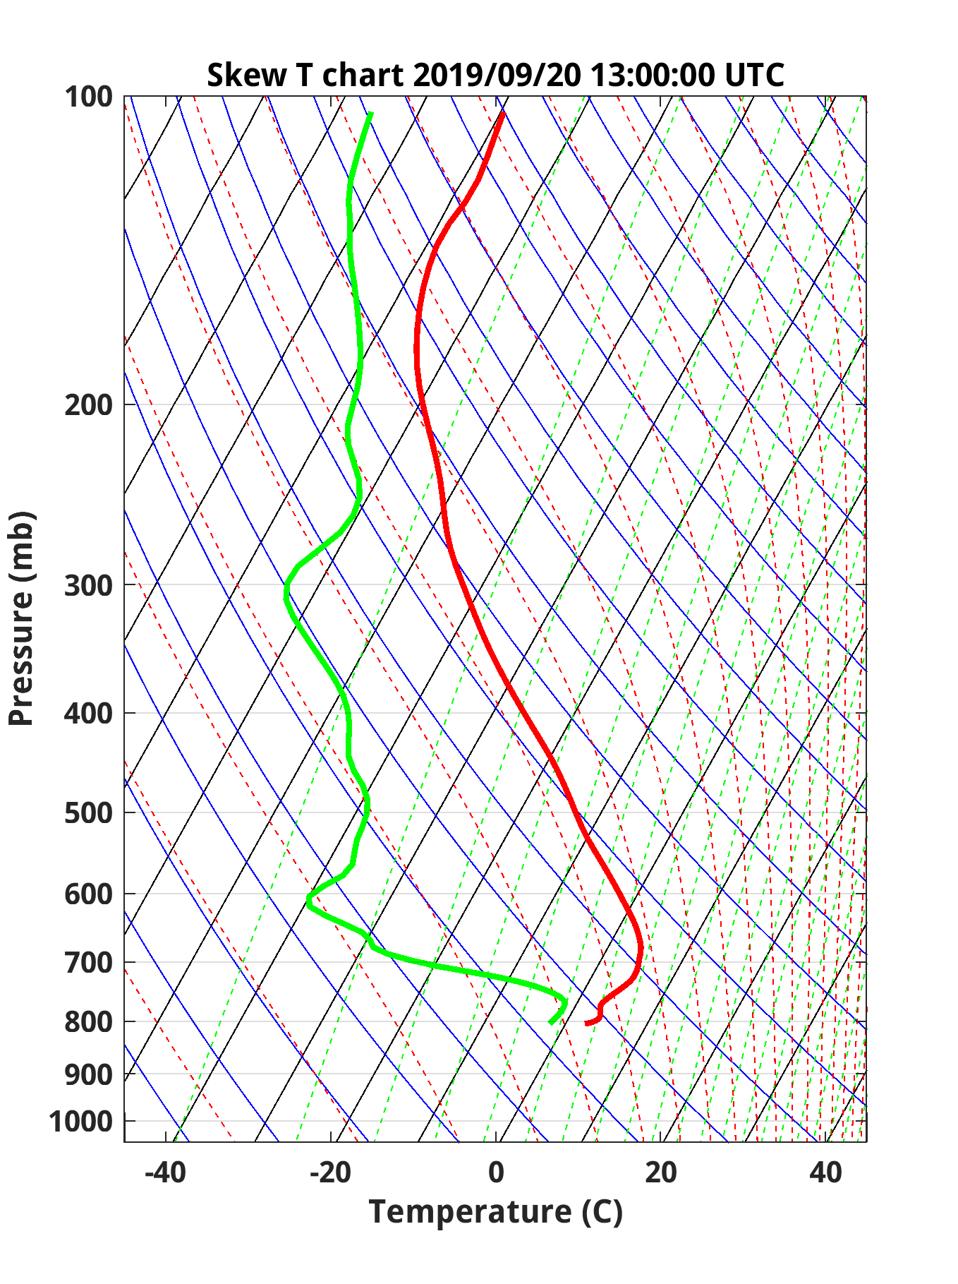
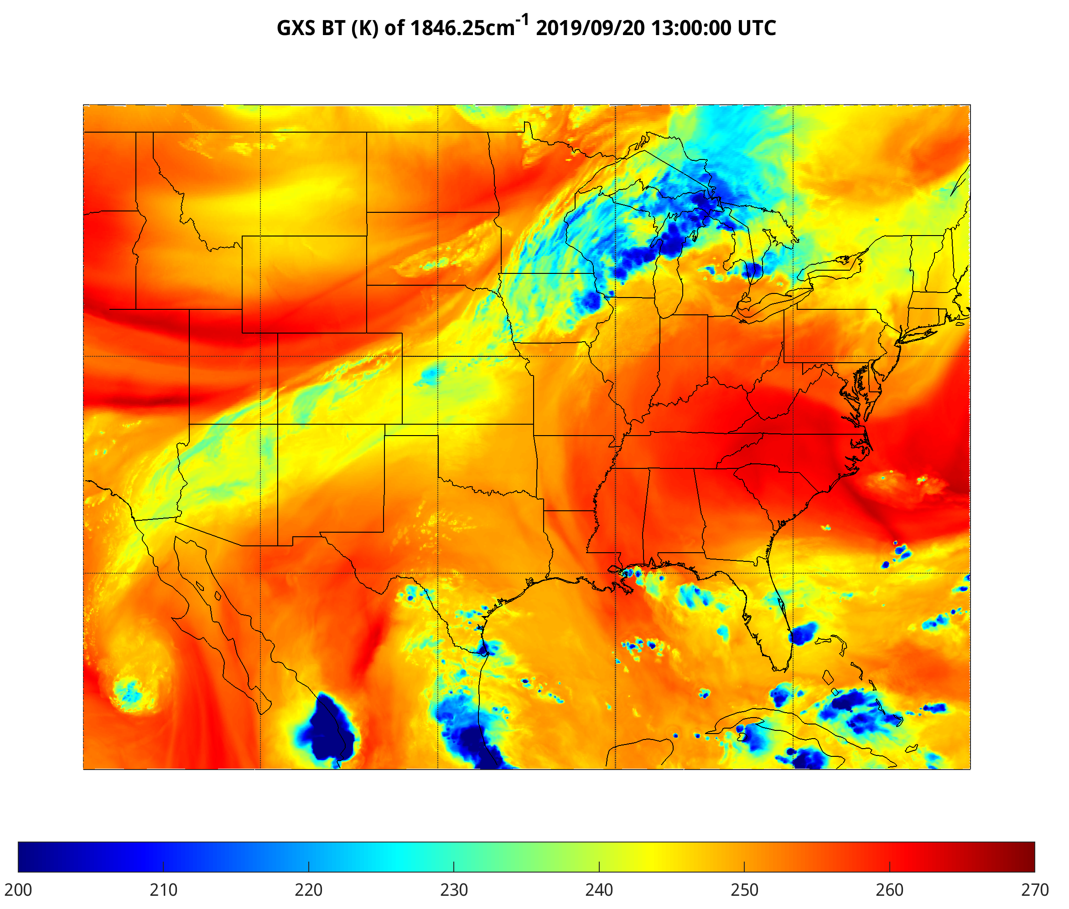
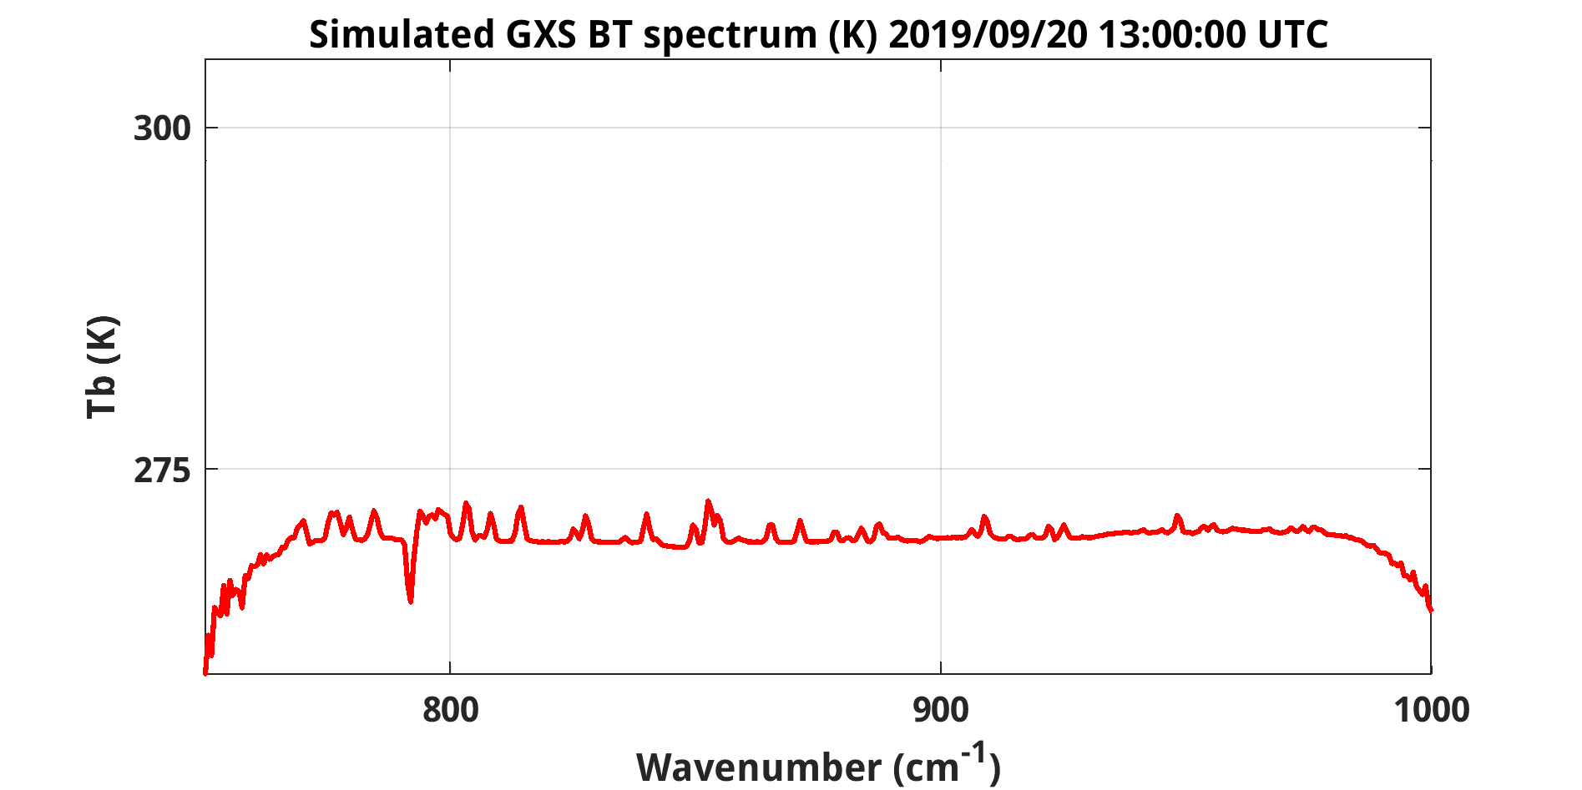
Wyoming Temperature inversion seen by GXS
Temperature inversion leads to warmer BT for WV absorption channels in window band!

Slide 20
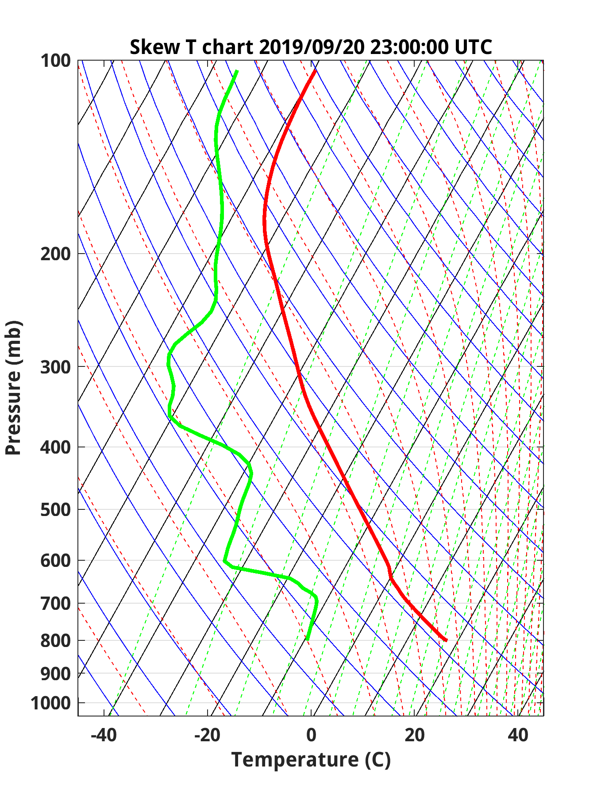
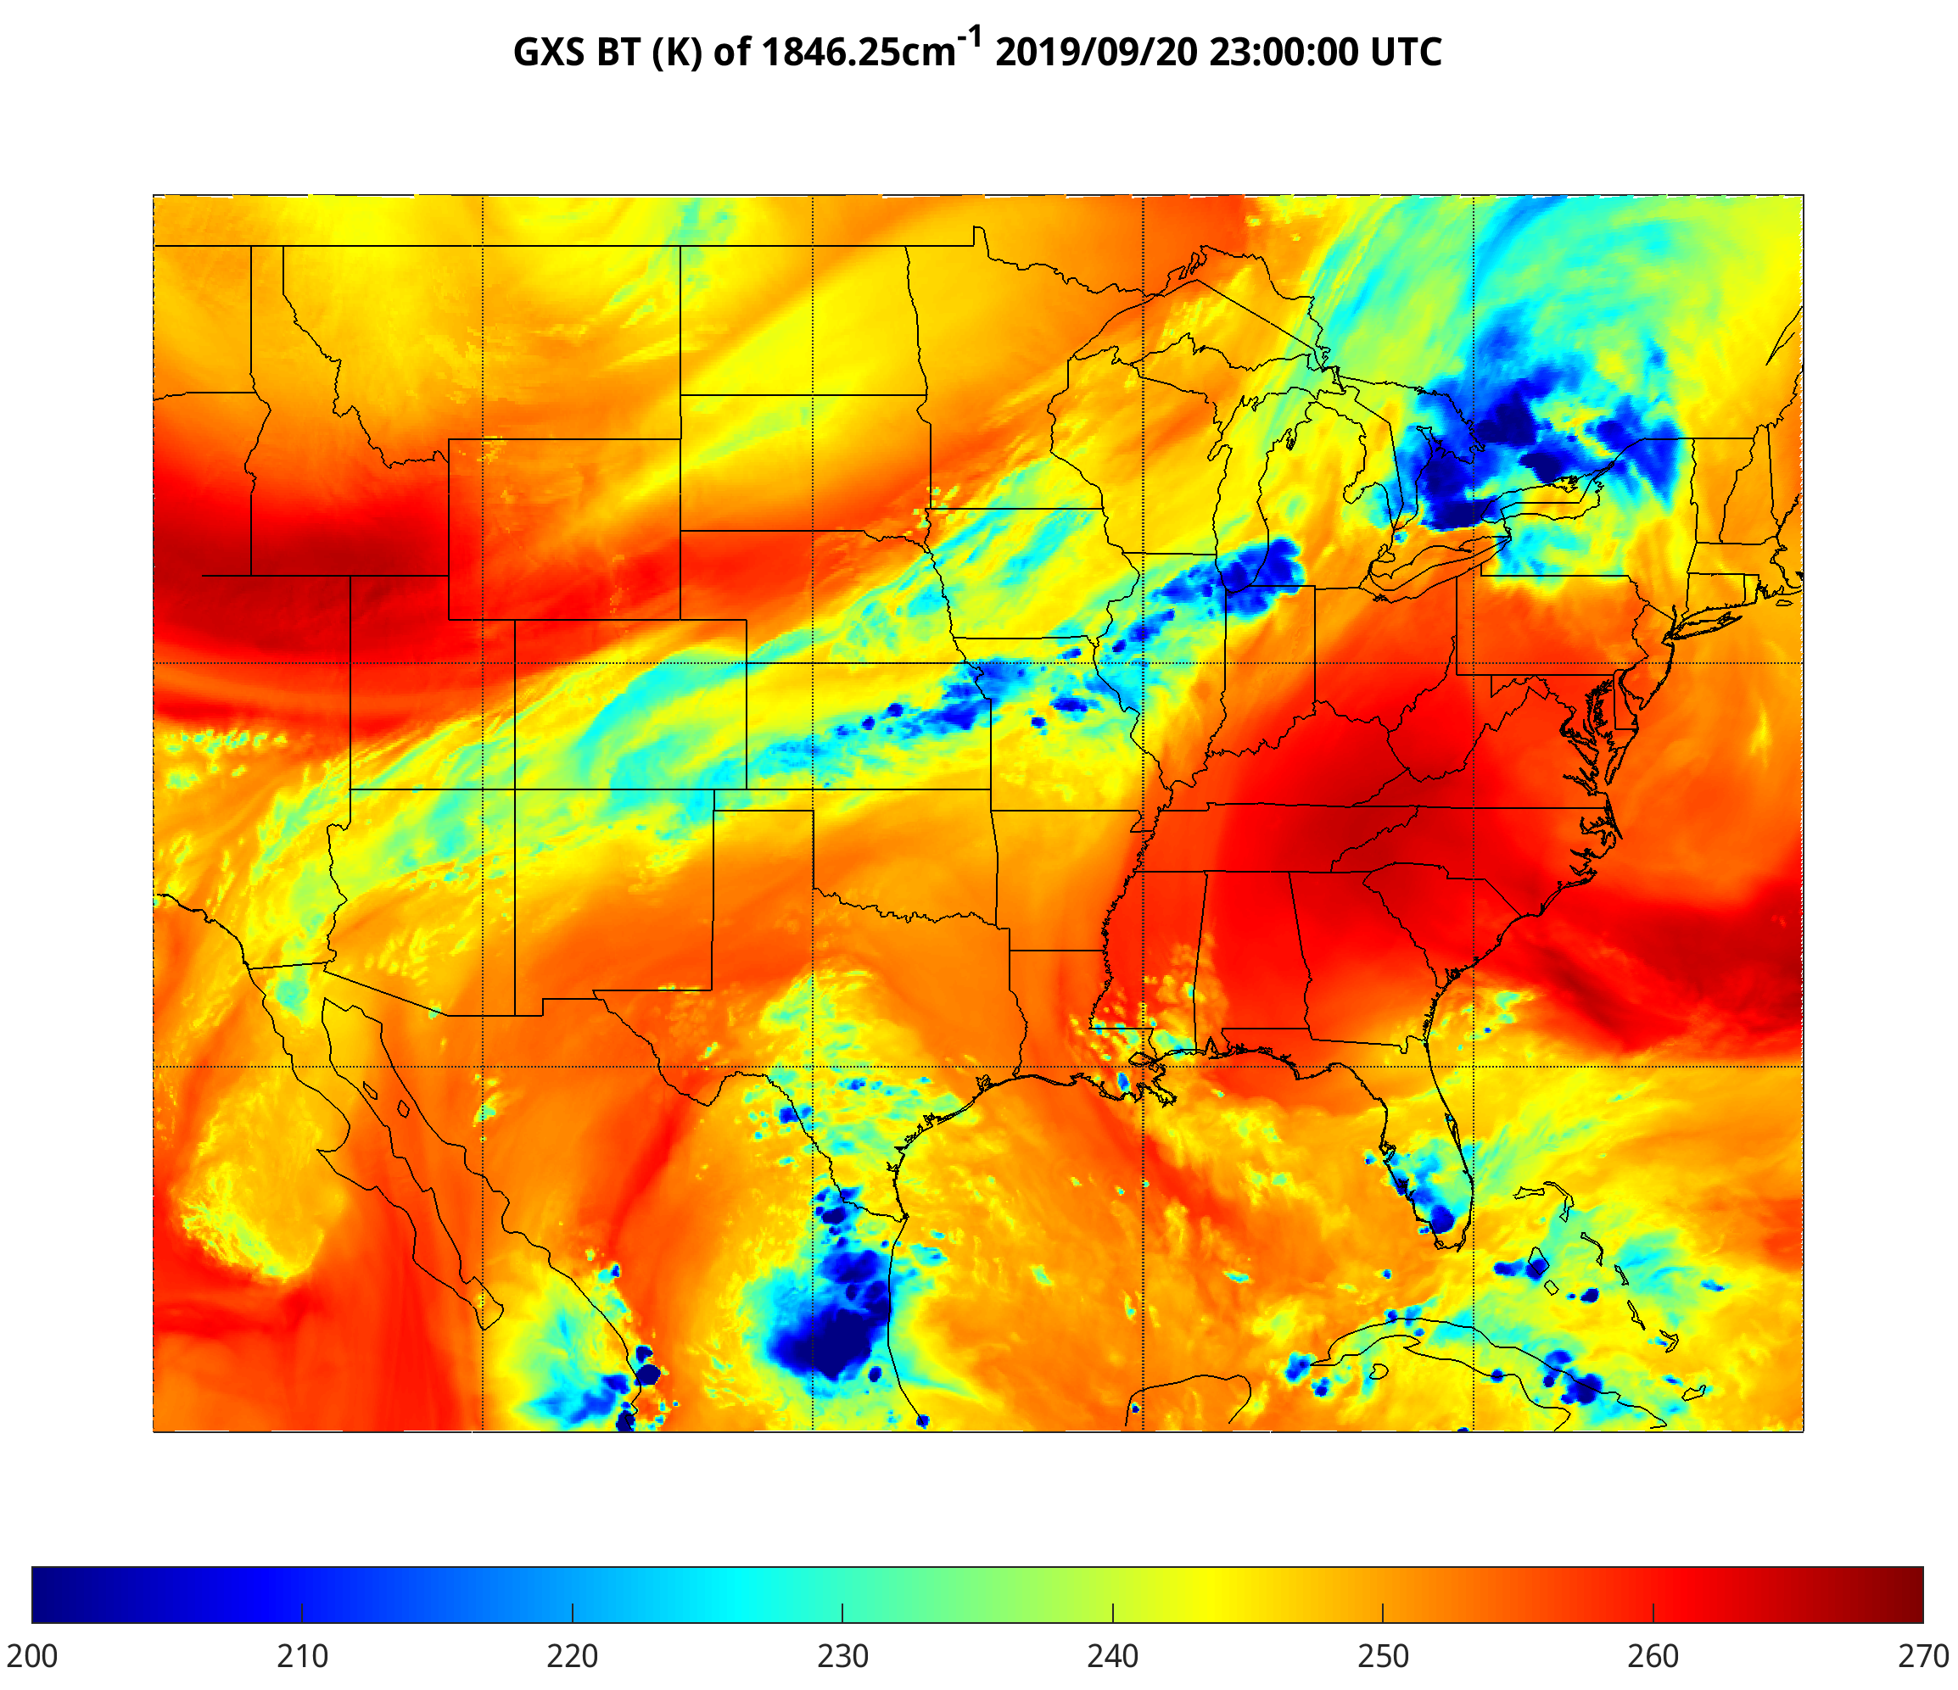
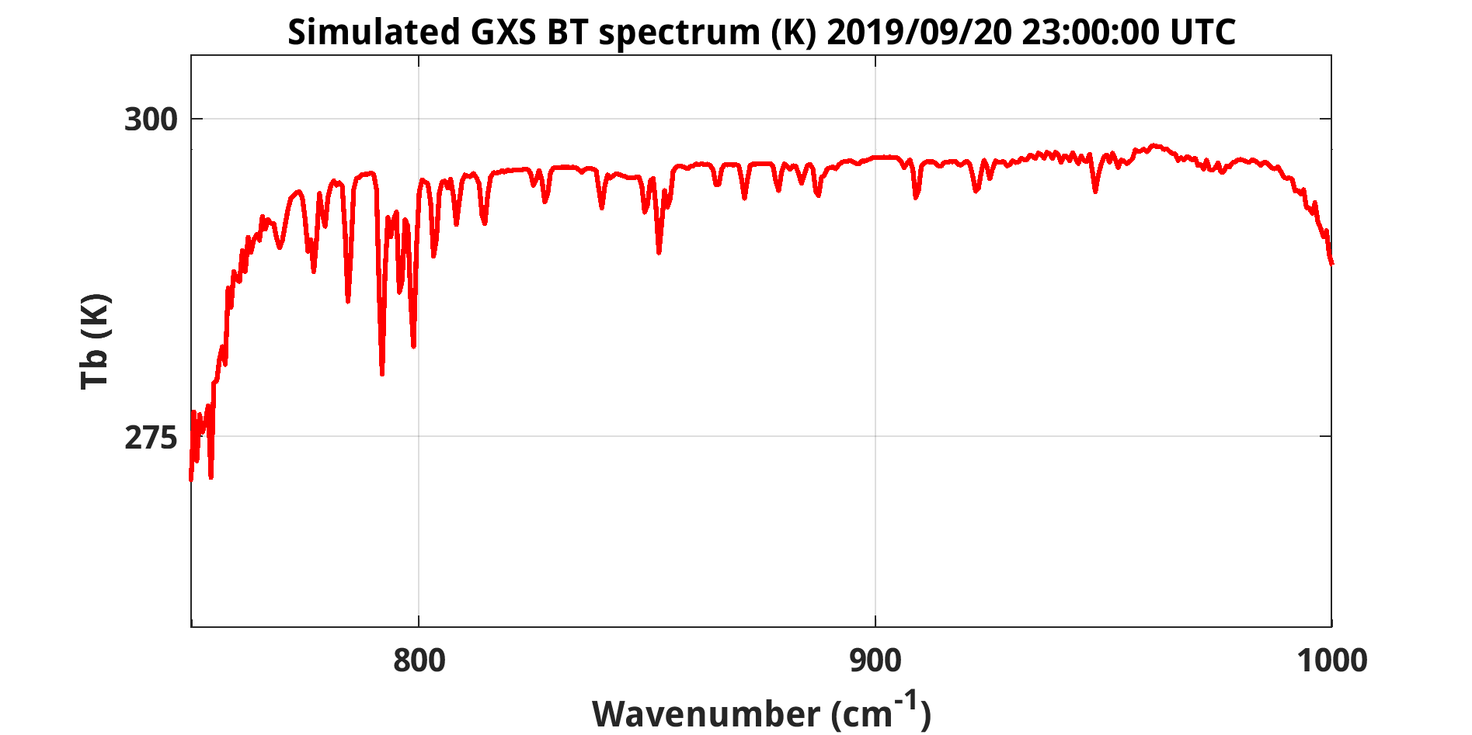
Wyoming Temperature inversion seen by GXS

Slide 21
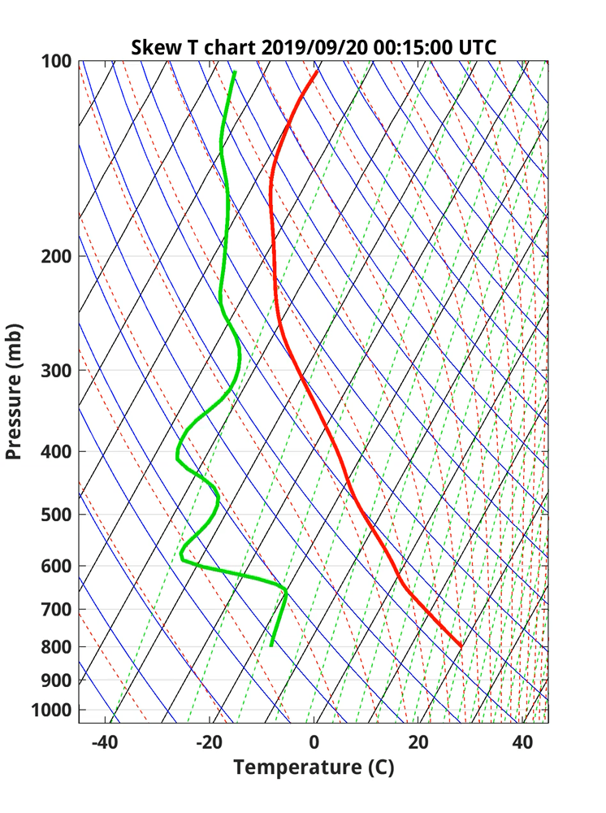
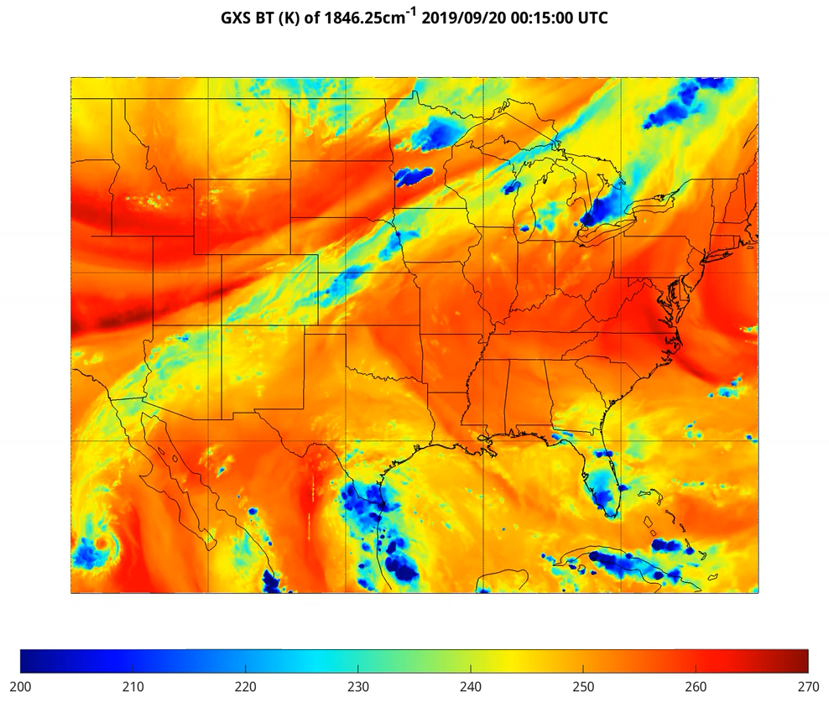
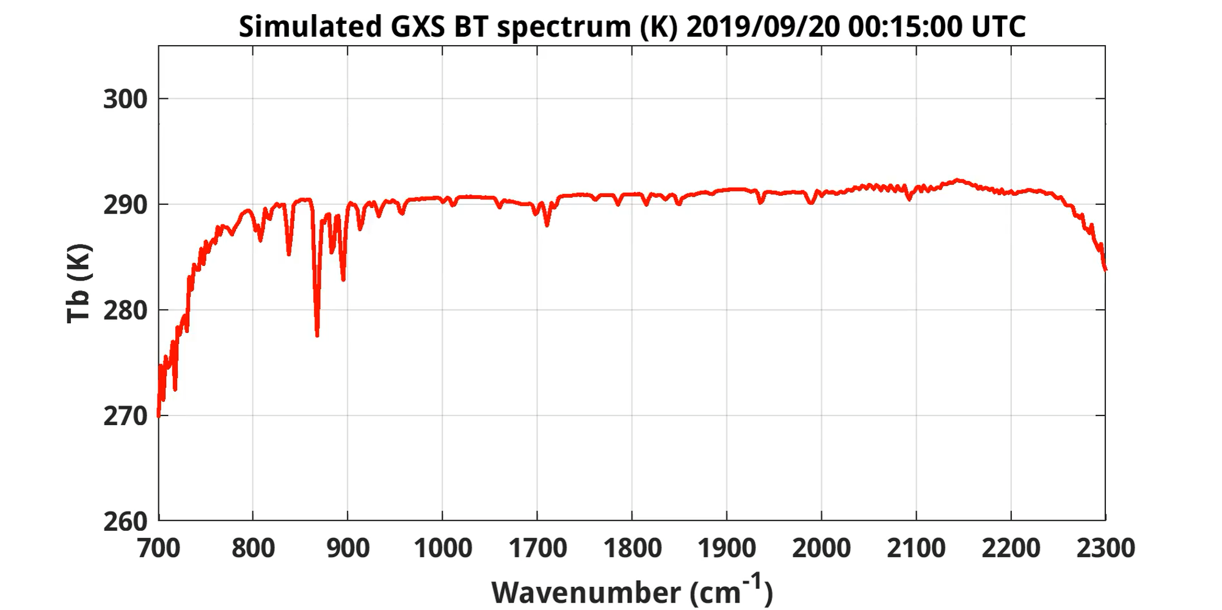
Wyoming Temperature inversion seen by GXS (24 hours)
Fingers up: Temperature inversion
Fingers down: No temperature inversion
animation

Slide 22
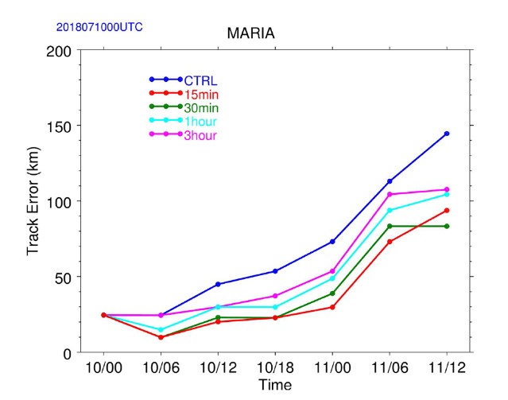
Improved track and intensity forecasts
Improving tropical cyclone forecasts with high temporal/spectral IR observations.
Track & intensity forecasts for Typhoon Maria are most improved with 15 min data, the track (> 40%) and the intensity (18%).
Precipitation forecasts also improved.
Improved Typhoon Maria track forecasts (2018), based on observed geostationary high-spectral resolution infrared data. The red line indicate with 15 min data. https://agupubs.onlinelibrary.wiley.com/doi/10.1029/2021GL093672

Slide 23
Need for high spectral & temporal observations
High-spectral-resolution observations provide much more information
  Imagers average out important vertical information
  LEO has shown the many benefits, especially on the global scale, lacks time resolution
Forecasting Applications – fill in critical gaps wrt vertical moisture, wind and temperature
  Nowcasting and Numerical weather prediction, especially on the regional/mesoscales
Additional applications
  improve derived products with only advanced imager data
    cloud-top properties, atmospheric motion vectors, dust detection, land and sea surface temperatures
  New areas
    Moisture flux, capping inversion, surface emissivity, trace gases (Ozone and Carbon Monoxide, etc.) and climate
Economic impacts (“billions”…) More with the benefits of 4dvar analysis …
Critical Component of the Global Constellation

Slide 24
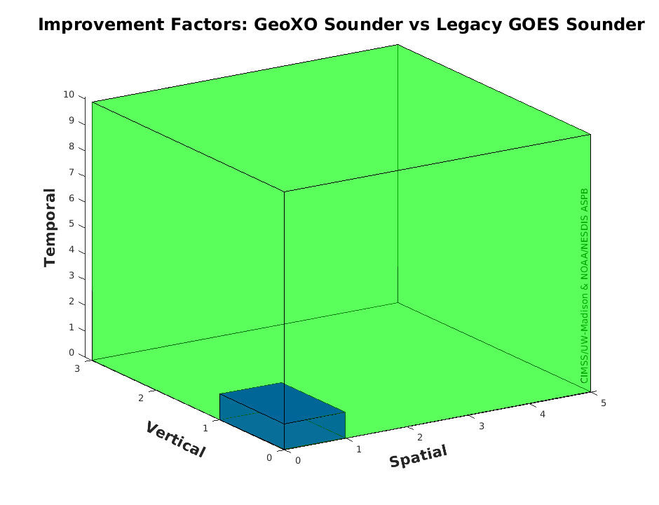
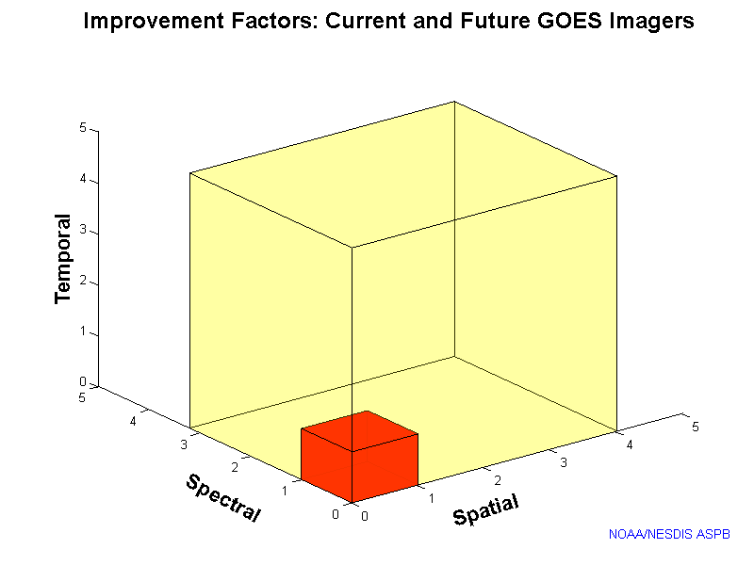
GXS/Legacy GOES Sounder > ABI/Legacy Imager
GeoXO Sounder could be something like 3, 5 and 10 times improved (vertical, spatial and temporal) over the legacy geo sounder! (The legacy sounder had many operational uses.)
“Everyone” knows about the ABI being 3, 4 and 5 times (spectral, spatial and temporal) improved over the legacy geo imager.
Improvement Factors: GeoXO Sounder and Legacy geo Sounders
Improvement Factors: ABI and Legacy geo Imagers
Notes:
Li, J., Menzel, W. P., Sun, F., Schmit, T. J., & Gurka, J. (2004). AIRS Subpixel Cloud Characterization Using MODIS Cloud Products, Journal of Applied Meteorology, 43(8), 1083-1094. Retrieved Oct 21, 2021, from https://journals.ametsoc.org/view/journals/apme/43/8/1520-0450_2004_043_1083_asccum_2.0.co_2.xml
Schmit, T. J., Li, J., Li, J., Feltz, W. F., Gurka, J. J., Goldberg, M. D., & Schrab, K. J. (2008). The GOES-R Advanced Baseline Imager and the Continuation of Current Sounder Products, Journal of Applied Meteorology and Climatology, 47(10), 2696-2711.
https://journals.ametsoc.org/view/journals/apme/47/10/2008jamc1858.1.xml
Sieglaff, J. M., Schmit, T. J., Menzel, W. P., & Ackerman, S. A. (2009). Inferring Convective Weather Characteristics with Geostationary High Spectral Resolution IR Window Measurements: A Look into the Future, Journal of Atmospheric and Oceanic Technology, 26(8), 1527-1541. https://journals.ametsoc.org/view/journals/atot/26/8/2009jtecha1210_1.xml
Schmit, T. J., Li, J., Ackerman, S. A., & Gurka, J. J. (2009). High-Spectral- and High-Temporal-Resolution Infrared Measurements from Geostationary Orbit, Journal of Atmospheric and Oceanic Technology, 26(11), 2273-2292. https://journals.ametsoc.org/view/journals/atot/26/11/2009jtecha1248_1.xml
Smith Sr., W. L., Revercomb, H., Bingham, G., Larar, A., Huang, H., Zhou, D., Li, J., Liu, X., and Kireev, S.: Technical Note: Evolution, current capabilities, and future advance in satellite nadir viewing ultra-spectral IR sounding of the lower atmosphere, Atmos. Chem. Phys., 9, 5563-5574, https://doi.org/10.5194/acp-9-5563-2009, 2009.
Li, J., Li, J., Otkin, J., Schmit, T. J., & Liu, C. (2011). Warning Information in a Preconvection Environment from the Geostationary Advanced Infrared Sounding System—A Simulation Study Using the IHOP Case, Journal of Applied Meteorology and Climatology, 50(3), 776-783. https://journals.ametsoc.org/view/journals/apme/50/3/2010jamc2441.1.xml
Menzel, W. P., Schmit, T. J., Zhang, P., & Li, J. (2018). Satellite-Based Atmospheric Infrared Sounder Development and Applications, Bulletin of the American Meteorological Society, 99(3), 583-603. Retrieved Oct 21, 2021, from https://journals.ametsoc.org/view/journals/bams/99/3/bams-d-16-0293.1.xml
Yin, R., Han, W., Gao, Z., & Li, J. (2021). Impact of high temporal resolution FY-4A Geostationary Interferometric Infrared Sounder (GIIRS) radiance measurements on Typhoon forecasts: Maria (2018) case with GRAPES global 4D-Var assimilation system. Geophysical Research Letters, 48, e2021GL093672. https://doi.org/10.1029/2021GL093672
Ma, Z., Li, J., Han, W., Li, Z., Zeng, Q., Menzel, W. P., et al. (2021). Four-dimensional wind fields from geostationary hyperspectral infrared sounder radiance measurements with high temporal resolution. Geophysical Research Letters, 48, e2021GL093794. https://doi.org/10.1029/2021GL093794
Yin, Ruoying, Wei Han, Zhiqiu Gao, and Di Di. “The evaluation of FY4A’s Geostationary Interferometric Infrared Sounder (GIIRS) long‐wave temperature sounding channels using the GRAPES global 4D‐Var.” Quarterly Journal of the Royal Meteorological Society 146, no. 728 (2020): 1459-1476. https://doi.org/10.1002/qj.3746
Holmlund, et al., P. (2021). Meteosat Third Generation (MTG): Continuation and Innovation of Observations from Geostationary Orbit, Bulletin of the American Meteorological Society, 102(5), E990-E1015. https://journals.ametsoc.org/view/journals/bams/102/5/BAMS-D-19-0304.1.xml
W. L. Smith et al., "Hyperspectral Satellite Radiance Atmospheric Profile Information Content and Its Dependence on Spectrometer Technology," in IEEE Journal of Selected Topics in Applied Earth Observations and Remote Sensing, vol. 14, pp. 4720-4736, 2021, doi: 10.1109/JSTARS.2021.3073482. https://ieeexplore.ieee.org/abstract/document/9406029
More: https://www.ssec.wisc.edu/geo-ir-sounder/

Slide 25
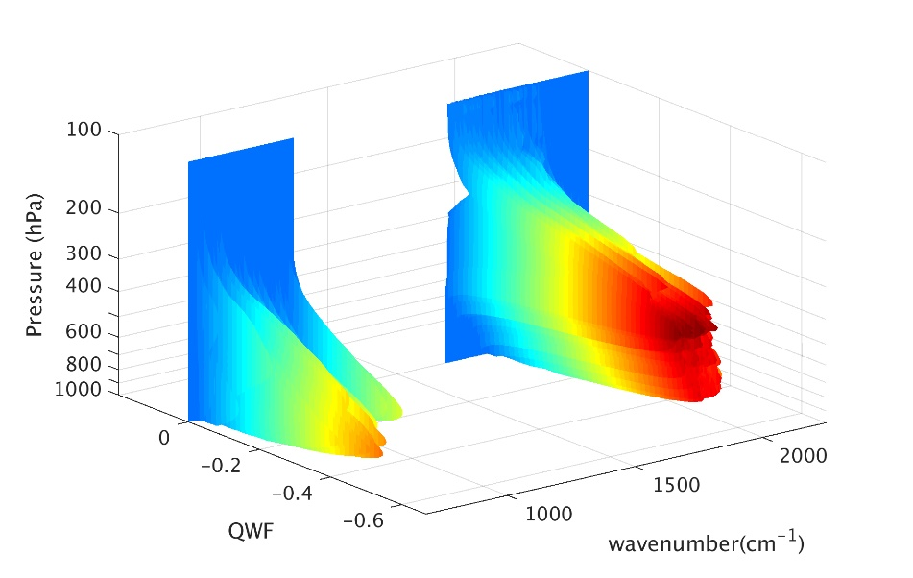

More Information
https://www.ssec.wisc.edu/geo-ir-sounder/
Home
OSSE
Proxy
Other Benefits
History
On-orbit examples
In-development
NOAA NESDIS Tech Report: Geostationary Extended Observations (GeoXO) Hyperspectral InfraRed Sounder Value Assessment Report
  https://repository.library.noaa.gov/view/noaa/32921
https://www.nesdis.noaa.gov/next-generation-satellites/geostationary-extended-observations-geoxo
PORD:
https://www.nesdis.noaa.gov/next-generation/geoxo/geoxo-sounder-gxs
Notes:
https://www.ssec.wisc.edu/geo-ir-sounder/need/

Slide 26
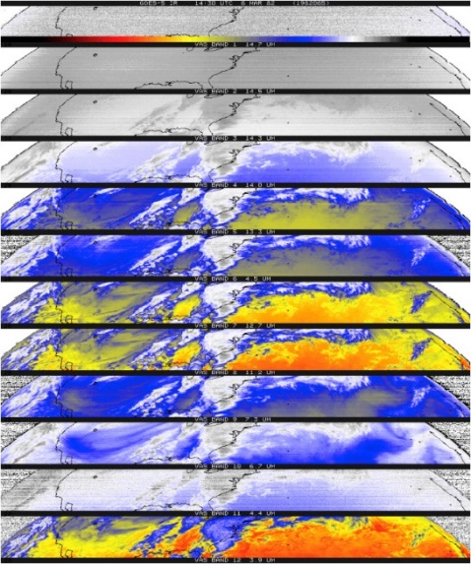
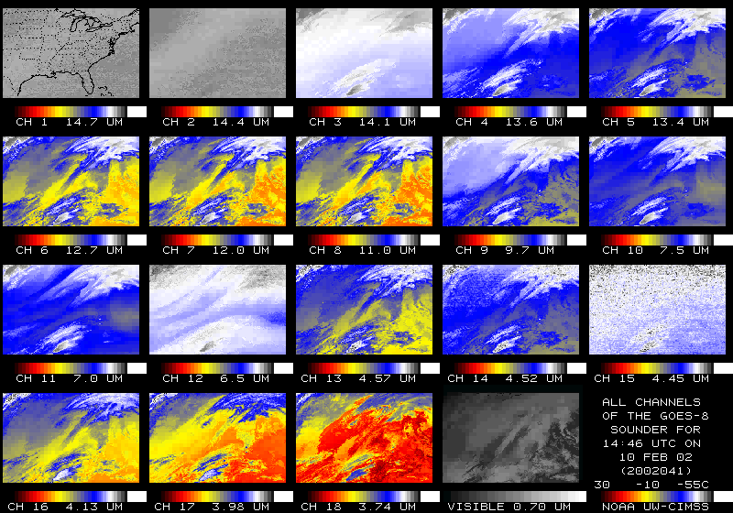
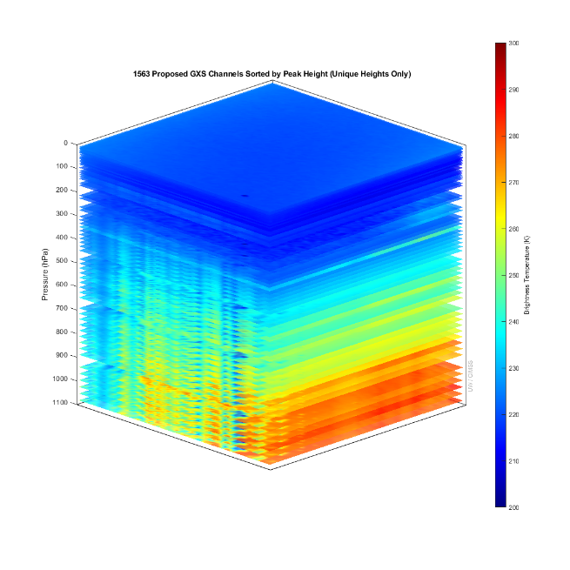
U.S. Geostationary Sounders
Item | # IR bands | Sounding
First Experimental | 12 | GOES-4 VAS (1980)
First Operational | 18 | GOES-8 (1994)
100x improved | ~1500 | High-spectral IR (2036)
NASA’s GIFTS (2000) was built and ground-tested and shown to provide high quality high resolution spectra, but was not able to get space borne.
The GOES-R series included advanced imagers, the first geostationary lightning mapper and space weather instruments.
Notes:
T. Schmit AMS presentation in Boston.

Slide 27
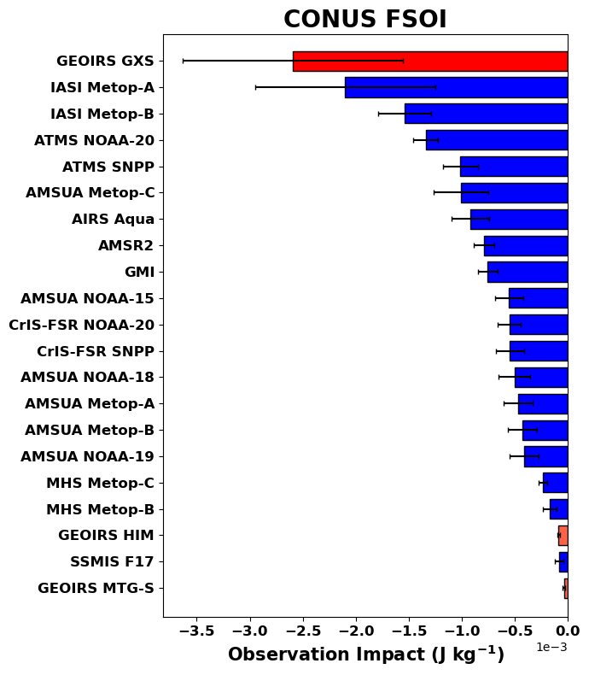
OSSE FSOI (24-hr)
Preliminary NASA’s GMAO OSSE: GXS will be a key contributor over the contiguous US region (included the 4 analysis times), even with all the other observations. These scores are for 24-hr forecasts. Credit: Erica McGrath-Spangler, Morgan State University and the whole GMAO team.
This OSSE shows impact for CrIS which is 2 times lower than AIRS and 2 to 3 times lower than IASI, this is not due to limitations of the CrIS, but with issues of how GMAO uses the data.
Other forecast systems, such as ECMWF, CrIS data has large impacts, as expected.
See later talk, this session:
Evaluating GXS Impact in the Context of International Coordination
More negative values mean more positive impacts

