Slide 1
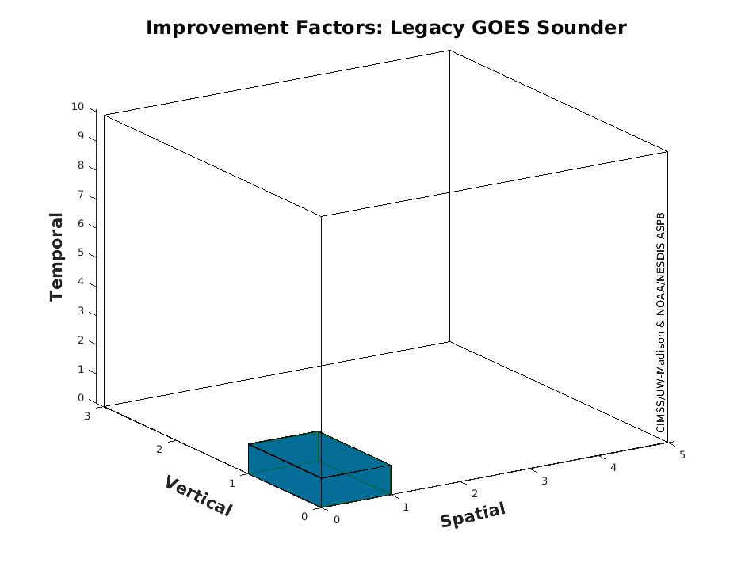

US Plans for Geostationary Hyper-spectral Infrared Sounders
GXS 101
Tim Schmit, NOAA NESDIS STAR CoRP ASPB
And many, many others ……
Dec, 2022

Slide 2

A (short) history of atmospheric sounding from space
Nimbus 3 carried IRIS and SIRS: first sounders in space
Kaplan, sounding retrieval method
GeoXO Sounder
Next Generation Polar
King: concept
MTG-IRS
1956
GIIRS onboard FengYun-A: first hyperspectral IR sounding system from GEO orbit
1959
TIROS-N series with TOVS sounding system
1969
2023
1978
2016
1980
INSAT-3D
GOES-4 VAS: first (experimental) geostationary sounder (low spectral resolutions
1994
2013
1998
2002
2006
2011
2002
CrIS
Aqua AIRS: first hyperspectral IR sounder used by weather operations
IASI: first operational hyperspectral IR sounder
GOES Sounder: first operational
Geo sounder (low spectral resolutions
NOAA-K: Advanced TOVS (ATOVS), first advanced microwave sounder
GOES-R/U Series HES cancelled
2
Notes:
Credit: Jun LI, CIMSS.

Slide 3
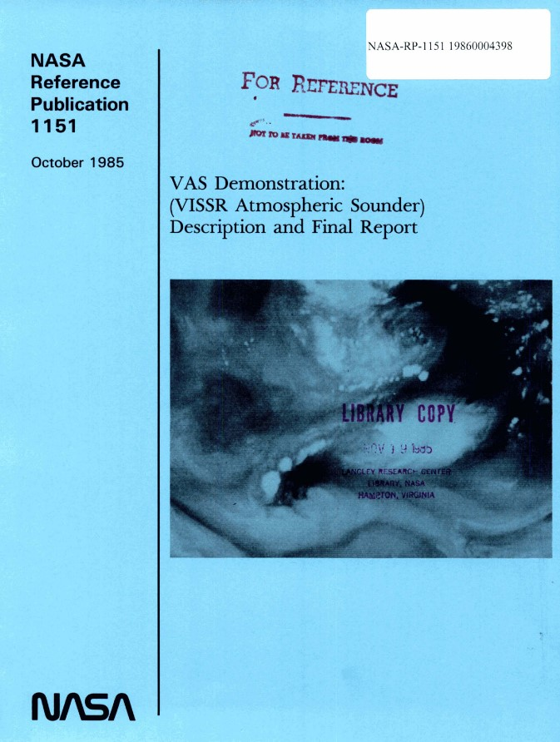
History
FOREWORD
What about the future?
These results are the foundation for future satellites. The VAS experience suggests that extension into the microwave region, and increased spectral resolution in the infrared region, are essential so that we can obtain soundings through persistent clouds and with improved vertical resolution. Geostationary microwave instruments and high spectral resolution infrared interferometers are feasible and would be highly useful.
The administrative mechanisms of interagency cooperation must be put into motion as soon as possible to accomplish this. We must not lose the momentum ....
Professor Verner E. Suomi
Director
Space Science and Engineering Center
University of Wisconsin-Madison
1985
[Bold highlights added]
Notes:
https://www.ssec.wisc.edu/geo-ir-sounder/need/

Slide 4
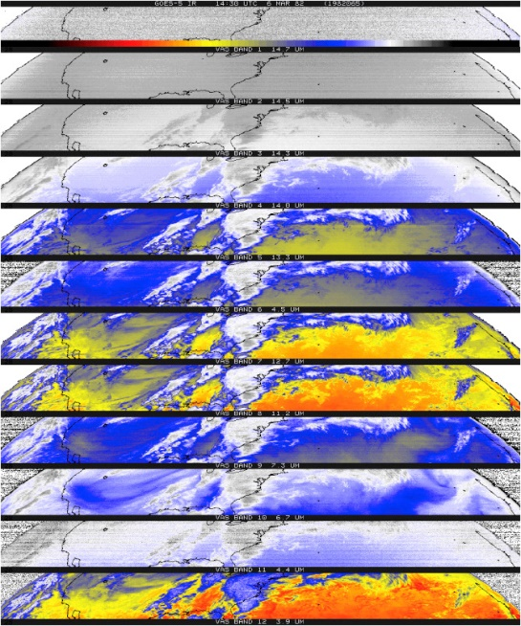
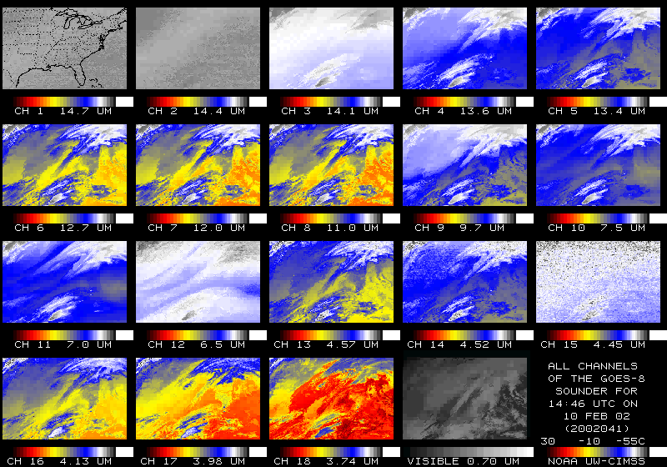
U.S. Geostationary Game-changers
Item | Imagery | Sounding
First of it’s kind (experimental) | ATS-1 (1966) | VAS (1980)
First Operational | GOES-1 (1975) | GOES-8 (1994)
Orders of magnitude improvements | GOES-R series (2016) | High-spectral IR (203?)
?
GOES-R series included the first geostationary lightning mapper
Notes:
T. Schmit AMS presentation in Boston.

Slide 5
ABI is not an advanced sounder!
“GXS”
The relative vertical number of independent pieces of information is shown. The moisture content is similar between the ABI and the current GOES Sounder. The Sounder does show more temperature information than the ABI. The ABI is not close to the information content of a high-spectral sensor.
Notes:
https://journals.ametsoc.org/view/journals/atot/26/11/2009jtecha1248_1.xml

Slide 6
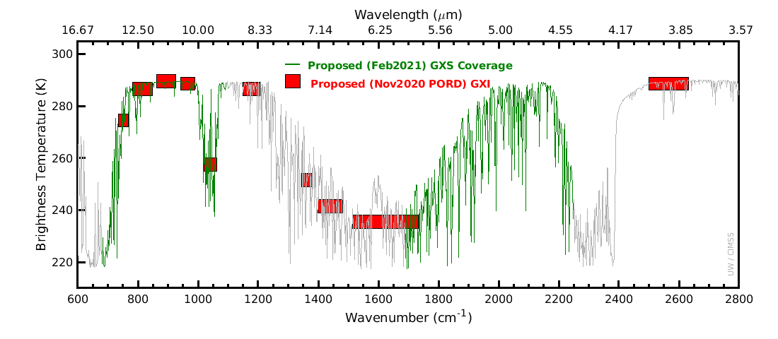
Spectral

Slide 7
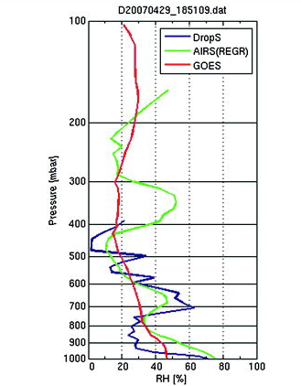
Improved Vertical Resolutions
Three RH soundings:
Although legacy GOES Sounder [similar to ABI or GXI] (red) has reasonable men accuracy in general, it lacks vertical structures when compared with dropsonde (blue).
The high-spectral-resolution observations of AIRS SFOV sounding (green) better depicts the fine structures in this case, which are close to those from the dropsonde.
Retrieval performance has improved over the last more than a decade.
2.1-7

Slide 8
Applications in forecasting
The improved vertical resolution allows for the critical vertical distribution of moisture to be monitoring (in clear skies)
NWS and other forecasters have been using hyperspectral sounder data from LEO satellites for years via the Hazardous Weather Testbed and NOAA Unique Combined Atmospheric Processing System (NUCAPS)
However, a LEO sounder has a revisit time of 12 hours for a spot over the equator compared to the GEO sounder that can revisit the same location in about 30 minutes
  The intrinsic nature of the geostationary orbit permits longer integration time of the detector over the same Earth scene and continuous data downlink. As a result, a GEO hyperspectral sounder can achieve a footprint on the Earth surface of 4 km
    Doubling the clear-sky yields, comparted to LEO

Slide 9
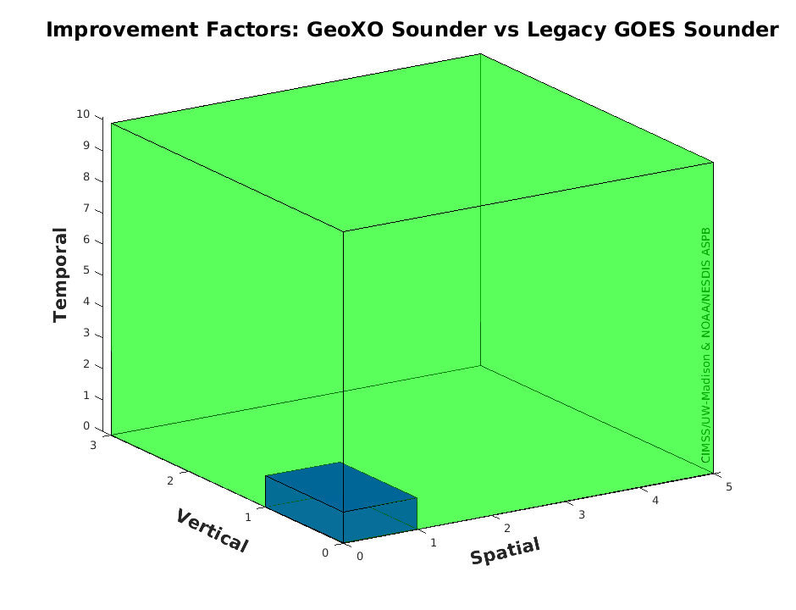
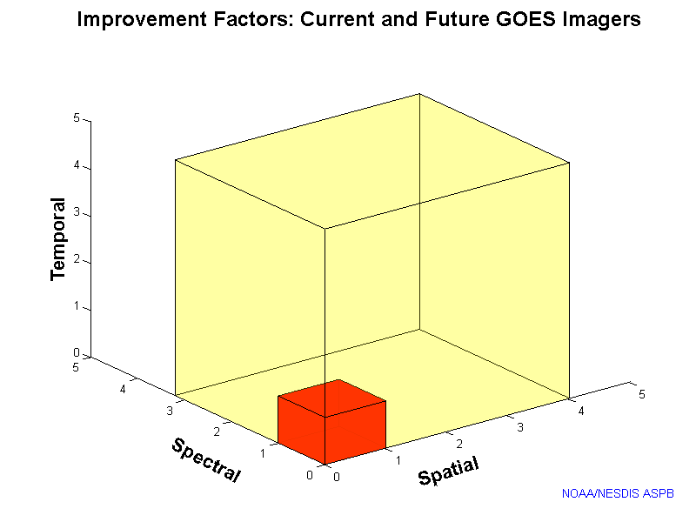
GXS/Legacy GOES Sounder > ABI/Legacy Imager
GeoXO Sounder could be something like 3, 5 and 10 times improved (vertical, spatial and temporal) over the legacy geo sounder! (The legacy sounder had many operational uses.)
“Everyone” knows about the ABI being 3, 4 and 5 times (spectral, spatial and temporal) improved over the legacy geo imager.
Improvement Factors: GeoXO Sounder and Legacy geo Sounders
Improvement Factors: ABI and Legacy geo Imagers
Notes:
Li, J., Menzel, W. P., Sun, F., Schmit, T. J., & Gurka, J. (2004). AIRS Subpixel Cloud Characterization Using MODIS Cloud Products, Journal of Applied Meteorology, 43(8), 1083-1094. Retrieved Oct 21, 2021, from https://journals.ametsoc.org/view/journals/apme/43/8/1520-0450_2004_043_1083_asccum_2.0.co_2.xml
Schmit, T. J., Li, J., Li, J., Feltz, W. F., Gurka, J. J., Goldberg, M. D., & Schrab, K. J. (2008). The GOES-R Advanced Baseline Imager and the Continuation of Current Sounder Products, Journal of Applied Meteorology and Climatology, 47(10), 2696-2711.
https://journals.ametsoc.org/view/journals/apme/47/10/2008jamc1858.1.xml
Sieglaff, J. M., Schmit, T. J., Menzel, W. P., & Ackerman, S. A. (2009). Inferring Convective Weather Characteristics with Geostationary High Spectral Resolution IR Window Measurements: A Look into the Future, Journal of Atmospheric and Oceanic Technology, 26(8), 1527-1541. https://journals.ametsoc.org/view/journals/atot/26/8/2009jtecha1210_1.xml
Schmit, T. J., Li, J., Ackerman, S. A., & Gurka, J. J. (2009). High-Spectral- and High-Temporal-Resolution Infrared Measurements from Geostationary Orbit, Journal of Atmospheric and Oceanic Technology, 26(11), 2273-2292. https://journals.ametsoc.org/view/journals/atot/26/11/2009jtecha1248_1.xml
Smith Sr., W. L., Revercomb, H., Bingham, G., Larar, A., Huang, H., Zhou, D., Li, J., Liu, X., and Kireev, S.: Technical Note: Evolution, current capabilities, and future advance in satellite nadir viewing ultra-spectral IR sounding of the lower atmosphere, Atmos. Chem. Phys., 9, 5563-5574, https://doi.org/10.5194/acp-9-5563-2009, 2009.
Li, J., Li, J., Otkin, J., Schmit, T. J., & Liu, C. (2011). Warning Information in a Preconvection Environment from the Geostationary Advanced Infrared Sounding System—A Simulation Study Using the IHOP Case, Journal of Applied Meteorology and Climatology, 50(3), 776-783. https://journals.ametsoc.org/view/journals/apme/50/3/2010jamc2441.1.xml
Menzel, W. P., Schmit, T. J., Zhang, P., & Li, J. (2018). Satellite-Based Atmospheric Infrared Sounder Development and Applications, Bulletin of the American Meteorological Society, 99(3), 583-603. Retrieved Oct 21, 2021, from https://journals.ametsoc.org/view/journals/bams/99/3/bams-d-16-0293.1.xml
Yin, R., Han, W., Gao, Z., & Li, J. (2021). Impact of high temporal resolution FY-4A Geostationary Interferometric Infrared Sounder (GIIRS) radiance measurements on Typhoon forecasts: Maria (2018) case with GRAPES global 4D-Var assimilation system. Geophysical Research Letters, 48, e2021GL093672. https://doi.org/10.1029/2021GL093672
Ma, Z., Li, J., Han, W., Li, Z., Zeng, Q., Menzel, W. P., et al. (2021). Four-dimensional wind fields from geostationary hyperspectral infrared sounder radiance measurements with high temporal resolution. Geophysical Research Letters, 48, e2021GL093794. https://doi.org/10.1029/2021GL093794
Yin, Ruoying, Wei Han, Zhiqiu Gao, and Di Di. “The evaluation of FY4A’s Geostationary Interferometric Infrared Sounder (GIIRS) long‐wave temperature sounding channels using the GRAPES global 4D‐Var.” Quarterly Journal of the Royal Meteorological Society 146, no. 728 (2020): 1459-1476. https://doi.org/10.1002/qj.3746
Holmlund, et al., P. (2021). Meteosat Third Generation (MTG): Continuation and Innovation of Observations from Geostationary Orbit, Bulletin of the American Meteorological Society, 102(5), E990-E1015. https://journals.ametsoc.org/view/journals/bams/102/5/BAMS-D-19-0304.1.xml
W. L. Smith et al., "Hyperspectral Satellite Radiance Atmospheric Profile Information Content and Its Dependence on Spectrometer Technology," in IEEE Journal of Selected Topics in Applied Earth Observations and Remote Sensing, vol. 14, pp. 4720-4736, 2021, doi: 10.1109/JSTARS.2021.3073482. https://ieeexplore.ieee.org/abstract/document/9406029
More: https://www.ssec.wisc.edu/geo-ir-sounder/

Slide 10
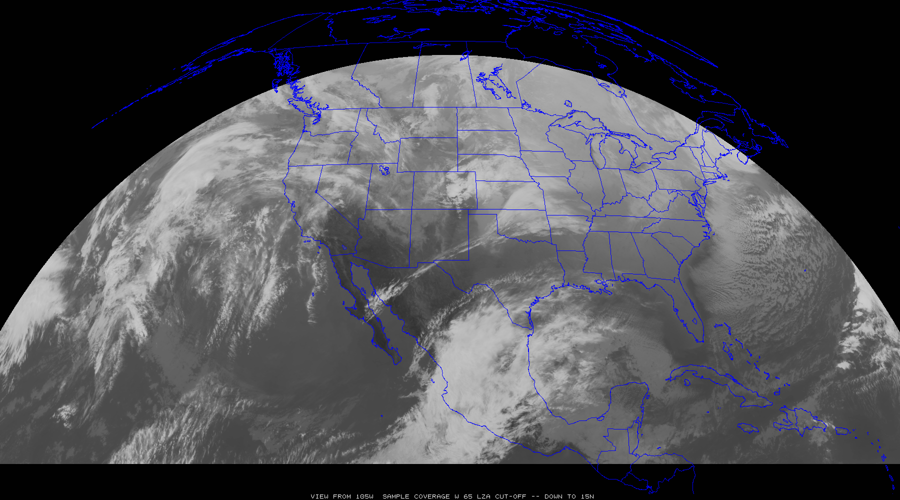
Sample GeoXO Sounder Uses
“clippers”
Most everywhere:
Pre-convection, stability, winds, high clouds, radiances for NWP, help GXI, ACX, etc.
“atmospheric
rivers”
Sub-tropical jets
“Nor-easters”
“dry lines”
“Atlantic
Tropical
Cyclones”
“EastPac Tropical Cyclones”
“return flow”

Slide 11
Need for high spectral and temporal observations
High-spectral-resolution observations provide much more information
  Imagers average out important vertical information.
  LEO has shown the many benefits, especially on the global scale, lacks time resolution
Forecasting Applications – fill in critical gaps wrt vertical moisture, wind and temperature
  Nowcasting and Numerical weather prediction, especially on the regional/mesoscales
Additional applications
  High-spectral-resolution sounder observations would also improve derived products with only advanced imager data (and or with polar-orbiter and other data)
    volcanic ash, cloud detection, cloud-top properties, atmospheric motion vectors, dust detection, land and sea surface temperatures.
  New areas
    Moisture flux, capping inversion, surface emissivity, trace gases and climate
Economic impacts (“billions and billions”…) More with the benefits of 4dvar analysis …
Critical Component of the Global Constellation

Slide 12
GeoXO : GXS Summary (What and Why)
Attribute |  | What |  | Why
Coverage |  | Sounding Disk as seen from both GOES-East and –West positions |  | The Atlantic for hurricane development and model initializations, CONUS for the pre-convective environment monitoring and the Pacific for both upstream weather and monitoring moisture (and winds) over the huge area with little conventional data.
Spatial Resolution |  | 4 km (at the satellite subpoint) |  | Doubling the clear-sky yields, comparted to LEO, for a given time. Also for finer moisture gradients to be monitored.
Temporal Resolution |  | Sounding Disks (60 min), CONUS (~30 min) and mesoscale (5 min) |  | Sounding Disk upstream information and hurricane monitoring, CONUS for pre-convective monitoring and the targeted (or mesoscale) for regions of extremely active weather. Also, also for clouds to move out and less get more clear sky information.
Spectral Coverage / Resolution |  | 680‐ 1095 cm‐1 14.7 – 9.13 μm 1689 – 2250 cm‐1 5.92 – 4.44 μm ) @ ~0.6 cm-1 |  | Spectral with information related to temperature, moisture and support select atmospheric compositions (ozone, NH3, isoprene, HNO3, N20 and CO). Need to resolve, not average out, the critical on/off spectral lines.
Other |  | Evolution of the radiances |  | Provides critical vertical information on atmospheric winds for both nowcasting and NWP applications.

Slide 13
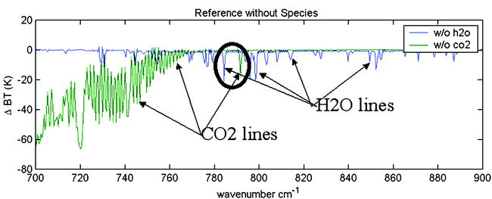
More vertical moisture and motion information; NWS support for high spectral IR observations
Geo hyperspectral IR sounder is the only way to measure boundary layers moisture changes on spatial and temporal resolution needed for the weather ready nation (Sieglaff et al 2009 and others)
The Assessment of Alternatives concluded that there were not other sensors that could fill the void of the HES with respect to vertical moisture.
  1999: NWS ORD “Goal of 2km for sounder spatial res”
  2010: NWS memo “Sounder on GOES-U” top geo item
  2019: NWS Director “Geo Sounder the next big thing”
Notes:
https://www.ssec.wisc.edu/geo-ir-sounder/wp-content/uploads/sites/36/2021/05/1999_NWS_ORD_combined1.pdf
https://www.ssec.wisc.edu/geo-ir-sounder/wp-content/uploads/sites/36/2021/05/NWS_Sounder_Memo_-_Signed-Sep_2010_saved2.pdf
AMS mtg in Boston and other statements: https://ams.confex.com/ams/JOINTSATMET/meetingapp.cgi/Paper/360858
Sieglaff, J. M., Schmit, T. J., Menzel, W. P., & Ackerman, S. A. (2009). Inferring Convective Weather Characteristics with Geostationary High Spectral Resolution IR Window Measurements: A Look into the Future, Journal of Atmospheric and Oceanic Technology, 26(8), 1527-1541. https://journals.ametsoc.org/view/journals/atot/26/8/2009jtecha1210_1.xml

Slide 14
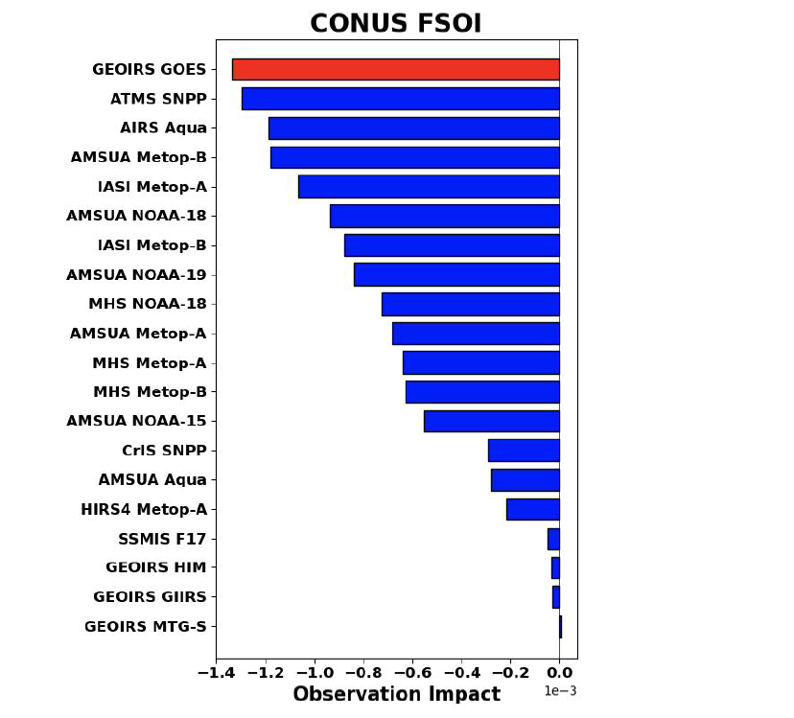
More info
Hyperspectral infrared (IR) sounders
  https://www.ssec.wisc.edu/geo-ir-sounder
NOAA NESDIS Tech Report: Geostationary Extended Observations (GeoXO) Hyperspectral InfraRed Sounder Value Assessment Report
  https://repository.library.noaa.gov/view/noaa/32921
GeoXO
  https://www.nesdis.noaa.gov/next-generation-satellites/geostationary-extended-observations-geoxo
Computer simulation of 24-hr Forecast Sensitivity Observation Impact ... for CONUS, for the four cycles:

Slide 15
Need for high spectral and temporal observations
High-spectral-resolution observations provide much more information
  Imagers average out important vertical information.
  LEO has shown the many benefits, especially on the global scale, lacks time resolution
Forecasting Applications – fill in critical gaps wrt vertical moisture, wind and temperature
  Nowcasting and Numerical weather prediction, especially on the regional/mesoscales
Additional applications
  High-spectral-resolution sounder observations would also improve derived products with only advanced imager data (and or with polar-orbiter and other data)
    volcanic ash, cloud detection, cloud-top properties, atmospheric motion vectors, dust detection, land and sea surface temperatures.
  New areas
    Moisture flux, capping inversion, surface emissivity, trace gases and climate
Economic impacts (“billions and billions”…) More with the benefits of 4dvar analysis …
Critical Component of the Global Constellation

Slide 16
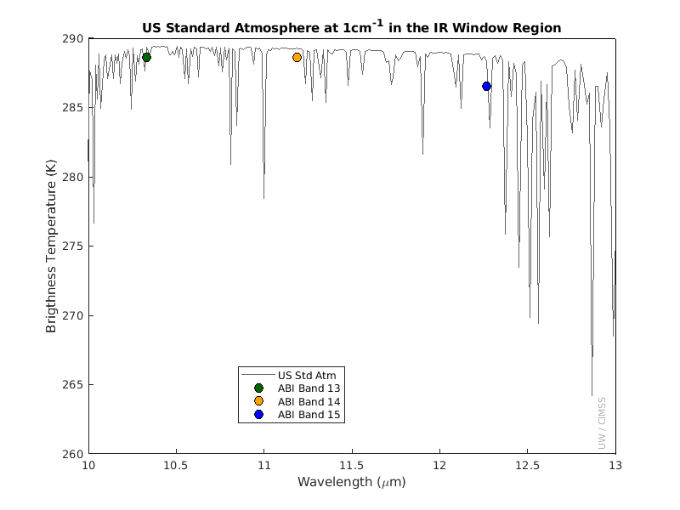
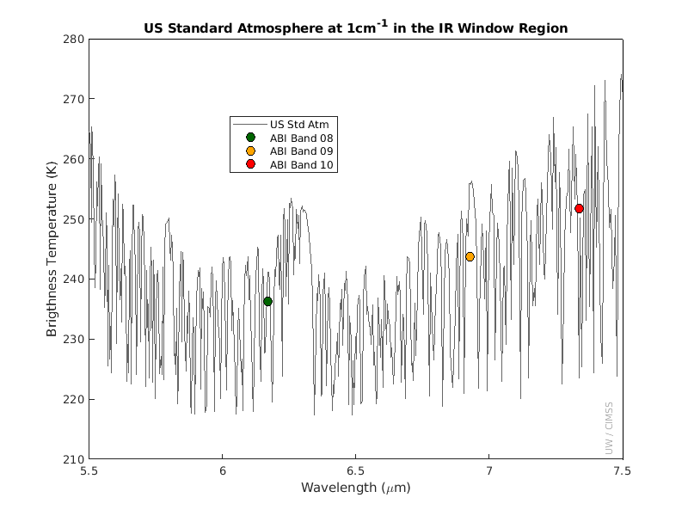
Questions ?
Advanced sounders have much more temperature and moisture vertical information (Images: Mat Gunshor, CIMSS)
Thanks to many who have contributed, especially Ed Grigsby and the geoXO Hyperspectral InfraRed Sounder value assessment team and the geoXO sounder working group

